Slide 1
List Views
14 August 2013
Notes:
Guidewire training materials contain Guidewire proprietary information that is subject to confidentiality and non-disclosure agreements. You agree to use the information in this manual solely for the purpose of training to implement Guidewire software solutions. You also agree not to disclose the information in this manual to third parties or copy this manual without prior written consent from Guidewire. Guidewire training may be given only by Guidewire employees or certified Guidewire partners under the appropriate agreement with Guidewire.

Slide 2
Lesson objectives
By the end of this lesson, you should be able to:
Describe the functionality of list views
Create new list views
Create and modify row iterator, row, and cell widgets
Reference list views from parent containers
This lesson uses the notes section for additional explanation and information. To view the notes in PowerPoint, choose View→Normal or View→Notes Page. If you choose to print the notes for the lesson, be sure to select “Print hidden slides.”

Slide 3
Lesson outline
List view basics
Creating list views
List view widgets
Referencing list views

Slide 4
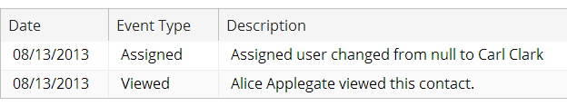
List views
ABContactHistoryLV
A list view is a container widget that typically displays a set of rows that are related to one object or one query
Users can view and, in some cases, edit the data

Slide 5
List view root objects
ABContactHistoryLV
HistoryEntry
ABContact
HistoryEntry
HistoryEntry
root object
array from root object
Container widgets typically have one root object
List views typically display objects in array associated with root object

Slide 6
List view contents
row
row
cells
cells
cells
Cell widgets display individual fields of data
Row widgets organize cells
Entire structure generated by row iterator
Notes:
Row widgets organize the layout of the cells for an object instance when the row iterator is manipulating that instance. Row widgets do not perform any "navigation" within the collection of object instances. Adding a second row widget would not display two different objects when the page is rendered, but would arrange the cells for each instance across two rows. The generated markup for a row widget is a <TR> HTML tag.
Row iterators are discussed in the next slide.

Slide 7
Row iterators
HistoryEntry
HistoryEntry
HistoryEntry
row widget
row iterator
cell widget
cell widget
cell widget
An iterator is a widget that takes a set of items and performs the same set of actions for each member
A row iterator is an iterator used to structure list views
Takes set of objects (typically in an array) and renders one row of cells for each
Notes:
The PCF architecture has several different types of iterators, including:
Menu item iterators, which take a set of objects and generate one menu item for each.
Panel iterators, which take a set of objects and generate one panel (typically, one detail view) for each.
PolicyCenter coverage iterators, which take a set of coverages associated with a covered item (such as a vehicle) and generate one coverage input for each coverage.

Slide 8
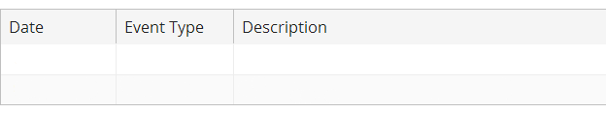
Row iterator example: no objects processed
HistoryEntry
HistoryEntry
HistoryEntry
row widget
row iterator
cell widget
cell widget
cell widget
Notes:
In the example shown above, the row iterator is associated with an array of HistoryEntry objects. For each object, it generates a row with three cell widgets. Initially, none of the rows have been processed.

Slide 9

Row iterator example: First object processed
HistoryEntry
HistoryEntry
row widget
row iterator
cell widget
cell widget
cell widget
Notes:
When the first object is processed, three fields of data are retrieved from the object: the CreateDate, the EventType, and the Description. Three cell widgets display this data, and the row widget organizes the three cells into a single row.

Slide 10
Row iterator example: Next object processed
HistoryEntry
row widget
row iterator
cell widget
cell widget
cell widget
Notes:
When the second object is processed, the procedure is repeated. The CreateDate, EventType, and Description fields are rendered as cell widgets that are organized into a row.

Slide 11
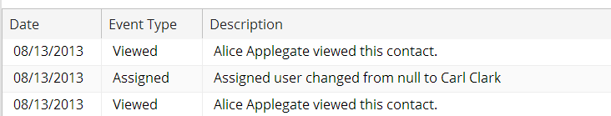
Row iterator example: Final object processed
row widget
row iterator
cell widget
cell widget
cell widget
Notes:
This process continues for each object in the set until there are no more objects to process. When the row iterator's work is complete, the relevant fields of every object in the object set are rendered in the list view.

Slide 12
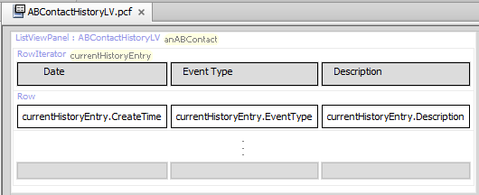
Reusable containers
When container (such as list view) is declared as top-level, it is reusable and can be embedded by reference
If container is likely to be needed in multiple places, create it in its own PCF file as top-level container
When container is configured as inline it is not reusable
Notes:
In the example above, ABContactHistoryLV is a top-level container. Other containers can therefore reference it. In TrainingApp, the ABContactHistoryPage.pcf file has a screen that references ABContactHistoryLV.

Slide 13
Lesson outline
List view basics
Creating list views
List view widgets
Referencing list views

Slide 14
Steps to create list view
Create the LV file
Specify the required variables
Optionally specify additional properties
Add a row iterator widget
Add a row widget
Add cell widgets
Reload UI metadata
Notes:
The steps to create an inline line view are the same as for a standalone list view, except at the very beginning.
Steps to create inline list views
Create the LV
Optionally specify additional properties
Add a row iterator widget
Add a row widget
Add cell widgets
Reload UI metadata

Slide 15
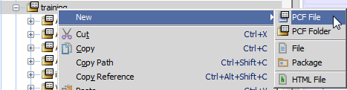
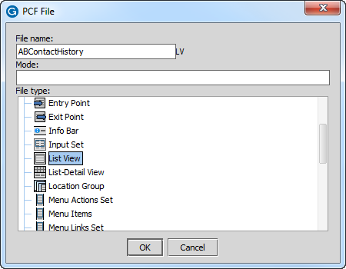
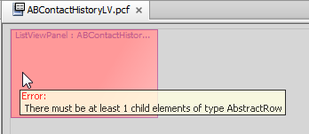
Step 1: Create the LV file
"LV" automatically appended to end of file name
Notes:
Do the following to create a PCF file that defines a list view:
In Studio's PCF editor, right-click the folder in which the list view file should be stored. Select New > PCF file.
Name the file and select "List View" for the file type. Studio automatically adds "LV" to the end of the file name. If you manually add "LV" to the end of the file name, Studio ignores it. Therefore, it is not possible to inadvertently name a file which ends in "LVLV".
Click OK.
Studio displays the new list view. At the top of the canvas, there is a link named "List View : <nameOfListView>". Otherwise, the file is empty.
The initial list view always displays an error because every list view needs a row element, yet a newly created list view is empty.
Inline list views
To create an inline list view, find the "List View" tool in the PCF editor toolbox. Drag the list view widget onto an existing screen, listdetail view, or card view.

Slide 16
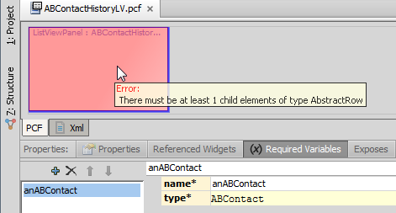
Step 2: Specify the required variable(s)
Root objects declared on list view's Required Variables tab
To display tab, click "ListViewPanel : <name>" link
For each required root object, click "+" and specify object's name and data type
Notes:
Recall that virtually every list view has one or more root objects. These root objects must be specified on the list view's Required Variables tab.
To display the list view's various property tabs, click the link at the top of the list view file labeled "ListViewPanel : <nameOfListView>".
Do the following to create a required variable:
Click the Required Variables tab.
Click the "+".
Specify the object's name. This is how the row iterator in the list view will reference the object.
Specify the object's data type.
Inline detail views
You do not need to specify root objects for inline list views. Because an inline list view can have only one parent, it automatically inherits the root objects of its parent.

Slide 17
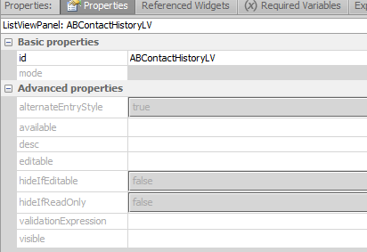
Step 3: Optionally specify additional properties
By default, all container widgets are:
Editable
Visible
Notes:
There are two states that a list view can be in: edit mode and read-only mode. If the editable property for a list view is true (or blank, which defaults to true), then the list view can be put into either read-only mode or edit mode. If the editable property for a list view is false, then the list view cannot be put into edit mode. It is always in read-only mode.
Inline list views
This step is the same for standalone and inline list views.

Slide 18
Lesson outline
List view basics
Creating list views
List view widgets
Referencing list views

Slide 19
Required properties of row iterator
Value: anABContact.History
HistoryEntry
HistoryEntry
HistoryEntry
row
cell currentObj. CreateDate
cell currentObj. EventType
cell currentObj. Description
row iterator
Element Name: currentObj
Editable - whether cells can be edited
Value - set of objects (array) to process
Element name - name used by cell widgets to map to object currently being processed
Notes:
Each cell widget inside the row widget is used to render data for multiple objects. For example, the first cell in the diagram above renders the CreateDate field for all three HistoryEntry objects in the array. The cell widget must therefore be bound to an abstract name that references each object in the array one at a time. The Element Name property of the row iterator defines what this name is. The value you select for the Element Name property is arbitrary, but whatever value you select must be used by the cell widgets in the row iterator.
To improve readability, use element names such as "current<object>" or "this<object>".

Slide 20

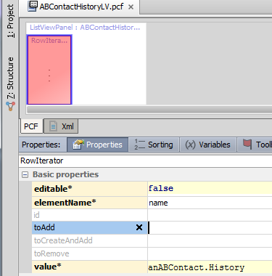
Step 4: Add a row iterator widget
Notes:
In this example:
Editable is false—the cells will be uneditable.
The name used to reference the object currently being processed is "currentHistoryEntry".
The object set to be processed is anABContact's History array.

Slide 21
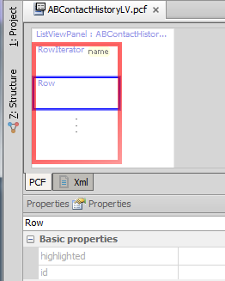
Step 5: Add a row widget
Typically, do not need to specify any properties

Slide 22

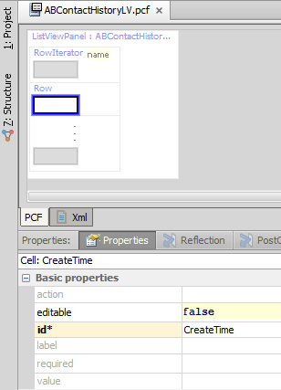
Step 6: Add cell widgets
Must be added inside row widget
Properties
editable is false by default
ID is required
(continued)

Slide 23
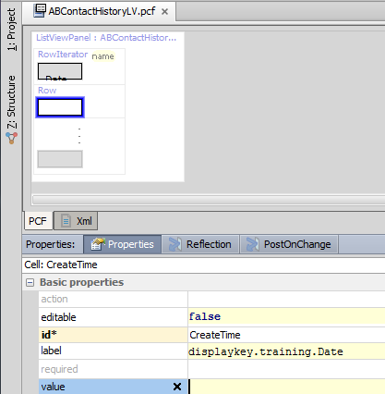
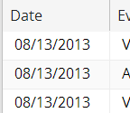
Step 6: Add cell widgets (label property)
Label property specifies label for column header

Slide 24
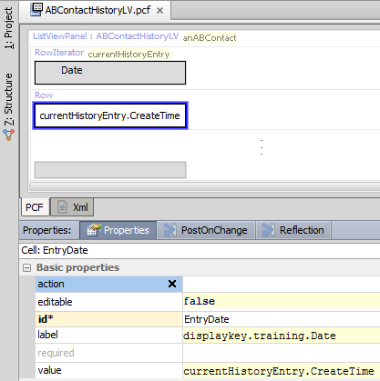
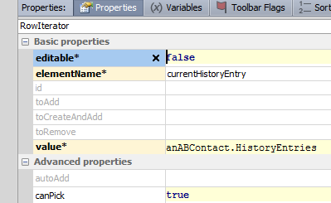
Step 6: Add cell widgets (value property)
Cell widget is inside row iterator, which is used to process multiple rows
Cell's value property must reference row iterator's element name

Slide 25
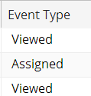
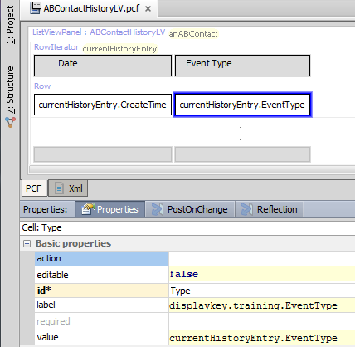
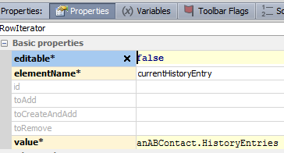
Example of second cell
Notes:
Note the following from the example above:
The label is set to the string "Event Type", which appears as the header for the column.
The value property uses the row iterator's element name, currentHistoryEntry, to reference the current object being processed. The value of "currentHistoryEntry.EventType" sets the cell's value to the event type of the current history entry.

Slide 26
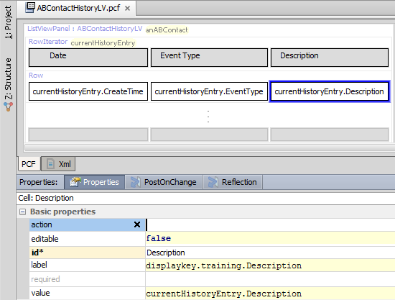
Example of third cell
Notes:
Note the following from the example above:
The label is set to the string "Description", which appears as the header for the column.
The value property uses the row iterator's element name, currentHistoryEntry, to reference the current object being processed. The value of "currentHistoryEntry.Description" sets the cell's value to the description of the current history entry.

Slide 27
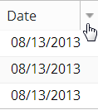
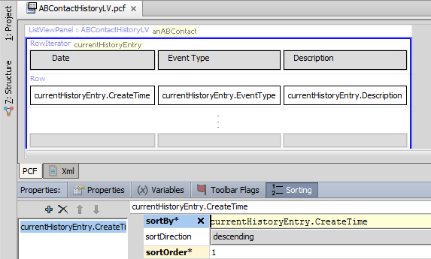
Sort order
Row iterator's Sorting tab used to specify default sort order of list
Notes:
A list view can have any number of sort criteria.
For each sort criterion, you must specify:
What value to sort by (the sortBy value)
Whether the sort should be ascending or descending (the sortDirection value)
The precedence of the criteria (the sortOrder value). The list is first sorted by the criteria with sortOrder 1. Then, any matching rows are sorted by the criteria with sortOrder 2, and so on.
You can create sort criteria that reference values not displayed in the list. For example, a list of history entries could be sorted by create date even though the create date isn't displayed in the list.
If a column has a sort criteria with sort order 1 (and the sortBy column is visible in the list), then it is initially rendered with an up-facing or down-facing arrow head next to the label. The direction of the arrow reflects the sortDirection value. Any criteria with a sort order of 2 or greater are rendered with an up-facing or down-facing double arrow head next to the label.
The Sorting tab specifies only the default sort criteria. Users can override this criteria by clicking any column header, which will reorder the list based on that column's data.
If a list view is sorted based on a typecode field, then the rows are sorted based on the priority and then name of the typecodes. For example, if a list of buildings includes a "BuildingType" column with possible values of "residential - single dwelling" (priority 10) and "residential - multiple dwelling" (priority 20) and the column has a defined ascending sort order, all "residential - single dwelling" buildings will be listed before any "residential - multiple dwelling" buildings.

Slide 28
Lesson outline
List view basics
Creating list views
List view widgets
Referencing list views

Slide 29
What can contain a list view?
screen a top-level container one can navigate to
Screen
secondary views collections of primary views organized for usability
Card View / ListDetail View
panel ref
primary views a single object (and its related data) or set of objects
Detail View
LV input
List View
Input Sets
atomic widgets individual elements of data and/or functionality
Atomic Widgets
Notes:
List views can be referenced by four types of containers: screens, card views, listdetail views, and detail views. The methods for embedding a list view in a screen, card view, or listdetail view are identical to one another. The method for embedding a list view in a detail view has a slight variation.

Slide 30
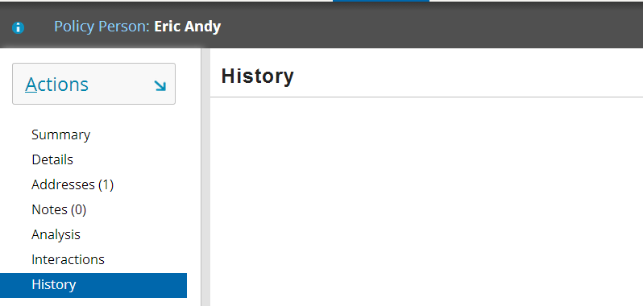
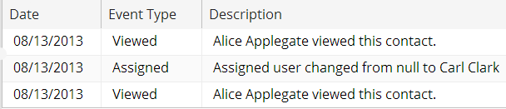
Steps to reference list views (from screens and secondary views)
Create panel ref widget
Add toolbar
Specify properties
Reload the metadata
screen
panel ref
ABContact HistoryLV
Notes:
Inline list views
For an inline list view, referencing does not occur. The only required step is to reload the metadata.

Slide 31
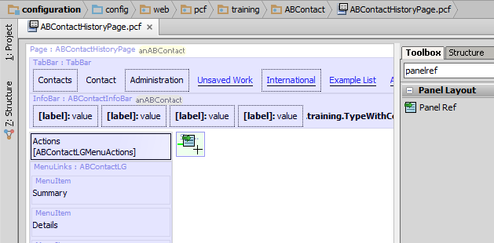
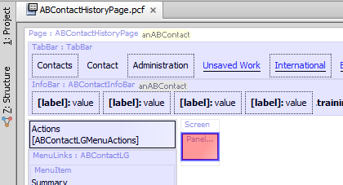
Step 1: Create panel ref widget
Notes:
The screenshot above shows the ABContactHistoryPage file before the list view has been added. Notice that at the top of the file you can see two rows of widgets in a light blue shading. The first row corresponds to the tab bar (which is declared in TabBar.pcf). The second row corresponds to the widgets in the ABContact location group's info bar (which is declared in ABContactInfoBar.pcf). Finally, below the left part of the info bar, there is a third light blue shaded area corresponding to the actions menu.
Before the list view is added to the ABContactHistoryPage file, the screen widget is empty.
Once the panel ref is added to the screen, Studio initially displays the panel ref with red shading. This is because you have not yet specified which list view the panel ref should reference.

Slide 32
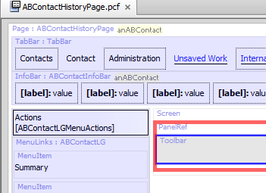

Step 2: Add toolbar
Paging is a list view behavior in which the set of rows in the list view is broken into multiple "list view pages"
Set of paging controls lets user move through each page of rows
List views typically require toolbars for paging control, even if toolbar has no buttons
Notes:
By default, paging is turned on for list views. The default number of rows per page is set in config.xml, which is set to 15 in the base applications. Each list view has a can have its own number of rows per page. To specify a non-default number of rows per page, set the row iterator's pageSize property. To disable paging (which will result in a list view that displays all rows, regardless of how many there are), set the row iterator's pageSize property to 0. (A list view with paging disabled does not require a toolbar.)
Both the toolbar and the list view must be inside the panel ref.

Slide 33
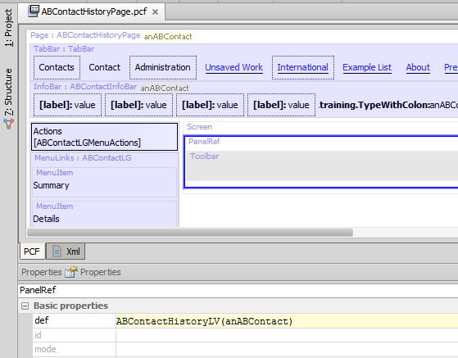
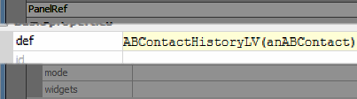
Step 3: Specify properties
def property identifies:
Name of list view to reference
Object to pass to list view for it to use as root objects
Notes:
The ABContactHistoryLV list view has one root object (required variable), which must be of type ABContact. Any panel ref that references ABContactHistoryLV must therefore pass an ABContact object to it.
If the list view had two or more root objects, then the panel ref would need to pass two or more objects. The order of the objects as listed in the panel ref's def property must match the order in which the objects are declared on the Required Variables tab.

Slide 34
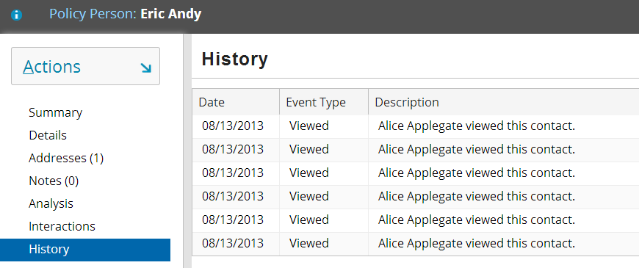
Step 4: Reload the metadata
Deploy UI changes by pressing ALT + SHIFT + L
Toolbar appears only when number of list entries exceeds maximum paging size

Slide 35
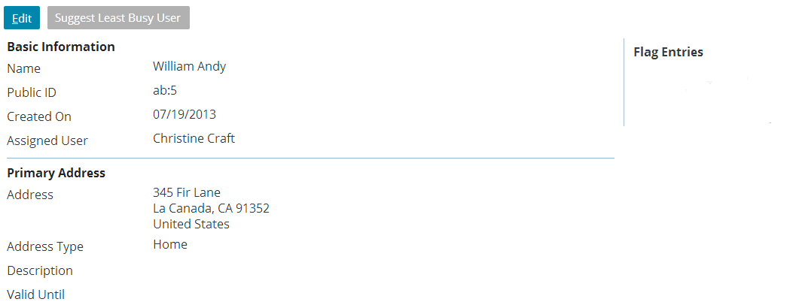
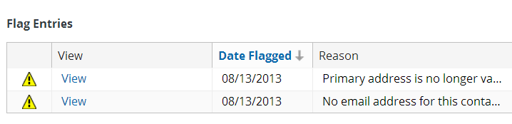
List view inputs
List view input is similar to panel ref, but used exclusively to embed list view in detail view
Treats embedded list view as if it was input widget
ABContactSummaryDV
FlagEntriesLV

Slide 36
Steps to reference list views (from detail views)
Create list view input widget
Add toolbar
Specify properties
Reload the metadata

Slide 37
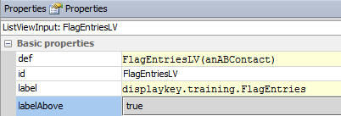
List view input labels
def property identifies list view to embed
label and labelAbove properties determine exact position and labeling of list view (see next slide)

Slide 38
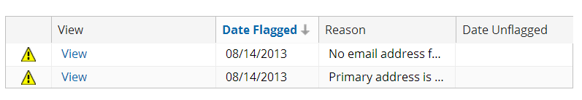
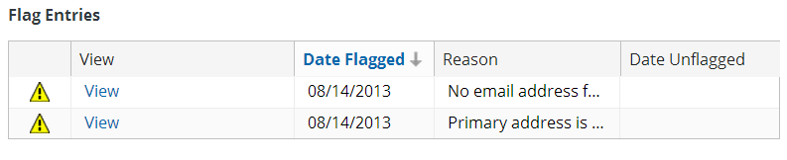
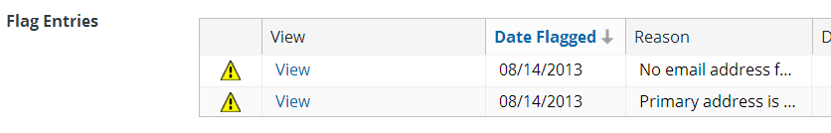
List view input label settings
no label; labelAbove = true
label specified; labelAbove = true
label specified; labelAbove = false
Notes:
The default value for labelAbove is false. When labelAbove is set to false, the application offsets the list view from the left side of the input column to make room for the label. This offset occurs even if no value is specified for the label itself. If you do not plan to use a label for the list view, you may want to set the labelAbove to true to make better use of the space on the screen.

Slide 39
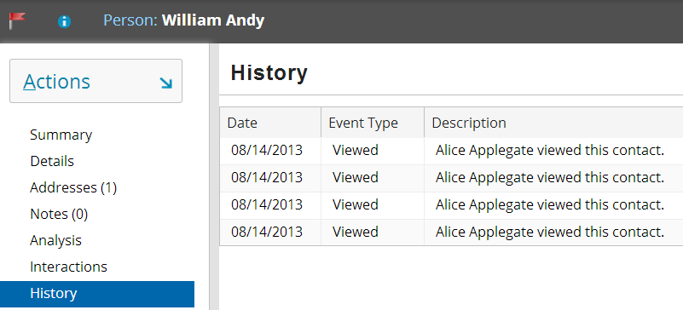
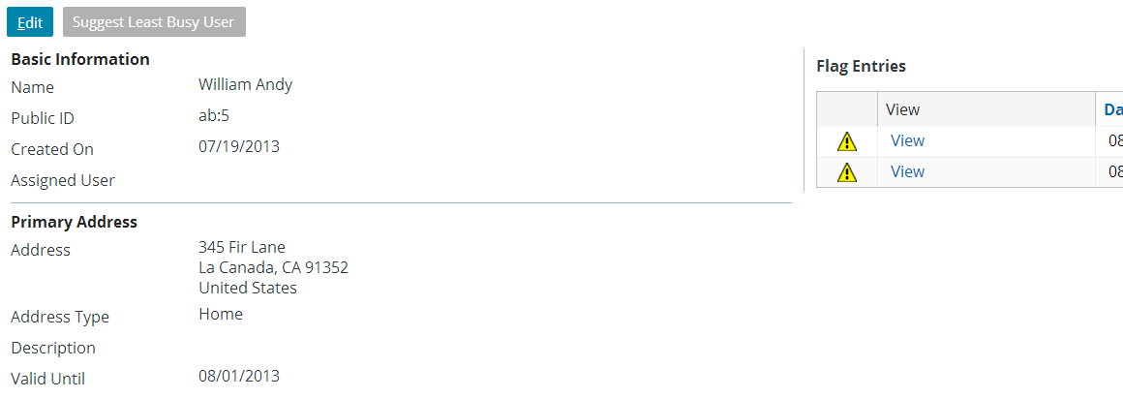
List views in read-only mode
By default, there is no way to put list view into edit mode
Next lesson discusses how to add Edit Buttons so that data can be modified

Slide 40
Lesson objectives review
You should now be able to:
Describe the functionality of list views
Create new list views
Create and modify row iterator, row, and cell widgets
Reference list views in parent containers

Slide 41
Review questions
In a list view:
What type of widget displays individual fields of data?
What type of widget organizes the individual fields of data?
Assume you have a list view with "anABContact" as the root object. The list view displays the contact's addresses.
What would the row iterator's "value" property be set to?
What would the row iterator's "element name" be set to?
What other widgets would make use of the element name?
A list view typically needs a toolbar, even if it is read-only. Why?
In what way is embedding a list view in a detail view different from embedding a list view in a screen?
Notes:
Answers
1. a) Cell widgets
b) Row widgets
2. a) anABContact.Addresses (assuming that the name of the addresses array is "Addresses")
b) The value is arbitrary, but it would probably be set to something like "currentAddress".
c) The cell widgets inside the row iterator's row. For example, a cell displaying the street would have a value of "currentAddress.Street".
3. The toolbar is needed for the paging controls. These controls are used to view each page of rows if the number of rows is greater than what can be displayed at one time.
4. To embed a list view in a detail view, you use a list view input. To embed a list view in a screen (or card view or listdetail view), you use a panel ref.

Slide 42
Notices
Copyright © 2001-2013 Guidewire Software, Inc. All rights reserved.
Copyright © 2001-2013 Guidewire Software, Inc. All rights reserved. Guidewire, Guidewire Software, Guidewire ClaimCenter, Guidewire PolicyCenter, Guidewire BillingCenter, Guidewire Reinsurance Management, Guidewire ContactManager, Guidewire Vendor Data Management, Guidewire Client Data Management, Guidewire Rating Management, Guidewire InsuranceSuite, Guidewire ContactCenter, Guidewire Studio, Guidewire Product Designer, Guidewire Live, Guidewire DataHub, Guidewire InfoCenter, Guidewire Standard Reporting, Guidewire ExampleCenter, Gosu, Deliver Insurance Your Way, and the Guidewire logo are trademarks, service marks, or registered trademarks of Guidewire Software, Inc. in the United States and/or other countries.
Guidewire products are protected by one or more United States patents.

