Slide 1
Editable List Views
14 August 2013
Notes:
Guidewire training materials contain Guidewire proprietary information that is subject to confidentiality and non-disclosure agreements. You agree to use the information in this manual solely for the purpose of training to implement Guidewire software solutions. You also agree not to disclose the information in this manual to third parties or copy this manual without prior written consent from Guidewire. Guidewire training may be given only by Guidewire employees or certified Guidewire partners under the appropriate agreement with Guidewire.

Slide 2
Lesson objectives
By the end of this lesson, you should be able to:
Configure a list view so that its rows can be modified
Configure a list view so that rows can be added to and removed from it
This lesson uses the notes section for additional explanation and information. To view the notes in PowerPoint, choose View→Normal or View→Notes Page. If you choose to print the notes for the lesson, be sure to select “Print hidden slides.”

Slide 3
Lesson outline
Editable list views
Iterator buttons

Slide 4
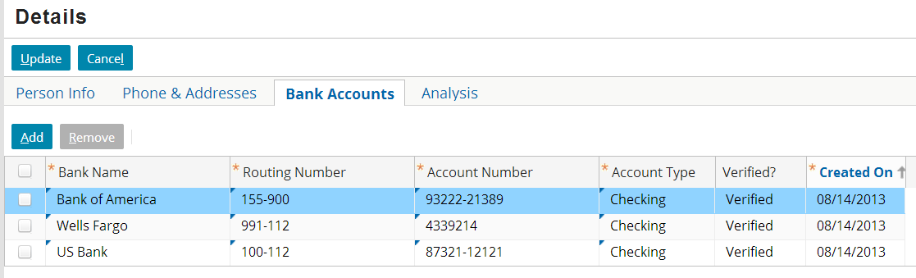
Editable list views
List views enable end users to manipulate data, including:
Modifying existing rows
Adding new rows
Removing existing rows

Slide 5
Editable hierarchy
For a cell to be editable, the row, row iterator, and list view in which the cell resides must also all be editable
List views can include editable cells (such as Account Type) and uneditable cells (such as Created On)
list view is editable
row iterator is editable
row is editable
cell is editable
Notes:
The following summarizes the default value of the editable property for each element:
A list view's editable property is blank. The property is not required. (A list view with no specified editable property is editable.)
A row iterator's editable property is blank, but this property is required. To have editable cells, it must be set to true, or to a condition that evaluates to true.
A row's editable property is blank. The property is not required. (A row with no specified editable property is editable.)
A cell's editable property is false. To have the cell be editable, you must set the property to true, or to a condition that evaluates to true.
In practice, the two elements you must explicitly set to editable to get editable cells are the row iterator and the cells that are to be made editable.

Slide 6
Multiple options for location of toolbars
Screen-level toolbar
List-level toolbar
Typically there are multiple places you can place a toolbar
In general, toolbar should be with container it acts on
The Edit Buttons shown above are needed for all containers in screen and are therefore put at the screen level
The Iterator Buttons shown are needed only for the list view, and therefore are put at the list level
Notes:
Because the PCF architecture is hierarchical in nature, there is often more than one place that a toolbar could go. For example, the screenshot above shows toolbars at both the screen level and list level. Typically, the best place for a toolbar is the highest place in the hierarchy of containers that you want it to affect. For example, if you need the same toolbar on every card of a card view, then you will provide users with a more intuitive interface if you place a single toolbar at or above the card view level as opposed to putting individual toolbars on every card.

Slide 7
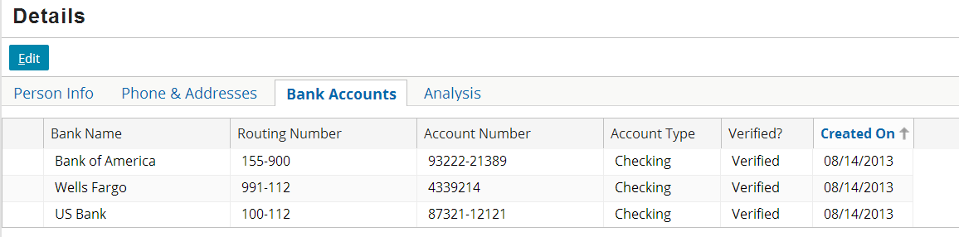
Putting lists into edit mode
To modify cell data, either:
Location containing list view must always be in edit mode, or
List view or one of its parent containers must have Edit Buttons
Notes:
It is possible to set a location so that it is always in edit mode. To configure this, set the location's startInEditMode property to true and alwaysInEditMode property to true. A location that is always in edit mode has only Update and Cancel buttons—there is no Edit button. Whenever either of the buttons is clicked, the changes are committed or canceled, and the location immediately reverts to edit mode.

Slide 8
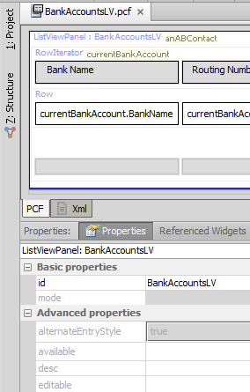
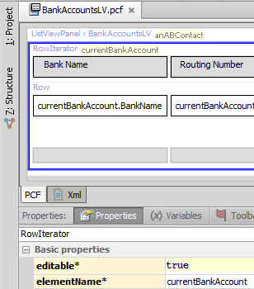
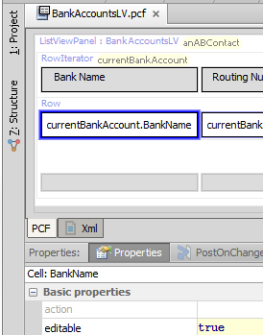
Example of cell with editable data
container default is "true"
must specify as "true"
Notes:
The screenshots above show the configuration within a list view needed to make the data in the Bank Name cells editable. Note the following about the BankAccountsLV list view:
The list view itself is editable. Editable is either blank or set to true.
The row iterator is editable.
The cell widget itself is editable.
This presumes that all container widgets that contain BankAccountsLV are also editable.

Slide 9
Lesson outline
Editable list views
Iterator buttons

Slide 10
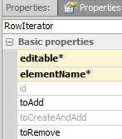
Iterator buttons and row iterators
Functionality of iterator buttons governed by properties of row iterator
toAdd - action to take when Add is clicked
toRemove - action to take when Remove is clicked

Slide 11
Steps to adding iterator buttons
Add iterator buttons to toolbar
Link iterator buttons to iterator
Specify toAdd property
Specify toRemove property
Configure checkbox behavior
Reload UI metadata

Slide 12
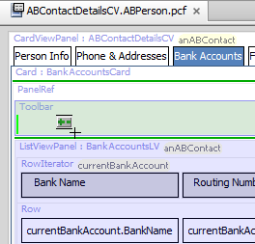
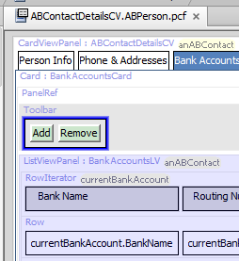
Step 1: Add iterator buttons to toolbar
Includes both Add and Remove buttons
Notes:
The Iterator Buttons widget contains both buttons needed to add and remove rows. The buttons also already have the appropriate visibility logic. They are visible only when the location is in edit mode.

Slide 13
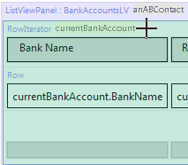
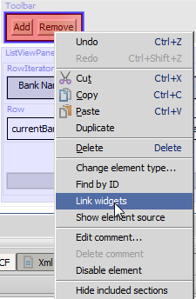


Step 2: Link iterator buttons to iterator
(1) Right-click iterator button for menu and select Link widgets
(3) Click row iterator
(4) Set iterator property
(2) Click iterator buttons
Notes:
Add the iterator buttons to the Toolbar first. The mouse cursor changes to a crosshair, and iterator buttons on the PCF turn green to indicate that they are available for linking. If you save the PCF without linking the buttons or give focus to another application before doing so, Studio changes the buttons to red to indicate that they have not been linked.
After you click the iterator buttons, Studio renders any row iterators as green to indicate that they are available for linking. You must click the row iterator itself; even though any contained row (as well as any widget contained by any row) also appears green, they cannot be clicked.
After linking the widgets, configure the iterator property of the iterator buttons to reference the exposed iterator. Click the SmartHelp button to display a list of exposed iterators, and select the appropriate one.
Although Studio identifies iterator buttons that have not been linked to a row iterator as an error, the PCF still functions at runtime. Iterator buttons that have not been configured to explicitly reference a particular iterator will implicitly reference and affect whichever row iterator appears after them physically in the page configuration.

Slide 14
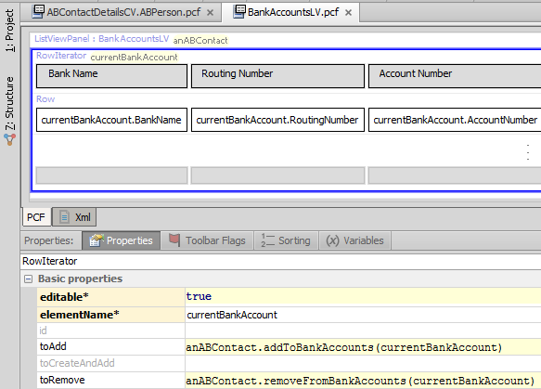
Step 3: Specify toAdd property
Syntax: parentObj.addToarrayName(elementName)
Notes:
For every array on an entity, there are inherently two methods added to that entity:
An addTo<arrayName>() method, which adds a specified object to the named array.
A removeFrom<arrayName>() method, which removes the specified object from the named array.
The addTo... method is used to enable the functionality of the Add button.
The syntax for the toAdd property is parentObj.addToArrayName(elementName), where:
parentObj is the parent object to which the array belong. In the example above, the BankAccounts array belongs to the anABContact object.
ArrayName is the name of the array.
elementName is the row iterator's element name. For an Add button, this creates a new object of the appropriate type and associates it with the array.

Slide 15
Step 4: Specify toRemove property
Syntax: parentObj.removeFromarrayName(elementName)
Notes:
For every array on an entity, there are inherently two methods added to that entity:
An addTo<arrayName>() method, which adds a specified object to the named array.
A removeFrom<arrayName>() method, which removes the specified object from the named array.
The removeFrom... method is used to enable the functionality of the Remove button.
The syntax for the toRemove property is parentObj.removeFromArrayName(elementName), where:
parentObj is the parent object to which the array belongs. In the example above, the BankAccounts array belongs to the anABContact object.
ArrayName is the name of the array.
elementName is the row iterator's element name. For a Remove button, this removes the selected row or rows from the array.

Slide 16
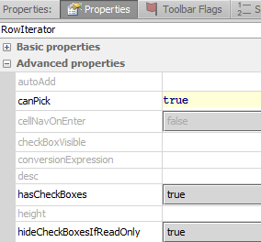
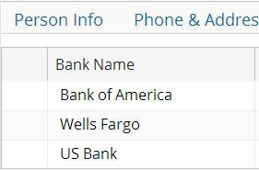
Step 5: Configure check box behavior
check boxes in edit mode
check boxes in read-only mode
Notes:
Check boxes enable the Remove button by identifying which rows to remove.
hasCheckBoxes displays check boxes.
hideCheckBoxesIfReadOnly hides check boxes in read-only mode.

Slide 17
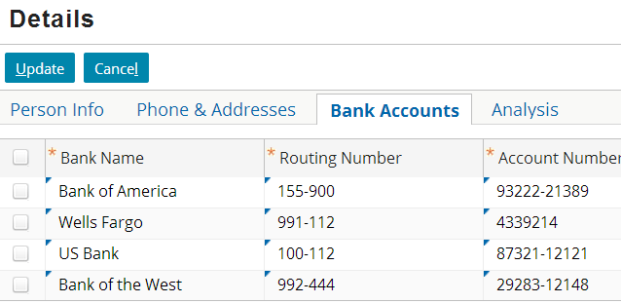
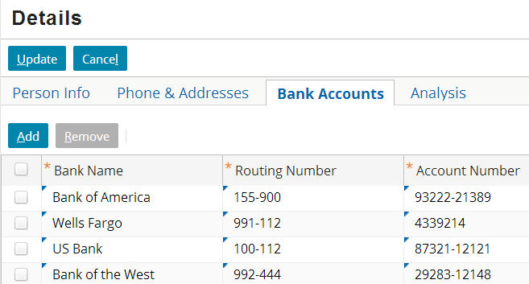
Step 6: Reload UI metadata
Deploy UI changes by entering ALT + SHIFT + L
Notes:
You should reload PCF files while in read-only mode. The screenshots above show the locations in edit mode so that the changes to the widgets are evident.

Slide 18
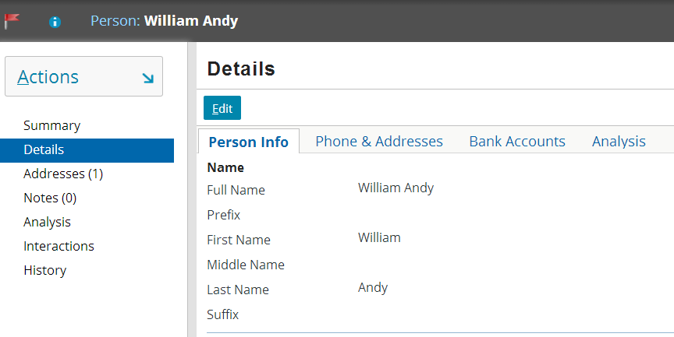
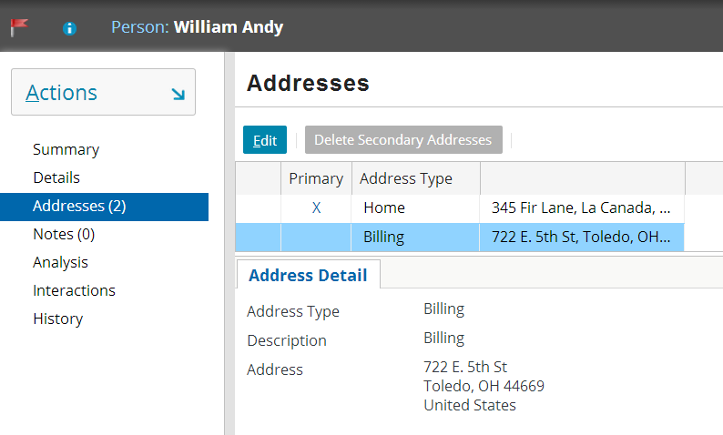
Card views and listdetail views
There are two types of secondary views that can contain detail views and list views
There isn't time in this course to cover them in detail
However, they are discussed in the "Additional UI Functionality" lesson, which you can review after the course
card view
listdetail view
Notes:
A card view is a collection of cards, each with one or more views.
A listdetail view consists of two views: a list view on top with one selected row and a card view on bottom that displays details about the selected row.

Slide 19
Lesson objectives review
You should now be able to:
Configure a list view so that its rows can be modified
Configure a list view so that rows can be added to and removed from it

Slide 20
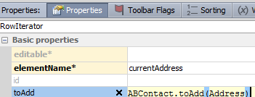
Review questions
For a cell to be editable, the cell’s Editable property must be set to true. What three other elements must also be editable to make the cell editable in the user interface?
When you drag an Iterator Buttons widget onto a toolbar, how many buttons are added?
Assume that an object called anABContact has an Addresses array and an Addresses list view whose row iterator is configured as shown. Identify the errors in how the property is configured.
Notes:
Answers
1. The list view itself, the list view's row iterator, and the row.
2. Two: an Add and a Remove button.
3. There are four errors: (1) The object is anABContact, not ABContact. (2) The method name starts with "addTo...", not "toAdd...". (3) The name of the array is missing from the end of the method name. (The method should be addToAddresses.) (4) The argument must reference the row iterator's element name, which is currentAddress.

Slide 21
Notices
Copyright © 2001-2013 Guidewire Software, Inc. All rights reserved.
Copyright © 2001-2013 Guidewire Software, Inc. All rights reserved. Guidewire, Guidewire Software, Guidewire ClaimCenter, Guidewire PolicyCenter, Guidewire BillingCenter, Guidewire Reinsurance Management, Guidewire ContactManager, Guidewire Vendor Data Management, Guidewire Client Data Management, Guidewire Rating Management, Guidewire InsuranceSuite, Guidewire ContactCenter, Guidewire Studio, Guidewire Product Designer, Guidewire Live, Guidewire DataHub, Guidewire InfoCenter, Guidewire Standard Reporting, Guidewire ExampleCenter, Gosu, Deliver Insurance Your Way, and the Guidewire logo are trademarks, service marks, or registered trademarks of Guidewire Software, Inc. in the United States and/or other countries.
Guidewire products are protected by one or more United States patents.

