Slide 1
Popups (for Viewing/Editing Objects)
15 August 2013
Notes:
Guidewire training materials contain Guidewire proprietary information that is subject to confidentiality and non-disclosure agreements. You agree to use the information in this manual solely for the purpose of training to implement Guidewire software solutions. You also agree not to disclose the information in this manual to third parties or copy this manual without prior written consent from Guidewire. Guidewire training may be given only by Guidewire employees or certified Guidewire partners under the appropriate agreement with Guidewire.

Slide 2
Lesson objectives
By the end of this lesson, you should be able to:
Describe the functionality of popups
Create popups used to view and edit objects
This lesson uses the notes section for additional explanation and information. To view the notes in PowerPoint, choose View→Normal or View→Notes Page. If you choose to print the notes for the lesson, be sure to select “Print hidden slides.”

Slide 3
Lesson outline
Popup basics
View/edit object popups

Slide 4
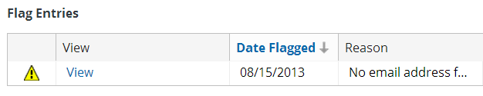
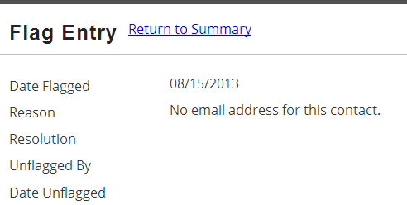
Popups
A popup contains a single screen and returns the user to the previous location once the popup is closed
Automatically has "Return to <previous location>" link
Notes:
Popup screens are designed to mimic the functionality of a true popup (which is an entirely separate window). True popups are difficult to architect because there is no easy way to avoid synchronization errors in which the system tries to update the same object in two separate windows. Popup locations as architected in Guidewire offer virtually the same functionality while avoiding the synchronization and usability issues.

Slide 5
Why not use true popups?
An industry-standard popup is a UI form displayed in an entirely separate window
Guidewire avoids true popups because of:
Potential synchronization problems with Internet Explorer when passing context and objects between windows
User tendency to have popup blockers
Guidewire popups provide almost all the functionality of true popups while avoiding these issues
Notes:
Popup screens are designed to mimic the functionality of a true popup (which is an entirely separate window). True popups are difficult to architect because there is no easy way to avoid synchronization errors in which the system tries to update the same object in two separate windows. Popup locations as architected in Guidewire offer virtually the same functionality while avoiding the synchronization and usability issues.

Slide 6
Typical use cases for popups
new object
selected object
Popup
Popup
Popup
Viewing and editing existing objects
Creating new objects
Executing "popped" searches

Slide 7
Viewing and editing existing objects
Notes:
A popup can be used to view and edit an object. This typically occurs when the object is displayed somewhere (such as in a list), but it is either not convenient to edit the object in that location, or some of the fields a user might wish to view or edit are not displayed in that location.

Slide 8
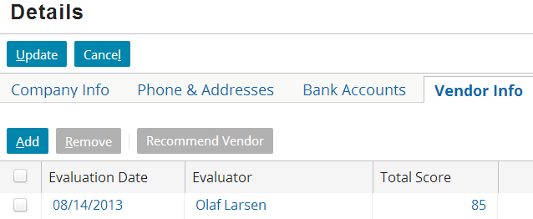
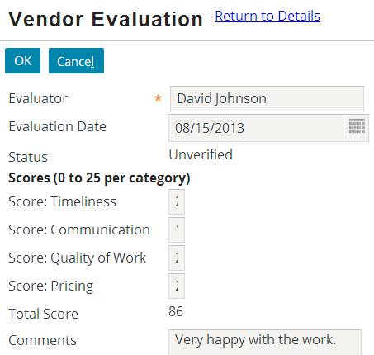
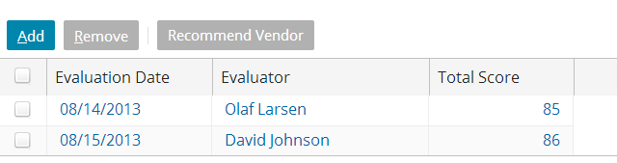
Creating new objects
popup
Notes:
A popup can be used to create new objects. In most cases, the popup used to create new objects is also used to view and edit existing objects.

Slide 9
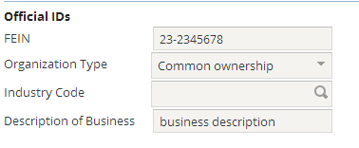
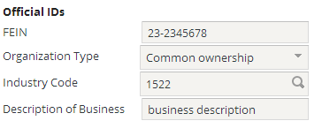
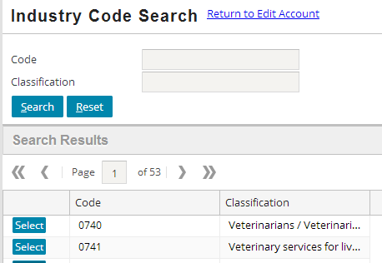
Executing "popped" searches
popup
Notes:
A popup can be used to search for an existing record. This typically occurs when the record is located in some portion of the user interface where it would not be convenient to include search functionality.
An application typically needs a certain level of complexity and functionality to require a popped search. TrainingApp is simple enough that it does not have an example of this type of popup. The example shown above is from PolicyCenter, where a popup is provided to allow the user to search for a valid industry code when creating a new account.

Slide 10
Lesson outline
Popup basics
View/edit object popups

Slide 11
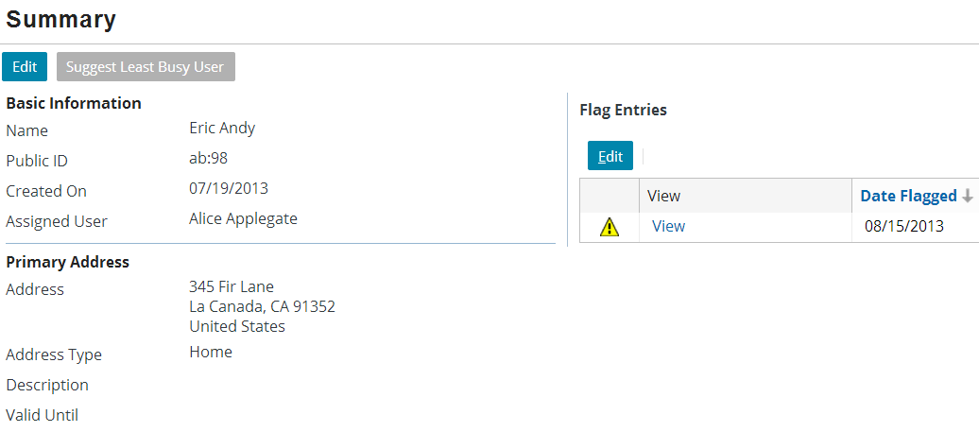
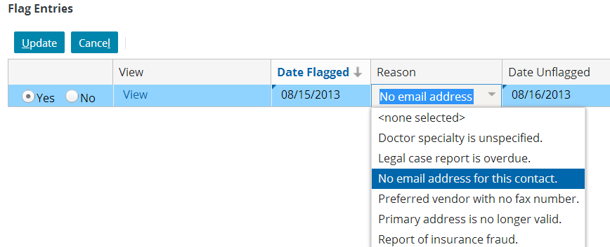
Widgets involved in view/edit popups
navigation widget (in FlagEntriesLV)
popup (FlagEntryPopup)
screen (inline in popup)
inner detail view (FlagEntryDV)
Notes:
A "view/edit popup" is a popup used to view and edit existing objects, but not to create new objects.
There are four primary widgets involved in the configuration of a view/edit popup:
The navigation widget that navigates to the popup. In the example above, it is the View button in the FlagEntriesLV list view.
The popup itself. In the example above, it is the FlagEntryPopup.
The screen referenced by the popup. Typically, there is no need for the screen to be reusable and it is therefore declared inline. In the example above, the screen is declared inline in FlagEntryPopup.
The "inner" detail view contained by the popup to display the object. In the example above, it is the FlagEntryDV detail view.

Slide 12
Steps to create a view/edit object popup
Create inner detail view
Create popup file
Specify the popup properties
Specify the popup variables
Specify the popup entry point
Create screen and reference detail view
Configure the navigation widget
Reload the metadata

Slide 13
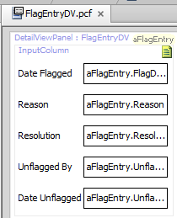
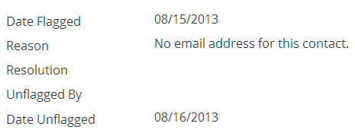
Step 1: Create inner detail view
Inner detail view created in same manner as any other detail view
If inner detail view does not need to be reusable, it can instead be created inline as part of step 6
Notes:
The example above shows the detail view being created as a reusable detail view.

Slide 14
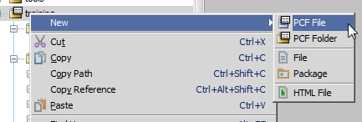
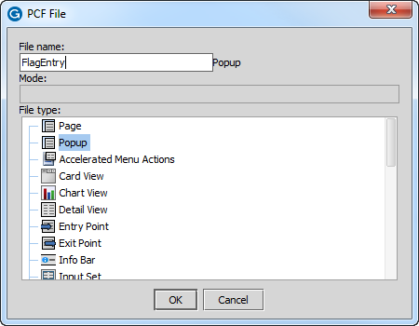
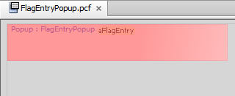
Step 2: Create popup file
"Popup" automatically appended to end of file name
Notes:
To create a PCF file that defines a popup:
In Studio, right-click the folder in which the popup file should be stored. Select New > PCF file.
Name the file and select "Popup" for the file type. Studio automatically adds "Popup" to the end of the file name. If you manually add "Popup" to the end of the file name, Studio ignores it. Therefore, it is not possible to inadvertently name a file that ends in "PopupPopup".
Click OK.
Studio displays the new popup. At the top of the canvas, there is a link named "Popup : <nameOfPopup>". Otherwise, the file is empty.

Slide 15
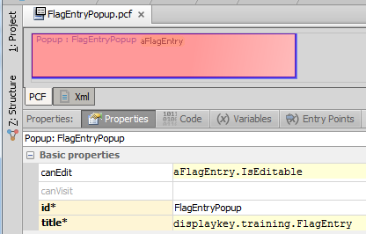
Step 3: Specify popup properties
title - sets top label
canEdit - if false, no container or widget in location's screen is editable
canVisit - if false, no widget navigating to location is visible/clickable
startInEditMode - determines if popup starts in read-only or edit mode
Notes:
The title property determines the label in the top blue bar. In the example above, the title is "Flag Entry".
Every location has a canEdit and canVisit property.
canEdit - This property determines if the screen and widgets contained in the screen are editable or not. If canEdit is false then the screen, every child container widget on the screen, and every atomic widget on the screen will not be editable.
canVisit - This property determines the behavior of widgets that navigate to the location. If it renders to false, then widgets that navigate to it are either not available or not visible. The specific behavior depends on the widget. For example, a cell widget that navigates to a location with its canVisit property set to false is visible but cannot be clicked. A menu item that navigates to a location with its canVisit property set to false is not visible.
The startInEditMode property determines if the popup is initially in edit mode or not. It can be set to a static value (true or false) or a Gosu expression, such as "aFlagEntry.IsEditable", which returns true if the flag entry is editable. (A flag entry is editable if it is open and the current user has "resolve flag entry" permissions.)

Slide 16
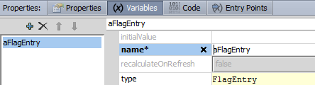
Step 4: Specify popup variables
One variable needed for every object passed to popup
Notes:
The Variables tab declares variables that are global to the location. In most cases, the only variables declared on this tab are those that are referenced by location entry points, which are discussed on the next slide.

Slide 17

Step 5: Specify popup entry point
An entry point is a reference used by widgets to navigate to a given location
Syntax: popupName( objName : objType )
Can specify multiple comma-delimited objects
Notes:
Recall that an entry point is a reference used by widgets to navigate to a given location. It specifies the location name and the values required to render the location. In the example above, the entry point name is "FlagEntryPopup" and the required value is a FlagEntry object that the popup puts in a variable named "aFlagEntry".
Every location must have at least one entry point. Any given location can have many entry points. An example of this appears later in the lesson.
The name of the entry point must be the same as the name of the file in which the location is declared.
Every object referenced in the signature (such as aFlagEntry in the screenshot above) must be declared on the Variables tab.

Slide 18
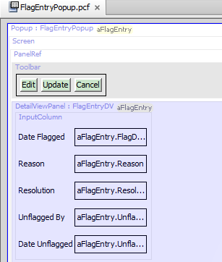
Step 6: Create screen and reference DV
Add a screen to popup
Add a panel ref to screen that references inner detail view
Use def property
If necessary, add toolbar and add Edit buttons to toolbar
Notes:
For step 6a, you can drag a screen onto the popup. You do not need to specify any properties for the screen.
The detail view can be a reusable detail view referenced by the screen, or it could be configured inline. For step 6b, refer to the "Detail Views" lesson for more information on referencing detail views through panel refs and creating inline detail views.
Step 6c is required if the object is to be both viewable and editable in the inner detail view. Refer to the "Editable Detail Views" lesson for more information on adding toolbars and edit buttons to detail views.

Slide 19
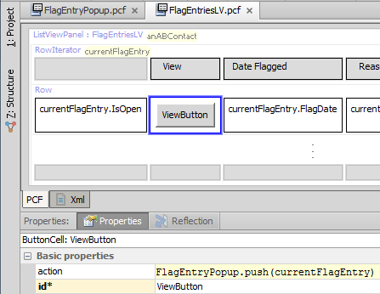
Step 7: Configure the navigation widget
Syntax: entryPointName.push( objectList )
FlagEntriesLV
FlagEntryPopup
Notes:
To create a navigation widget that navigates to a popup:
Open the destination location's PCF file.
Determine the relevant entry point.
Specify widget's action property using the syntax shown above.
Refer to the "Introduction to Locations" lesson for more information on creating navigation widgets.

Slide 20
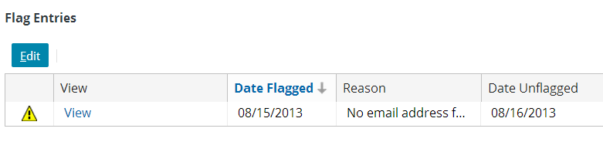
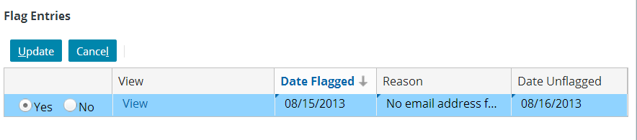
Step 8: Reload the metadata
Deploy UI changes by pressing ALT + SHIFT + L

Slide 21
Lesson objectives review
You should now be able to:
Describe the functionality of popups
Create popups used to view and edit objects

Slide 22
Review questions
What are the three primary use cases for popups?
What happens if a location's canEdit property evaluates to false?
What happens if a location's canVisit property evaluates to false?
Notes:
Answers
1. Viewing and editing existing objects, creating new objects, and executing popped searches.
2. The screen and its contents are non-editable.
3. The widget navigating to the location is either not visible or not clickable.

Slide 23
Notices
Copyright © 2001-2013 Guidewire Software, Inc. All rights reserved. Guidewire, Guidewire Software, Guidewire ClaimCenter, Guidewire PolicyCenter, Guidewire BillingCenter, Guidewire Reinsurance Management, Guidewire ContactManager, Guidewire Vendor Data Management, Guidewire Client Data Management, Guidewire Rating Management, Guidewire InsuranceSuite, Guidewire ContactCenter, Guidewire Studio, Guidewire Product Designer, Guidewire Live, Guidewire DataHub, Guidewire InfoCenter, Guidewire Standard Reporting, Guidewire ExampleCenter, Gosu, Deliver Insurance Your Way, and the Guidewire logo are trademarks, service marks, or registered trademarks of Guidewire Software, Inc. in the United States and/or other countries.
Guidewire products are protected by one or more United States patents.

