Slide 1
Popups (for Creating New Objects)
19 August 2013
Notes:
Guidewire training materials contain Guidewire proprietary information that is subject to confidentiality and non-disclosure agreements. You agree to use the information in this manual solely for the purpose of training to implement Guidewire software solutions. You also agree not to disclose the information in this manual to third parties or copy this manual without prior written consent from Guidewire. Guidewire training may be given only by Guidewire employees or certified Guidewire partners under the appropriate agreement with Guidewire.

Slide 2
Lesson objectives
By the end of this lesson, you should be able to:
Describe the differences in behavior between a "view/edit only" popup and a "view/edit/create new" popup
Configure a popup so that it can create new objects
Configure a popup to dynamically render in read-only or edit mode
This lesson uses the notes section for additional explanation and information. To view the notes in PowerPoint, choose View→Normal or View→Notes Page. If you choose to print the notes for the lesson, be sure to select “Print hidden slides.”

Slide 3
Lesson outline
Behaviors of a "create new" popup
Configuring a "create new" popup
Dynamically setting edit mode

Slide 4
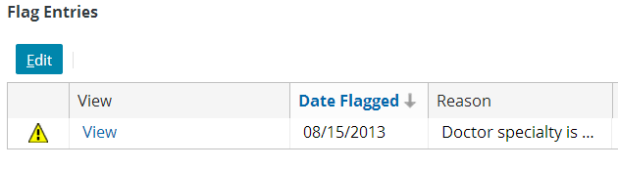
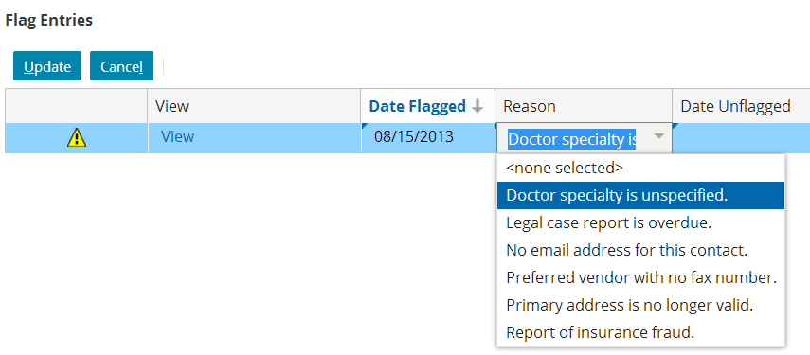
Two common types of popups: Type 1 - View/edit only
Some popups are used only to view and edit existing objects
These popups cannot be used to create new objects
Notes:
In the example above, the FlagEntryPopup popup is used to view existing flag entry objects and, if the user has sufficient permissions, edit them. However, it cannot be used to create flag entry objects. Flag entries are created only by the application business logic, not manually by a user.
"View/edit only" popups are discussed in detail in the "Popups (for Viewing and Editing Objects)" lesson.

Slide 5
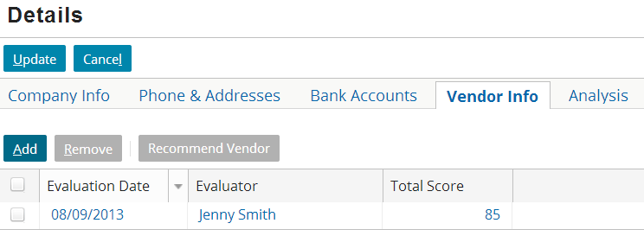
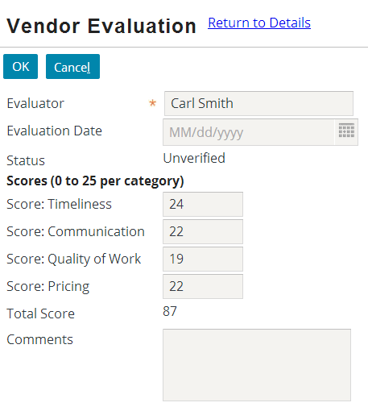
Two common types of popups: Type 2 - View/edit/create
create new object
view/edit existing object
Some popups are used to view and edit existing objects and create new objects
Notes:
In the example above, the VendorEvaluationPopup popup is used to view and edit existing vendor evaluation objects and to create new ones.
There is a third type of popup that occurs occasionally in Guidewire applications - search popups. These popups are designed to let the user execute a search in a popup and then select one value in the search results, which is then returned to the widget that called the popup.
Theoretically, you could create a popup that was used to create new objects but that could not be used to view and edit objects. In practice, there are not many business scenarios that would justify this type of behavior.

Slide 6
Configuring a popup to create new objects
When you configure a "create new" popup, you typically:
Create the popup as a "view/edit only" popup
Test the configuration
Modify the popup so it can also create new objects
Test the configuration
To configure a "view/edit only" popup so that it can create new objects, you must configure four behaviors:
The behavior of the list view's Add button
The number of entry points for the popup
The creation of a new object by the popup
The return of the new object to the list view
Notes:
Incremental testing is a fundamental practice of software implementation in general and Guidewire implementations in particular. If you had a popup that was needed for both viewing/editing objects and creating new objects, you could theoretically build the entire popup and then test the popup after all of the functionality had been created. In practice, this is not recommended, as it takes longer to track down flaws in the configuration. It is almost always faster to build the view/edit functionality of the popup, test it to verify it works, and then build the "create new" functionality of the popup.

Slide 7
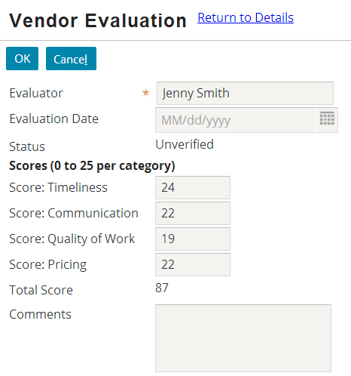
Clicking "Add" navigates to the popup
Clicking "Add" does not create a new blank row in the list view
Instead, the application navigates to the popup
Notes:
An editable list view can let you create new objects in one of two places. Some editable list views let you create new objects in-line (in a new row in the list view itself). Other editable list views let you create new objects in a separate popup.
By default, editable list views let you create new objects in-line. Clicking the "Add" button does not cause the application to navigate to a new location. Instead, the application remains in the current location, and a new row simply appears at the bottom of the list view.
When a list view is configured to create new objects in a separate popup, then the list view must navigate to the popup when the new object is to be created.

Slide 8
Popup has a second entry point
Entry point 2 - Used by Add button - Does not pass an object from the list to the popup - Used to create new objects
Entry point 1 - Used by list view cell widgets - Passes the relevant object - Used to view/edit the object
Notes:
A "view/edit only" popup has only a single entry point, as described above in "entry point 1".
A "view/edit/create new" popup has two entry points. The first is used for viewing and editing existing objects. The second is used for creating new objects.

Slide 9
"Add" navigation does not pass an object
(no vendor eval)
The navigation used by the "Add" button does not pass any object from the list to the popup
Instead, the popup automatically creates a new, blank object
aVendor Evaluation
Notes:
The navigation examples so far have involved a location that expects one or more objects and a navigation widget that passes one object to the location for every object the location needs. However, it is possible to create a location that expects no objects. When it is called using a no-object entry point, you can configure the destination location to create the new object.

Slide 10
Popup returns new object to list view
Returning an object called "aVendorEvaluation", of type VendorEvaluation.
I will add it to the associated array.
aVendor Evaluation
The popup must return the new object to the list view so that the list view can add the object to the associated array
The popup specifies the object name and datatype
Notes:
Technically speaking, when a popup is used to view or edit an existing object, the popup does not "return" the object to the parent list view. The parent list view already knows about the object, and the object already belongs to the array that is being displayed by the list view. Therefore, the popup simply commits and changes to the object in the database, and the parent list view simply refreshes its information from the database.
When a popup is used to create a new object, the parent list view does not already know about the object. Therefore, the popup must return to the object to the parent view. This is so that the parent list view can add the object to the appropriate array. If the popup doesn't return the newly created object, it might get committed to the database (depending on the presence of referential integrity constraints), but it would not get associated to the array. From a UI perspective, the object would simply disappear.

Slide 11
Lesson outline
Behaviors of a "create new" popup
Configuring a "create new" popup
Dynamically setting edit mode

Slide 12
Steps to configure a "create new" popup
Create and test a "view/edit" popup
Configure the popup so that it has an entry point that requires no passed objects
Configure the popup so that it creates a new object when it receives no objects
Configure the popup to return the new object to the parent list view
Configure the parent list view so that the "Add" button navigates to the popup
Reload the metadata

Slide 13
Step 1: Create and test a "view/edit" popup
This is discussed in detail in the "Popups (for Viewing and Editing Objects)" lesson

Slide 14
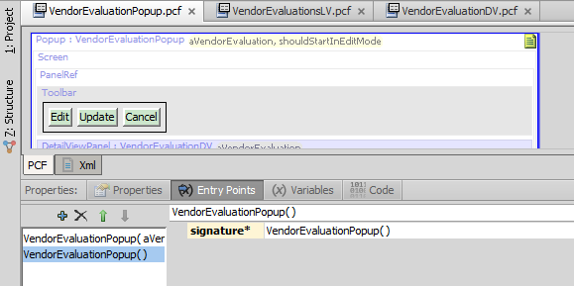
Step 2: Configure the popup so that it has an entry point that requires no objects
Create a second entry point for the popup
This entry point names the popup but takes no objects
Notes:
Locations can have multiple entry points. This is often done for locations where different widgets might navigate to it under different circumstances. For example, when a popup is used to both edit an existing object and create a new one, it must have multiple entry points, one for each circumstance.
Having multiple entry points is similar to the concept of "overloading a method" in object-oriented programming. When a location has multiple entry points, each entry point must have a unique list of expected objects and their data types. For example, a popup could theoretically have:
One entry point with no objects
One entry point with a single VendorEvaluation object
One entry point with a single boolean value
One entry point with a VendorEvaluation object and a boolean value
Whenever a widget navigates to this popup, it would need to specify either no objects, or one object of type VendorEvaluation, or one object of type boolean, or two objects - one of type VendorEvaluation and one of type boolean. The Guidewire application can automatically determine the correct entry point to use.

Slide 15
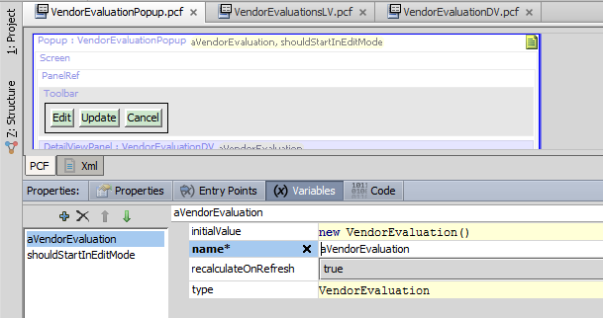
Step 3: Configure the popup so that it creates a new object when it receives no objects
From the Variables tab, select the object the popup displays
Set the initialValue to new objectType()
Notes:
Every location variable has an initialValue property. This property is not used when the location receives an object by that name from the navigation widget that called it. Rather, it is used only when the navigation widget does not pass in an object by that name. In this situation, the object must be created by the location itself.
The initialValue of "new objectType()" says "Whenever the navigation widget doesn't pass this object to the location, create a new blank object to the type specified here."

Slide 16
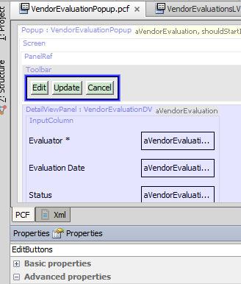

Step 4: Configure popup to return object (Specifying return object's name)
Every view/edit popup must have a toolbar with an EditButtons tool
Set the pickValue of this tool to the name of the object that the popup returns
Notes:
The behavior discussed above is similar to creating a method for an object-oriented class. If the method has a return value, then you must specify a value to return in the method. For example, consider the following Gosu method:
function convertPoundsToKilograms ( poundValue : float ) : float {
var kilogramValue = poundValue / 2.2
return kilogramValue
}
The final line of the convertPoundsToKilograms method identifies that the value to return is the value of "kilogramValue". A "create new" popup is analogous to a method. It has a return value. The popup shown in the slide returns the value of "aVendorEvaluation".
With regards to this step, one common question is "Why is the property called 'pickValue'?" The property that names the object returned from the popup is called "pickValue" for historical reasons. Originally, popups were designed to be used for "popup searches". This was needed when a widget referenced an object that one typically needed to look up. For example, an AccountDetailView might have an IndustryCode field. If there are hundreds of industry codes, the user typically needs to look up the code that is needed. To do this, they would click a button next to the widget. This would launch a search window in a popup. The user could entry criteria (such as the name associated with the industry code) and click Search. A list of matching industry codes would appear, and the user could pick one of them. This code would then be returned to the IndustryCode widget. Thus, the term pickValue was used because the value the popup returned was picked from a list of search results. Later, the capabilities of popups were expanded to include the ability to create new objects. But for backwards compatibility, the name "pickValue" had to be kept as is.

Slide 17
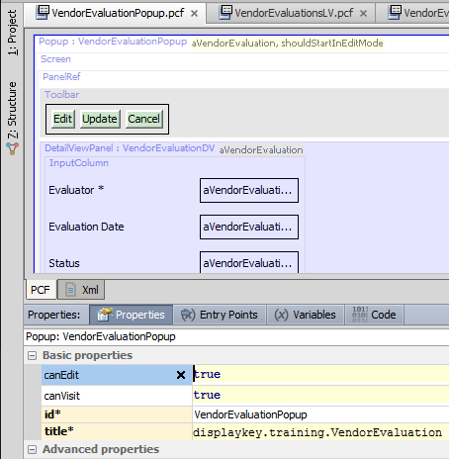

Step 4: Configure popup to return object (Specifying return object's type)
On the popup itself, set the returnType property to the type of object returned by the popup
Notes:
The behavior discussed above is similar to creating a method for an object-oriented class. If the method has a return value, then you must specify the return value's type. For example, consider the following Gosu method:
function convertPoundsToKilograms ( poundValue : float ) : float {
var kilogramValue = poundValue / 2.2
return kilogramValue
}
The method signature (the first line) identifies that the method returns a float value. A "create new" popup is analogous to a method. It has a return value with a specific type. The popup shown in the slide returns a VendorEvaluation value (an object of type VendorEvaluation).

Slide 18
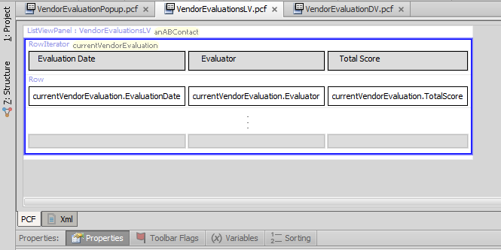
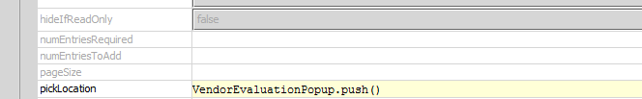
Step 5: Configure the parent list view so that the "Add" button navigates to the popup
Go to the parent list view's row iterator
Set the pickLocation property to: popupName.push()
This makes use of the popup's new no-object entry point

Slide 19
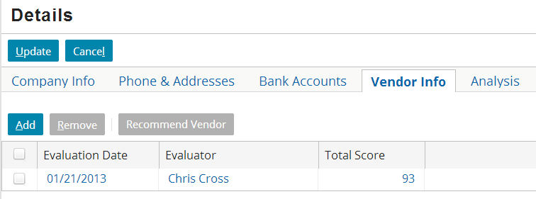
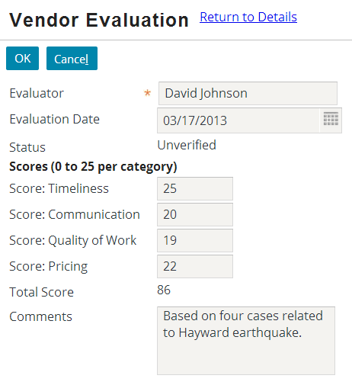
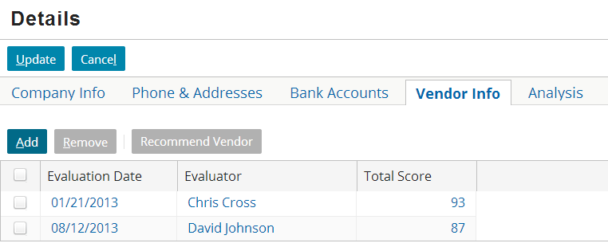
Step 6: Reload the metadata
Deploy UI changes by pressing ALT + SHIFT + L

Slide 20
Summary of "new object" configurations
Behavior | Where To Set Property | Property To Set | Value To Set It To
Allow for navigation to the popup without passing any objects to it | Popup's Entry Points tab | Entry point signature | popupName( <empty list>)
In popup, create a new object if navigation widget didn't pass one in | Popup's Variables tab | initialValue | new objType()
Once new object is saved, pass the new object back to the parent list view | Popup's detail view toolbar's EditButtons | pickValue | objName
 | Popup | returnType | objType
On parent list view, when "Add" is clicked, navigate to the popup | Parent list view's row iterator | pickLocation | popupName.push()

Slide 21
Lesson outline
Behaviors of a "create new" popup
Configuring a "create new" popup
Dynamically setting edit mode

Slide 22
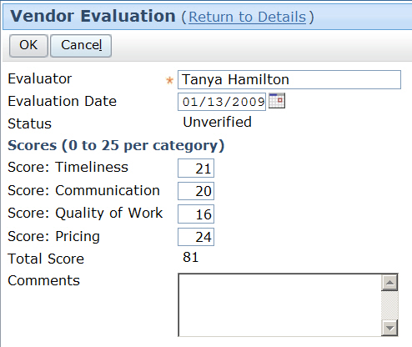
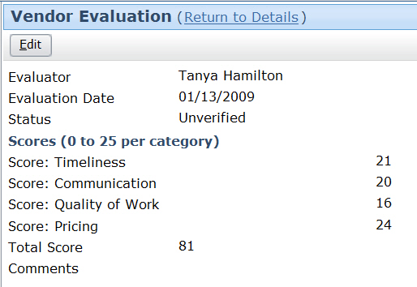
startInEditMode
All locations have a property that determines the edit mode to use when the popup is first rendered
startIn EditMode = true
startIn EditMode = false
Notes:
When startInEditMode is set to true, the popup is initially rendered in edit mode, as shown in the screenshot on the left. When startInEditMode is set to false, the popup is initially rendered in read-only mode, as shown in the screenshot on the right.
The behavior described in this section of the lesson is not required for a "create new" popup to work correctly. Rather, it discusses behavior that may provide for more user-friendly behavior.

Slide 23
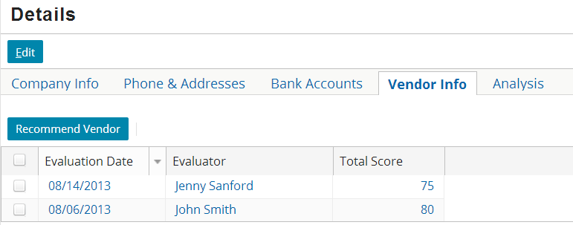
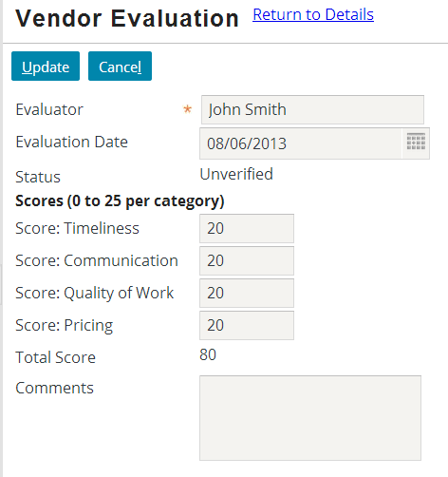
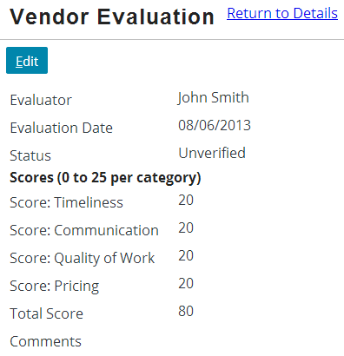
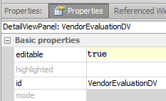
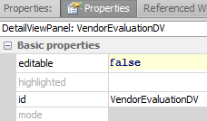
startInEditMode
All locations have a property that determines the edit mode to use when the popup is first rendered
startIn EditMode = false
startIn EditMode = true
Notes:
When startInEditMode is set to true, the popup is initially rendered in edit mode, as shown in the screenshot on the left. When startInEditMode is set to false, the popup is initially rendered in read-only mode, as shown in the screenshot on the right.
The behavior described in this section of the lesson is not required for a "create new" popup to work correctly. Rather, it discusses behavior that may provide for more user-friendly behavior.

Slide 24
Should the popup be in edit mode?
Desired action | Is the parent list view in edit mode? | Should the popup be in edit mode?
View or edit an existing object | No | No (List view is in read-only mode, so popup should initially match this)
View or edit an existing object | Yes | Yes (List view is in edit mode, so popup should initially match this)
Create a new object | (n/a) | Yes (User wants to specify values for a new object, which requires being in edit mode)
Notes:
The table above summarizes the standard behavior for popups in the base application. This is based on developing application behavior that is as user-friendly as possible. These are not absolute rules, nor are they technical requirements.

Slide 25
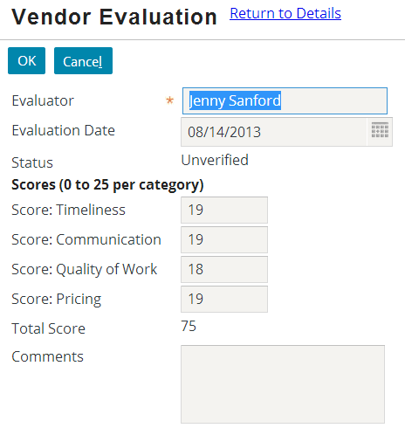
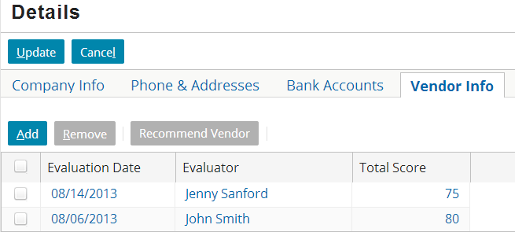
Determining edit mode dynamically
You can configure a popup to start in edit mode dynamically by having the list view pass an additional boolean value
When navigating from the "Add" button, pass "true"
When navigating from an existing object, pass "true" if the list view is in edit mode; otherwise, pass "false"
When rendering the popup, start in edit mode if the value passed was "true"
true
if list in edit mode -> true; otherwise false

Slide 26
Steps to configure popup for dynamic edit mode
For the popup, create a new "shouldStartInEditMode" boolean variable
Modify entry points so that boolean value can be received
Change "Add" button navigation so that it always passes "true"
Change list view cell navigation so that it passes "true" or "false" depending on list view's edit mode

Slide 27
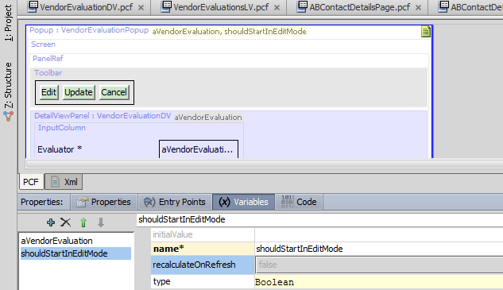
Step 1: Create new boolean variable
The new variable is used to determine if the popup should start in edit mode
It will always be specified by the navigation widget, so it does not need an initial value

Slide 28
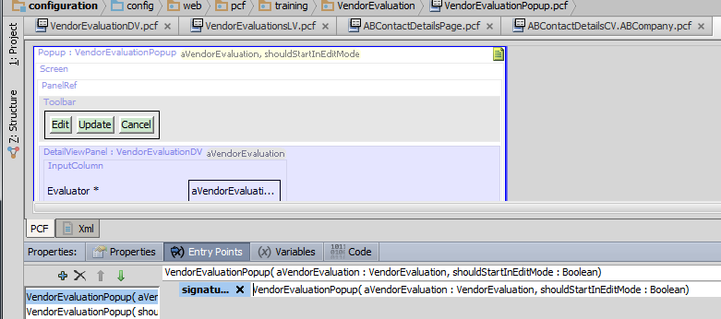
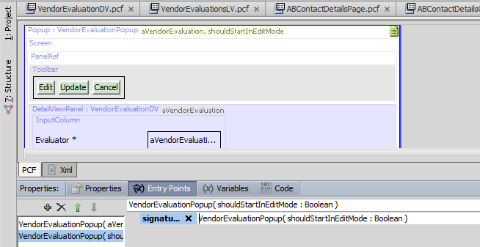
Step 2: Modify popup entry points
View/Edit Navigation (pass in an object to view/edit and a boolean to indicate edit mode)
"Create New" Navigation (pass in just a boolean to indicate edit mode)
Notes:
In this step, all of the existing entry points are modified so that they require a boolean value from the navigation widget. In every case, this value is stored in the variable created in Step 1 (shouldStartInEditMode).

Slide 29
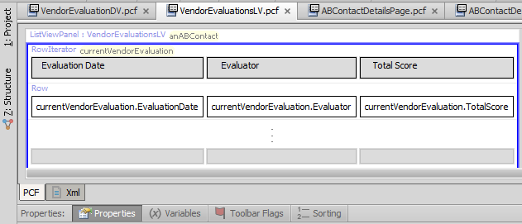

Step 3: Modify "Add" button navigation
Modify the parent list view's row iterator's pickLocation value so that a value of "true" is always passed
This means that when you click the "Add" button, the resulting popup is always rendered in edit mode

Slide 30
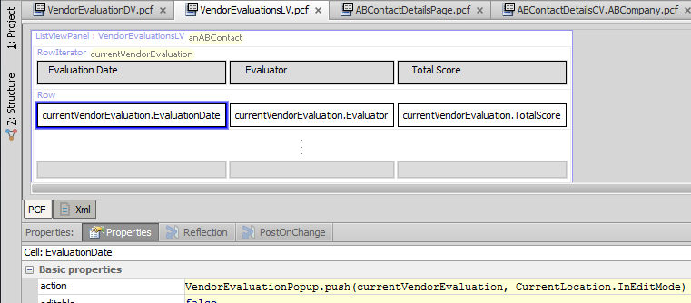
Step 4: Modify list view cell navigation
Modify the parent list view's cells' action value so that a value of "true" or "false" is passed, depending on whether the list view is in edit mode
The expression CurrentLocation.InEditMode returns true if the location is in edit mode and false if it isn't
Notes:
Every location has an InEditMode property that returns true if the location is in edit mode and false if it is in read-only mode.
From a widget or location, you can access information about the current location by referencing the CurrentLocation object. This object represents the location the user is currently at. From here, you can access information about that location, such as whether it is in edit mode or not.

Slide 31
Lesson objectives review
You should now be able to:
Describe the differences in behavior between a "view/edit only" popup and a "view/edit/create new" popup
Configure a popup so that it can create new objects
Configure a popup to dynamically render in read-only or edit mode

Slide 32
Review questions
When does a popup need to have two entry points?
When you click a list view's "Add" button, where does the new object get created when...
...the row iterator's pickLocation property has a value, such as "NewVendorPopup.push()"?
...the row iterator's pickLocation property has no value?
Assume a location has a variable such as "aVendorEval", with an initialValue, such as "new VendorEvaluation()". Under what circumstances does this initial value get used? Under what circumstances is it ignored?
If a popup creates a new object, it must pass that object back to the parent list view. Why?
(continued)
Notes:
Answers
1. A popup needs two entry points when the popup is used for both viewing and editing existing objects and creating new objects. One entry point is used to view or edit an existing object. The other is used to create a new one.
2. a) The new object gets created in the specified popup (in this case, NewVendorPopup).
b) The new object gets created in a new row at the bottom of the list view. In this case, no navigation occurs.
3. The initial value of the object is used if the navigation widget did not pass the object to the location. The initial value is ignored if the navigation widget did pass the object to the location.
4. A popup must pass a newly created object back to the list view so that the list view can add the new object to the appropriate array.

Slide 33
Review questions
Behavior | Where To Set Property | Property To Set | Value To Set It To
Allow for navigation to popup without passing any objects to it | Popup's Entry Points tab | Entry point signature | (5)
In popup, create a new object if navigation widget didn't pass one | Popup's Variables tab | initialValue | (6)
Once new object is saved, pass the new object back to the parent list view | Popup's detail view toolbar's EditButtons | pickValue | (7)
 | Popup | returnType | (8)
On parent list view, when "Add" is clicked, navigate to the popup | Parent list view's row iterator | pickLocation | (9)
For each "create new" popup behavior, specify the value to set the given property to.
a) new objType() b) objName c) objType
d) popupName( <empty list>) e) popupName.push()
Notes:
Answers
5. D. A location entry point must start with the name of the location. If it accepts no objects, then it ends with a set of parentheses with no objects, "()".
6. A. When an object isn't passed to a popup, the initial value of the object variable is "new objType()", such as "new VendorEvaluation()" for a popup that creates vendor evaluations.
7. B. The "pickValue" is the value - or the name of the object - to be returned to the list view.
8. C. The "returnType" is the type of the object to be returned to the list view.
9. E. This is the only answer that can be used by a navigation widget to navigate to a location. In other words, it's the only one that ends in a .go() or .push().

Slide 34
Notices
Copyright © 2001-2013 Guidewire Software, Inc. All rights reserved. Guidewire, Guidewire Software, Guidewire ClaimCenter, Guidewire PolicyCenter, Guidewire BillingCenter, Guidewire Reinsurance Management, Guidewire ContactManager, Guidewire Vendor Data Management, Guidewire Client Data Management, Guidewire Rating Management, Guidewire InsuranceSuite, Guidewire ContactCenter, Guidewire Studio, Guidewire Product Designer, Guidewire Live, Guidewire DataHub, Guidewire InfoCenter, Guidewire Standard Reporting, Guidewire ExampleCenter, Gosu, Deliver Insurance Your Way, and the Guidewire logo are trademarks, service marks, or registered trademarks of Guidewire Software, Inc. in the United States and/or other countries.
Guidewire products are protected by one or more United States patents.

