Slide 1
Dependent Dropdowns
21 August 2013
Notes:
Guidewire training materials contain Guidewire proprietary information that is subject to confidentiality and non-disclosure agreements. You agree to use the information in this manual solely for the purpose of training to implement Guidewire software solutions. You also agree not to disclose the information in this manual to third parties or copy this manual without prior written consent from Guidewire. Guidewire training may be given only by Guidewire employees or certified Guidewire partners under the appropriate agreement with Guidewire.

Slide 2
Lesson objectives
By the end of this lesson, you should be able to:
Create dependent dropdowns
This lesson uses the notes section for additional explanation and information. To view the notes in PowerPoint, choose View→Normal or View→Notes Page. If you choose to print the notes for the lesson, be sure to select “Print hidden slides.”

Slide 3
Lesson outline
Dependent dropdowns

Slide 4
Review: Filtering typelists
Two mechanisms exist to constrain a field such that only some typecodes in typelist are available
Typelist filter
A typelist filter is a named subset of typecodes in typelist
Declared at typelist level
Typecode category
A typelist category is a "parent value" that must be present for a given "child value" to be available
Declared at typecode level

Slide 5
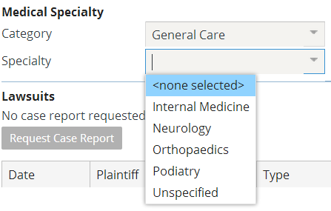
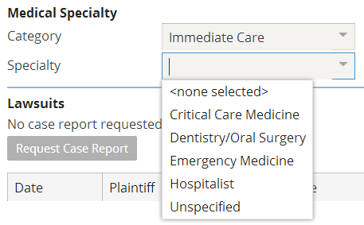
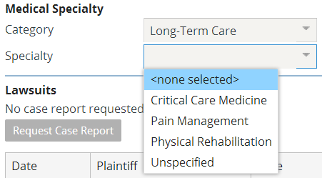
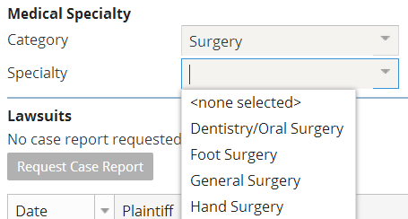
Review: Typecode categories
Value of "parent" field constrains choices in given field

Slide 6
UI requirements for dependent dropdowns
To work correctly:
Category dropdown and child dropdown must be declared in the same PCF file
Typecode dropdown must come after the category dropdown
It does not need to be immediately after the parent
It does not need to be in the same input column
Notes:
Dependent dropdown filtering will not work correctly if the parent and child dropdowns are declared in separate PCF files (such as having the parent dropdown on a screen and the child dropdown on a reusable detail view referenced by the screen).
These requirements are imposed by the Guidewire user interface architecture.

Slide 7
Steps to implement dependent dropdowns
Add a desired typecode to the typelist
Specify a category for the typecode
If adding to UI, confirm that child widget comes after parent widget

Slide 8
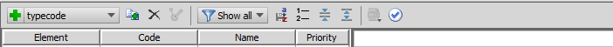
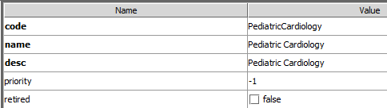
Step 1: Add a desired typecode to the typelist
code
name
Notes:
The typecode code should not contain spaces.

Slide 9
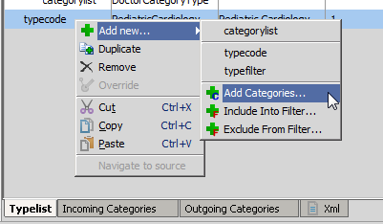
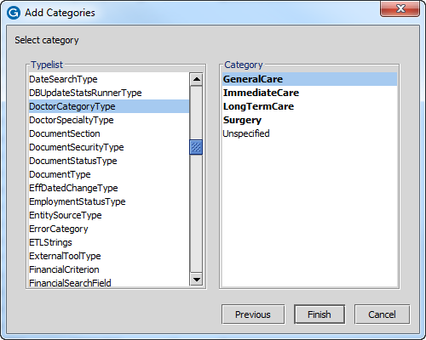
Step 2: Add a valid category for the typecode
You must add each category individually
Notes:
Select the typcode and right-click for a context menu. Add a category for the newly added typecode using the Add Categories Wizard. If you want to add more categories, right-click on the typecode again. You must add each category individually.

Slide 10
Review: Deploying data model extensions
Optionally regenerate Data Dictionary and check for validation errors
gwXX regen-dictionary
Restart the application server
gwXX dev-stop, and then
gwXX dev-start

Slide 11
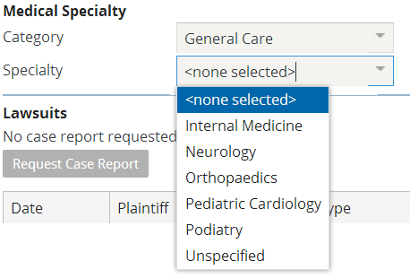
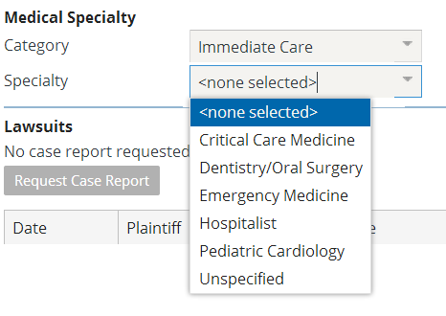
The deployed dependent dropdown

Slide 12
Lesson objectives review
You should now be able to:
Create dependent dropdowns

Slide 13
Notices
Copyright © 2001-2013 Guidewire Software, Inc. All rights reserved. Guidewire, Guidewire Software, Guidewire ClaimCenter, Guidewire PolicyCenter, Guidewire BillingCenter, Guidewire Reinsurance Management, Guidewire ContactManager, Guidewire Vendor Data Management, Guidewire Client Data Management, Guidewire Rating Management, Guidewire InsuranceSuite, Guidewire ContactCenter, Guidewire Studio, Guidewire Product Designer, Guidewire Live, Guidewire DataHub, Guidewire InfoCenter, Guidewire Standard Reporting, Guidewire ExampleCenter, Gosu, Deliver Insurance Your Way, and the Guidewire logo are trademarks, service marks, or registered trademarks of Guidewire Software, Inc. in the United States and/or other countries.
Guidewire products are protected by one or more United States patents.

