Slide 1
Client-side Widget Behavior
23 September 2013

Slide 2
Lesson objectives
By the end of this lesson, you should be able to:
Describe the most common client-side dynamic widget behaviors
Change a widget's value to reflect some other change prior to data commitment
This lesson uses the notes section for additional explanation and information. To view the notes in PowerPoint, choose View→Normal or View→Notes Page. If you choose to print the notes for the lesson, be sure to select “Print hidden slides.”

Slide 3
Lesson outline
Client-side widget behavior
Reflecting widget values
Additional reflection techniques

Slide 4
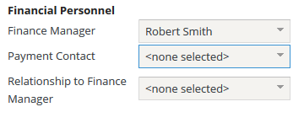
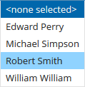
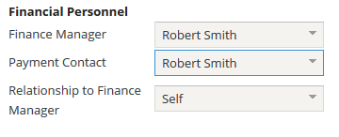
Client reflection
Two or more widgets
One or more triggers
One or more listening
Trigger widget changes value
Listening widget(s) reflects change
Value
Availability
Trigger widget changes value
Listening widget reflects change
Notes:
In the example above, whenever a change is made to the either the Finance Manager or Payment Contact, the Relationship to Finance Manager field reflects the change.
With client reflection, it is possible to update the value and/or availability of listening widgets. Availability as property indirectly determines the editability of a listening widget. It is not possible to update the visibility, requiredness, and/or the label properties of a listening widget.

Slide 5
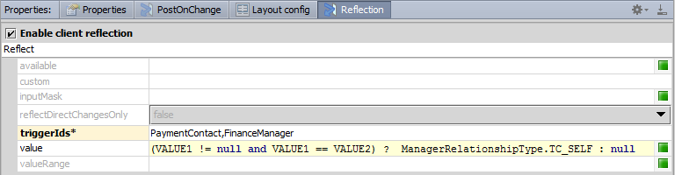
Client reflection configuration
TypeKeyInput: FinanceMgrRelationship
Configuration on listening widget
Reflection properties tab
Enable client reflection
Define triggerIds property
Value property
References triggerId field with VALUE keyword token
Notes:
The triggerIds property can specify one or more widget ids, comma delimited. When you specify more than one triggerId, each argument becomes a numbered token as in VALUE1, VALUE2, VALUE3, etc. The value field for the listening widget can be a Gosu expression.
Complex expressions, such as code function, require an immediate server-side post back and are referred to as server-side client reflection. Server-side client reflection is deprecated in Emerald.

Slide 6


Client-side widget behavior
Client-side widget behavior consists of widget behavior in which processing is done in user's browser
Less performance hit than server-side processing
Most commonly used technique is reflection
server
browser
reflection
postOnChange onChange
Notes:
The "Server-Side Widget Behavior" lesson focuses on dynamic widget behaviors that are server-side.

Slide 7
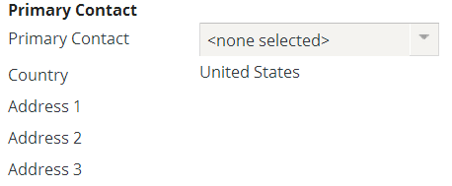
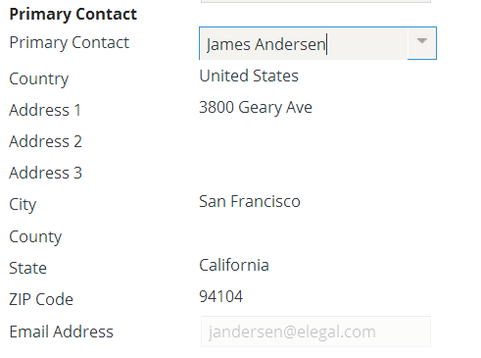
Reflection
Reflection involves a "trigger widget" and one or more "listening widgets"
When change occurs in trigger widget, listening widgets reflect change
change in value
reflect change
Notes:
In the example above, whenever a change is made to the Primary Contact widget (the trigger widget), the Email Address widget (a listening widget) reflects the change. All of the widgets from Email Address through Postal Code are listening widgets and all reflect changes in Primary Contact.

Slide 8
Reflection capabilities
Reflection can be used to set listening widget's:
Value, Availability (and indirectly its editibility)
reflect change
Reflection cannot be used to set listening widget's:
Visibility, Requiredness, Label

Slide 9
Lesson outline
Client-side widget behavior
Simple reflection
Additional reflection techniques

Slide 10
Client reflection
Two or more widgets
One or more triggers
One or more listening
Trigger widget changes value
Listening widget(s) reflects change
Value
Availability
Trigger widget changes value
Listening widget reflects change
Notes:
In the example above, whenever a change is made to the either the Finance Manager or Payment Contact, the Relationship to Finance Manager field reflects the change.
With client reflection, it is possible to update the value and/or availability of listening widgets. Availability as property indirectly determines the editability of a listening widget. It is not possible to update the visibility, requiredness, and/or the label properties of a listening widget.

Slide 11
Client reflection configuration
TypeKeyInput: FinanceMgrRelationship
Configuration on listening widget
Reflection properties tab
Enable client reflection
Define triggerIds property
Value property
References triggerId field with VALUE keyword token
Notes:
The triggerIds property can specify one or more widget ids, comma delimited. When you specify more than one triggerId, each argument becomes a numbered token as in VALUE1, VALUE2, VALUE3, etc. The value field for the listening widget can be a Gosu expression.
Complex expressions, such as code function, require an immediate server-side post back and are referred to as server-side client reflection. Server-side client reflection is deprecated in Emerald.

Slide 12
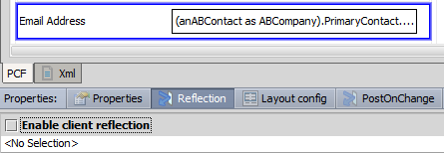
Reflection tab
Reflection is configured on listening widget's Reflection tab

Slide 13
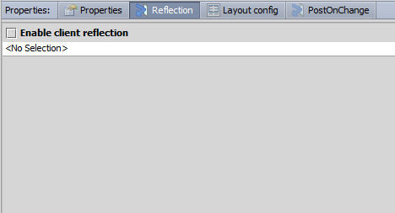
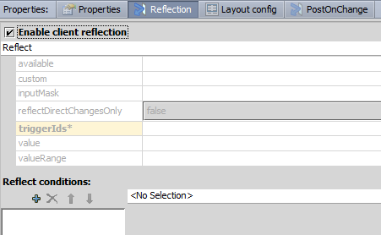
Enabling reflection
To enable reflection, first select "Enable client reflection" checkbox

Slide 14
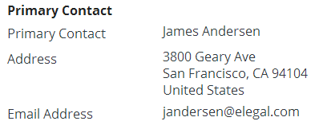
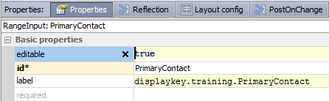
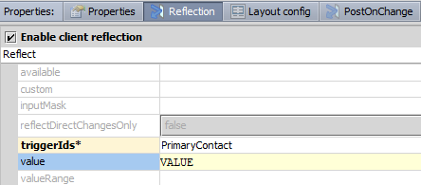
Configuring value reflection
Listening widget must identify:
Triggering widget(s)
Widget value
triggering widget
listening widget
"VALUE" is token that contains value of triggering widget
Notes:
The VALUE token represents the value of the widget that is referenced by the triggerIds property.
It is possible for a single widget to reflect changes from multiple triggering widgets. As earlier stated, each argument becomes a numbered token as in VALUE1, VALUE2, VALUE3, etc. The value field for the listening widget can be a Gosu expression.
There is one circumstance where the value property on the Reflection tab is optional. If the listening widget is a property on an object and the triggering widget is a foreign key to that object, then the value property on the Reflection tab is not required. In this situation, a Guidewire application can infer the value from the value property on the Properties tab. For example, if the listening widget is the EmailAddress1 field on a contact object, and the triggering widget PrimaryContact points to that same object, then a Guidewire application can infer that the Reflection value should be PrimaryContact.EmailAddress1. However, including the value property does not cause problems and may make the configuration more readable.
The value field is required if:
The triggering widget is not a foreign key field pointing to an object, or
The triggering widget is a foreign key field pointing to an object, but the reflecting widget reflects a value that is not a field on that object

Slide 15
Value reflection in action
selected PrimaryContact is Richard Madison
Displayed email is VALUE.EmailAddress1, which is Richard Madison's Email Address 1
selected PrimaryContact is William Andy
Displayed email is VALUE.EmailAddress1, which is William Andy's Email Address 1
Notes:
In the example above, the Email Address widget's client reflection has been enabled with the following properties set as stated:
triggerIds is set to "PrimaryContact"
value is set to "VALUE"
Changes made to the primary contact widget are immediately reflected in the EmailAddress widget.
Keep in mind that the example shows the selected value of Primary Contact and the displayed email address. Because these changes are occurring in Edit mode, the values of Primary Contact and Email Address remain null until the Update button is clicked.

Slide 16
Lesson outline
Client-side widget behavior
Simple reflection
Additional reflection techniques

Slide 17
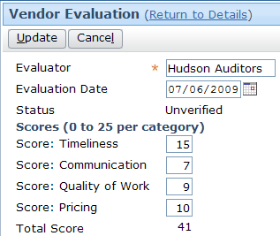
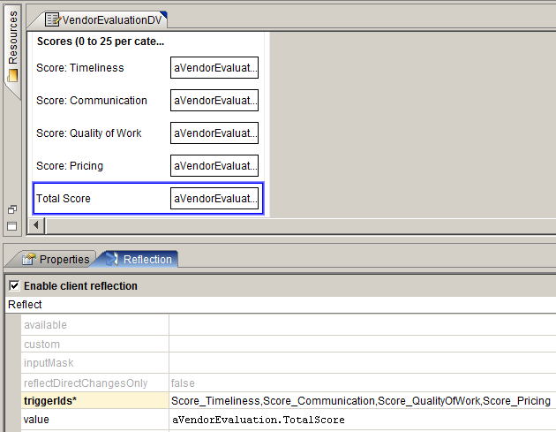
Reflection with multiple trigger widgets
Notes:
A single reflecting widget can have multiple triggers. A change to any of the trigger widgets will cause a change in the reflecting widget.
To configure multiple trigger widgets, the ID of each triggering widget must be listed in the triggerIds property in a comma-delimited list with no spaces.
There are two approaches that you can take to setting the "value" reflection attribute:
You can set the attribute to a pre-existing property or method. This is shown in the example above, where the value attribute is set to aVendorEvaluation.TotalScore. TotalScore is a virtual property declared in the VendorEvaluationEnhancement that simply sums the scores for timeliness, communication, quality of work, and pricing.
You can set the attribute to an expression that directly makes use of the values in the trigger widgets. To do this, the value of each trigger widget must be referenced as VALUEX where X is an integer identifying one of the widgets based on the order in which they are listed in the triggerIds property. (For example, the value attribute shown above could also have been written as "VALUE1 + VALUE2 + VALUE3 + VALUE4".)
If the logic that calculates the value to be reflected already exists, then it is better practice to use this existing logic. This means that if there are any changes to this logic in the future, then the change needs to be made in only one place. (For example, the logic to calculate a vendor evaluation's total score exists in the VendorEvaluationEnhancement. It is better practice for the reflection to use that value so that any changes made to the enhancement will automatically be included in the reflection functionality.)
If the logic that calculates the value to be reflected does not already exist, then you will need to declare it explicitly using a VALUE1...VALUE2...VALUEX expression.

Slide 18
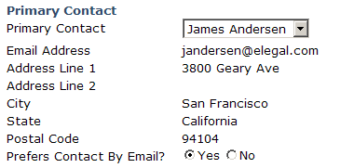
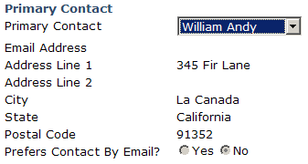
Reflecting editability
You cannot use reflection to directly modify widget editability
However, you can modify availability (and unavailable widgets cannot be edited)
Prefers email is available only if email specified
Notes:
In the example above, the "Prefers Contact By Email?" widget is always editable. However, it is not always available. The availability changes based on the state of the chosen Primary Contact. If the contact has an email address, then the widget is available. Otherwise, it is not. When the widget is not available, its value cannot be modified.
Implementing dynamic editability using reflection and availability can provide better performance than implementing dynamic editability through the editable property and postOnChange because postOnChange involves a round trip to the server, whereas reflection does not.

Slide 19

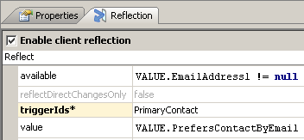
Reflecting editability using availability
Set editable to true
Set reflection tab's available property as needed
Notes:
In the example above, the PrefersContactByEmail widget's editable property is set to true. Also, the widget's client reflection has been enabled with the following properties set as stated:
available is set to a boolean that is true if the trigger widget's email address is not null.
triggerIds identifies the PrimaryContact field the trigger widget.
Changes made to the primary contact widget are immediately reflected in the PrefersContactByEmail widget.
Be aware of the fact that if a widget makes use of reflection, then its availability is determined at two points in time: (1) when the widget is initially rendered in Edit mode, and (2) when the value of the trigger widget changes. In most cases, any logic that is specified in the available attribute on the Reflection tab should also be specified in the available attribute on the Properties tab. This ensures that the same availability logic is being used at all times. (For example, in the slide above, the "Prefers Contact By Email?" widget if shown to be not available when the Primary Contact field changes and the new primary contact has no email address. If the same availability logic is not specified in the Properties tab's available attribute, then the widget has no availability logic when initially rendered in Edit mode. This means that when you put the company into Edit mode, the "Prefers Contact By Email?" widget will initially be available, even if the company has no primary contact.)

Slide 20
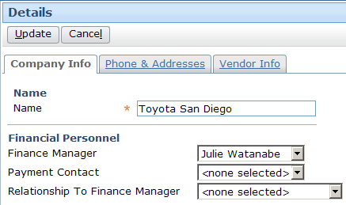


Conditional reflection
Widgets can reflect one value from a set of several possible values
if Finance Manager == Payment Contact, reflect "self"
Otherwise, reflect null
Notes:
The example above shows an example of reflection in which the reflected value depends on the state of the triggering widget. The "Relationship..." widget is the reflecting widget. It maps to a typekey field that includes values such as "Self", "Administrative Assistant", and "Other". The triggering widget is the Payment Contact widget. If the triggering widget's value matches the Finance Manager value (in other words, if the Payment Contact is the Finance Manager), then the typecode for "Self" is reflected. Otherwise, a null value is reflected, and the user must specify the relationship manually.

Slide 21

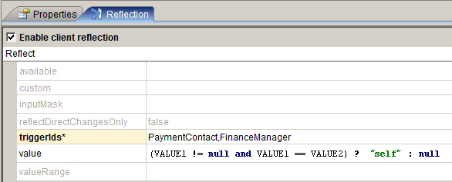
Configuring conditional reflection
If trigger widget 1 (PaymentContact) is not null, and if triggering widget 1 equals trigger widget 2 (FinanceManager), reflect "self". Otherwise, reflect null.
Notes:
In the example above, the value attribute has two checks:
The first check verifies that the Payment Contact is not null. This check prevents the situation of the Finance Manager and Payment Contact both being null and the Relationship field reflecting "self".
The second check verifies that Payment Contact and Finance Manager reference the same contact.
The value attribute above uses a ternary operator to specify that if both checks return true, then the value to reflect is the "self" typecode. If either check is false, then the value to reflect is null. (Recall that the ternary operator returns one of two values and uses the syntax: condition ? returnValueIfTrue : returnValueIfFalse )
If three or more return values are needed, you could use embedded ternary expressions. If this option is too unreadable, you could also put the logic in a method and reference the method from the value property.
It is also possible to construct conditional reflection using the Reflect conditions controls at the bottom of the Reflection tab. However, this method is no longer recommended. Widgets created for earlier versions of Guidewire base applications used this approach, and developers may still encounter examples of this. Thus, Studio retains the functionality for backwards compatibility. Any newly created conditional reflection conditions should use the method described above.

Slide 22

postOnChange and reflection
postOnChange = true
changes to Widget 1 affect Widget 2
Widget 3 reflects changes to Widget 2
postOnChange forces screen redraw
Reflect reflects changes made after screen is redrawn
postOnChange prevents reflection code from executing
Notes:
The execution of a redraw triggered by postOnChange would prevent reflection code from executing, so the data and logic that Widget 3 depends on would not be available for its rendering.

Slide 23
Review of dynamic widget behaviors
This conditional behavior... | ...is implemented by...
Visibility | Visible property (+ postOnChange)
Requiredness | Required property (+ postOnChange)
Editability | Editable property (+ postOnChange) OR reflection tab's available property
Label with dynamic value | Label attribute + display key with {0}
Toggling between labels | Label property with ternary expression (condition ? label 1 : label 2)
Execution of code when widget value changes | onChange (+ postOnChange)
Value of widget reflects value of some other widget | Reflection tab's value property
blue = server-side technique red = client-side technique
Notes:
In the table above, the postOnChange property becomes relevant if the dynamic behavior needs to be implemented whenever a widget value changes. Recall that it is the changing widget whose postOnChange must be set to true; postOnChange indicates this widget should "announce" its changes to other widgets.

Slide 24
Lesson objectives review
You should now be able to:
Describe the most common client-side dynamic widget behaviors
Change a widget's value to reflect some other change prior to data commitment

Slide 25
Review questions
Name two dynamic widget properties that cannot be modified using reflection.
Imagine that, for a given company, whenever the company's Country value changes, the PreferredCurrency field should be reset to the currency of that country.
On which widget would you enable the reflection tab?
On the reflection tab, what is the name of the property that would reference the other widget?
On the reflection tab, what does the keyword VALUE represent?
You cannot directly modify a widget's editability using reflection. How can you indirectly modify it using reflection?
Notes:
Answers
1. Possible answers: visible, required, label
2. a) The PreferredCurrency widget, as it should reflect changes in Country. b) The triggerIds property, which in this case would reference Country.
3. VALUE represents the value stored in the widget referenced by the triggerId.
4. You can modify a widget's availability. If you make a widget always editable but available based on reflection, it has the same effect as making the widget conditionally editable.

