Slide 1
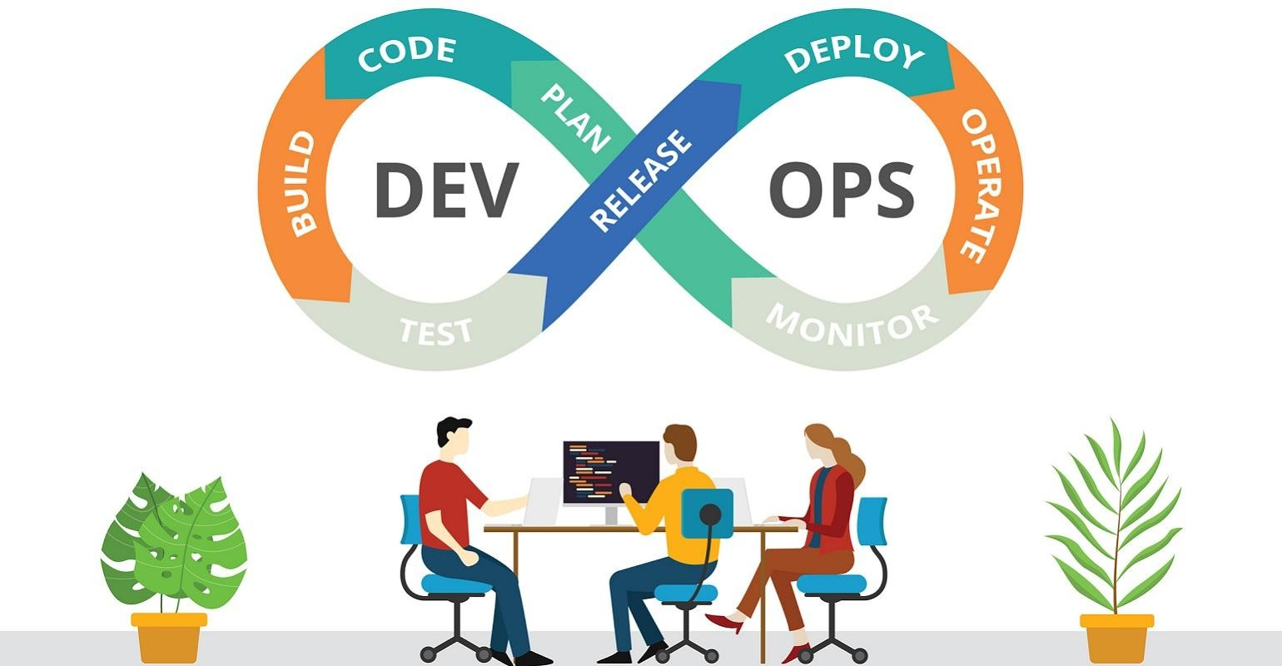
Secure DevOps - Lab 4
Overview
In this lab, you will familiarise yourself with Docker Compose and Docker Swarm.
What you need to complete this project
2 Linux servers running Ubuntu 20.04 which can communicate with each other
Internet access

Slide 2
Tasks
1
Task 1 - Install Docker Compose
Install the latest Docker Compose following the instructions here.
Conﬁrm Compose has been installed successfully
docker-compose version
Task 2 - Setup a Portainer stack using Docker Compose
Download portainer.zip from Blackboard Module 4 and extract the content to a directory on your host.
Change to the directory where you extracted the context of `portainer.zip`.
Open the Compose instructions here.
Review the Compose YAML ﬁle and follow the instructions to start the Docker stack.
Try accessing Portainer on http://localhost:9000
Use Docker CLI to inspect Nextcloud services to understand about
  Docker volumes the stack uses
  The stack network setup (port mapping, etc)
  Compose options such as `restart`
Use the Docker Compose CLI to interact with the stack
  Tail the stack standard out log
docker-compose logs -f

Slide 3
2
Task 3 - Setup a NextCloud stack using Docker Compose
NextCloud is an awesome open source productivity platform. Read more about it here.
Download nextcloud.zip from Blackboard Module 4 and extract the content to a directory on your host.
Change to the directory where you extracted the context of `nextcloud.zip`.
Open the Compose instructions here.
Review the Compose YAML ﬁle and follow the instructions to start the Docker stack.
Try accessing NextCloud on http:// localhost
Try accessing Portainer http:// localhost:9000 and use the UI to inspect the Nextcloud stack.
Use Docker CLI to inspect Nextcloud services to understand about
  Docker volumes the stack uses
  The stack network setup (port mapping, etc)
  Compose options such as `restart`
Use the Docker Compose CLI to interact with the stack
  Tail the stack standard out log
docker-compose logs -f
  Stop all services of the stack
docker-compose stop
  Start all services of the stack
docker-compose start
  Stop and remove all services of the stack
docker-compose down
Change the Compose ﬁle and make the `nc` service dependent on the `db` service. See here for the syntax.
Re-deploy the stack and observe that the `db` service will start before the `nc` service (Hint: use `docker-compose logs -f` to observe the starting sequence).

Slide 4
2
Task 4 – Deploy a stack to a Swarm
Deploy a complete application stack to the swarm. Read more about it here.
Set up a Docker registry
Create the example application
Test the app with Compose
Push the generated image to the registry
Deploy the stack to the swarm

Slide 5
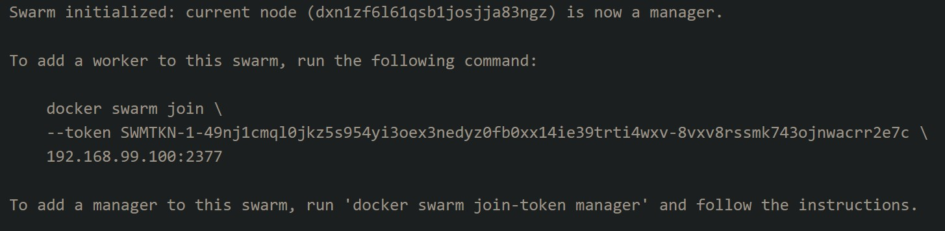
3
Task 5 - Deploy the NextCloud stack using Docker Swarm across 2 servers
Make sure you start the 2 Linux VMs that you have and they can communicate with each other.
There is no need to install Docker Swarm as it is included with the Docker Engine you installed in Lab 1. Conﬁrm by running the command
docker swarm
Make sure you know the IP address of each server. Use `ip a` to retrieve the IP address if required.
Pick a server to become the Swarm leader (node 1 for example). Then, init the Swarm
docker swarm init --advertise-addr <MANAGER-IP>
If the initiation succeeded, you will be presented with the instruction on how to join new nodes to the newly created Swarm
6. On the worker node (node 2), execute the`docker swarm join` command output in Step 5 to join node 2 to the Swarm.
docker swarm join --token <TOKEN> <MANAGER-IP:PORT>

Slide 6
4
On the Manager node, you should now see 2 nodes in the Swarm. Note that node 1 should be the Leader.
docker node ls
In this exercise, we would like to deploy the database service on node 2 and the nextcloud app on node 1. To do that, let's give the nodes some labels.
docker node update --label-add nc=true node1 docker node update --label-add database=true node2
Inspect the node to make sure that the labels are assigned correctly
docker node inspect node1 docker node inspect node2
Inspect the context of `nextcloud-swarm.yaml` to understand the `deploy` instructions. See here for reference.
Deploy the stack using Docker CLI
docker stack deploy -c nextcloud-swarm.yaml nc
Try accessing NextCloud from http://<NODE1-IP> or http://<NODE2-IP>
List services of the Swarm
docker service ls
Remove the stack
docker stack rm nc

