Slide 1
Anomaly Detection Overview
Farrukh Rahman

Slide 2
Machine Learning
Supervised
Unsupervised
Semi-supervised
Reinforcement
Deep learning – universality theorem

Slide 3
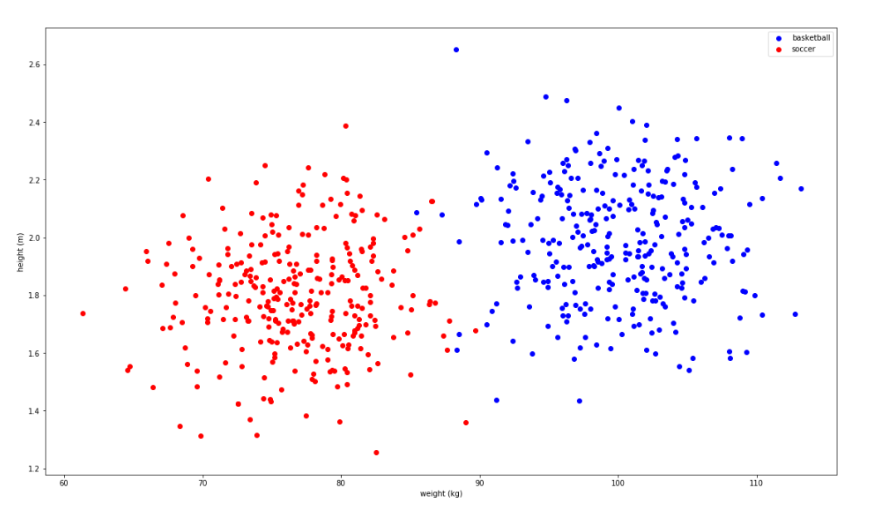
Supervised
Notes:
Logistic regression for basketball players vs soccer players.
Supervised learning can be simplified as function approximation, in this case for a classification problem.

Slide 4
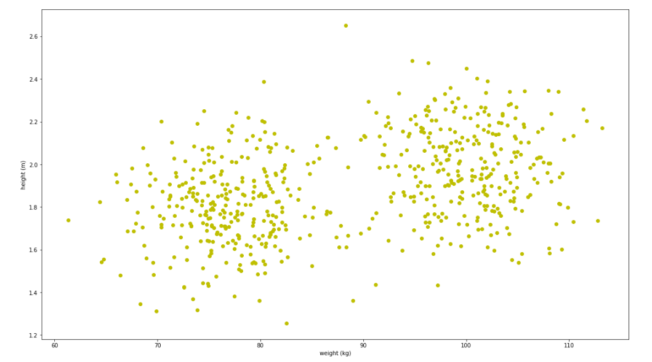
Unsupervised

Slide 5
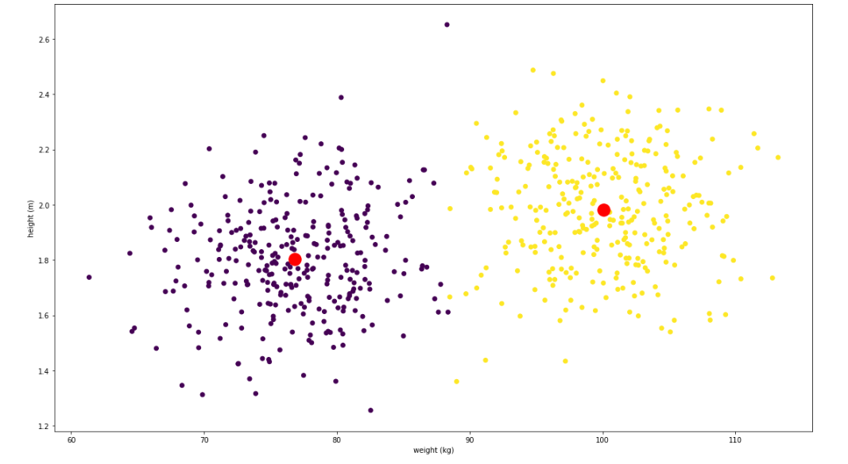
Unsupervised

Slide 6
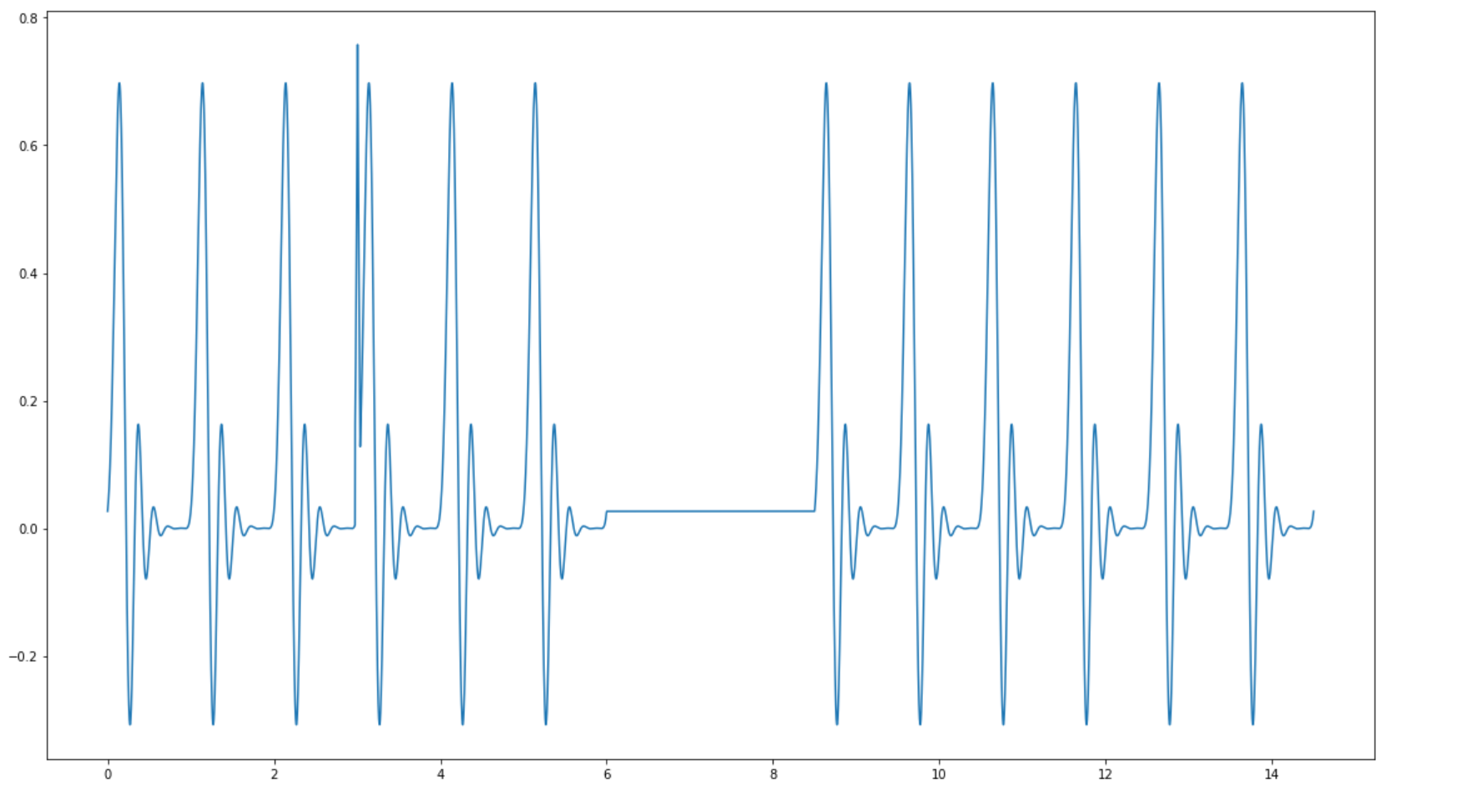
Anomaly detection
Anomalies are patterns in data that do not conform to a well defined notion of normal behavior.
Point Anomalies
Contextual Anomalies
Collective Anomalies
Notes:
3 general types
Point Anomalies. If an individual data instance can be considered as anomalous with respect to the rest of the data (e.g. purchase with large transaction value) (also called additive anomalies, growth of metric in a short period)
Contextual Anomalies, If a data instance is anomalous in a specific context, but not otherwise ( anomaly if occur at a certain time or a certain region. e.g. large spike at the middle of the night)
Collective Anomalies (sometimes also called global anomalies or temporal changes). If a collection of related data instances is anomalous with respect to the entire dataset, but not individual values. They have two variations.
1. Events in unexpected order ( ordered. e.g. breaking rhythm in ECG)
2. Unexpected value combinations ( unordered. e.g. buying a large number of expensive items)

Slide 7
Anomaly Detection Challenges
Defining normal
encompasses all possible normal behavior
Evolution of normal behavior
Notion of anomaly is dependent on data and domain.
What types of anomalies should be detected?
Availability of labelled data
Noise

Slide 8
Anomaly Detection Approaches
Rule based
Statistical - process control
Supervised
Unsupervised
Probabilistic - HMM, MC
Time series analysis
Signal decomposition
ARIMA, exponential smoothing
PCA – dimension reduction
Deep learning
Notes:
Basically, an anomaly detection algorithm should either label each time point with anomaly/not anomaly, or forecast a signal for some point and test if this point value varies from the forecasted enough to deem it as an anomaly.
Rule based: based on rule threshold
Basic statistical approach: fit distribution to the data (or assume it) and use statistical outlier tests, e.g. 6 sigma, 8 sigma etc. OR use process limits
Supervised approaches:
Can use - SVM, CART (classification and regression tree, can be supervised or unsupervised)
Anomalies are rare under most conditions. Hence, even when training data is available, often there will be few dozen anomalies exists among millions of regular data points. The standard classification methods such as SVM or Random Forest will classify almost all data as normal because doing that will provide a very high accuracy score (e.g. accuracy is 99.9 if anomalies are one in thousand).
Generally, the class imbalance is solved using an ensemble built by resampling data many times. The idea is to first create new datasets by taking all anomalous data points and adding a subset of normal data points (e.g. as 4 times as anomalous data points). Then a classifier is built for each data set using SVM or Random Forest, and those classifiers are combined using ensemble learning.
Unsupervised approaches:
clustering, neighbors
Not bound to the structure of the signal, can introduce many features to get sophisticated models. But this impacts computational performance / scalability.
Markov chains and Hidden Markov chains can measure the probability of a sequence of events happening. This approach builds a Markov chain for the underline process, and when a sequence of events has happened, we can use the Markov Chain to measure the probability of that sequence occurring and use that to detect any rare sequences.
Time series approach: data must follow certain characteristics. These models are also specific to the data
Dimension reduction: The main idea is that after applying dimension reduction, a normal data can be easily expressed as a combination of dimensions while anomalies tend to create complex combinations.

Slide 9
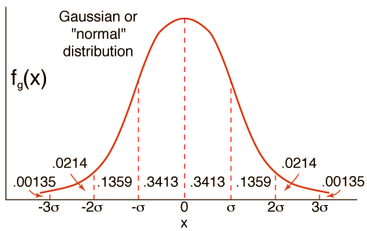
Basic statistical approach
Fit (or assume) distribution
Hypothesis testing
Notes:
They are measuring the statistical significance of the new data point as to whether it does or does not belong to the disbrubtion (hypothesis testing). Reject null hypothesis that the value belongs to the distribution.

Slide 10
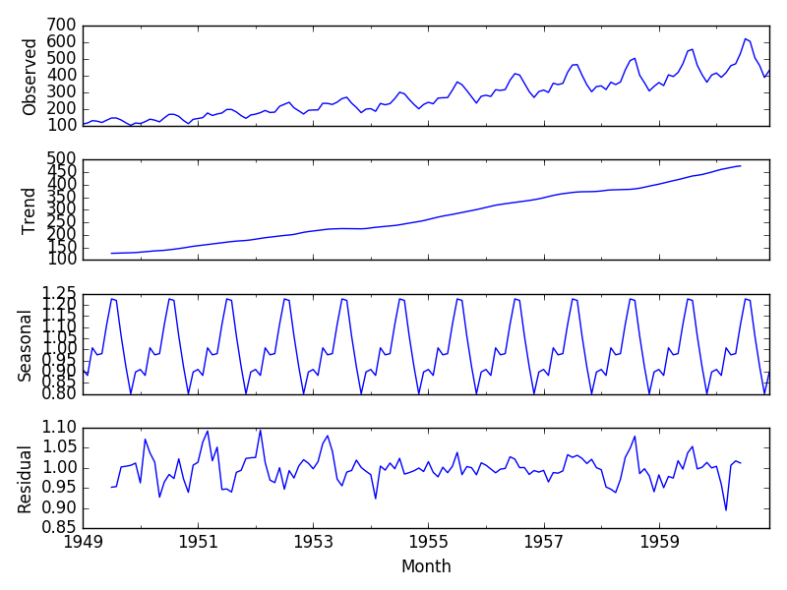
Signal decomposition
Remove trends & seasonality
Model distribution to residuals
Notes:
Note that this signal would have no anomalies.
Decomposition image from https://machinelearningmastery.com/decompose-time-series-data-trend-seasonality/

Slide 11
Prealert -> X-pack ML
“Statistical model of system state using Bayesian methods.”
3 main properties
Model data – predict a distribution
check for outliers
hypothesis testing
Model decay (aging mechanism)
Online
Notes:
What elastic does seems to be a combination of a few of the techniques mentioned earlier, that is statistical approaches with time series analysis

Slide 12

Model System
Assumption: the model (PDF) can be parametrized by a set of functions that depend on the data. (or a subset of the data).
Weight function (matrix) – which subset of data do we use?
Notes:
Weight is a time indicator function that helps

Slide 13
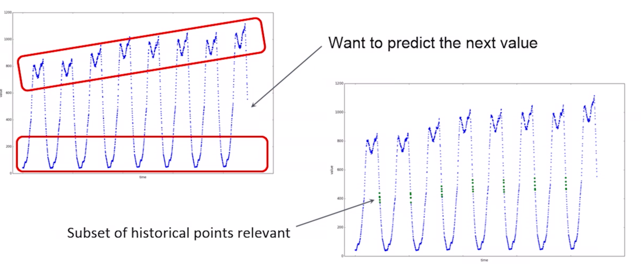
Model system
Notes:
Suppose elastic wants to predict the next value

Slide 14
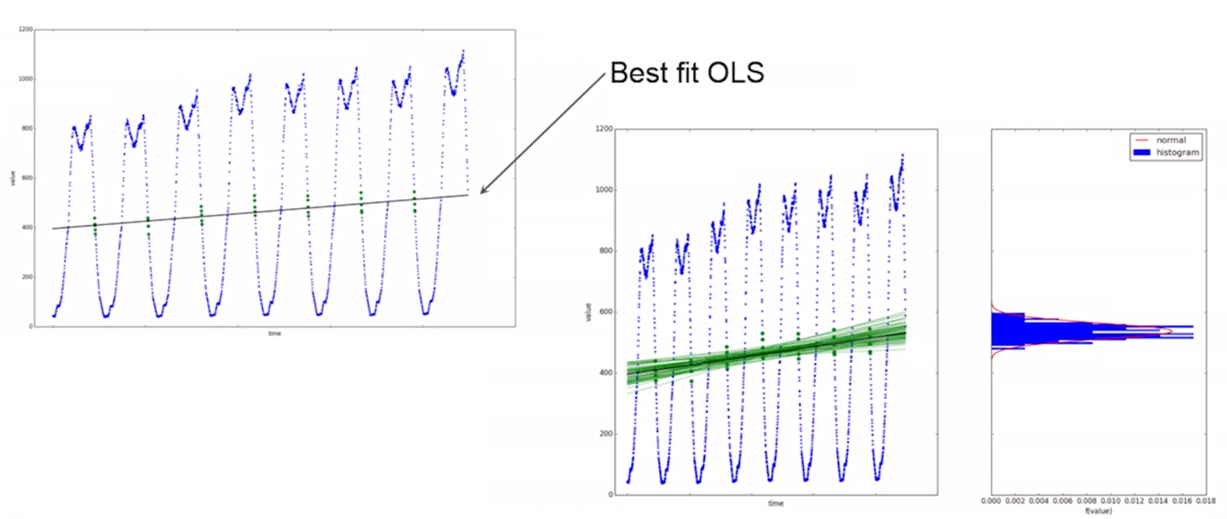
Notes:
Weight function helps select the points you want.
Fit ordinary least squares regression model and extrapolate to time you want to make prediction.
Bootstrap sample with replacement to (resampling methods to fit family of regression models, make multiple predictions and approximating that to to the and use bootstrapping with replacement

Slide 15
Outlier testing
Does new data conform to the estimated model?
Low probability-> anomaly
probability normalized into anomaly score.
Notes:
They are measuring the statistical significance of the new data point as to whether it does or does not belong to the disbrubtion (hypothesis testing). Reject null hypothesis that the value belongs to the distribution.
the p value actually represents the probability that the results would be as extreme as this observed value if you repeated this experiment.

Slide 16
Model Decay
System Intrinsically online
Relax identified distribution over time.
Notes:
As mentioned in the challenges of anomaly detection the system is online, so the identified distribution may not hold for all time.
This was not entirely explained. I have to do more research here.
This is important because it defines how soon the model will respond to state changes.

Slide 17
Multivariate analysis
Multiple time series
| metrics | * |partitions|
The probabilities unchanged
Probabilities are pooled together from the multiple time series and normalized into a score
Why?
Notes:
Elastic’s use case here noted that the system problems were associated with outliers with one or more of the performance metrics. Each metric’s dependence on each other we note that system problems are nearly always associated with outliers in one or more of the performance metrics people gather, which will typically include database query times, dropped packets, CPU utilization and so on. Effects of the sort discussed earlier could correspond to a relative phase change in two periodic signals, and are typically not the only symptoms of some significant hardware or software failure. As such, people are generally interested in whether any of the metrics they gather display significant anomalies in their own right. In this context, we can aggregate individual q-values of a collection of observations by considering either their order statistics or some suitable estimate of the joint probability.

Slide 18
Elastic X-pack challenges
Pooling of probabilities
Detection of state changes
Bucket span
Notes:
These are additional challenges specific to the use of X-pack, note that the challenges associated with anomaly detection outlayed earlier still apply.

Slide 19
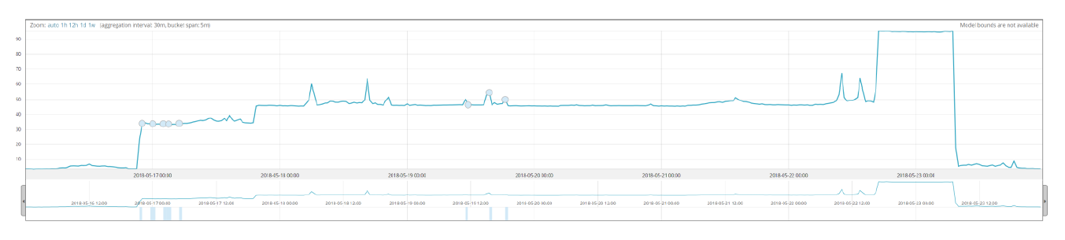
anomaly & state change not detected in job with partitioning on systems. (15 min bucket)
anomaly & state change detected in ML job isolated on a system. (15 min bucket)
Anomaly & state change undetected. 5 min bucket span with partitioning on systems.

Slide 20
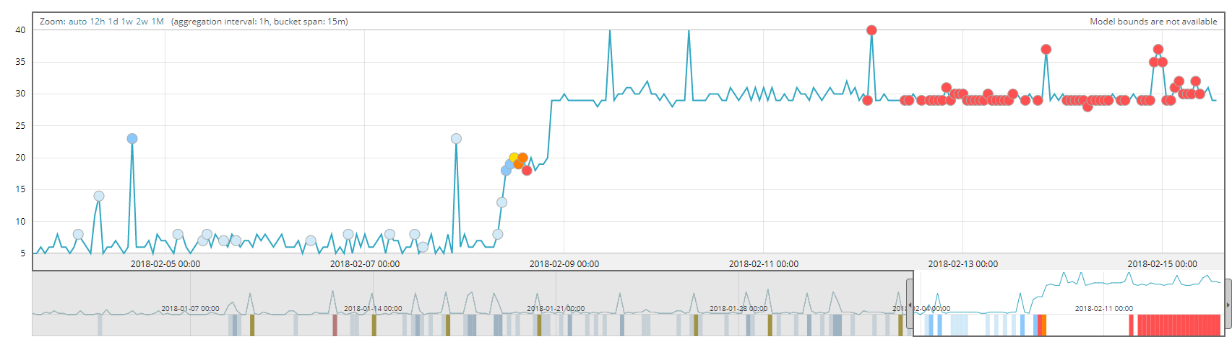
Elastic X-pack challenges
Notes:
State changes are a bigger issue than just detection. When a state change is detected, one would ideally want to forget the old model.. It may still affect anomaly detection.
Decay affects this but it’s a balance (may be domain specific)

Slide 21
References
Thomas J. Veasey and Stephen J. Dodson, "Anomaly Detection in Application Performance Monitoring Data," International Journal of Machine Learning and Computing vol.4, no. 2, pp. 120-126, 2014.
Varun Chandola, Arindam Banerjee, Vipin Kumar, “Anomaly detection: A survey,” ACM computing vol 41 issue 3, No. 15, 2009

Slide 22
Questions?

