Slide 1









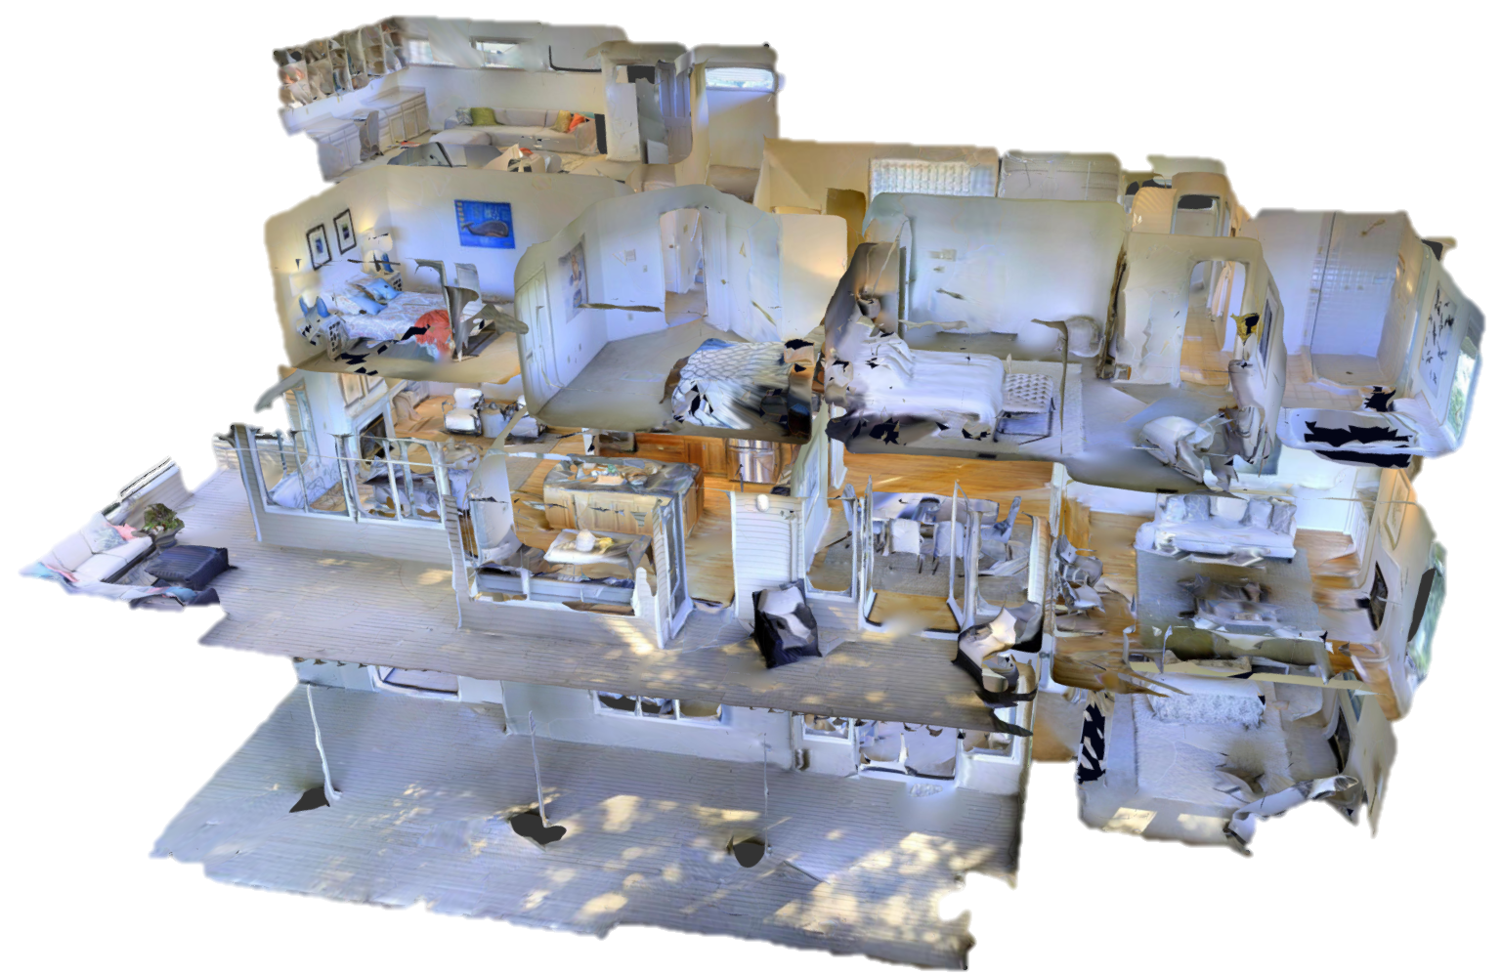
USER
USER
USER
Put the coffee in the living room.
Yes, please do.
Approve Plan
ROBOT
Flow Orchestrator
Flow Orchestrator
Flow Orchestrator
Task Formalizer
routing reason (edited)
Since no coffee is available, should we make some with the coffee machine?
routing reason (edited)
at-end condition (edited)
First, we need to find the objects needed for the task.
Great, let’s proceed with planning.
always conditions (edited)
@ USER
@ Task Formalizer
sometime conditions (edited)
@ Scene Explorer
World Model
I’ve translated the task into formal constraints.
Scene Explorer
@ Planning Manager
I’ll check the scene using the Scene Query tool.
Scene query
PDDL plan
Planning Manager
/scene_query
I’ve prepared the subgoals. I’ll now use the PDDL Plan tool to generate a plan.
…
/pddl_plan
Scene Explorer
discovered objects (edited)
Planning Manager
There’s no coffee, but I found a cup and a coffee machine in the kitchen.
final plan (edited)
Plan generated successfully!
@ Flow Orchestrator

