Slide 1
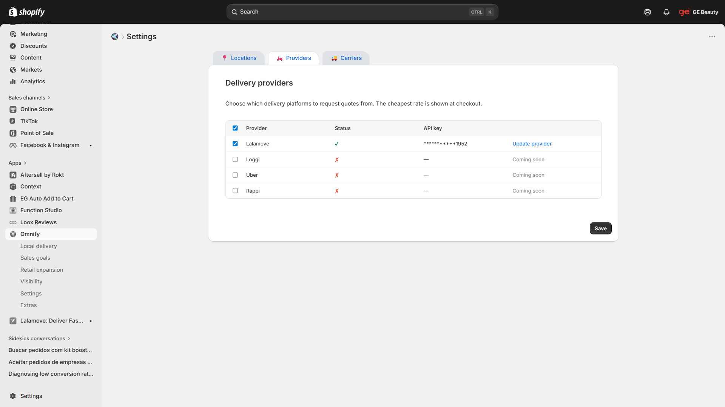
Omnify > Settings > Providers {current state}

Slide 2
Omnify > Settings > Providers {desired state}
Preferences
...1952
Vehicle: LALAGO
Max 7 orders/route
Extra time: up to 30 min
…
Update

Slide 3
Omnify > Settings > Providers {desired state_details}
Credentials
Preferences
...1952
Vehicle: LALAGO
Max 7 orders/route
Extra time: up to 30 min
…
Update
button to update preferences (see slide 6)
# ‘Define’ if preferences are empty
# ‘Update’ if preferences are defined
Change the Status column
# Header and content: align to center
# content logic
## providers not yet availabe for integration:
### ‘Coming soon’ text (already exists at other column)
## providers already availabe for integration but not configured:
### ✗ icon
## providers already availabe for integration ald already configured :
### ✓ icon (no changes needed)
Changes to API key column
# Header and content: align to center
# Header: rename as Credentials
# content:
### API credentials for available provider (not yet configured):
#### ‘Add’ link-style button
### API credentials for available provider (already configured)
#### ‘****ac1f’ (4x * + 4 last digits)
##### clickable to edit API credentials (see page 4)
### API credentials not yet configured
#### ‘—’ (no changes needed)
Preferences (new column)
# Header and content: align to left
## content (see page 5)
### defined preferences, in following order:
#### preferred Vehicle: “vehicle: {vehicle-type}’
#### max orders per Route for preferred Vehicle: ‘max {orders} orders/route’
#### special requests (when enabled)
##### thermal bag: ‘thermal bag’
##### extra time: ‘extra time: {extra-time}‘
##### return trip: ‘return trip’

Slide 4
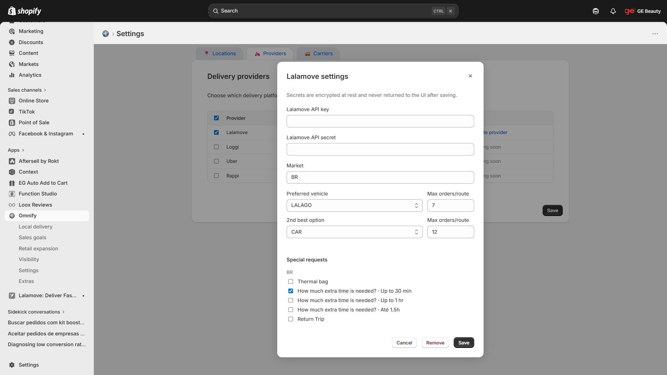
Omnify > Settings > Providers > Lalamove API {current state}
Lalamove credentials
Lalamove credentials
Notes:
Current state is a single modal with diferente types of settings

Slide 5
Omnify > Settings > Providers > Lalamove API {credentials-desired-state}
Lalamove credentials
Lalamove credentials
*********************ac1f
*********************
Remove
Edit

Slide 6
Omnify > Settings > Providers > Lalamove API {credentials-desired-state_details}
Lalamove credentials
Lalamove credentials
*********************ac1f
*********************
Remove
Edit
# ‘Lalamove Preferences’ modal will be split into two modals
## ‘Lalamove credentials’ (1/2)
### triggered by clicking at Credentials column content(see page 3)
#### ‘Add’ when no credentials exist
#### ‘****ac1f’ when credentials already exist
### remove text ‘Secrets are encrypted at rest and never returned to the UI after saving.’ from modal
## fields to keep on current modal
### Lalamove API key
### Lalamove API secret
### Market
## fields to remove (will move to new modal)
### Preferred vehicle + max orders
### 2nd option + max orders
### special requests
Reorganize buttons:
# Cancel: align to left of block
# Edit: include new button
## secondary-style
## between Remove and Save
## unlocks API Key and API secret fields
### when unlocked, click erases current content ( API Keys are never reviewed)
When Lalamove credentials already exist
# display Lalamove API key in
## semi-Hidden format: ‘* x (total-chareacters – 4){last 4-digit); eg.: ‘*********************ac1f’
## uneditable field
# display Lalamove API secret in
## totally-Hidden format ‘***********’
## uneditable field

Slide 7
Omnify > Settings > Providers > Lalamove API new modal {lalamove-preferences_collapsed}
Lalamove preferences
Wait time
# ‘Lalamove Preferences’ modal was split into two modals
## new modal ‘Lalamove preferences’ must be created
### triggered by clicking at Preferences column content(see page 3)
#### ‘Define’ when no preferences exist
#### ‘Update’ when preferences already exist
### remove text ‘Secrets are encrypted at rest and never returned to the UI after saving.’ from modal
## fields to keep from original modal
### Preferred vehicle + max orders
### 2nd option + max orders
### special requests
Buttons:
# align to right corner ofmodal
##’Cancel’: secondary-style (closes modal; no changes saved)
##’Save’: primary-style (saves changes + closes modal)
Refactor Special requests toggles:
# remove wait time options from default view
# add ‘Wait time’ at second row, below Thermal bag

Slide 8
Omnify > Settings > Providers > Lalamove API new modal {lalamove-preferences_expanded}
Lalamove preferences
Wait time
Refactor Special requests toggles:
# when ‘Wait time is toggled
## expand to show options related to Lalamove special requests > extratime:
### 30 min
### 1 hour
### 1.5 hour

Slide 9
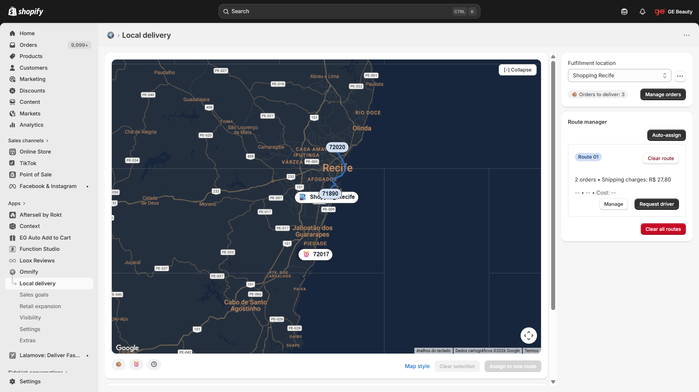
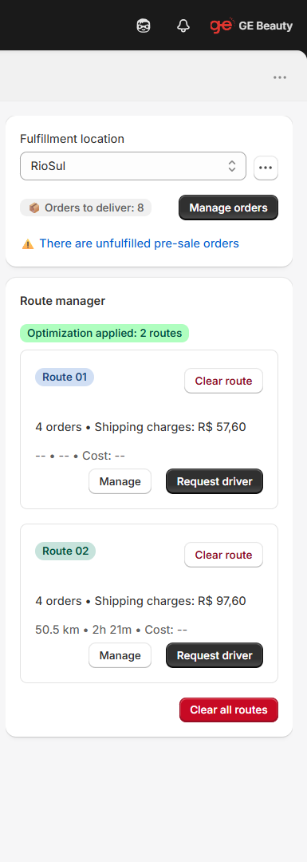
Omnify > Local delivery > Route manager > auto-assign
Order 72017 not assigned: not in delivery area
When 1 or more orders cannot be assigned because they are not in delivery area, display feedback
# inside an yellow bagde
# at same position as success badge displayed when all orders are assigned
## eg: ‘Order 72017 not assigned: not in delivery area’ when only one
## eg: ‘N orders not assigned: not in delivery area’ when N > 1
Notes:
When order not in delivery area, display feedback inside an yellow bagde

