Slide 1


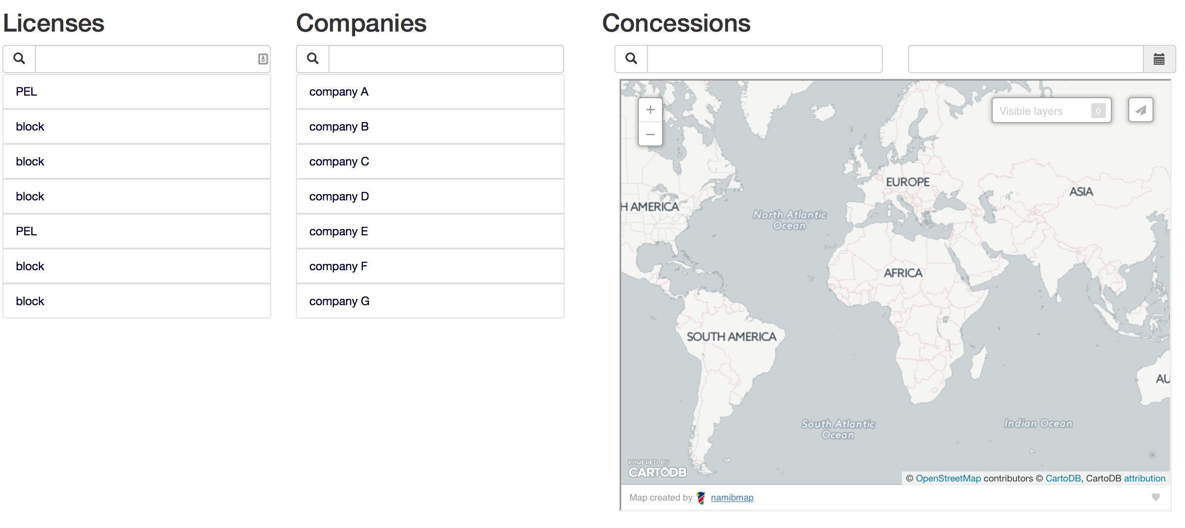




SELECT license_number FROM licenses;
SELECT concession_number
FROM concessions, licenses
WHERE concession_license_id = licenses.license_id
AND licenses.license_number = ‘PEL00XX’;
SELECT company_name FROM companies;
SELECT * FROM concessions;

