Slide 1
AERIS
AUTOMATIC IRRIGATION
SYSTEM
FOR FARMERS

Slide 2
CONTENTS
PROBLEM
BRIEF SOLUTION
IRRIGATION USED
CIRCUIT AND BLOCK DIAGRAM
COMPONENTS USED
WORKING OF PROJECT
USE CASE DIAGRAM
ADVANTAGES
CHALLENGES AND SOLUTION

Slide 3
PROBLEM
Closed loop irrigation solution for farmers:
Irrigation of fields by farmers is done by the traditional knowledge. Farmers do not have the idea how much and when to irrigate the fields. They do it by traditional knowledge and have no means to detect the moisture level of soil and the amount of water hence required for a given crop for a particular soil type.
Over Irrigation
Under Irrigation

Slide 4
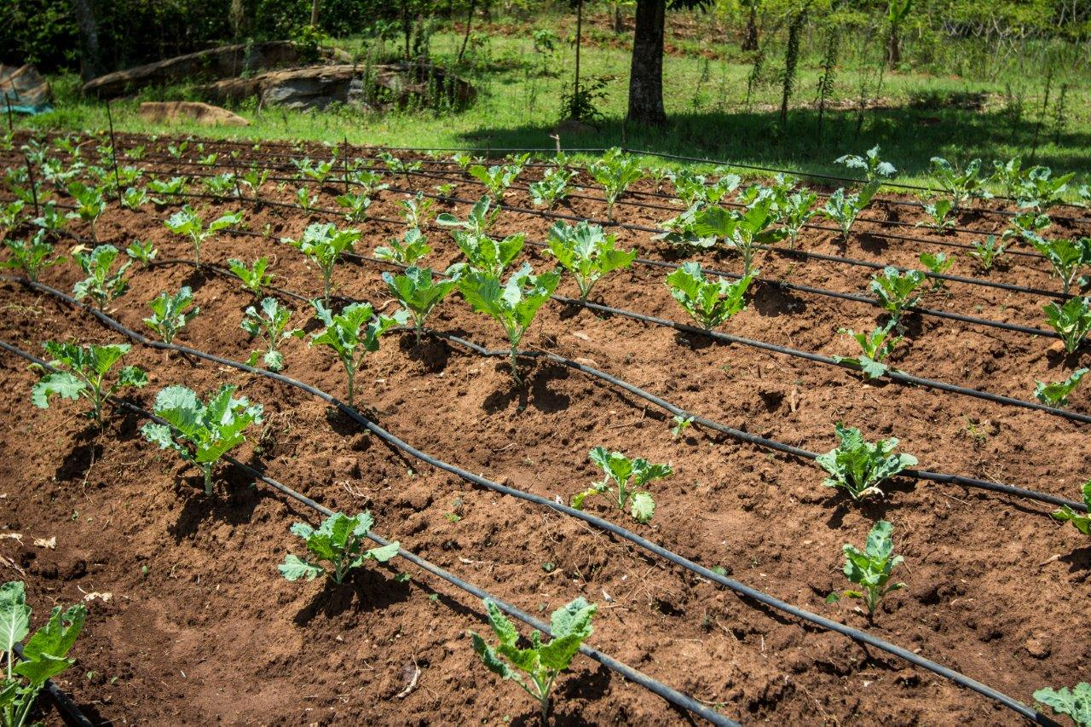
IRRIGATION TYPE USED
DRIP IRRIGATION
Drip irrigation is sometimes called trickle irrigation and involves dripping water onto the soil at very low rates from a system of small diameter plastic pipes fitted with outlets called emitters or drippers.

Slide 5
BRIEF SOLUTION
We have implemented a project where by using soil moisture sensor we will detect the level of moisture in soil. Afterwards, if the soil moisture detected is low then by automatic irrigation the motor will pump water and irrigate the field.
In case of extreme weather conditions or different from the one expected, the farmer will send a message from his/her cellphone to the GSM MODULE implemented in the system. There will be specific keywords according to which the threshold value will change and the motor will pump water accordingly.

Slide 6
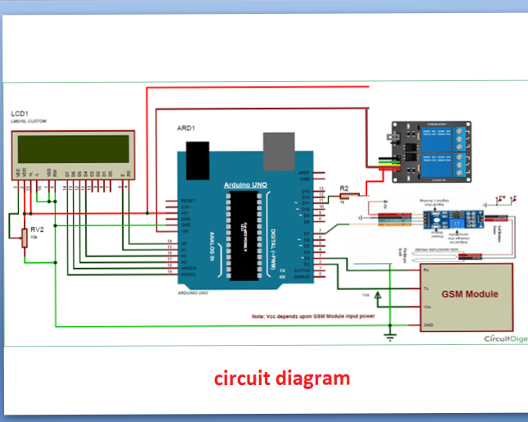
CIRCUIT DIAGRAM

Slide 7
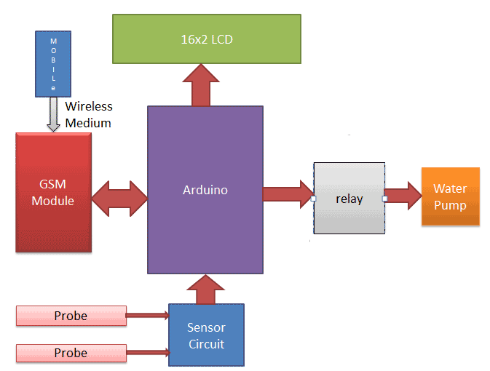
BLOCK DIAGRAM

Slide 8
COMPONENTS
USED

Slide 9
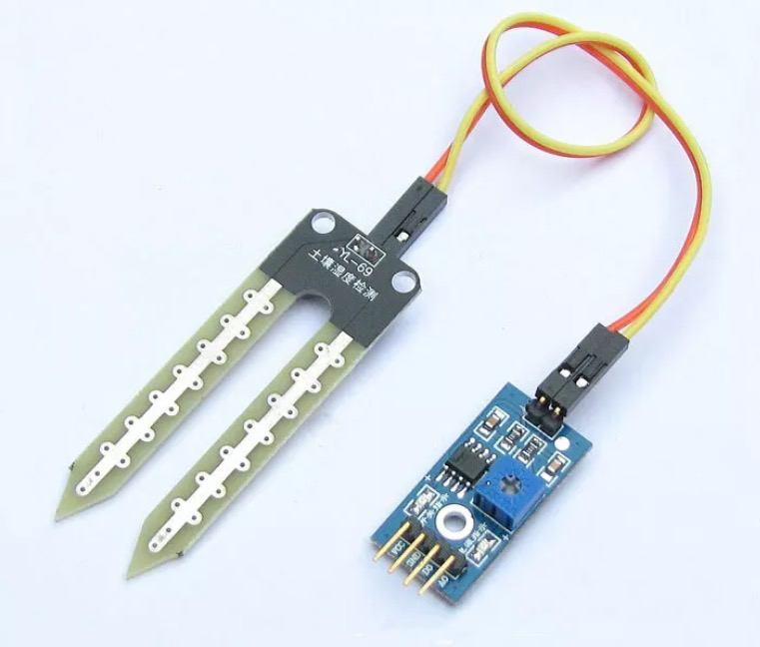
SOIL MOISTURE SENSOR
The Soil Moisture Sensor uses capacitance to measure the water content of soil (by measuring the dielectric permittivity of the soil, which is a function of the water content).
Simply insert this rugged sensor into the soil to be tested, and the volumetric water content of the soil is reported in percent.

Slide 10
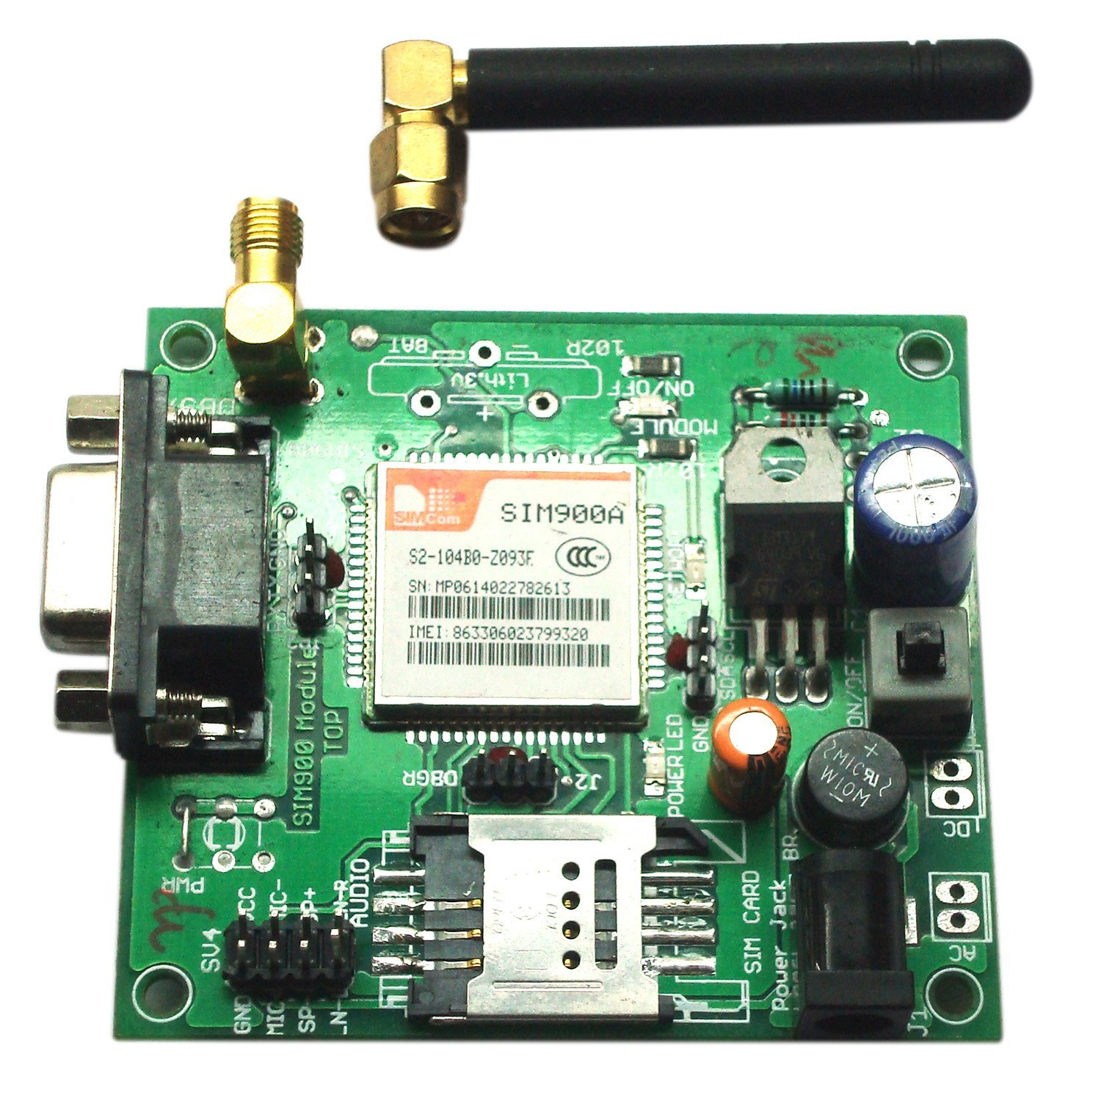
GSM MODULE
This is a very low cost and simple Arduino GSM module. We use the module SIM Com SIM900A.
It’s a mobile communication modem which is used for transmitting mobile voice and data services .One of the feature of GSM MODULE is short message service .

Slide 11
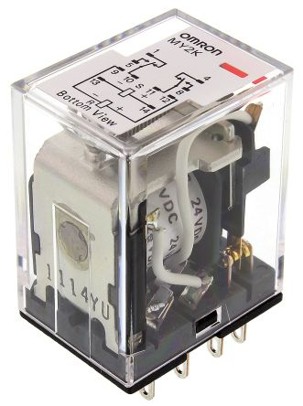
RELAY(HALF HORSE POWER)
A relay is an electromagnetic switch i.e. used to turn on and turn off a circuit by a low power signal or where several circuits must be controlled by one signal.

Slide 12
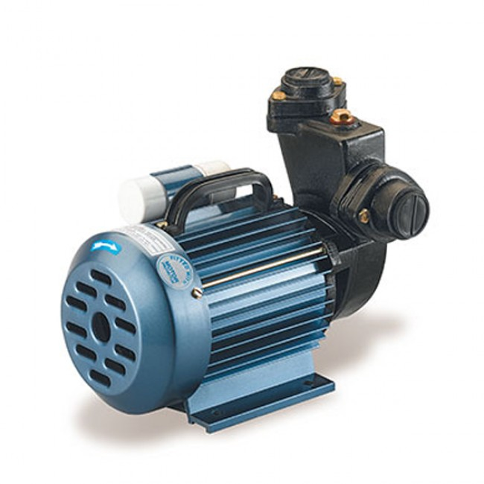
HALF HORSE POWER MOTOR
We are using AC motor and it uses the main supply directly but DC motor requires a converter which makes them expensive to manufacture AC motor cost less and power output is way better than a DC motor.
Pumping a motor requires high power which can be achieved from an AC main supply. AC motor do not use brushes so they are pretty rugged and have a longer life. It is speed is control by varying the frequency.

Slide 13
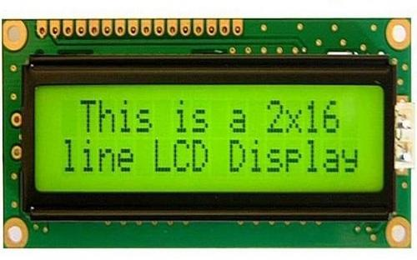
LCD(LIQUID CRYSTAL DISPLAY)
An LCD is an electronic display module which uses liquid crystal to produced a visible image. The 16*2 LCD display is a basic module commonly used. In this LCD each character is displayed in a 5*7 pixel matrix.

Slide 14
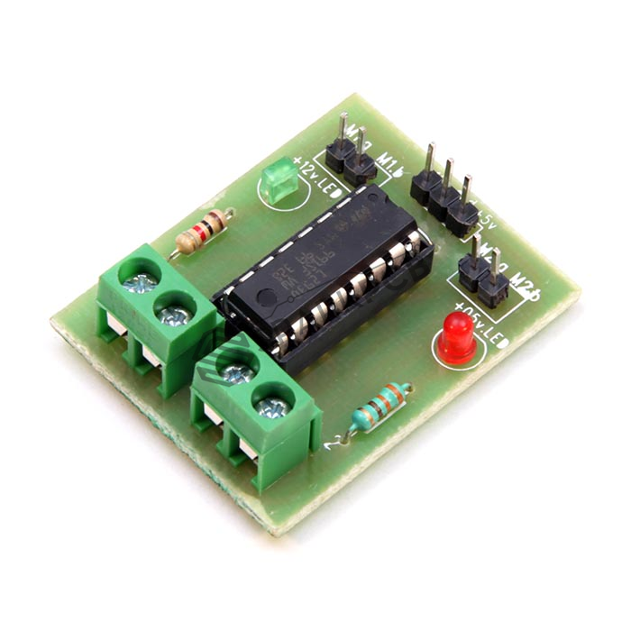
MOTOR DRIVER
A Motor driver is a small current amplifier whose function is to take a low current control signal and turn it into a higher current signal that can drive a motor.

Slide 15
WORKING OF PROJECT
The moisture sensor will detect the moisture of the soil and display it on the LCD screen. We will be having datasets for various crops and the moisture level of the particular soil to be maintained for that particular crop. The system will fetch the data and compare it with the soil moisture detected. Once that is done, the motor will pump water and the irrigation will be done accordingly. We are using the method of drip irrigation here.
There would be input of crop as well as soil which would determine threshold for the moisture of the soil which would be directly send by the farmer through his phone over the GSM module implanted over the board.
And the SIM in the GSM module would be subscribed to the weather updates tariff of SIM provider which would daily send the weather updates.
For conditions, like when it’s known that it will rain today or consider, it will be a really, hot sunny day then attached GSM MODULE would receive the update, and will manipulate its threshold value according to the crop and weather updates.
Once the moisture level of the soil is attained the motor will stop pumping water.

Slide 16
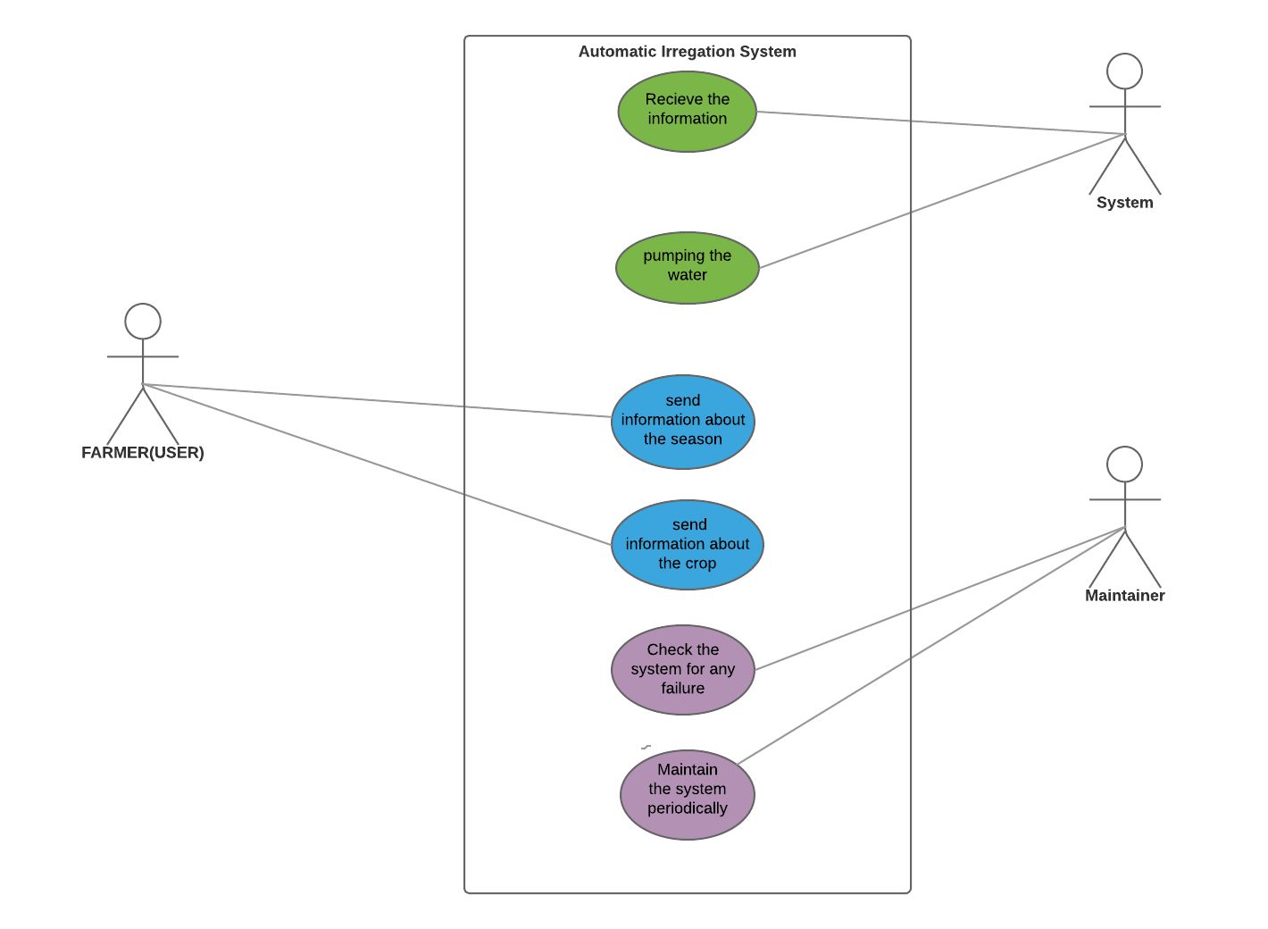
USE CASE
DIAGRAM

Slide 17
HOW OUR IDEA IS UNIQUE?
We will be sending messages through GSM module and there will be no need of datasets. Threshold will be set through messages only. Hence, the cost is reduced by not using datasets with IOT as Raspberry Pi.
Daily weather update through mobile tariff will also manipulate the threshold value of the device. Example, If someday the weather prediction is “rainy” then the threshold will decrease automatically.
Cost Effective.

Slide 18
CHALLENGES AND
SOLUTIONS

Slide 19
The number of moisture sensors required are too much for a large area.
Best suited for DRIP IRRIGATION- uniform irrigation and all the patches dry at the same rate.
A single hardware in a particular line can provide accurate results.

Slide 20
The tractors and ploughing will destroy sensors.
The moisture sensor will be implemented near the motor which is implanted in an isolated patch of soil.
Hardware connected through the same pipe of drip irrigation which would not let it be destroyed by the farmers.

Slide 21
People in villages are not educated enough to understand the technology and use it optimally.
Language is the barrier; we can resolve it by making some native of the village understand our idea and thoughts and then the native will convey the whole idea to the village.
People trust and understand better those who they are familiar with or have some connection.

Slide 22
Villages do not receive enough electricity.
Our system can be operated such that the moisture can be detected over the DC Battery in the absence of electricity.

Slide 23
ADVANTAGES
NO INTERNET REQUIREMENT
PREVENTS UNEVEN WATERING
HEALTHY CROP
SAVING THE TIME
REDUCE LABOUR
LOWER WATER BILL

Slide 25
PROJECT
SUBMITTED BY
NIMESH VIJAY HEENA VASDANI ISHIKA GUPTA
NAMIT PATNI MAHIMA KHANDELWAL

