Slide 1
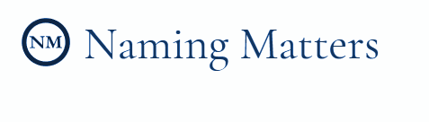
Common Law Trademark
Hannah Burak, Keeley Takimoto, Kevin Chow, Atul Madhugiri, and Andrew Nichol

Slide 2
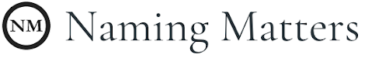

Identifying Common Law Trademarks
Client:
Goal: Identify potential common-law conflicts associated with potential company names, which may pose a risk of lawsuit.
Factors in Assessing Possible Trademarks: character match; phonetic similarity; industry/product match
Notes:
The problem being solved: Companies choosing names for their entity spend thousands of dollars for reports which identify their legal risk for a trademark suit based on their company name and industry. These reports are assembled by hand, with results from manual database searches. Naming Matters already produces reports for companies based on risk of suit from companies with registered trademarks. However, companies can also be at risk for suit from companies with common-law trademarks. A common law trademark is owned by a company with an established reputation and history of operation in a certain industry. Common-law trademarks apply to companies providing similar products or services with identical or similar-sounding names. Naming Matters came to us to help them identify potential common-law trademarks that may pose a risk for suit associated with the company names being considered by its customers.

Slide 3
Approach
Method One
Method Two
Goal: Derive value from any source of unstructured text using deep learning
Input: Blob of text
Features: integer-coded characters and words
Model: Convolutional Neural Network
Goal: Replicate legacy process in a streamlined and automated fashion
User Input: potential company name, industry(ies)
Features: Processed metrics on articles resulting from queries to real-time article/web search API(s)
Model: Random Forest/Logistic

Slide 4
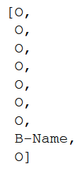

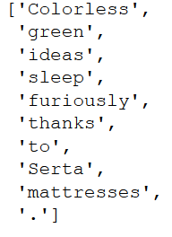
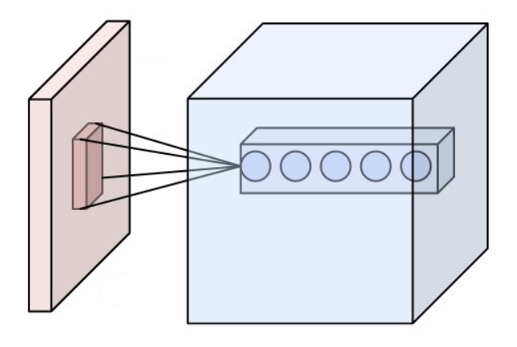
Raw Input
Preprocess/Transform
Computation
Output
Tokenize by sentence, then word
Integer- code corpus words and characters
CNN
Custom name tags
Full text document (article, etc)
Tag names
Notes:
Architecture of the solution

Slide 5
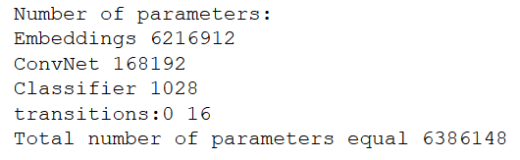
Results - Method One
Reached 98% accuracy on training data
Converged at around 84.5% accuracy on validation/test data
Number of false positives about equal to number of false negatives
Pros:
Intuitive approach to problem
Based on recent research approaches to NLP, POS tagging, NER
Cons:
Overall predictive power poor
Computationally expensive to train
Specificity of training data => possible future generalization problems

Slide 6
Initial Input
Input Data
Feature Engineering
Computation
Output
Counts,
Named Entity Recognition, Character Distance, Metadata
Tree-based Model
(Random Forest)
Potential Name, Industries
Text: Press releases, news articles, etc
Risk Score
Query
APIs
CSV:
Riskiest articles
Metadata: API metrics
Web scrape/APIs
ML for smart source filtration/ weighting
Notes:
Architecture of the solution

Slide 7

Results - Method Two
Pretty Good.
Practical/Simple
Fast
Real-time updating
Direct to the goal
SB liked it!
CONS:
Potentially difficult to scale
Leverages outside sources
Stronger on more obvious

Slide 8
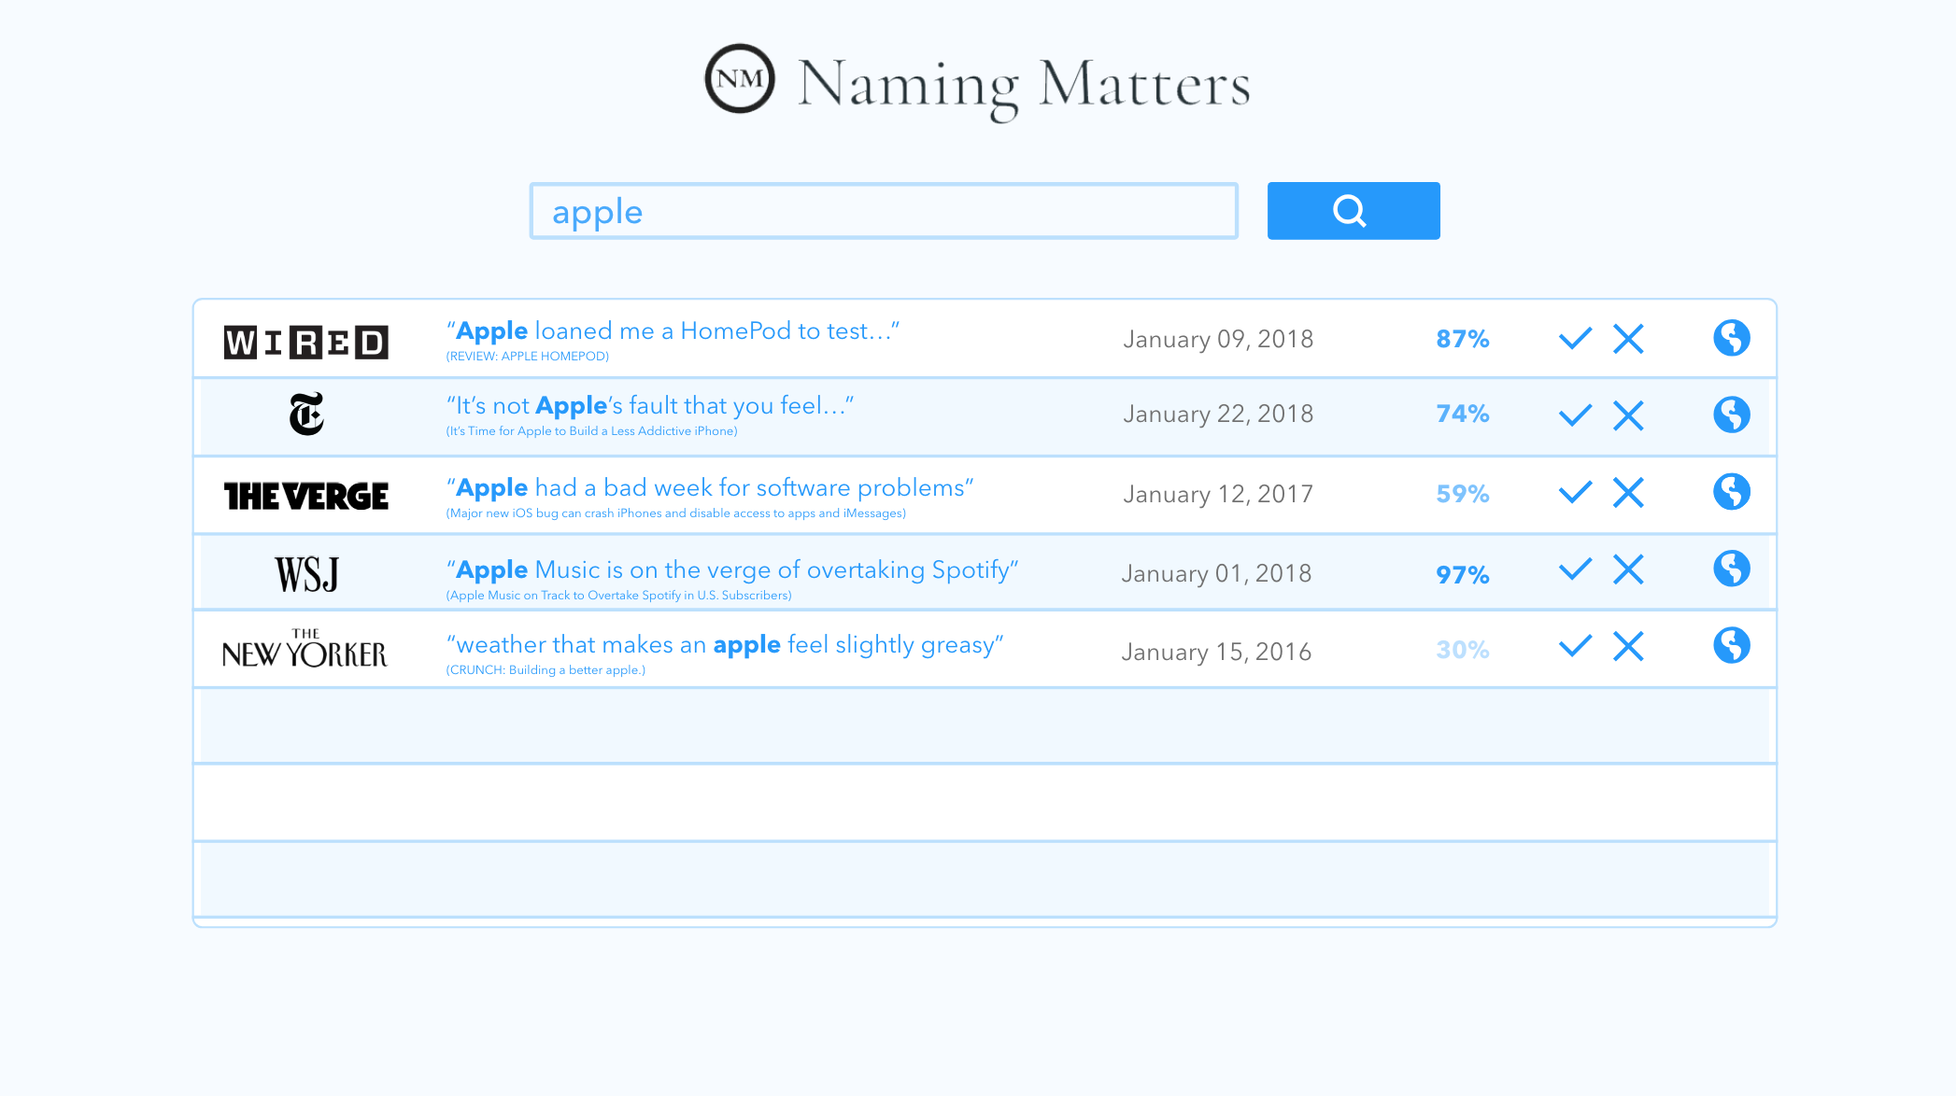

User Interface

Slide 9
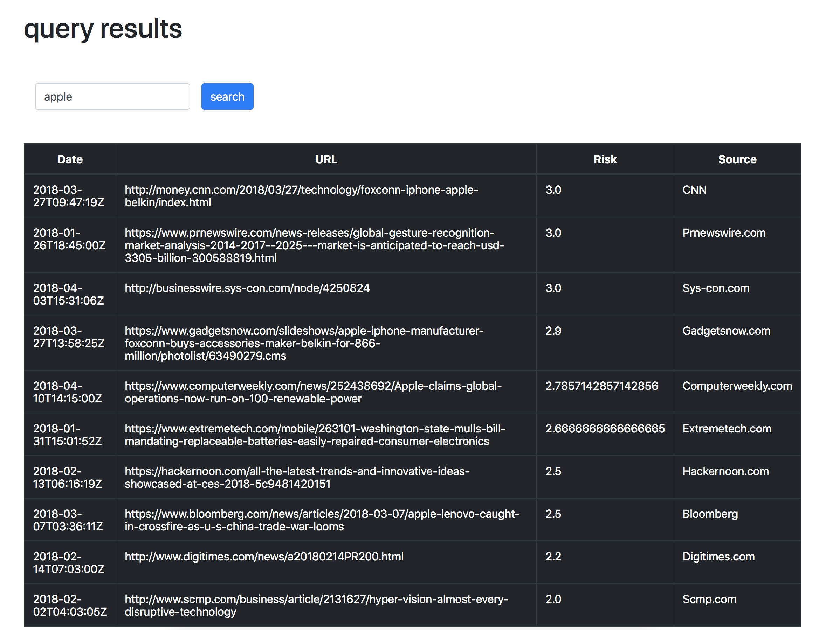

Slide 10
Demo

Slide 11
Learning Path
Decide on risk score output
Process NYT annotated corpus
Tree-based model
Learn about trademarks
Brainstorm models and desired output
Create Training Data
Models
Search for labeled training data
Process News API search results
Neural Network
Notes:
Summarize the learning path: From where did you start in terms of basic understanding, how did you get to the solution, what ideas did you try first, what else did you try, in what order, what experiments did you try to test, etc.
Initial efforts towards full-text trademark name tagging included tfidf as input for logistic regression (abandoned due to poor performance). We also tried exploring word embeddings to look for a related vector subspace, or using embeddings as model inputs, but didn’t have much success with either due to A. lacking enough data to create robust word embeddings on our own and B. computational limitations of personal laptop when using large pre-trained set (google news embeddings)
Brainstorming types of models and desired output
Creating training data
Searching for useful databases
Two models, two training sets:
Simple-tree-based model
Neural network model

Slide 12
Potential Improvements / Next Steps
Improvements to the Models:
- Neural Network
- scale: size of data set, number of training epochs
- input data: more detailed labeling (‘brand’, ‘product’, etc)
- Real-time Model
- training data: better negative training data and more training data in general
- sources: more APIs/sources. Potentially offline unstructured as well
- tuning: additional model/metric tuning
General Improvements:
Gather more unstructured sources to be used for either model
Industry canonization/classification tools could be helpful
We should put the key improvements that could be made to either or both models and what we would do if we had more time/resource/expertise etc.

Slide 13

Thanks!
Questions?

Slide 14
Github Link: http://tinyurl.com/dataxday1000

