Slide 1
Module I - Design
Testing and Debugging Programs
Software Development
Portability and Standards

Slide 2
Session Objectives-1
Testing and Debugging Programs
Testing
  Black Box
  White Box
Syntactical Errors
Semantic Errors
Software Development
Life Cycle
Waterfall Model
Open Source Model
Design

Slide 3
Session Objectives-2
Portability and Standards
Standard C89
Standard C99
Portability Checks

Slide 4
Testing
Software testing is the process used to measure the quality of developed computer software.
Quality is constrained to such topics as correctness, completeness, security, and technical requirements such as capability, reliability, efficiency, portability, maintainability, compatibility, and usability.
Testing is a process of technical investigation, performed on behalf of stakeholders.

Slide 5
Black Box Testing-1
External factors are determinant. Internal structure is irrelevant.
  testing to specifications
  input-output driven
  data driven
The number of possibilities to be tested may be too great.

Slide 6
Black Box Testing-2
Equivalence Classes
  Develop a manageable set of test cases.
  Create equivalence classes with boundary values.
    for example, <1, 1...25, >25
  Experience suggests that faults frequently exist at and on boundaries.
  Test either side of the boundaries of the equivalence class as well as on the boundary itself
    for example, 0, 1, 2, 17, 24, 25, 26

Slide 7
White Box Testing-1
Internal structure is determinant.
  glass box
  logic-driven
  path-oriented
Each possible path through the code is executed at least once. The number of possibilities to be tested may be too great.

Slide 8
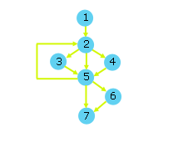
White Box Testing
Flow Graphs-1
Develop a control flow graph that represents the sequences, selections and iterations in the program.
Each flow graph node represents one or more sequence statements.

Slide 9
Flow Graph-2
Criteria
  statement coverage - every elementary statement is executed at least once
  edge coverage - every edge is traversed at least once
  condition coverage - all possible values of the constituents of each compound condition are exercised at least once
  path coverage - all paths from initial node to final node are traversed at least once.

Slide 10
Flow Graph-3
Iterations
  skip the iteration entirely
  pass through the iteration once
  pass through the iteration less than the specified number of times
  pass through the iteration the specified number of times
  pass through the iteration once more than the specified number of times

Slide 11
Flow Graph-4
Compound Conditions
  break into simple conditions

Slide 12
Syntactical Errors
manual tracing
using different compilers
common errors
  missing semi-colon
  undeclared variable name
  unmatched parentheses
  left-side of assignment is not an l-value
  for example: 3=x;
  return statement missing

Slide 13
Semantic Errors
vocalization
manual tracing
intermediate output
interactive tracing
  Visual Studio C++ 6.0
  Visual Studio .net
  Borland C++
Common errors:
  = instead of ==
  iteration has no body
  Un-initialized variable
  infinite iteration
  operator precedence
  dangling else
  off-by-one iteration
  integer division
  mismatched data types
  & instead of &&

Slide 14
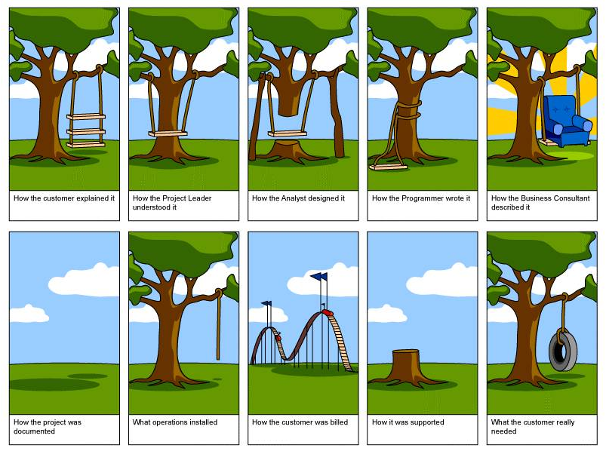
Software Development

Slide 15
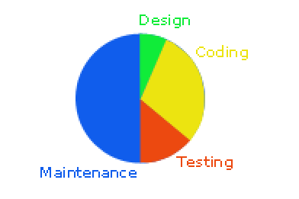
Life Cycle
The life cycle of work of software extends from concept inception through testing and maintenance to retirement.
About half of the maintenance time is often spent understanding the source code and the documentation.

Slide 16
Quality-1
For a program to have longevity, it helps to have a quality design.
What makes a quality design:
External Features:
  Usability
  Portability
  Correctness
  Reliability
Internal Features:
  Maintainability
    Understandability
    Testability
    Modifiability
  Reusability
  Efficiency
  Security

Slide 17
Quality-2
Some tools we use to achieve these features:
  structured programming
  object-oriented programming
  standards compliance
  documentation

Slide 18
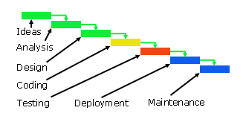
Waterfall Model-1
The waterfall model is the traditional model of the software life cycle.
The waterfall model is a linear model that progresses from ideas to maintenance, step by step

Slide 19
Waterfall Model-2
Notable deficiencies of the waterfall model include:
  the requirements are seldom fully known at the outset and grow throughout the software life cycle
  the user does not see the result until it has been completed
  the user provides little or no feedback in the development process

Slide 20
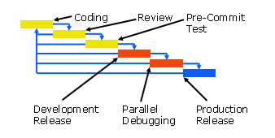
Open Source Model

Slide 21
Open Source Model-2
The Open Source model is an incremental, non-hierarchical model.
Its focus is user-driven rather than concept driven.
The rise of the Internet enabled this approach.
Advantages over the waterfall model include:
  reliability
  robust functionality
  responsiveness to user needs

Slide 22
Design
Design is about the relationship of parts to the whole.
A program may work, but be poorly designed.
If the program models a real world situation, the program will more than likely be simpler to upgrade.

Slide 23
Function-Oriented Design
Hide the information:
hide the representation of data
hide the properties of data
hide the solution structure

Slide 24
Data-Oriented Design
Based on structured programming principles:
depict orderly motion of data from process to process
focus on data availability controlling the execution

Slide 25
Object-Oriented Design
Focus on real-world objects (study in the next semester)

Slide 26
Portability and Standards
We can compile and execute portable programs on different hardware, operating systems or compilers either with no change or with minor changes to the header file alone.
To enable portability, compiler writers agree from time to time to provide a common subset of language standards.
If we restrict our use of the language to the standard subset, we may expect to be able to port our programs from one platform to another without any modification whatsoever.

Slide 27
C Standards
The first edition of "The C Programming Language" by Kernighan and Ritchie published in 1978 provided the original description of the C language. Since then, the C language has undergone several 'standard' definitions: C89, C95 and C99.

Slide 28
Standard C89
In 1982, the American National Standards Institute formed a committee (X3J11) to propose a standard for C.
An international group converted this standard with minor modifications into the ISO/IEC 9899:1990 standard, which ANSI then adopted. This is called Standard C.

Slide 29
Standard C95
In 1995, ANSI introduced some amendments to Standard C, called C95, which included new conversion specifiers for printf and scanf and numerous new library functions.

Slide 30
Standard C99
ISO/IEC approved a new international standard in 1999: ISO/IEC 9899:1999 (C99). Compiler vendors are gradually updating their compilers and libraries to conform to this new standard.

Slide 31
Portability Checks
Programming Styles
  Adopting a popular standard may enable you to make use of checking tools that support the standard.
Two frequently used programming standards:
  Indian Hill Style
  MISRA

Slide 32
Programming styles
Some common standards include:
#includes should follow the header comments. #defines should follow the #includes.
constants should be of the same data type as the variables that the constants initialize,
avoid declarations that shadow declarations at a higher level,
split compound conditions into one simple condition per line,
avoid defaulting a test condition to non-zero,
compare of FALSE rather than TRUE,
comment each fall through in a switch,
attach unary operators to their operand without spaces,
#define constants in all CAPS,
avoid names that differ in case only,
avoid names that look like each other,
compare a ointer to NULL instead of 0,
avoid assuming ASCII,
avoid assumptions about parameter passing and order of evaluation,
avoid possible side effects such as a[i] = b[i++];,
use explicit casts when mixing signed and unsigned.

Slide 33
Summary
Testing and Debugging Programs
  Testing
    Black Box
    White Box
  Syntactical Errors
  Semantic Errors
Software Development
  Life Cycle
  Waterfall Model
  Open Source Model
  Design
Portability and Standards
  Standard C89
  Standard C99
  Portability Checks
Q&A

