Slide 1
Scalable Big-Data Malware Traffic Analysis with Spark & Kafka
PRESENTED BY Arsh Panesar (ap9332), Charlotte Xiu (yx2867), Namit Surana (ns6518), Yize Liu (yl7401)
12/09/2025
Notes:
namit

Slide 2
Dataset Overview
CTU-IoT-Malware-Capture Dataset (12 files · 3.2GB total)
Development File: CTU-IoT-Malware-Capture-3 (23MB → 156,103 records)
Labeling
label: Malicious / Benign
detailed-label: attack type (PortScan, C&C, etc.)
Imbalance Summary
Malicious: 151,567
Benign: 4,536
Dominant attack: Horizontal Port Scan (145,597 flows)
Feature Domains (23 columns)
Protocol, connection state, ports, bytes, duration, timestamps, etc.
Notes:
Yize

Slide 3
Dataset Overview(Cont. )
Problems
Modern systems generate huge volumes of network traffic
Malicious packets are mixed with benign flows and hard to spot at scale
Security teams need fast, scalable tools to understand attack patterns
Motivation
Hundreds of packets per second per machine → tens of millions of records
Even a single data center produces “big data” network logs
Streaming + distributed processing are necessary, not optional
Dataset Link: https://www.kaggle.com/datasets/agungpambudi/network-malware-detection-connection-analysis
Notes:
Yize

Slide 4
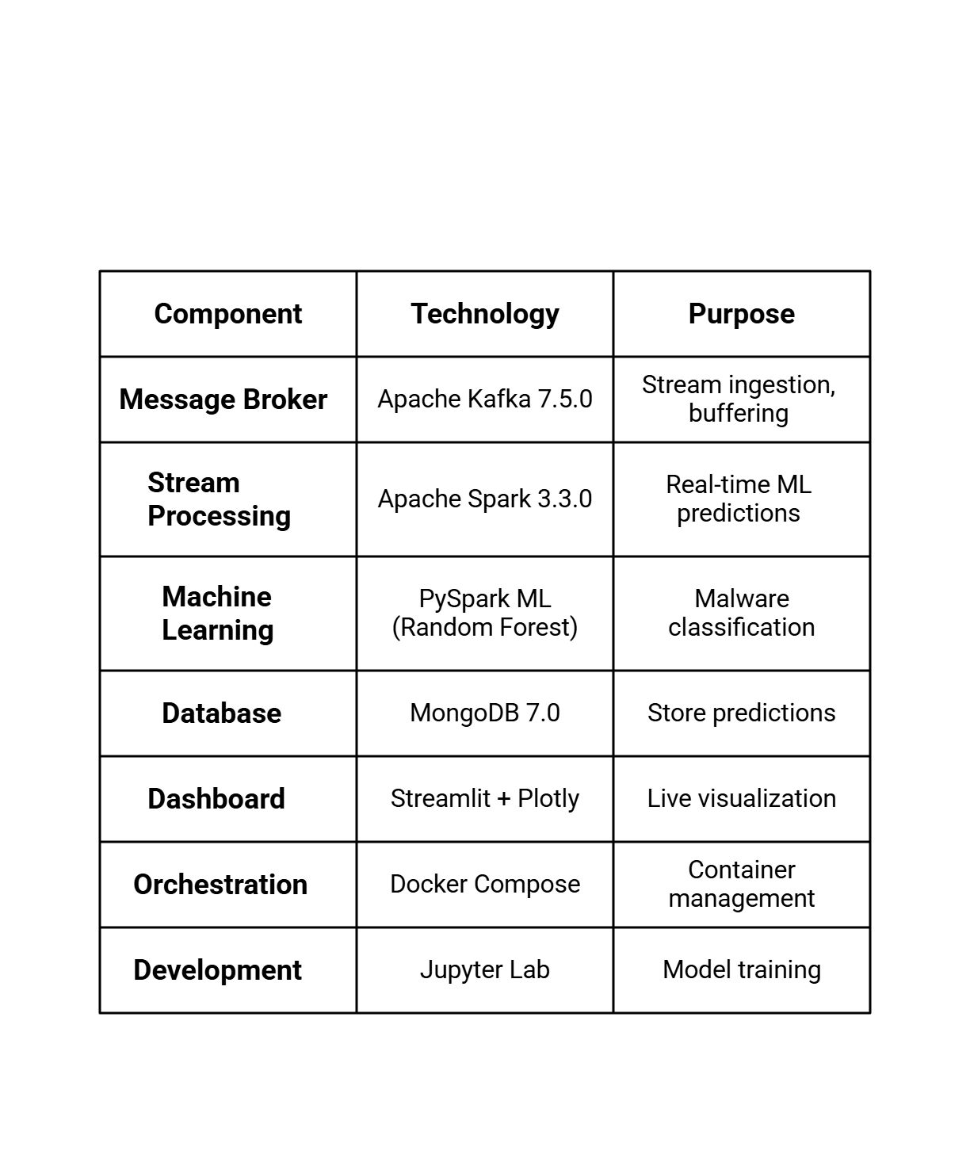
Technologies & Infrastructure
Infrastructure Setup
7 Docker Containers running concurrently
Dual listener Kafka architecture (internal/external)
Spark Master/Worker cluster setup
Volume mapping for data persistence
Notes:
Arsh

Slide 5
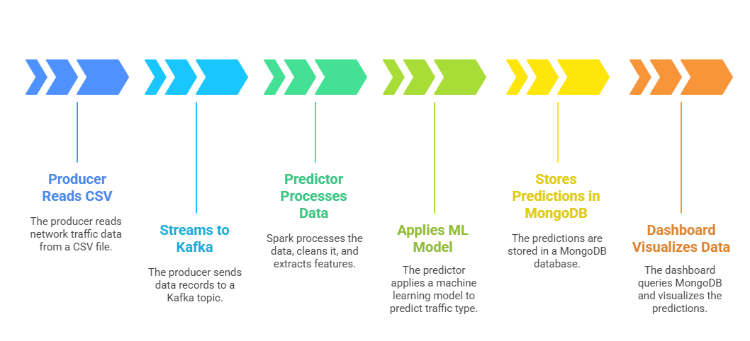
Data Pipeline & Processing
Notes:
Charlotte

Slide 6
Big Data Operations
Use Kafka to read large CSV datasets, serializes them into JSON, and streams them to a Kafka topic
Use Spark Structured Streaming to consume micro-batches in real-time, enforcing strict schemas and handling windowed aggregations.
Use MongoDB as the sink for processed streams, storing unstructured prediction results and metadata for the dashboard.
Use Spark ML to perform distributed data cleaning, categorical encoding (StringIndexer/OneHotEncoder), and numerical scaling across the cluster, training our model.
Use Spark ML to load the pre-trained model into the streaming pipeline to make predictions in real time
Notes:
Yize

Slide 7
Machine Learning Model
Model | Accuracy | F1-Score
Random Forest | 0.99939 | 0.99939
Gradient Boosted Trees | 0.99994 | 0.99994
Model Tested:
Random Forest
Gradient Boosted Trees (best)
Training Process:
Load 156K records from Kafka
Feature engineering pipeline
Train/ test split (80/20)
Model training with cross-validation
Key Features (Importance): bytes_per_sec/ total_bytes/ conn_state_encoded/ duration/ proto_encoded
Notes:
Charlotte

Slide 8
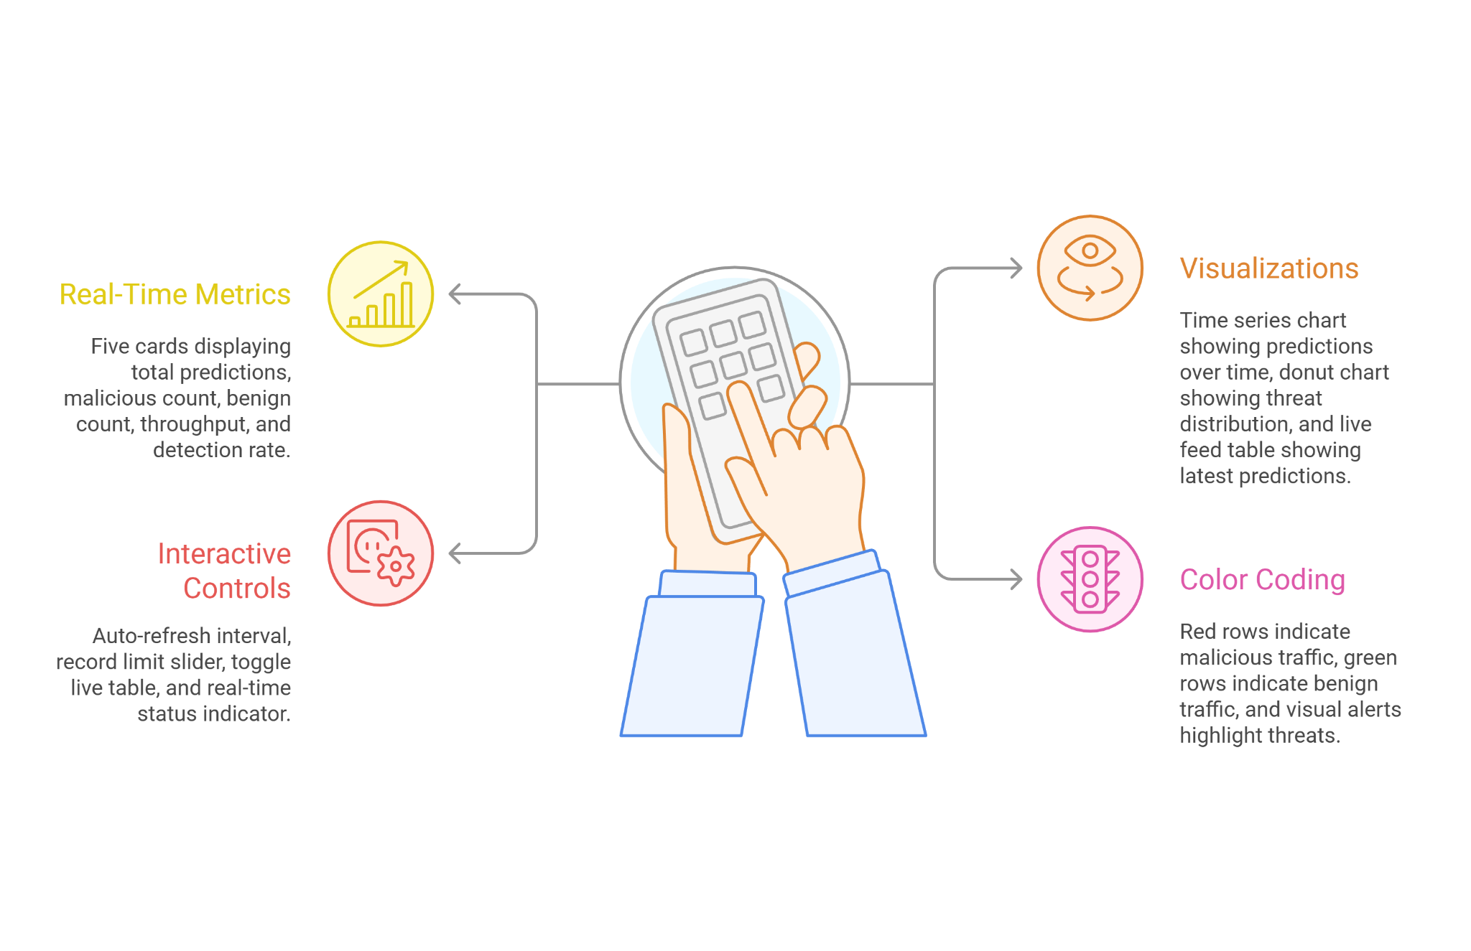
Real-Time Dashboard Features
Notes:
namit

Slide 9
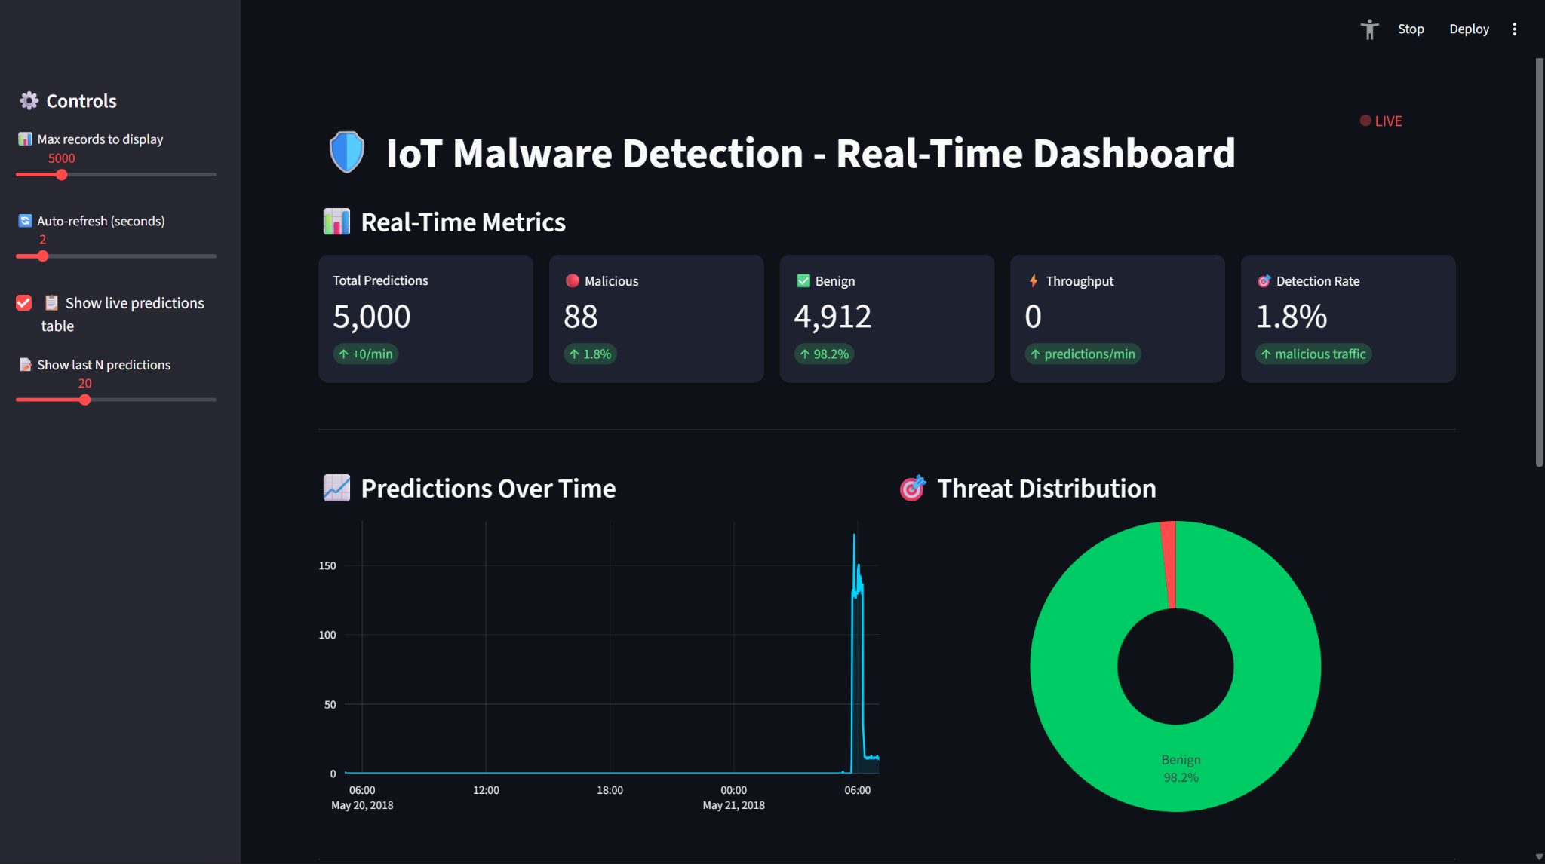
Results & Insights
Notes:
namit

Slide 10
Testing & Optimization
Load Test (Batch Mode):
Full 1.3 GB capture (10.45M rows) processed in ~8.9s
Predictions consistent with dataset skew (~10.38M Malicious, ~72.5k Benign)
Key Tuning Knobs:
maxOffsetsPerTrigger, trigger interval, Kafka partitions
Spark memory + shuffle settings
Backpressure + checkpointing enabled for recovery
Pipeline achieves low-latency streaming with substantial capacity for higher ingest rates; validated end-to-end on the largest dataset.
Performance (Streaming):
5k record micro-batch processed in 0.1-0.22s
Effective processing capacity ~25k rows/sec
Ingest capped at ~2.5k rows/sec by rate limit → Spark has headroom
Notes:
Charlotte

Slide 11
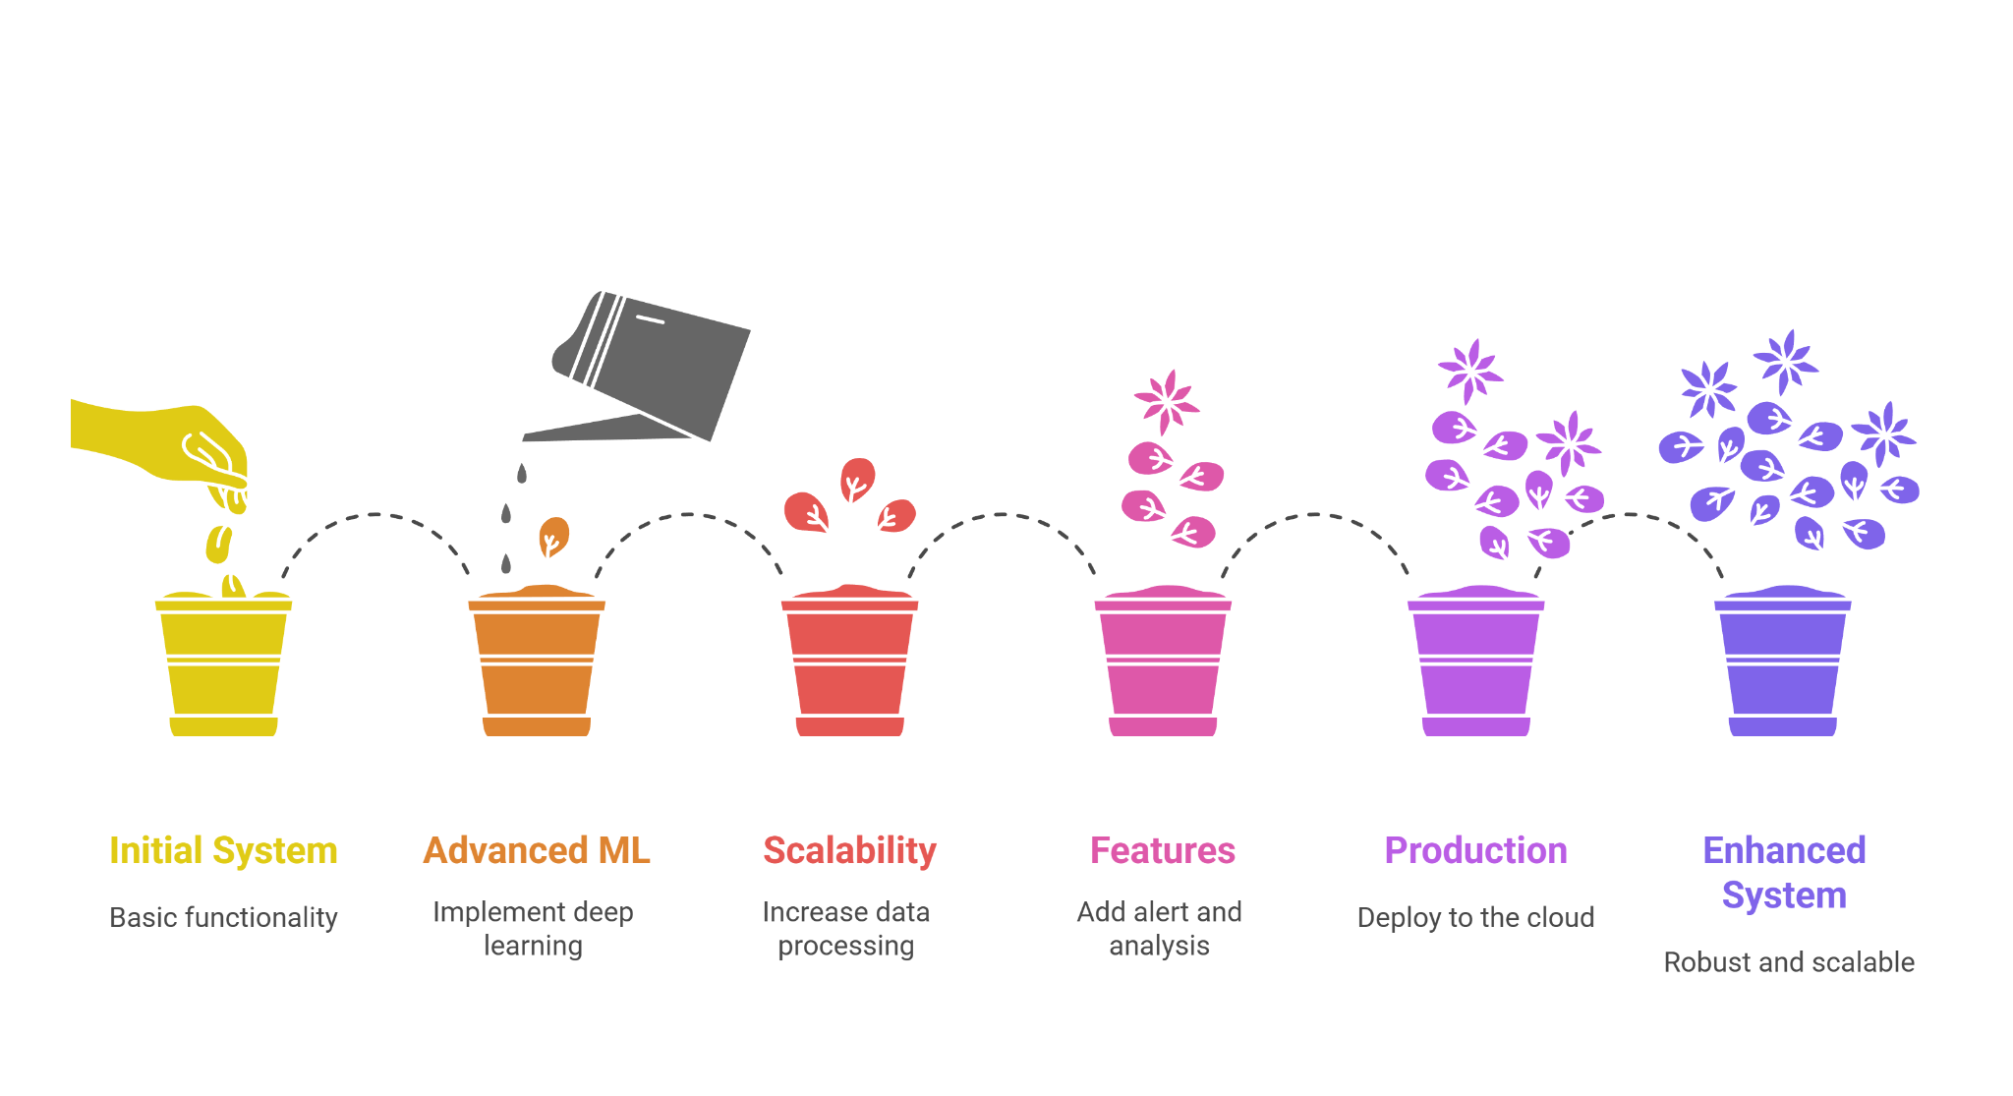
Future Work
Notes:
Arsh

Slide 12
THANKS!
Q&A
Notes:
arsh

