Slide 1

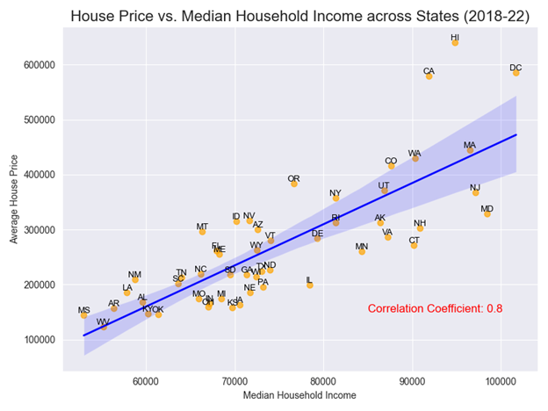
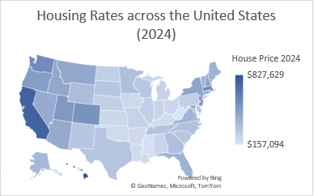
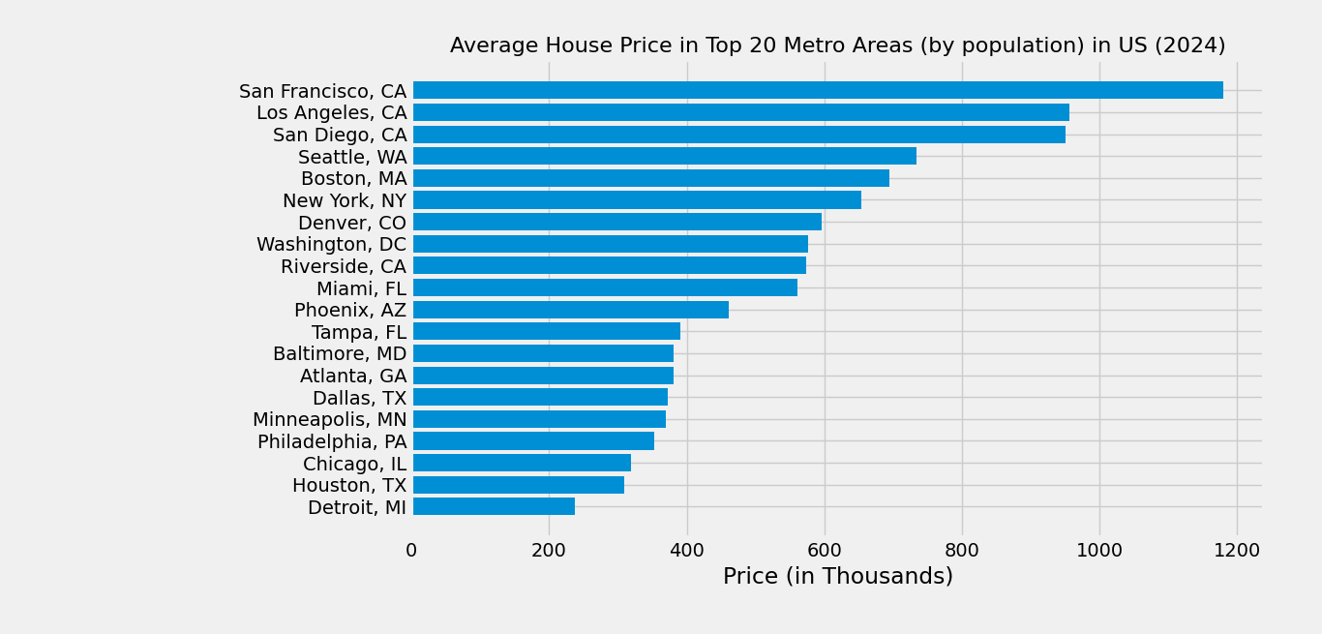
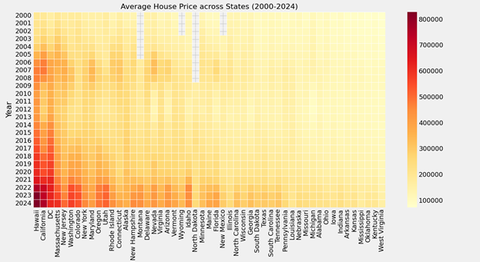
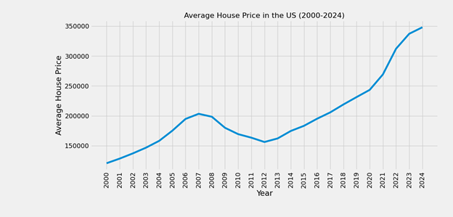
Correlation of Income and Housing Rates in the U.S.
Team 22391-3
Introduction
Methods
Results
Conclusion
The house prices all throughout the United States have been rising over the past years, which has a huge societal issue which affects many people across the nation.
The shortage of affordable housing has been a burden on many families because they spend more than the threshold.
This analysis can build a deeper understanding about housing rates and their correlation with income. By analyzing these rates, a greater understanding can be developed about lack of affordable housing across different regions in the United States.
Data Collection:
Housing Data: Zillow Home Value Index - Single-Family homes data for state, county, and metro data
Income Data: Median Household Income for state and county from HD Pulse (2018-22)
Data Exploration and Analysis
Sorting and filtering of data through Excel
Data visualization was mainly done using Python using three libraries – Pandas, Matplotlib, Seaborn
The research done shows that rising home prices and median household income being disproportionate has become a major affordability issue. This trend is particularly shown greater in metropolitan areas where house prices exceed median household incomes.
Next Steps
The correlation coefficient between house price and median household income across states is 0.8, a strong positive correlation which suggests that when income increases, house prices tend to increase. Many states are significantly above the regression line.
The next steps are for the government to act. Additional and more comprehensive data is also needed to predict the long-term effects of this crisis. Without intervention, the economy can get unstable, making inflation worse, which will lead to higher house prices. Ultimately, this can put millions of Americans in financial hardship. With proper action taken, the affordable housing rates can increase.
Results
Purpose
The findings from this research are to gain a deeper understanding of the rising housing prices across the United States and to present a common trend that can help better explain why this might be true. More and more Americans have been complaining about rising housing prices. In this issue, there is an increasing number of people with affordability problems regarding housing prices, and this can cause problems to a huge number of Americans.
The data gathered here will show the trend specifically between median household income and house prices. Additionally, the study will include housing price trends in certain regions.
References
House Prices across U.S. ranging from $157,094 to $827,629 in 2024
Light Blue – Below ~$500,000
Dark Blue – Above ~$500,000
Center for American Progress. Americans Recognize Housing Affordability Crisis, Support New Policies to Fix the Market and Build More Homes. www.americanprogress.org/article/americans-recognize-housing-affordability-crisis-support-new-policies-to-fix-the-market-and-build-more-homes/. Accessed 2 Feb. 2025.
Kline, Justin. “U.S. Homelessness Jumps to Another Record High, Amid Affordable Housing Shortage and Rising Costs.” NPR, 27 Dec. 2024, www.npr.org/2024/12/27/us-homelessness-jumps-to-record-high. Accessed 2 Feb. 2025.
National Institute on Minority Health and Health Disparities. HDPulse: An Ecosystem of Minority Health and Health Disparities Resources. hdpulse.nimhd.nih.gov. Accessed 2 Feb. 2025.
National Low Income Housing Coalition. “The Gap: A Shortage of Affordable Homes.” National Low Income Housing Coalition, www.nlihc.org/gap. Accessed 2 Feb. 2025.
U.S. Census Bureau, Population Division. Annual and Cumulative Estimates of Resident Population Change for Metropolitan Statistical Areas in the United States and Puerto Rico and Metropolitan Statistical Area Rankings: April 1, 2020 to July 1, 2023 (CBSA-MET-EST2023-CHG). Mar. 2024.
U.S. Department of Housing and Urban Development. “Affordable Housing.” HUD Exchange, www.hud.gov/program_offices/comm_planning/affordablehousing/. Accessed 2 Feb. 2025.
Zillow Research. Zillow. www.zillow.com/research. Accessed 2 Feb. 2025.
The average house price in these regions were high.
These are areas that are the most and heavily populous in the country, nearly 40% of the U.S. population.
House price increases across the states throughout the years. This suggests that almost all the people are affected throughout the U.S., whether it be a big or small change.
House price typically increases on a national scale. Ever since the pandemic, the price increased at a rapid rate especially in 2020 to 2022.
Notes:
1

