Slide 1
LabGo
CAPSTONE PROJECT
Presented By:
1. Namita D A-BMS College of Engineering-Computer Science

Slide 2
OUTLINE
Problem Statement (Should not include solution)
Proposed System/Solution
System Development Approach (Technology Used)
Algorithm & Deployment
Result (Output Image)
Conclusion
Future Scope
References

Slide 3
PROBLEM STATEMENT
Problem Statement 11: AI Lab Manual and Experiment Generator
Educators and students often face significant challenges in preparing, accessing, and standardizing laboratory manuals and experiments across various educational institutions. The manual creation of lab guides is time-consuming, error-prone, and frequently lacks alignment with updated curriculum standards, safety protocols, and available infrastructure. Additionally, the absence of customizable experiment plans and automated evaluation rubrics makes it difficult to adapt lab experiences to different classroom environments and learning needs.
There is a pressing need for a system that can dynamically generate accurate, curriculum-aligned, and equipment-sensitive lab manuals, complete with procedural instructions, safety guidelines, and grading rubrics. The solution must be scalable, adaptable to multiple subjects and education boards, and capable of retrieving and synthesizing relevant data from trusted academic sources.

Slide 4
PROPOSED SOLUTION
Created an Agentic AI which generates lab manual and experiments.
Data Collection:
Gathered multiple experiments with all details for grade 12 for chemistry,physics and biology.
Data Preprocessing:
Cleaned and standardized the extracted data for consistency.
Removed duplicates, filled in missing values, and aligned formatting across subjects.
Organized data into sections with a uniform template for all experiments.
Agentic AI logic:
Used LangGraph framework and ReAct architecture.
Natural Language is processed through a vector database called lab_experiments
Deployment:
Develop a user-friendly interface or application that provides real-time solutions for lab-experiments and its alternatives.
Deploy the solution on a scalable and reliable platform, considering factors like server infrastructure, response time, and user accessibility.
Evaluation:
Accuracy of experiment data
Adhered to NCERT Guidelines

Slide 5
SYSTEM APPROACH
System requirements
Processor:Dual core(i3 or above)
RAM:4GB minimum
Storage:SSD with minimum 128GB free space
Network adapter:Wi-fi or Ethernet with stable connectivity
Operating System:Windows/macOS/Linux
Web Browsers:Google Chrome/Microsoft Edge/Mozilla Firefox
Library required to build the model
IBM Cloud: watsonx service
Agentic AI lab(beta version)
Framework: LangGraph
Architecture: reAct
Added tools: Google search, DuckDuckGo search, Wikipedia , Webcrawler
Document Search: labexperiments Word Document (consists of defined experiments by Namita)

Slide 6
ALGORITHM & DEPLOYMENT
Algorithm Selection:
The core architecture utilizes an Agentic Workflow Model implemented via the LangGraph framework, a powerful system for building dynamic, branching workflows with memory and tool usage capabilities. LangGraph enables stateful interactions between language models and tools like retrievers, databases, and formatters. This architecture suits the task well because the generation of lab manuals involves multiple stages: query interpretation, curriculum data retrieval, formatting, safety and rubric generation, and final compilation—all of which benefit from modular, traceable steps and memory.
Data Input:
Vector data: labExperiments Word document
Course code or Subject
Preferred topic
Preferred format (PDF/Markdown)
Equipment availability (optional constraint)
Prediction Process:
Uses RAG (Retrieval-Augmented Generation) to fetch relevant experiment procedures, safety guidelines, and rubrics from NCERT and other academic repositories

Slide 7
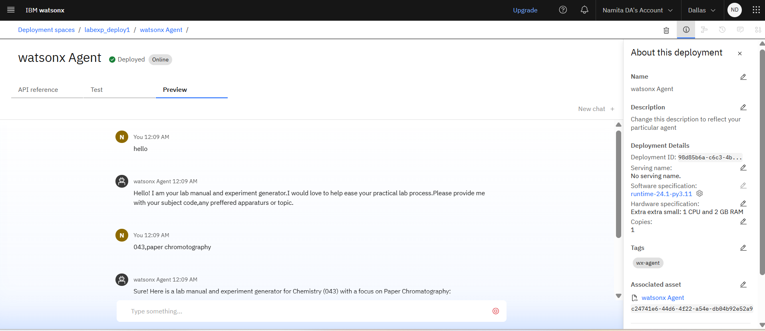
RESULT
Test Case 1: Providing subject code and preferred topic
Test result: Matches the experiment provided in our input document along with rubrics.
.

Slide 8
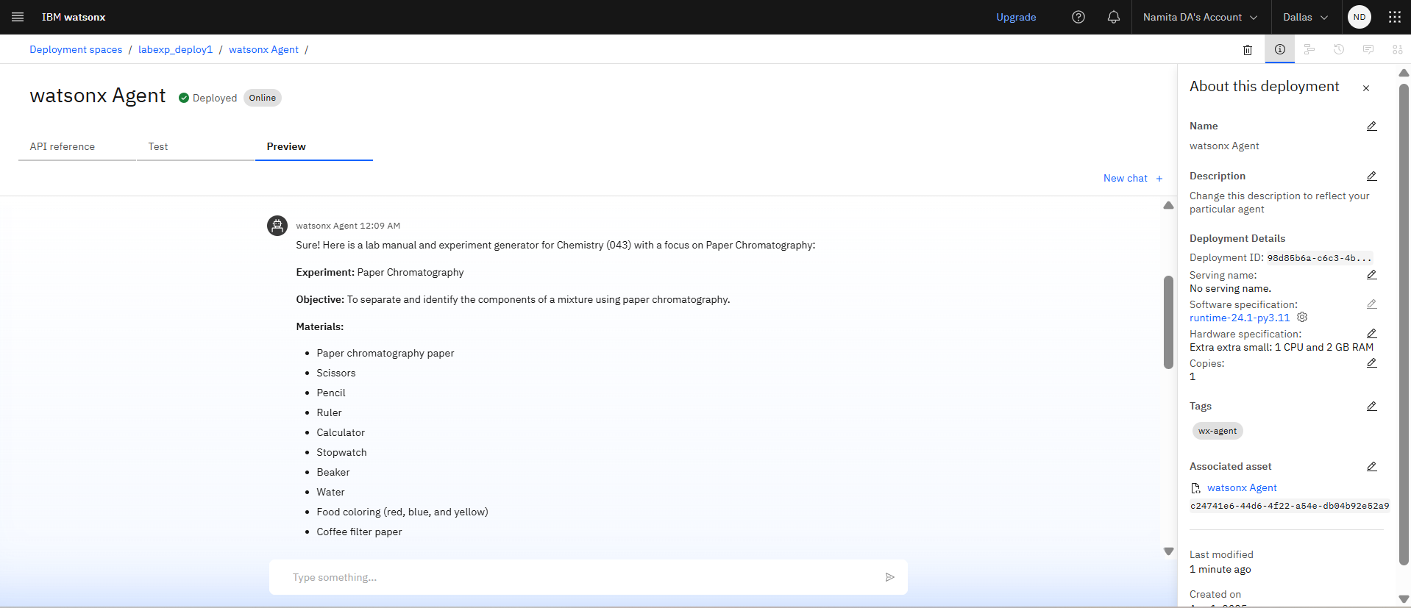
RESULT
.

Slide 9
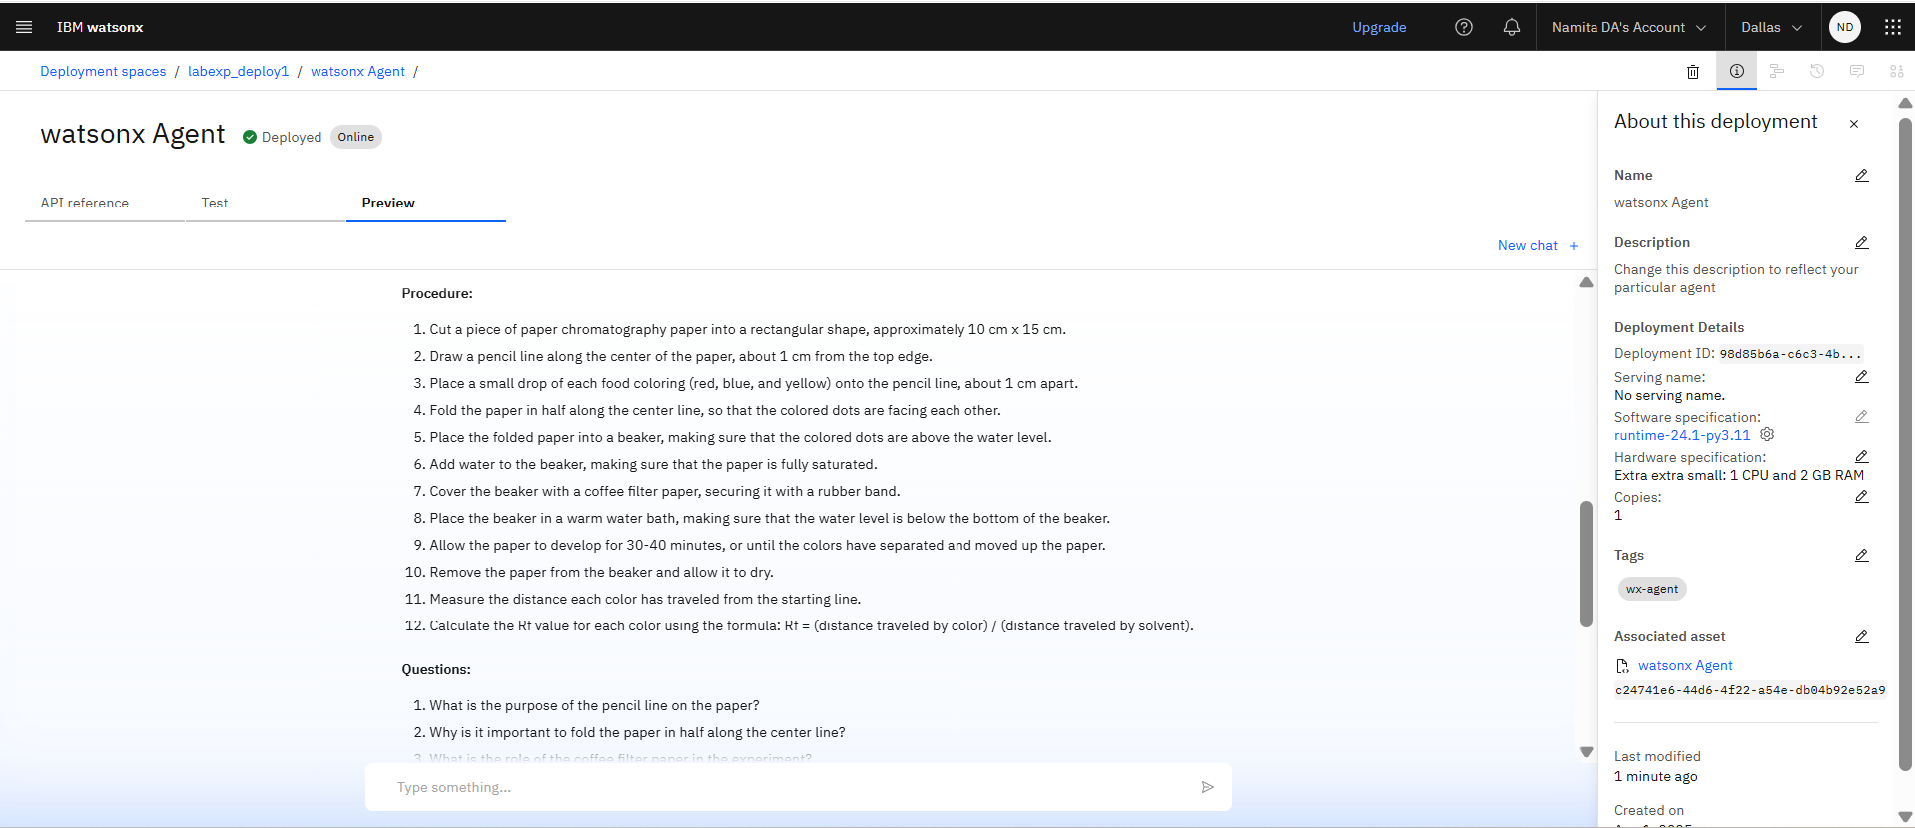
RESULT
.

Slide 10
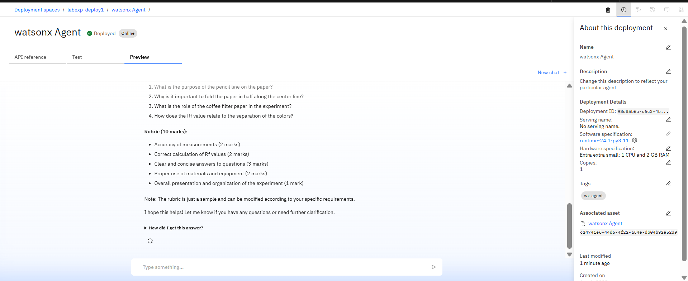
RESULT
.

Slide 11
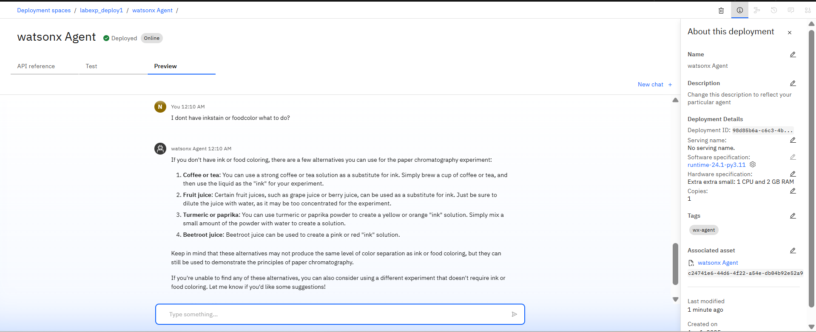
RESULT
Test Case 2: Asking for alternative Apparatus.
Test result: Provided alternative Apparatus.
.

Slide 12
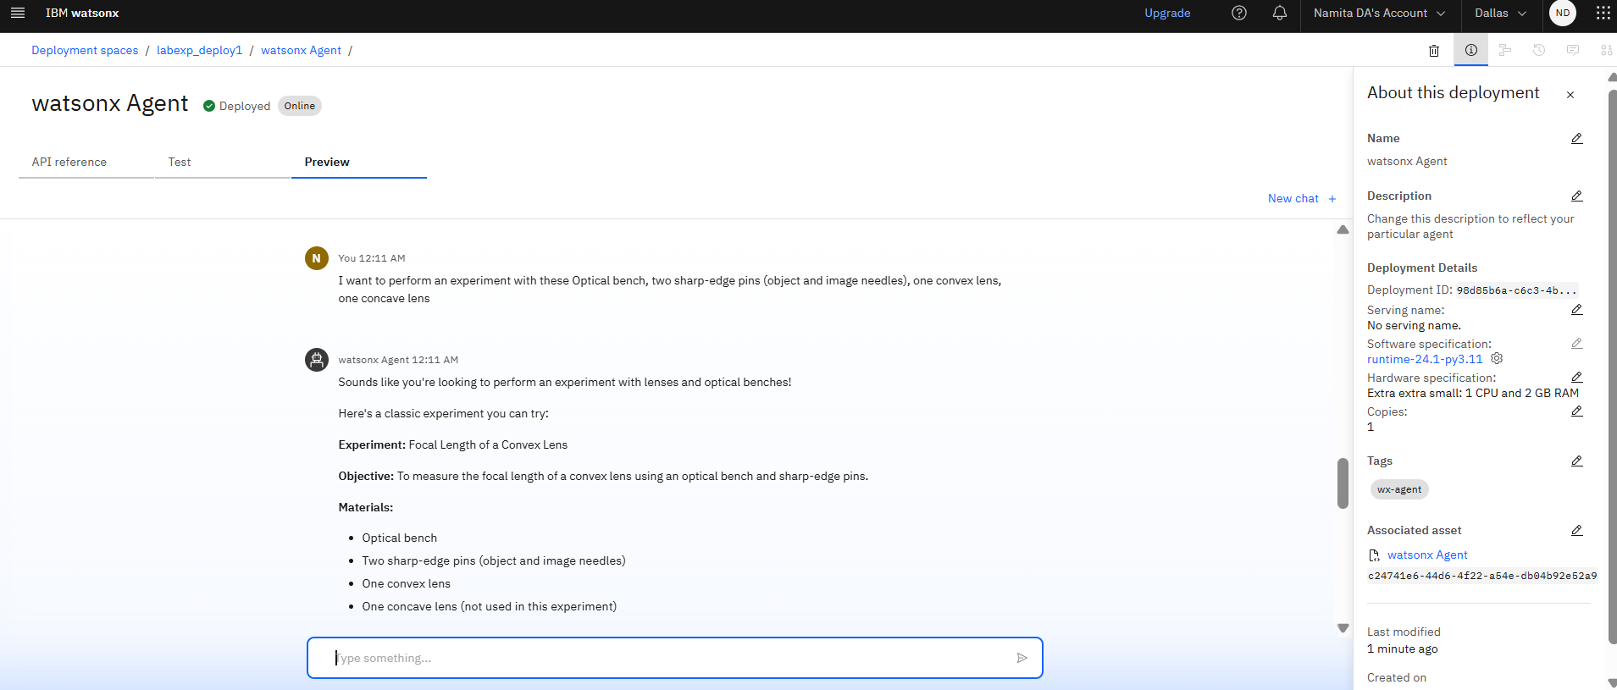
RESULT
Test Case 3: Asking for experiment suggestions with available equipment.
Test result: Provided a detailed documentation of an experiment using the available equipment.
.

Slide 13
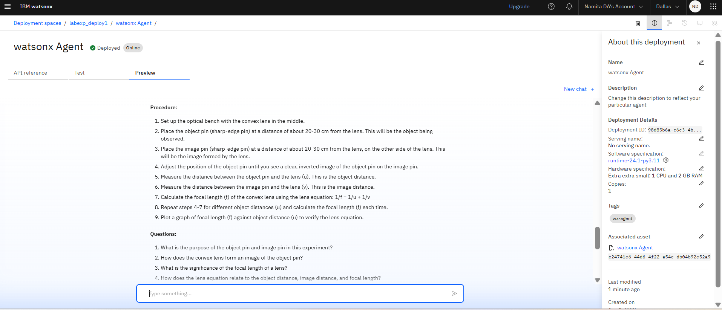
RESULT
.

Slide 14
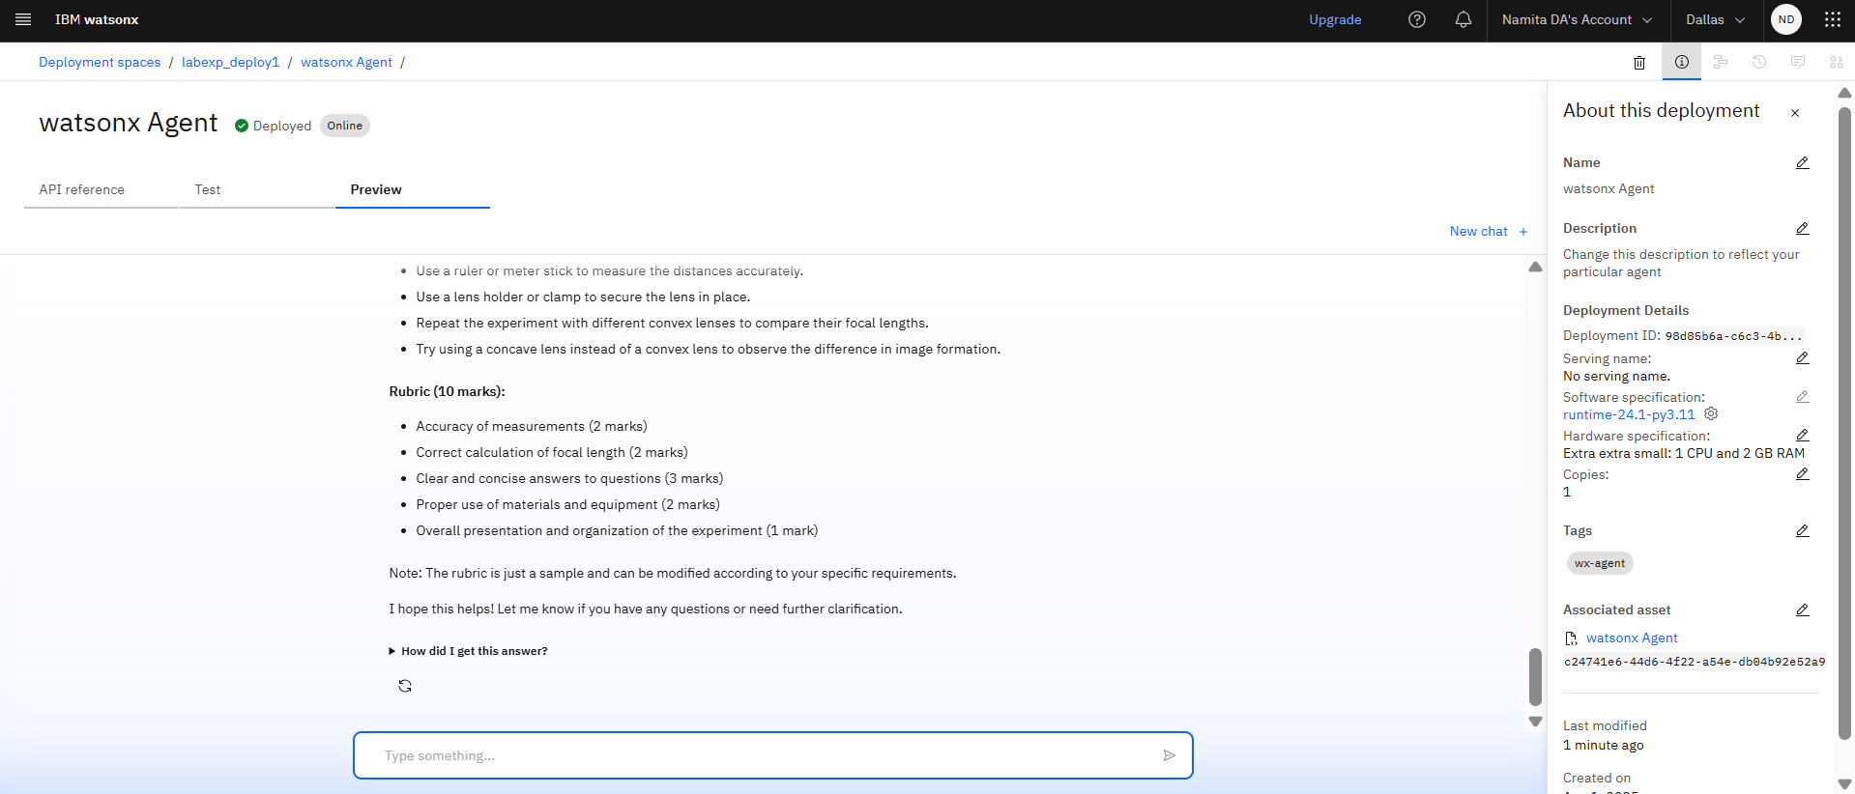
RESULT
.

Slide 15
RESULT
.
Deployment Link: https://dataplatform.cloud.ibm.com/ml-runtime/deployments/98d85b6a-c6c3-4bd5-9a38-d789639e7eea/chat?space_id=c5a8351d-42f6-43b0-b2a3-d3c0ea83cf07&context=wx&flush=true

Slide 16
CONCLUSION
The Agentic AI Lab Manual & Experiment Generator, built using the LangGraph framework with Retrieval-Augmented Generation (RAG), successfully automated the creation of structured, syllabus-aligned lab manuals for Class 12 Physics, Chemistry, and Biology. The system was able to:
Generate detailed experiment sections (aim, apparatus, procedure, safety standards, and rubrics) accurately.
Customize content based on syllabus inputs and subject selection.
Maintain consistency and format readiness across all experiments.
Reduce manual effort by automating information retrieval, formatting, and evaluation criteria inclusion.
This agentic system proved especially effective for educators seeking standardized, printable, and customizable lab documentation aligned with NCERT and CBSE norm

Slide 17
FUTURE SCOPE
Multilingual and voice input
Adaptive and Personalised learning
Real-time safety compliance monitoring
Integration with virtual lab and Stimulators

Slide 18
REFERENCES
Central Board of Secondary Education
https://cbseacademic.nic.in
Laboratory Manual Physics – Class XII, NCERT
Laboratory Manual Chemistry – Class XII, NCERT
Laboratory Manual Biology – Class XII, NCERT Available at: https://ncert.nic.in/textbook.php
Automating with AI Agents IBM Documentation
URL:https://dataplatform.cloud.ibm.com/docs/content/wsj/analyze-data/fm-agents-overview.html?context=wx&audience=wdp

Slide 19
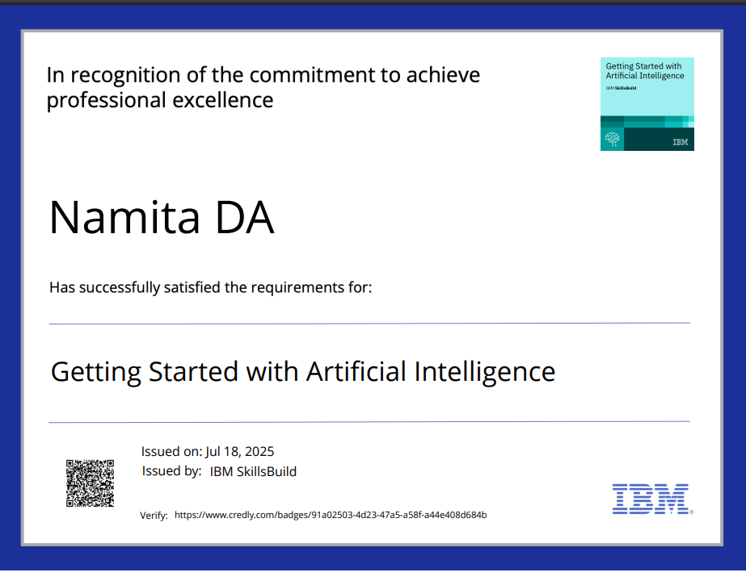
IBM CERTIFICATIONS
Getting started with Artificial Intelligence certificate

Slide 20
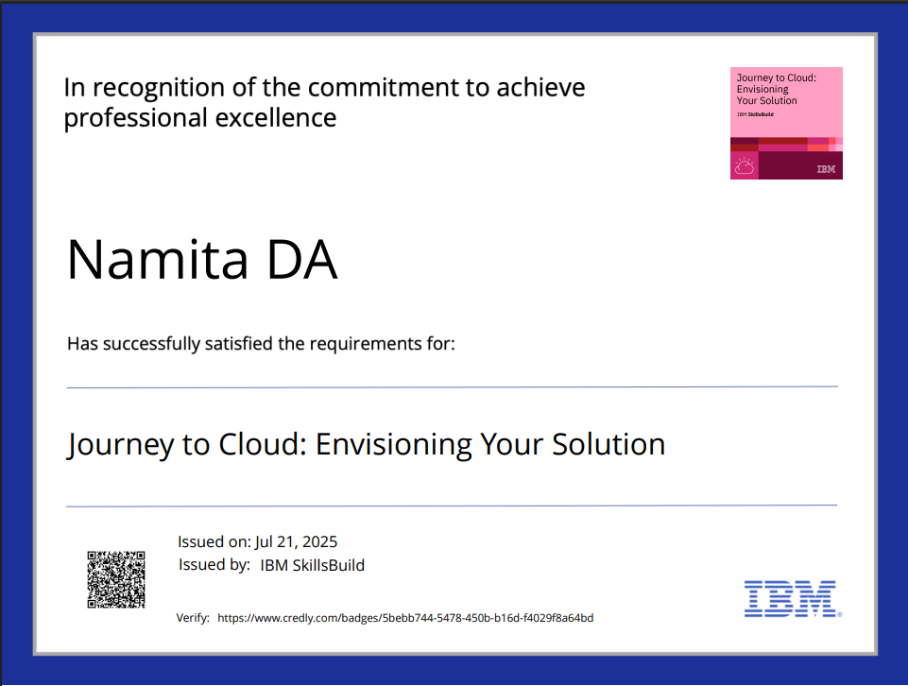
IBM CERTIFICATIONS
Journey to cloud completion certificate

Slide 21
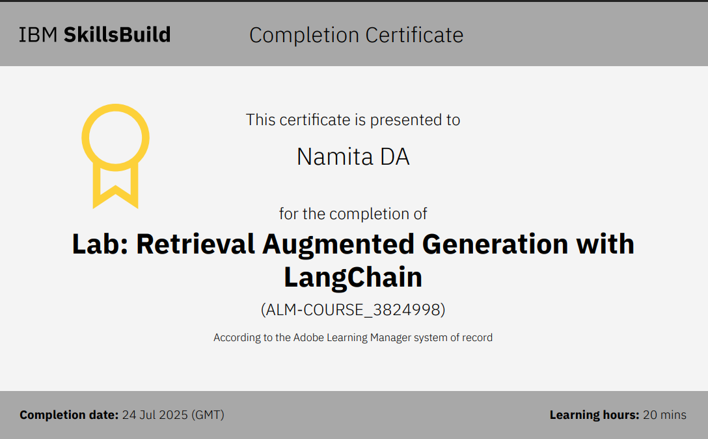
IBM CERTIFICATIONS
RAG Lab completion certificate

Slide 22
THANK YOU

