Slide 1

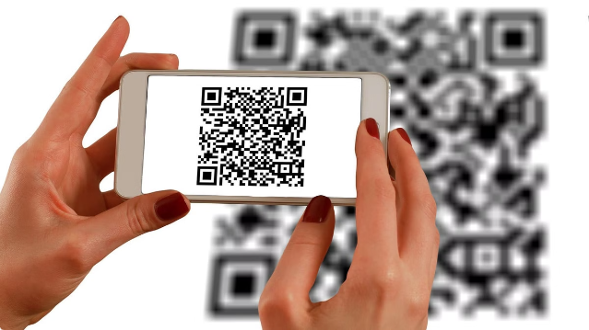

QR Code and Barcode Scanning with OpenCV
"Scan, Detect, Display: Real-time QR Code and Barcode Scanner in Python with OpenCV and Pyzbar for effortless data retrieval."

Slide 2


Requirements:
Requirements
OpenCV, pyzbar, NumPy
Installation
pip install opencv-python pyzbar numpy
Run the Code
python qr_barcode_scanner.py

Slide 3
Overview
Import Libraries: The necessary libraries cv2, numpy, and pyzbar are imported.
Display Help Function: The display_help function provides user instructions.
Main Function:
Initializes the video capture.
Checks if the capture device is opened successfully.
Enters a loop to continuously capture frames from the video feed.
Detects QR codes and barcodes, displaying the results and drawing bounding boxes around detected codes.
Provides controls to quit, pause, and clear detections.

Slide 4
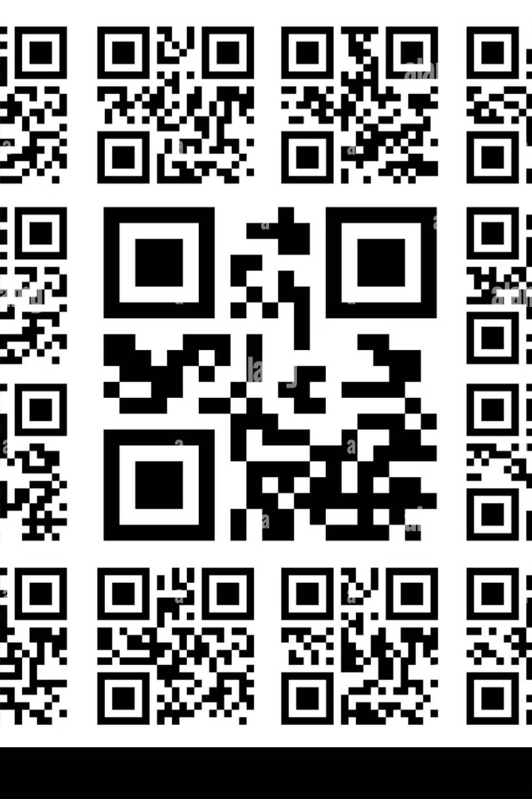
How It Works?
1
Capture Frame
Use OpenCV to capture video frames from the camera.
2
Detect Codes
Leverage the pyzbar library to detect and decode QR codes and barcodes.
3
Display Results
Overlay the decoded data on the video feed and display it to the user.

Slide 5

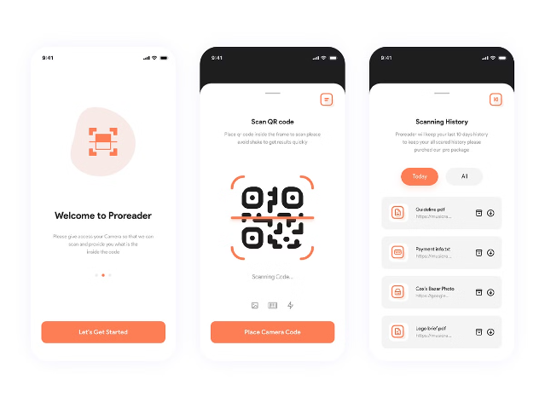
Handling User Interactions
Pause and Resume: 'p'
Allow users to pause and resume the scanning process.
Clear Detections: 'c'
Provide an option to clear the list of previously detected codes.
Exit the Program: 'q'
Add a 'quit' function to gracefully exit the application.

Slide 6
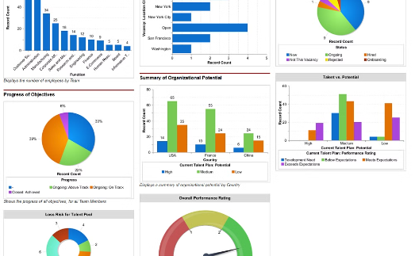
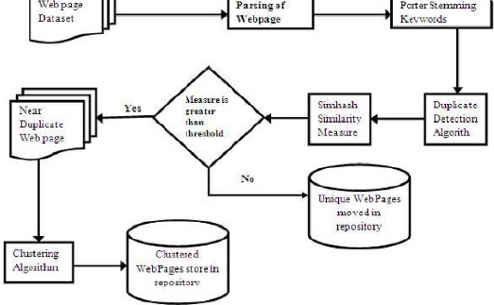
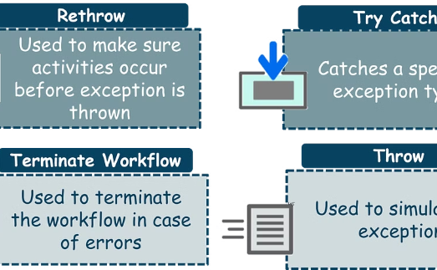
Performance Optimization
Frame Counting
Duplicate Detection
Error Threshold
Track the number of processed frames to monitor performance.
Maintain a set of unique codes to avoid reporting the same code multiple times.
Implement a threshold for the number of frames without a successful detection before exiting.

Slide 7

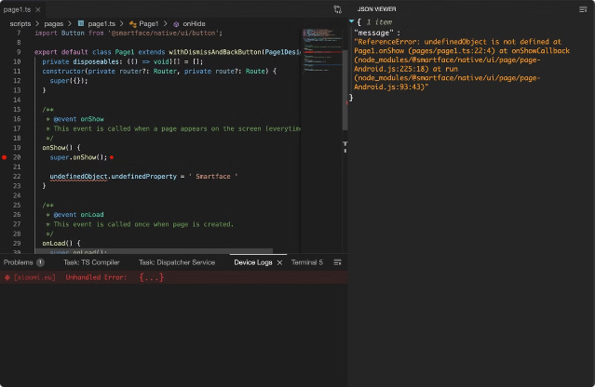
Error Handling
1
Capture Failures
Handle errors when the camera fails to capture frames.
2
Decoding Issues
Gracefully handle exceptions that may occur during code decoding.
3
No Code Detected
Provide a clear indication if no QR code or barcode is found.

Slide 8


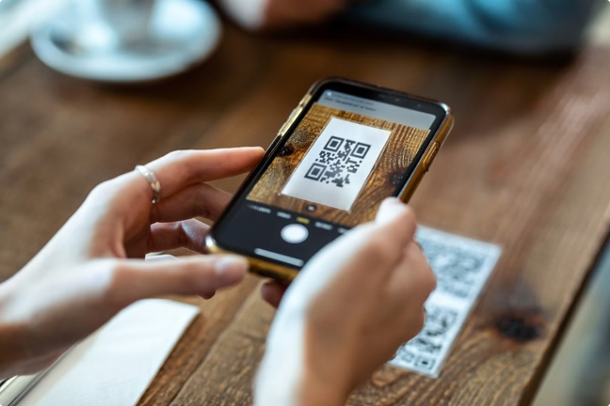


Practical Applications
Inventory Management
Streamline inventory tracking and item identification.
Mobile Payments
Enable secure, on-the-go transactions using QR codes.
Logistics and Shipping
Optimize supply chain processes with barcode scanning.

