Slide 1
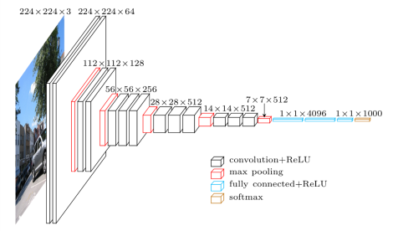
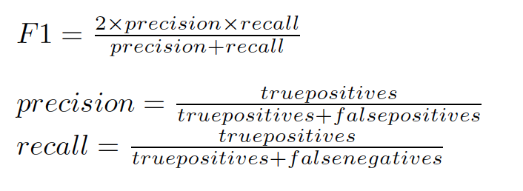
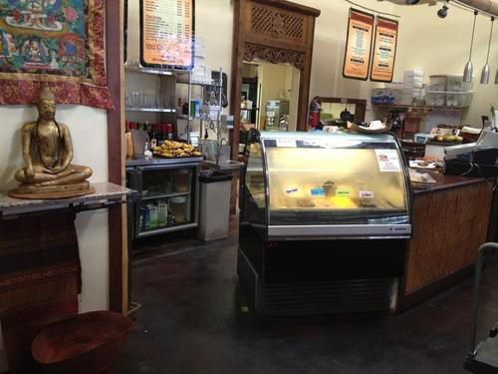
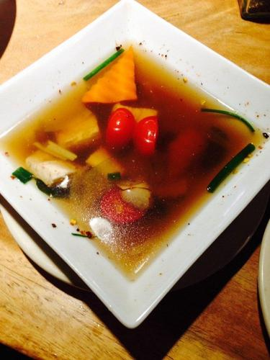
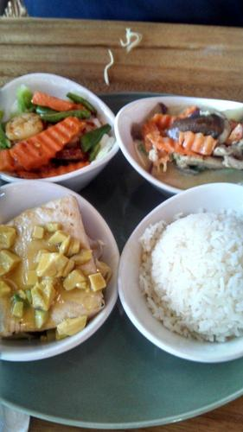
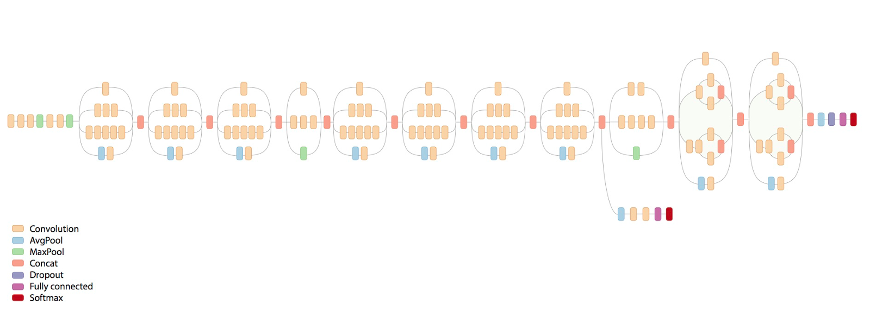
YELP-RESTAURANT PHOTO CLASSIFICATION
Rakshit Gautam - 111168264 Namita Mhatre - 110929172
abstract
VGG-16 NEURAL NETWORK
results
Yelp Restaurant Photo Classification is a challenge on Kaggle.
Yelp is a community driven website related to reviews and recommendations of restaurants, entertainment etc.
The challenge requires us to predict attribute labels for restaurants using user-submitted photos.
The problem of predicting labels is a multi-label and a multi-class classification problem.
VGG-16 neural network comprises of 16 Weight Layers.
Following is the sequence of layers in a VGG-16 network:
InputLayer(shape=(None, 3, 224, 224))
2 : 3x3 ConvLayer- 64 channels (pad=1)
MaxPoolLayer (2x2 window, stride=2)
2 : 3x3 ConvLayer- 128 channels (pad=1)
MaxPoolLayer (2x2 window, stride=2)
3 : 3x3 ConvLayer- 256 channels (pad=1)
MaxPoolLayer (2x2 window, stride=2)
3 : 3x3 ConvLayer- 512 channels (pad=1)
MaxPoolLayer (2x2 window, stride=2)
3 : 3x3 ConvLayer- 512 channels (pad=1)
MaxPoolLayer (2x2 window, stride=2)
2 : DenseLayer (Fully Connected)- 4096 channels
DropoutLayer
DenseLayer (Fully Connected)- 1000 channels VGG – 16 ARCHITECHTURE
SoftMax layer source : https://www.cs.toronto.edu/~frossard/post/vgg16/
Convolution layer : During the forward pass, each filter is convolved across the width and height of the input volume, computing the dot product between the entries of the filter and the input and producing a 2-dimensional activation map of that filter. As a result, the network learns filters that activate when they see some specific type of feature at some spatial position in the input.
Maximim Pool Layer : It partitions the input image into a set of non-overlapping rectangles and, for each such sub-region, outputs the maximum. The intuition is that once a feature has been found, its exact location isn't as important as its rough location relative to other features. The function of the pooling layer is to progressively reduce the spatial size of the representation to reduce the amount of parameters and computation in the network, and hence to also control overfitting.
ReLu (Rectified Linear Units) : It increases the nonlinear properties of the decision function and of the overall network without affecting the receptive fields of the convolution layer.
Softmax Layer : The loss layer specifies how the network training penalizes the deviation between the predicted and true labels and is normally the last layer in the network.
Performance of the model:
We judged the efficiency of the model by computing the F1 score, which is given by:
Using VGG-16:
F1 score for class 0 : 0.246658566221 F1 score for class 1 : 0.730971491835
F1 score for class 2 : 0.733858267717 F1 score for class 3 : 0.486444314414
F1 score for class 4 : 0.564832793959 F1 score for class 5 : 0.763460066343
F1 score for class 6 : 0.903733200597 F1 score for class 7 : 0.476884536552
F1 score for class 8 : 0.692283950617
Mean F1 score : 0.686912156997
Using the Inception V3:
F1 score for class 0 : 0.297049847406 F1 score for class 1 : 0.727802037846
F1 score for class 2 : 0.744872362402 F1 score for class 3 : 0.495571886188
F1 score for class 4 : 0.588628762542 F1 score for class 5 : 0.770086035738
F1 score for class 6 : 0.892339331620 F1 score for class 7 : 0.488262910798
F1 score for class 8 : 0.719317300233
Mean F1 score : 0.695484307254
CONCLUSION :
Thus, we trained our classifier using both VGG-16 and Inception V3 pre-trained models and from the results it is evident that the Inception V3 is more efficient than VGG-16 and provides a better mean F1 score.
INTRODUCTION
Yelp Restaurant Photo Classification is a Kaggle challenge that requires us to predict labels for a business, based on user submitted photos and tags for a business.
The training dataset given to us by Yelp comprises of 2000 businesses assigned multiple labels from 0-8. Each of the label represents a tag associated with a business.
For these 2000 businesses, we have 2,34,842 images which are labelled.
We have split the train dataset given to create new training and testing datasets.
The labels associated with the businesses are –
0: good for lunch 4: restaurant is expensive
1: good for dinner 5: has alcohol
2: takes reservations 6: has table service
3: outdoor seating 7: ambience is classy
8: good for kids
A business can be assigned multiple labels from these labels. For example, the images below are from the training dataset and have the labels: 0, 5, 6, and 8.
INCEPTION- V3
WORKING
The Inception V3 was trained with an effective batch size of 1600 across 50 GPU's, where each GPU ran a batch size of 32. We are using this pre-trained model from tensorflow for classification.
The inception V3 has three mode different types of layers than VGG-16. We have Average pool layer, Concatenation layer and a dropout layer.
Inception V3 reaches a 3.46% on the top-5 error where as the VGG-16 yields a 6.8% on the same.
Also, the computation cost of VGG-16 is much higher as compared to Inception V3.
The only drawback of inception V3 is it’s architectural complexity.
Following image shows the Inception V3 architecture :
We have trained our model on the training images for 100 businesses ensuring that the uniformly cover all 9 labels. For testing, we have chosen 50 businesses from the remaining dataset.
Following is the methodology we followed:
Feature Computation : The VGG-16 network is pre-trained on ImageNet dataset. We have acquired the pre-trained VGG-16 network as a pickle file. The predictions for our training images on this pre-trained network will be used as features for modelling our classification problem. (VGG-16 explained later) We take the output of the last Dense layer with 4096 channels as feature vector for an image. These features are then fed to the Neural network for training.
Training the model , Classification : We have used the OneVsRest classifier from sklearn package in python. It uses the SVM (Support Vector Machine) classifer. N classifiers are generated for N different labels and are then integrated to form a single model. In our case, we have 9 labels. So, 9 individual classifiers are generated and are combined into a single model. We use this trained model for testing the data.
Testing the model : We tested the model on the 50 chosen businesses to get the F1 score. The F1 score obtained by the Inception V3 model is slightly better than that obtained by the VGG-16.
Performance evaluation : To judge the performance of the model, we used the F1 score. F1 score is the tradeoff between precision and recall. Precision is the fraction of retrieved instances that are relevant and recall is the fraction of relevant instances that are retrieved. We computed the mean F1 score by computing a weighted mean of individual F1 scores of all classes. We then compared this mean score for VGG-16 and Inception V3.
REFERENCES
Lasagne Documentation :. https://lasagne.readthedocs.io/en/latest/ .
K. Simonyan and A. Zisserman. Very deep convolutional networks for large-scale image recognition. CoRR , abs/1409.1556, 2014.
C. Szegedy, V. Vanhoucke, S. Ioffe, J. Shlens, and Z. Wojna. Rethinking the inception architecture for computer vision. CoRR , abs/1512.00567, 2015.
https://www.cs.toronto.edu/~frossard/post/vgg16/
https://www.tensorflow.org/versions/master/tutorials/image_recognition/index.html

