Slide 1
Pneumonia Detection in Chest X-Ray Images.
Using Neural Networks.
Notes:
1. Table of contents
2. Introduction
3. Identifying information
4. Patient medical history
5. Review of systems
6. Physical examination
7. Big picture
8. Findings
9. Discussion
10. Discussion summary
11. Comparison
12. Diagnosis
13. Treatment
14. Patient monitoring
15. Contraindications and indications
16. Post-prevention
17. Case timeline
18. Conclusions
19. References
20. Our team

Slide 2
OVERVIEW
Business Problem
Models used
The Data
Results

Slide 3
Business Problem
Building a model that can classify whether the patient is suffering from Pneumonia or not.
Using chest X-Ray Images.
Metrics used:
Accuracy
Recall

Slide 4
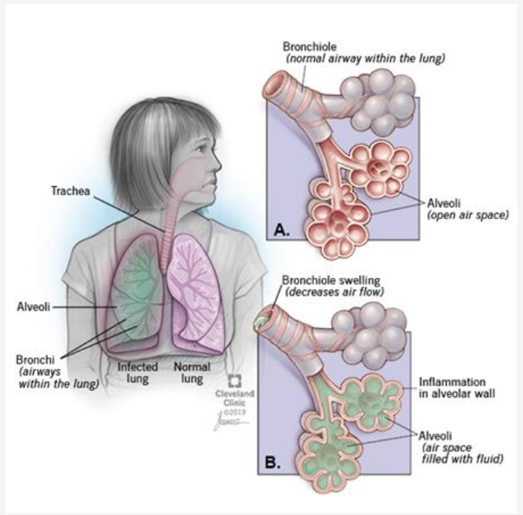
Pneumonia Background:
Pneumonia is an infection that causes the lungs air sacs to inflame with fluid/pus making breathing difficult.
Caused by Bacteria,Viruses,Fungi.
Severe pneumonia can inflame the lungs to a point where they cannot take enough oxygen or expel enough carbon-di-oxide.
It causes:
Cough
Fever
Chills
Breathing issues.

Slide 5
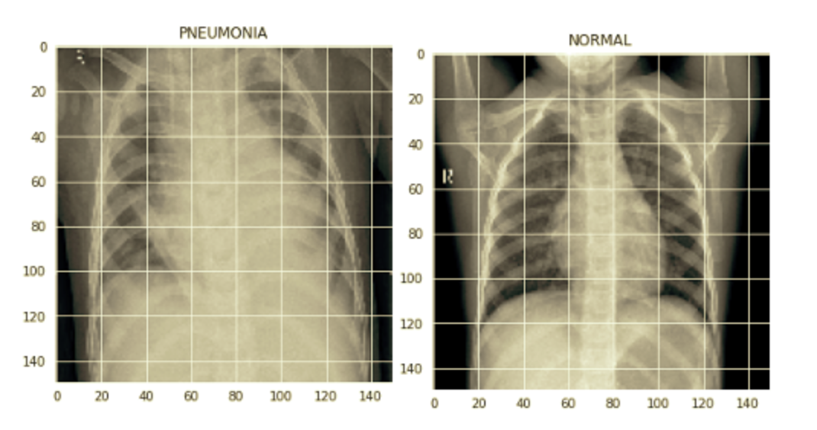
Data:
01
02
Source: Kaggle
No of X-Ray Images(JPEG:
5,863, divided in 2 categories(Pneumonia/Normal
Train: 5216
Test: 624
Validation: 16

Slide 6
Models Implemented:
Convolutional Neural Network Model.
Proposed two CNN models-
One with a dropout layer
One without a dropout layer
Data augmentation was applied.

Slide 7
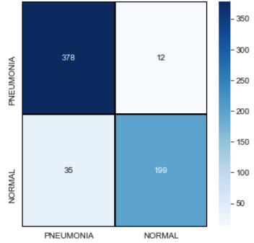
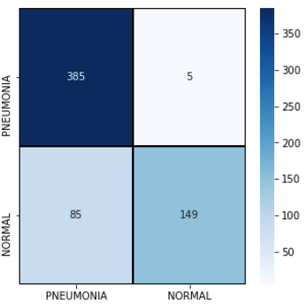
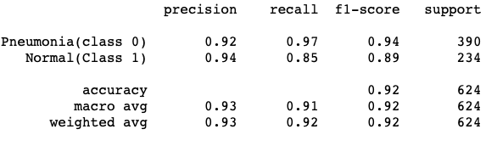
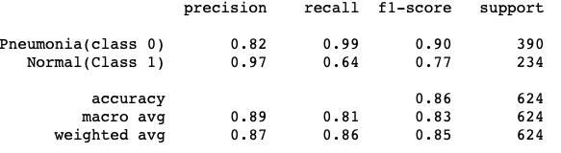
CNN model Results:
Without a dropout layer:
With a dropout layer:

Slide 8
Conclusion
CNN(without dropout layers)performed best with an accuracy of 93%.
Results are not completely reliable.
If model’s recall and accuracy scores are good it can surely help in reducing patient wait times.
Using Transfer learning methods can provide room for improvement.

Slide 9
Way forward:
Training selected models with a a higher no of epochs to try to reach convergence.
Gathering more data for a better model.
Testing this data on different models.
This work can be extended to detect and classify X-Ray images with lung cancer & Pneumonia.

Slide 10
Thank you
Namita Rana
Email:namitarana21@gmail.com
Github:https://github.com/namitarana1

