Slide 1
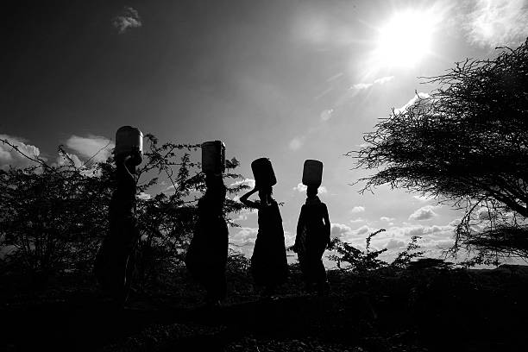
The Tanzanian Water Crisis
SAVE WATER SAVE HUMANITY

Slide 2
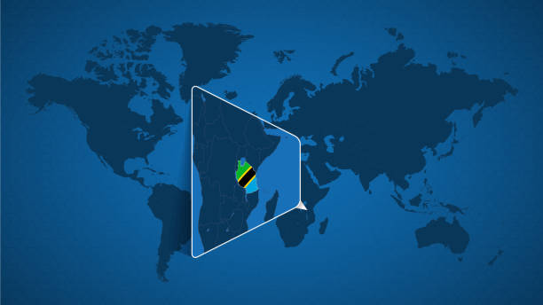
OUTLINE
BUSINESS PROBLEM
THE DATA
THE METHOD
THE RESULTS
CONCLUSION

Slide 3
BUSINESS PROBLEM
STAKEHOLDER
Predicting the operating condition of a waterpoint for each record in the dataset.
GOVERNMENT OF TANZANIA

Slide 4
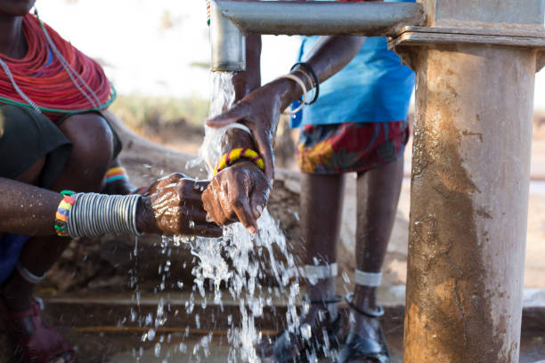
DATA USED
Tanzanian Ministry of Water.
Taarifa.

Slide 5
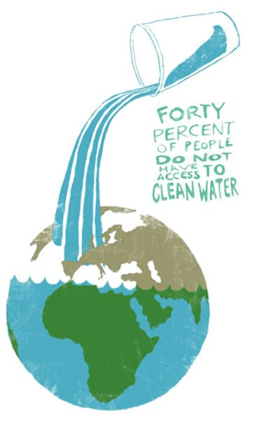
OUR MISSION
Help ensure clean drinking water is accessible to communities across Tanzania.
Predict the condition of the wells.

Slide 6
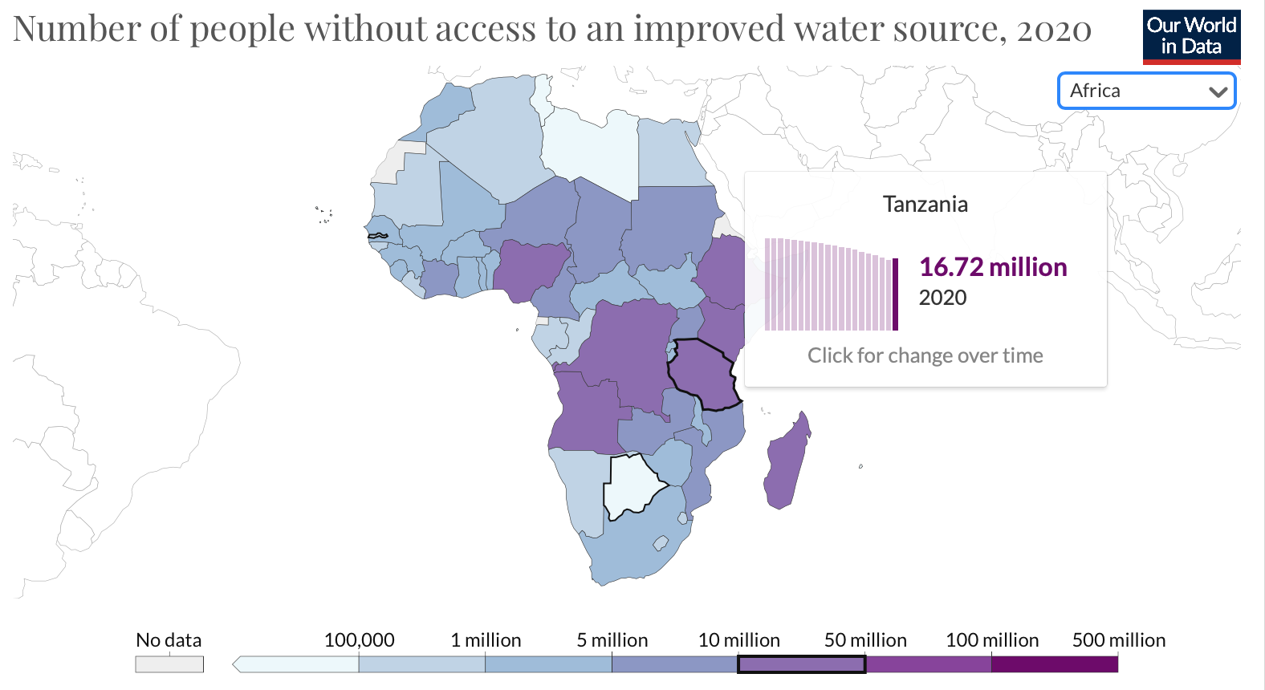
BACKGROUND
Developing Country.
Population : 59 million.
4 M Lack access to safe water.
29 million people lack access to improved sanitation.
36% of the total population lives on less than $3.20 per day

Slide 7
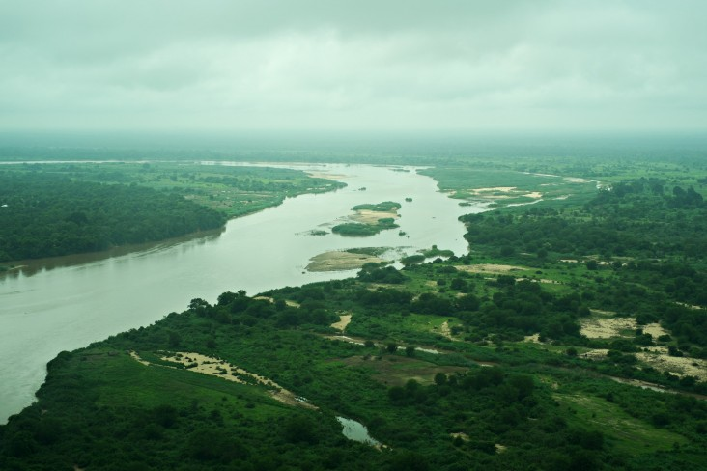
INSIGHTS INTO THE DATA:
Over 59,000 wells
distributed throughout Tanzania.
Functional
Functional Needs Repair
Non Functional
35
25
15

Slide 8
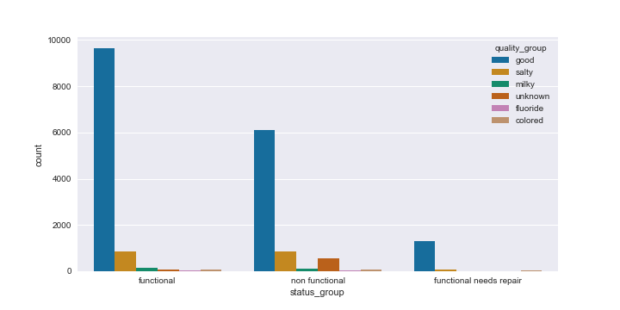
Water Quality:
Data tested on 20000 wells:
9000 are functional has good quality water.
6000 has good quality water but are non functional.
1800 would have been functional if repaired.

Slide 9
WHAT WE LOOKED
WHAT WE FOUND
Water quality is highly related to the type of well.
Government funded wells are the most non functional ones.
Maintenance of the wells is related to payment.
Communal standpipe has the most functional wells.
Condition of the wells: functional,non functional,needs repairs.
Water quality of the wells.
Seasonality of the wells.

Slide 10
THE METHOD:
Different models were tested.
Best performing:
XG Boost.
Focus on minimizing FP.
Using Precision,accuracy as metrics.
P
P
86%
87%
87%
P
79%
P
84%
81%
82
77.8%
79.3%
DT
RF
Knn
XGB

Slide 11
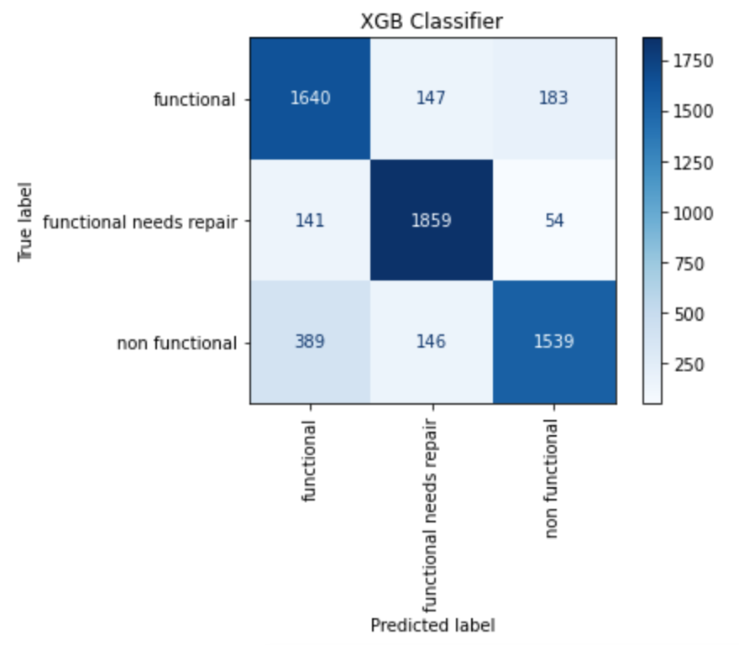
MODEL CHOSEN
XGBoost
Metric used:
Accuracy
Precision:

Slide 12
CONCLUSION
Improve data:
Quantify qualitative data to improve model
Remove fewer categories at the cost of processing time.
Consider regional factors: rainfall,climate.

Slide 13
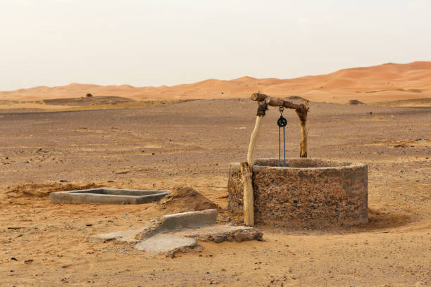
THANK YOU
Namita Rana
Email:namitarana21@gmail.com
Github:https://github.com/namitarana1

