Slide 1

House Prices - Advanced Regression Techniques Predict sales prices and practice feature engineering, RFs, and gradient boosting- EDA For House Price Data Set
Team Analytica
Shilpa Gupta
March 7 2023

Slide 2
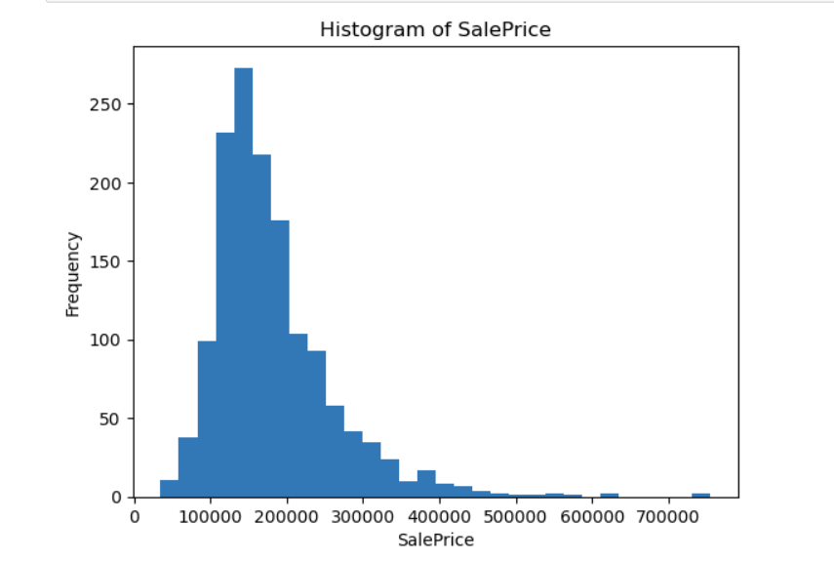
Target Variable Distribution
Histogram of the SalePrice variable, with the x-axis showing the range of prices and the y-axis showing the frequency of each price.
It appears that the distribution of prices is right-skewed, meaning there are more homes with lower prices and fewer homes with higher prices

Slide 3
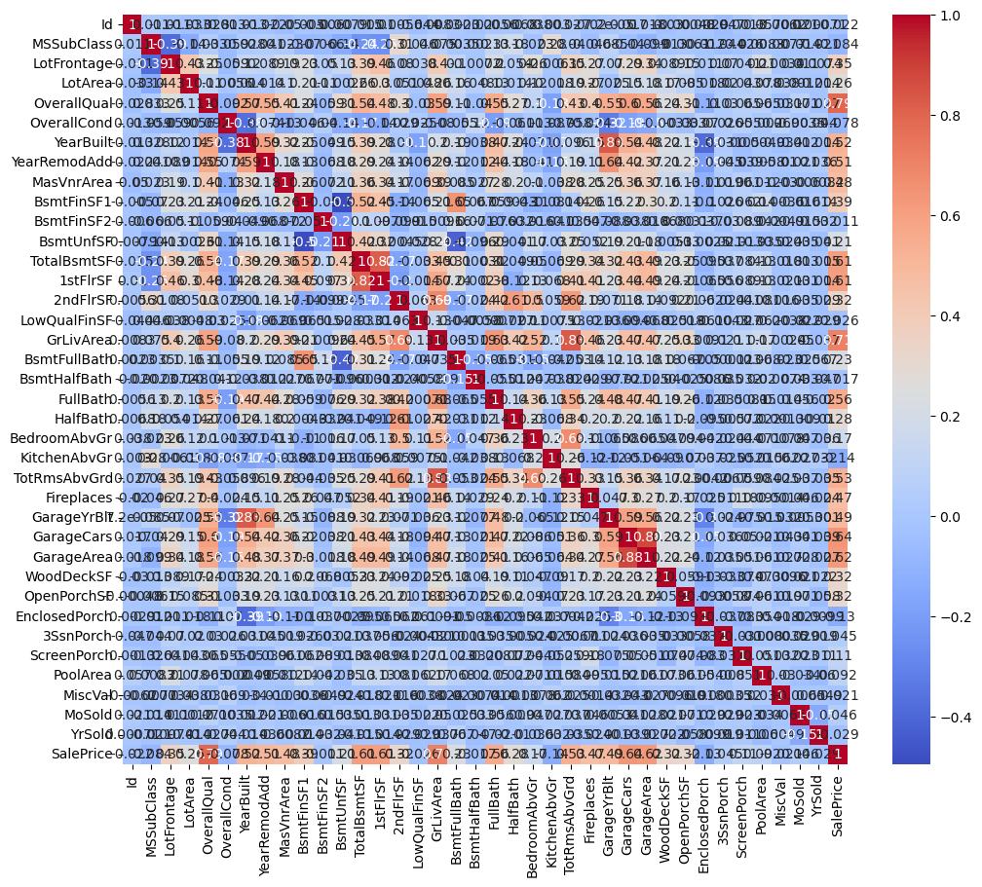
Correlation Matrix
Heatmap of the correlations between the SalePrice and the other features in the dataset.
The most important features that are strongly correlated with the target variable (SalePrice) are:
OverallQual
GrLivArea
GarageCars
GarageArea
TotalBsmtSF
1stFlrSF
These features have positive correlations with SalePrice, indicating that as these features increase, the sale price of the house is likely to increase as well.

Slide 4
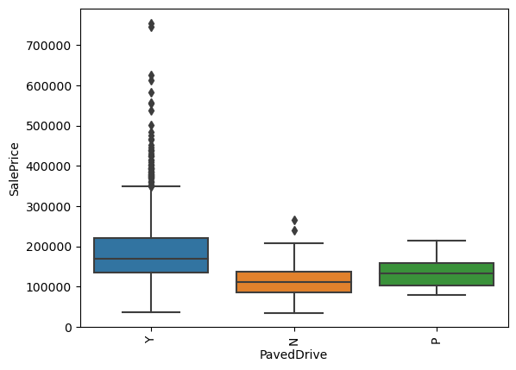
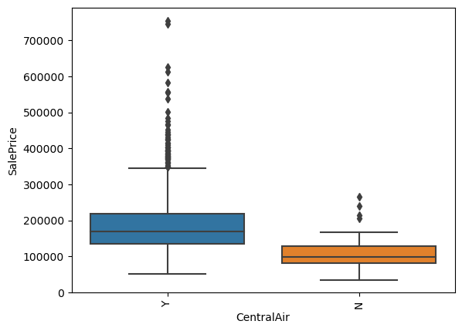
Box Plots
Box plots to visualize the distribution of the SalePrice for each category or group in categorical features
The median price of homes with a CentralAir conditioning system is higher than that of homes without it.
The median price of homes with a PavedDrive is higher than that of homes with a DirtDrive

Slide 5
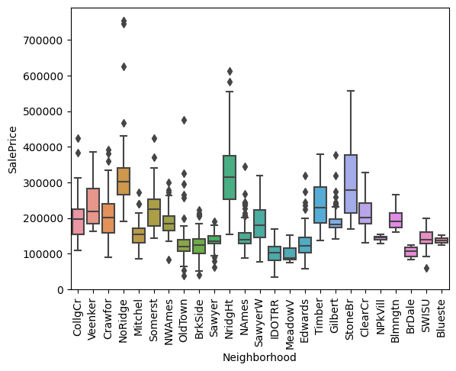
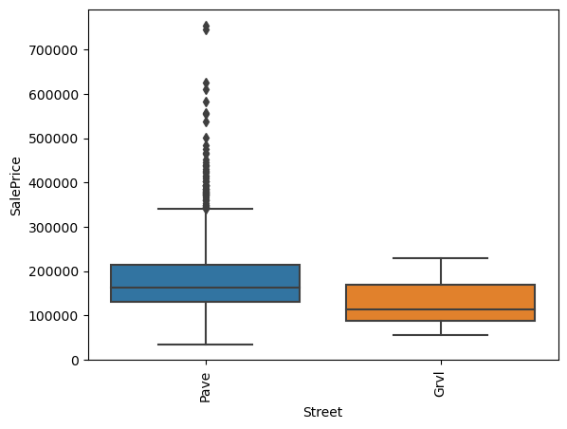
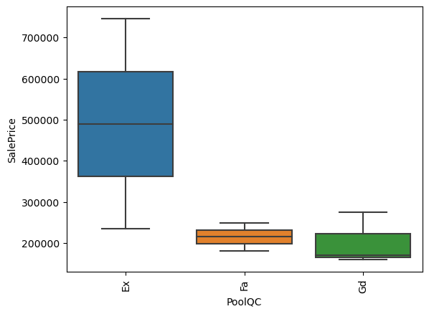
Box Plots Contd..
The median price of homes in neighborhoods such as NridgHt, NoRidge, StoneBr, and Veenker are generally higher than that of homes in other neighborhoods.
The median price of homes with a pool is higher than that of homes without a pool.
There are very few homes with a pool in the dataset, so this result may not be representative of the general population

Slide 6
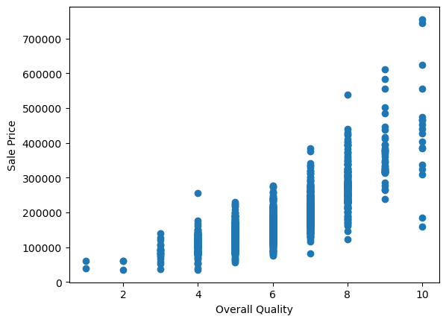
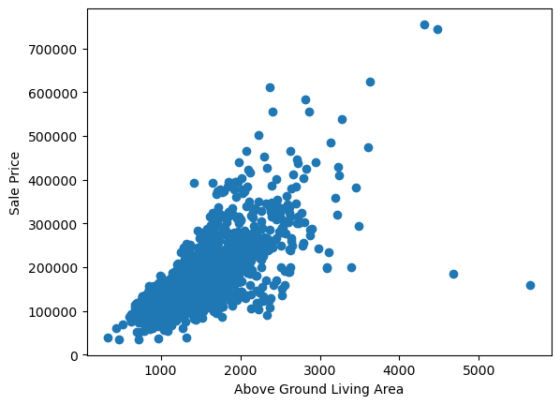
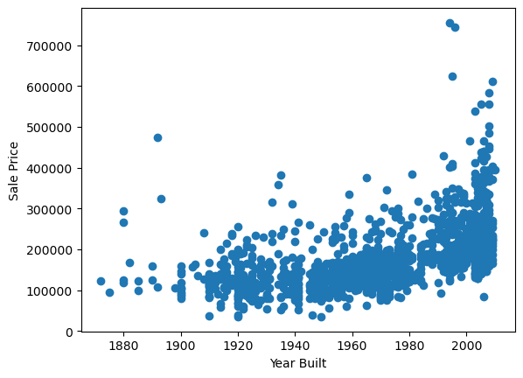
Scatter Plots
Scatter plots to visualize the relationship between the target variable (SalePrice) and the OverallQual, GrLivArea, and YearBuilt features
Linear patterns between the SalePrice and features such as the living area, number of bedrooms, number of bathrooms, and overall quality.
Non-linear patterns between the target variable and features such as the year built and the year remodeled.
Outliners /anomalies in some of the scatter plots, such as the extremely high-priced homes with large living areas, and the low-priced homes with high numbers of bedrooms and bathrooms.

Slide 7
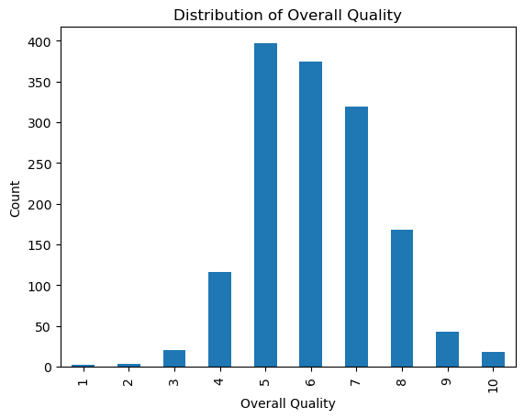
Bar Plot
We can see that the majority of the houses have an overall quality rating of 5, 6, or 7.
The number of houses with ratings above 7 gradually decreases, while the number of houses with ratings below 5 is very small.

Slide 8
Summary
The dataset contains information about 1460 houses with 81 features, including the target variable SalePrice.
The target variable SalePrice ranges from $34,900 to $755,000 with a mean value of $180,921 and a median value of $163,000.
The distribution of SalePrice is positively skewed with a long tail to the right, indicating that there are a few very expensive houses in the dataset.
OverallQual, GrLivArea, GarageCars, GarageArea, TotalBsmtSF, 1stFlrSF, and FullBath are the features that are most strongly correlated with the target variable SalePrice.
There are several categorical features in the dataset, including MSZoning, Street, LotShape, LandContour, Utilities, LotConfig, Neighborhood, Condition1, Condition2, BldgType, HouseStyle, RoofStyle, RoofMatl, Exterior1st, Exterior2nd, MasVnrType, ExterQual, ExterCond, Foundation, BsmtQual, BsmtCond, BsmtExposure, BsmtFinType1, BsmtFinType2, Heating, HeatingQC, CentralAir, Electrical, KitchenQual, Functional, FireplaceQu, GarageType, GarageFinish, GarageQual, GarageCond, PavedDrive, SaleType, and SaleCondition.
The most common MSZoning is RL (Residential Low Density), followed by RM (Residential Medium Density), FV (Floating Village Residential), RH (Residential High Density), and C (Commercial).
The most common Neighborhood is NAmes (North Ames), followed by CollgCr (College Creek), OldTown (Old Town), Edwards, and Somerst (Somerset).
The most common BldgType is 1Fam (Single-family Detached), followed by TwnhsE (Townhouse End Unit), Duplex, Twnhs (Townhouse Inside Unit), and 2fmCon (Two-family Conversion).
The most common HouseStyle is 1Story (One story), followed by 2Story (Two story), 1.5Fin (One and one-half story: 2nd level finished), SLvl (Split Level), and SFoyer (Split Foyer).
The most common SaleCondition is Normal, followed by Partial, Abnorml (Abnormal Sale), Family, and Alloca (Allocation).
OverallQual, FullBath, and TotRmsAbvGrd are the categorical features that have the strongest impact on SalePrice.
There are some outliers and anomalies in the data, including houses with very large GrLivArea but relatively low SalePrice, and houses with very high SalePrice but relatively low OverallQual or GrLivArea.
There are also some missing values in the dataset, especially in the features related to basement and garage, which may need to be imputed or dropped depending on the analysis.

