Slide 1
W
WorkHub Platform
Team Workflow & Event Operations
Management System
A Full-Stack MERN Collaborative Work Management Platform for Enterprise Event Portfolios, Departments & Operations
DELIVERABLE
TECH STACK
DATABASE
ARCHITECTURE
Final Capstone Project
MERN Stack (Zero AI)
MongoDB Atlas & Local DB
Org → Workspace → Team → Room

Slide 2
PROJECT OVERVIEW
Executive Summary & Project Scope
WorkHub is an integrated, collaborative operations management platform built to coordinate large-scale events, department workflows, and cross-functional teams from initial concept to completion.
The Real-World Scenario
True Collaborative Focus
Zero AI / Strict Determinism
Institutions organizing mega events (e.g. Vignan Mahotsav 2027 with 15,000+ participants) require seamless synergy across 10+ teams: Logistics, Stage AV, Sponsorship, PR, and Hospitality.
Moves beyond single-user to-do lists. WorkHub provides real collaborative rooms, departmental standups, synchronized master calendars, and multi-collaborator review pipelines.
Engineered as deterministic, production-grade enterprise software with strict 5-tier RBAC, audit trails, and data isolation between workspaces and rooms.
WorkHub – Collaborative Team Workflow & Operations Platform
Final Capstone Submission

Slide 3
NEED FOR WORKHUB
Problem Statement: Challenges in Modern Event & Work Operations
01
Fragmented Communication Channels
02
Lack of Hierarchical Visibility
Teams rely on unstructured WhatsApp groups, disconnected emails, and loose notes, causing critical deadlines and responsibilities to fall through the cracks.
Event coordinators and workspace managers cannot see department progress, room task bottlenecks, or overdue deliverables without manual, tedious daily check-ins.
03
Static, Dead-End Spreadsheets
04
Rigid Member Onboarding
Traditional Excel/Google sheets lack real-time accountability, status workflows, subtask checkpoint tracking, and live audit trails for approvals.
Existing systems either expose global data or force rigid administrative manual account creation rather than flexible invite links, unique IDs, and request workflows.
WorkHub – Collaborative Team Workflow & Operations Platform
Final Capstone Submission

Slide 4
SYSTEM INNOVATION
Proposed Solution: The WorkHub Operations Engine
Structured 4-Tier Hierarchy
Streamlined Collaboration
Accountability & Daily Sync
Flexible Member Access
• Organization level governance
• Multi-collaborator assigned tasks
• Daily planner (Today WIP & Tomorrow Plan)
• Shareable workspace invite links
• Independent workspace portfolios
• Drag & drop Kanban board pipeline
• Department daily update inspection
• Direct add by Unique Member ID (WH-XXXXXX)
• Department / Team operational squads
• Leader review and change request cycles
• Workspace-wide blocker triage table
• Directory search & join request approval
• Isolated rooms for specific execution channels
• Live comments and suggestion triage
• FullCalendar multi-level aggregation
• Fine-grained 5-tier RBAC authorization
WorkHub – Collaborative Team Workflow & Operations Platform
Final Capstone Submission

Slide 5
ARCHITECTURE
Core Application Hierarchy: Organization → Workspace → Team → Room
LEVEL 1: ORGANIZATION
Multi-tenant foundation hosting global policies, organization settings, executive leaders, and multiple concurrent workspaces.
Top-Level Entity (e.g. Vignan University)
GLOBAL GOVERNANCE
LEVEL 2: WORKSPACE
Self-contained project environment containing master event calendars, overall progress metrics, announcements, and department standup summaries.
Event Portfolio (e.g. Vignan Mahotsav 2027)
PROJECT / EVENT SCOPE
LEVEL 3: TEAM / DEPARTMENT
Autonomous departmental units with assigned Team Leaders, mandate checklists, department schedules, discussion forums, and daily updates inspection.
Functional Squad (e.g. PR, Tech Team, Logistics)
DEPARTMENTAL UNIT
LEVEL 4: ROOM / CHANNEL
Focused working spaces with Kanban boards, multi-assignee task workflows, subtask checkpoints, milestones, room discussions, and activity history.
Execution Area (e.g. Stage Sound & Lighting)
EXECUTION CELL
WorkHub – Collaborative Team Workflow & Operations Platform
Final Capstone Submission

Slide 6
SECURITY & GOVERNANCE
5-Tier Role-Based Access Control (RBAC) System
Organization Owner
Enterprise
Total governance, organization provisioning, org settings, archive/delete workspaces.
Organization Admin
Organization
Create workspaces, invite organization members, assign managers, access all event portfolios.
Workspace Manager
Workspace
Create teams/departments, post announcements, review all-teams daily standups, approve join requests.
Team Leader
Department
Create collaborative rooms, allocate room members, review member daily updates & team suggestions.
Team Member
Room
Execute assigned tasks, complete subtask checkpoints, submit review requests, post daily plans.
WorkHub – Collaborative Team Workflow & Operations Platform
Final Capstone Submission

Slide 7
TECHNICAL FOUNDATION
MERN Technology Stack Specification (Zero AI)
FRONTEND
BACKEND
DATABASE
REAL-TIME
React 18 + Vite 6
Node.js + Express.js
MongoDB + Mongoose 8.x
Socket.IO Engine
Single-page application with component architecture, fast HMR bundling, and production asset optimization.
RESTful API server with modular controllers, centralized error handling, and robust middleware stack.
Document-oriented database with normalized collections, indexed schemas, and relational references.
Bi-directional WebSocket communication for real-time room status updates and notifications.
CORE LIBRARIES
CORE LIBRARIES
CORE LIBRARIES
CORE LIBRARIES
Tailwind CSS, TanStack Query v5, FullCalendar, Recharts, Lucide React, Axios
Zod validation schemas, JWT, bcryptjs, Helmet, Cookie-Parser, Morgan logging
Local MongoDB daemon + MongoDB Atlas cloud cluster support with failover
Room-scoped broadcasts, real-time sync status indicators in Header
WorkHub – Collaborative Team Workflow & Operations Platform
Final Capstone Submission

Slide 8
SYSTEM ARCHITECTURE
Full-Stack System Architecture & Data Flow
Client Layer (Browser)
API & Gateway Layer
Data & Storage Layer
React 18 SPA + Vite
Node.js + Express.js
MongoDB & Cloudinary
AuthContext & SocketContext
JWT Authentication & Cookies
17 Normalized Mongoose Models
TanStack Query Server State Cache
5-Tier RBAC Middleware Guard
Unique Member & Invite Code Hooks
REST / JSON
& WSS ➔
Mongoose
Driver ➔
Protected App / Workspace Layouts
Zod Request Body Schema Validators
MongoDB Atlas Cloud Cluster
FullCalendar & Recharts Renderers
15 Modular REST Domain Controllers
Local MongoDB Failover Support
Axios Interceptors with Credentials
Socket.IO Event Dispatcher
Audit Trail & Activity Logs
WorkHub – Collaborative Team Workflow & Operations Platform
Final Capstone Submission

Slide 9
DATA ARCHITECTURE
Database Design: 17 Normalized Collections & References
Users
Schedules
name, email, memberId (WH-XXXXXX), password, role, title, avatarUrl
workspaceId, teamId, roomId, title, startTime, endTime, type, attendees
Organizations
DailyPlans
name, slug, logoUrl, createdBy
userId, teamId, date, accomplishments, inProgress, tomorrowPlan, blockers
Workspaces
Approvals
organizationId, name, slug, inviteCode (INV-XXXXXX), managers, status
taskId, workspaceId, submittedBy, reviewer, status (APPROVED/CHANGES)
Teams
WorkspaceJoinRequests
workspaceId, organizationId, name, slug, leader, members, responsibilities
workspaceId, userId, status (PENDING/APPROVED/REJECTED), message
Rooms
Announcements
workspaceId, teamId, name, slug, leader, members, status
workspaceId, teamId, title, content, priority (URGENT/NORMAL), author
Tasks
ActivityLogs
roomId, workspaceId, title, assignees, status (5 tiers), priority, checkpoints
organizationId, workspaceId, actor, action, entityType, entityId
WorkHub – Collaborative Team Workflow & Operations Platform
Final Capstone Submission

Slide 10
MEMBER ADMISSION
Innovative Collaborative Onboarding Workflows
METHOD 1
METHOD 2
METHOD 3
Shareable Invite Link
Direct Add by Unique ID
Explore, Search & Join
/join-workspace/:codeOrId
Member ID: WH-XXXXXX
Discovery Directory
Workspace owners share a clean invitation link with an invite code (e.g. MAHOTSAV27). Visitors view the event brief and managers, and send a request to join.
Every registered user has an indexed, unique Member ID. Workspace owners can immediately add users by their ID or email without invitation link dependency.
Members search active workspaces by title, category, or code. Live status badges indicate membership, pending status, or one-click request submission.
Benefit:
Fast viral distribution across student & faculty bodies
Benefit:
Instant addition with automatic organization enrollment
Benefit:
Self-service discovery with manager approval gatekeeping
WorkHub – Collaborative Team Workflow & Operations Platform
Final Capstone Submission

Slide 11
WORKFLOW PIPELINE
Task Review & Approval Lifecycle
1. TO DO
2. IN PROGRESS
3. UNDER REVIEW
4. EVALUATION
5. COMPLETED
Task Allocation
Work Execution
Approval Submission
Leader Decision
Audit Log & KPI
Manager or lead creates task, sets assignees, checkpoints, priority, and deadline.
Collaborators execute deliverables, check off subtask items, and post work progress.
Assignee submits task for review with delivery notes and verification attachments.
Leader reviews submission: Approves to Completed or Requests Changes with feedback.
Task verified, activity audit logged, workspace & room velocity metrics updated.
WorkHub – Collaborative Team Workflow & Operations Platform
Final Capstone Submission

Slide 12
OPERATIONAL SYNC
Daily Work Planner, Standups & Future Planning
Individual Contributor View
Department Leader Inspection
Executive Manager Oversight
Daily Planner (/daily-planner)
Team Standups (/teams/:id/daily-updates)
All-Teams Summary (/workspaces/:id/daily-standups)
• Record today’s completed milestones
• Filter standups by team member and date
• Comprehensive cross-department status matrix
• Detail current work-in-progress tasks
• Track individual accomplishment logs
• Total submission compliance count
• Draft tomorrow’s prioritized work plan
• Identify bottlenecks and delayed tasks
• Critical blocker triage table across teams
• Flag operational blockers and dependencies
• Propose course corrections in team discussions
• Live export and report generation
WorkHub – Collaborative Team Workflow & Operations Platform
Final Capstone Submission

Slide 13
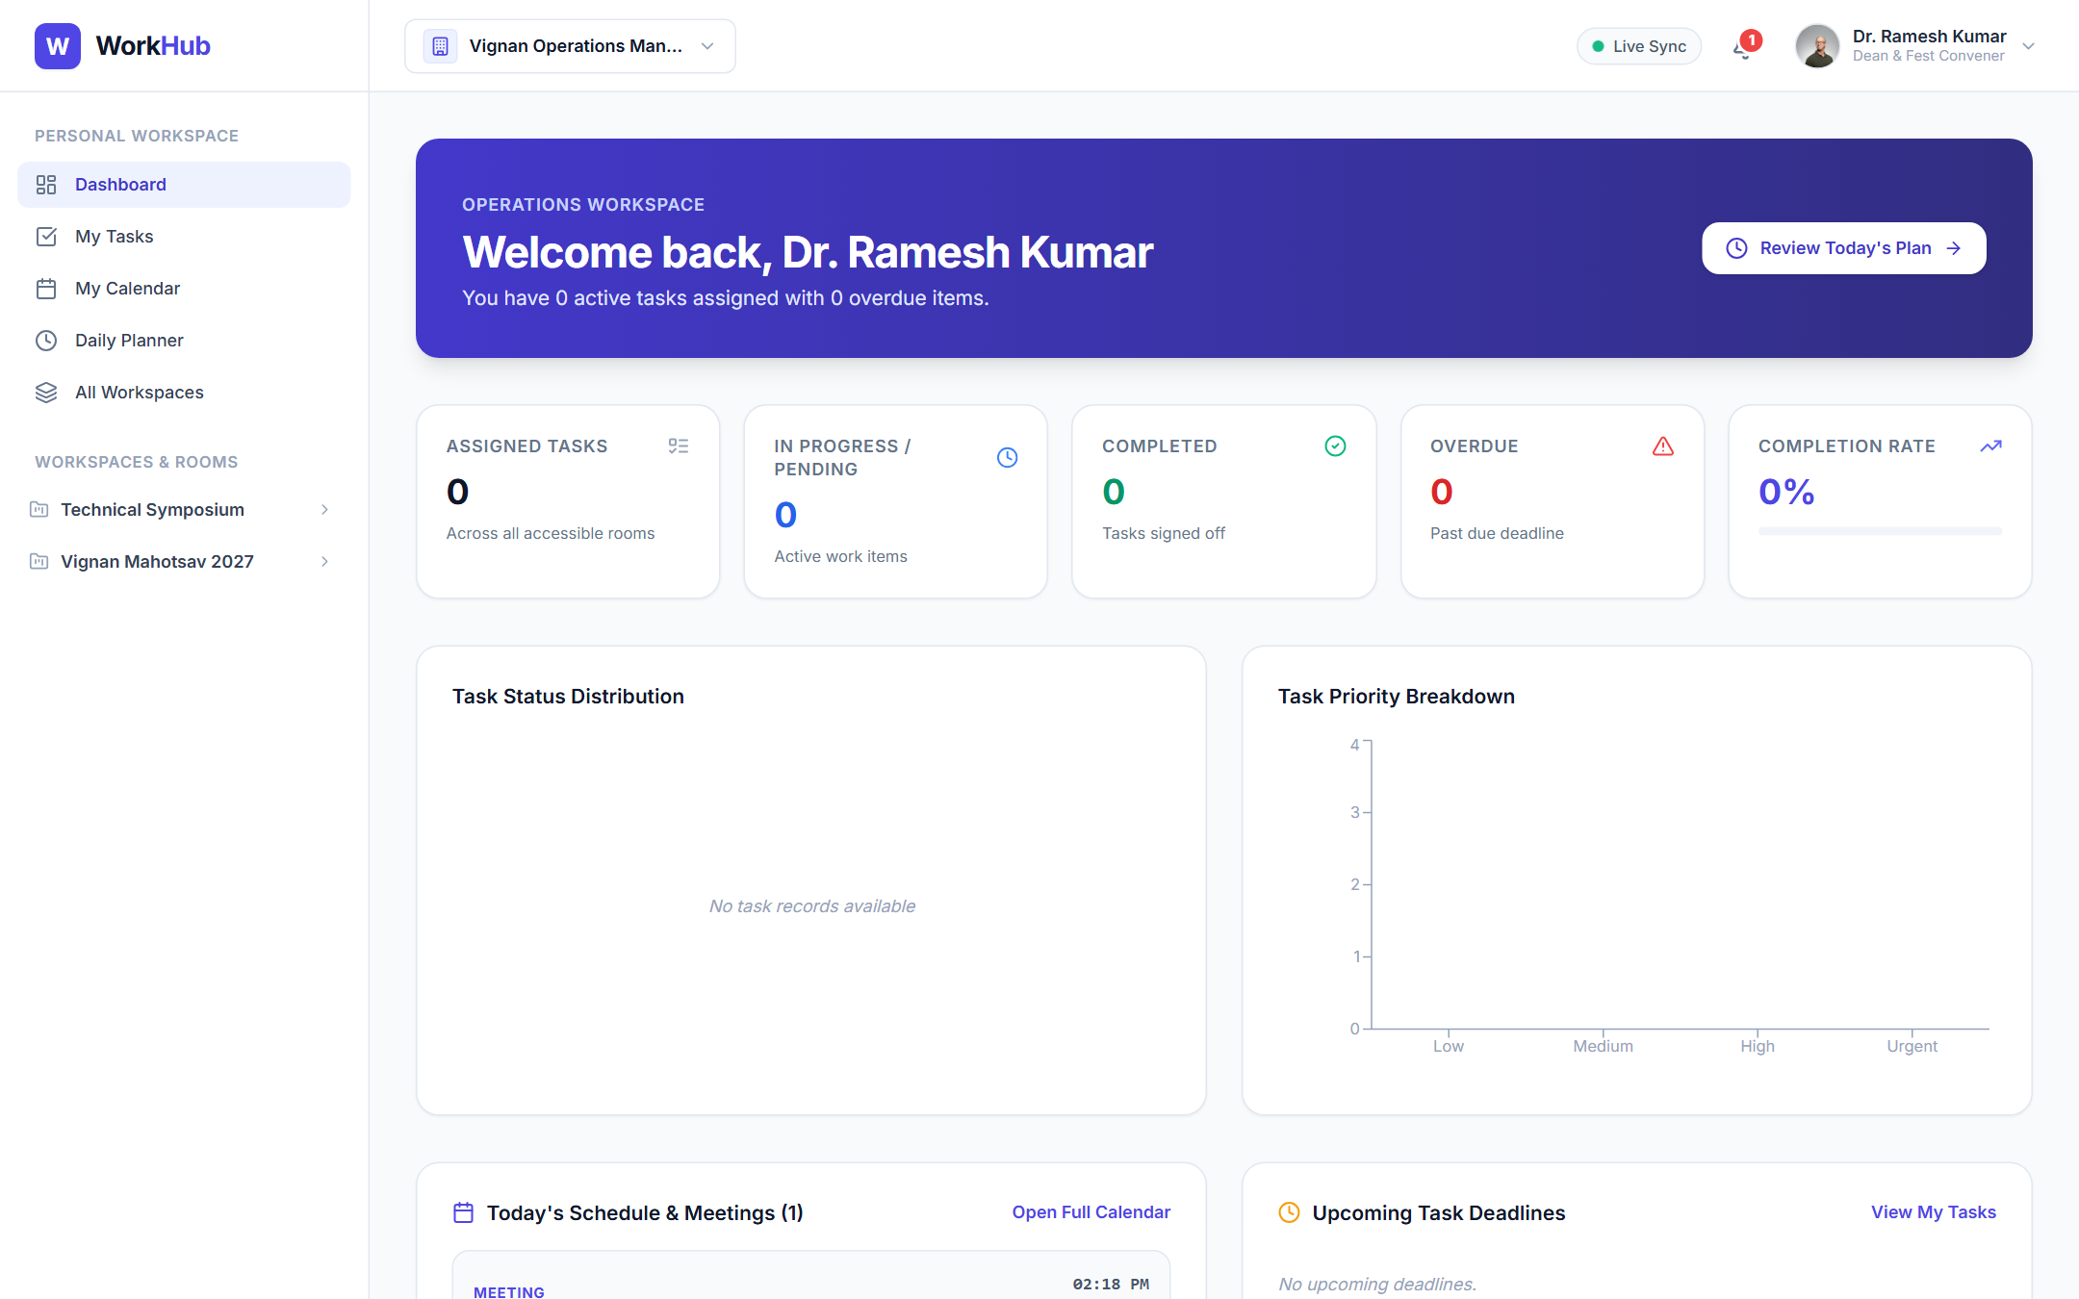
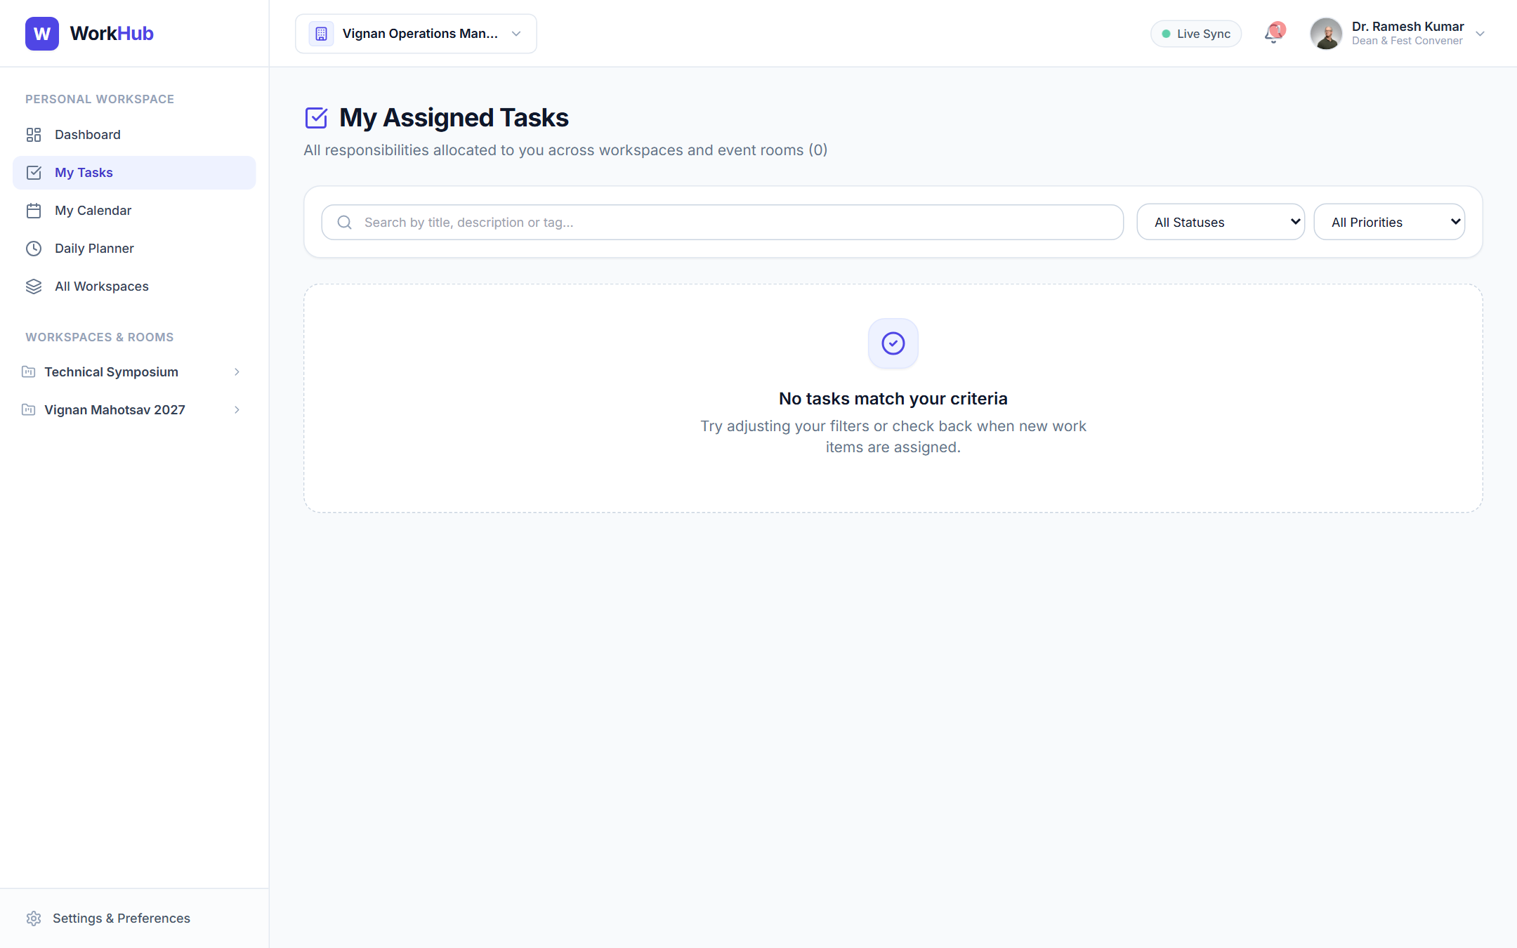
ACTUAL IMPLEMENTATION
Application Showcase: Executive Dashboard & Task Hub
Figure 1: Personal Dashboard with Recharts KPI Visualizers & Recent Activity
Figure 2: Unified Cross-Workspace Task Responsibility List
WorkHub – Collaborative Team Workflow & Operations Platform
Final Capstone Submission

Slide 14
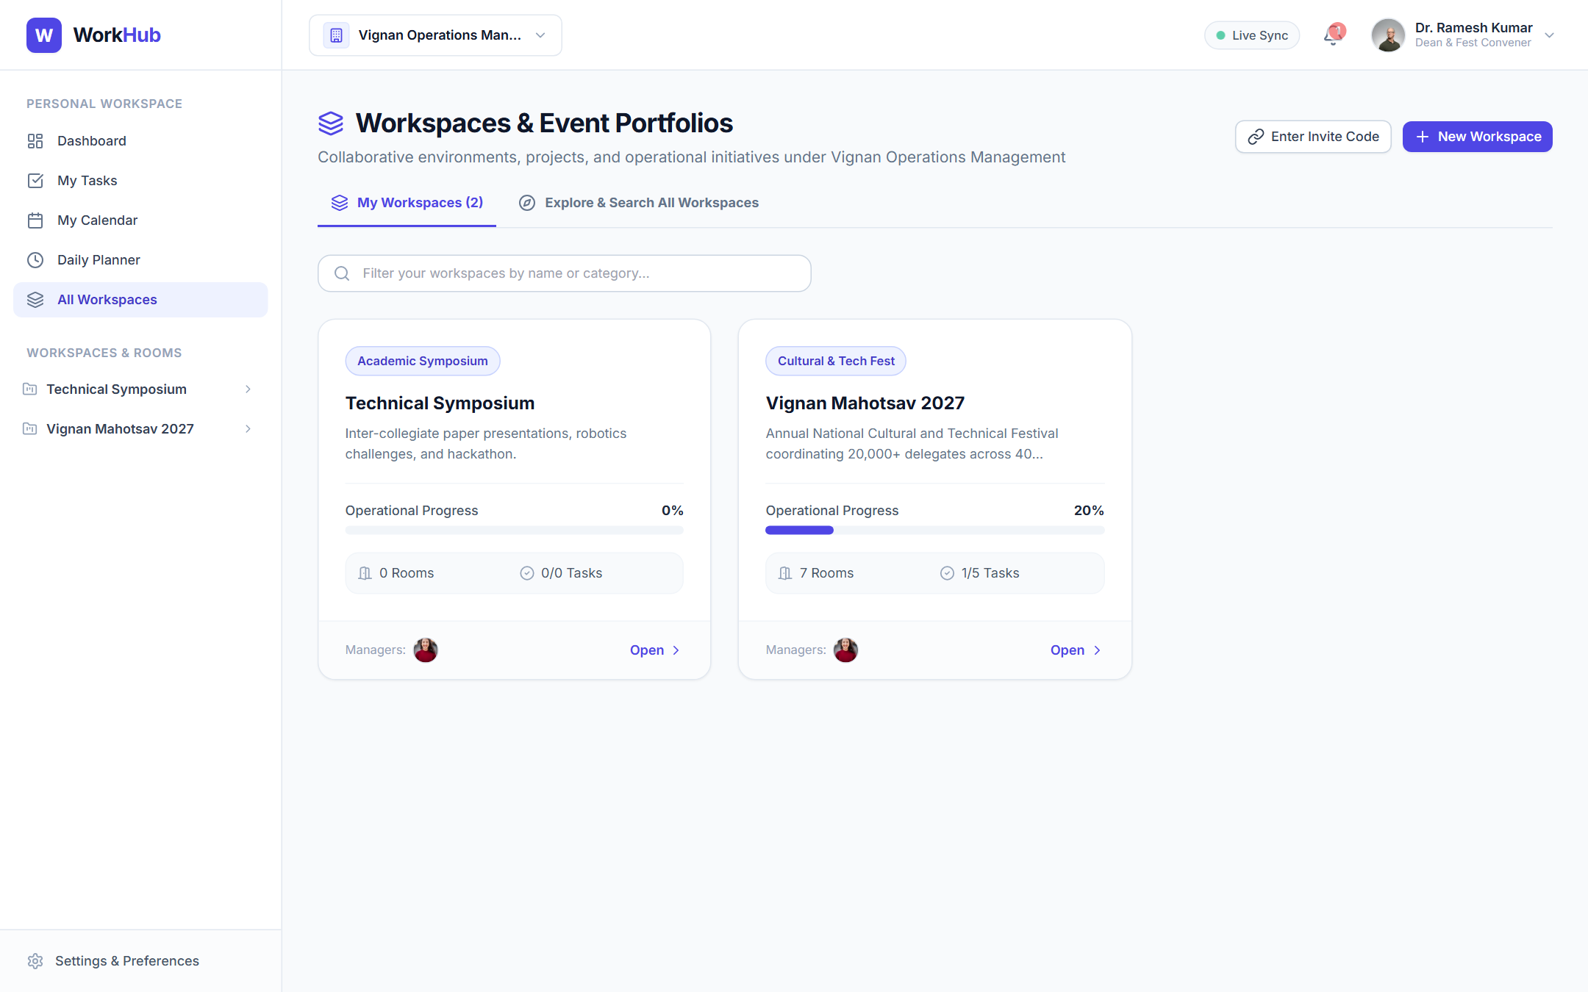
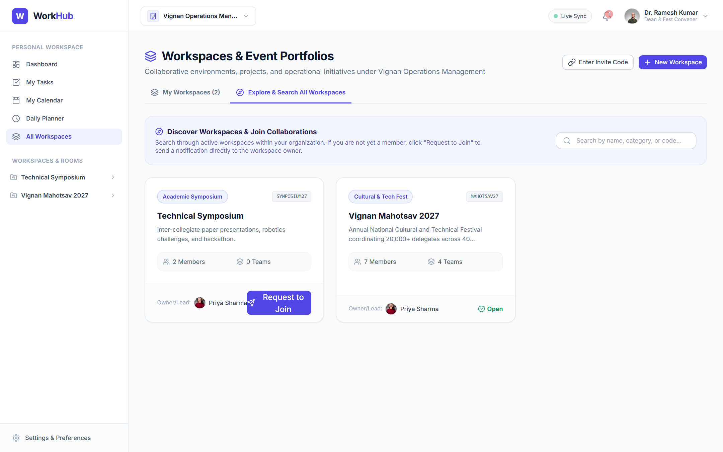
ACTUAL IMPLEMENTATION
Application Showcase: Workspaces & Onboarding Discovery
Figure 3: Active Workspaces Directory (Portfolio & Progress Cards)
Figure 4: Explore & Search Workspaces with Live Join Request Triggers
WorkHub – Collaborative Team Workflow & Operations Platform
Final Capstone Submission

Slide 15
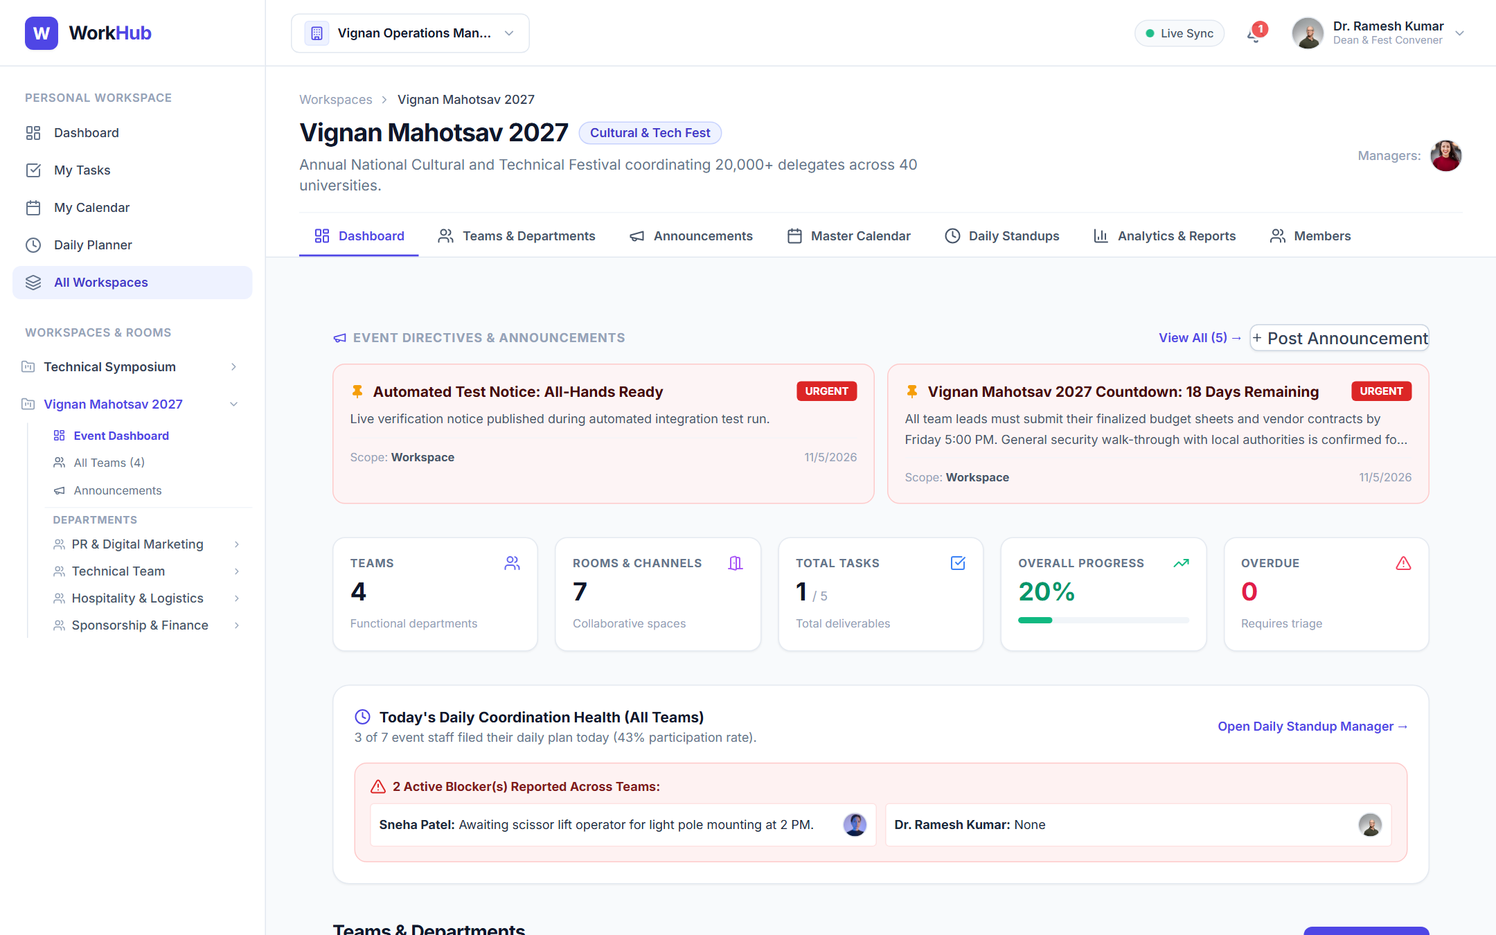
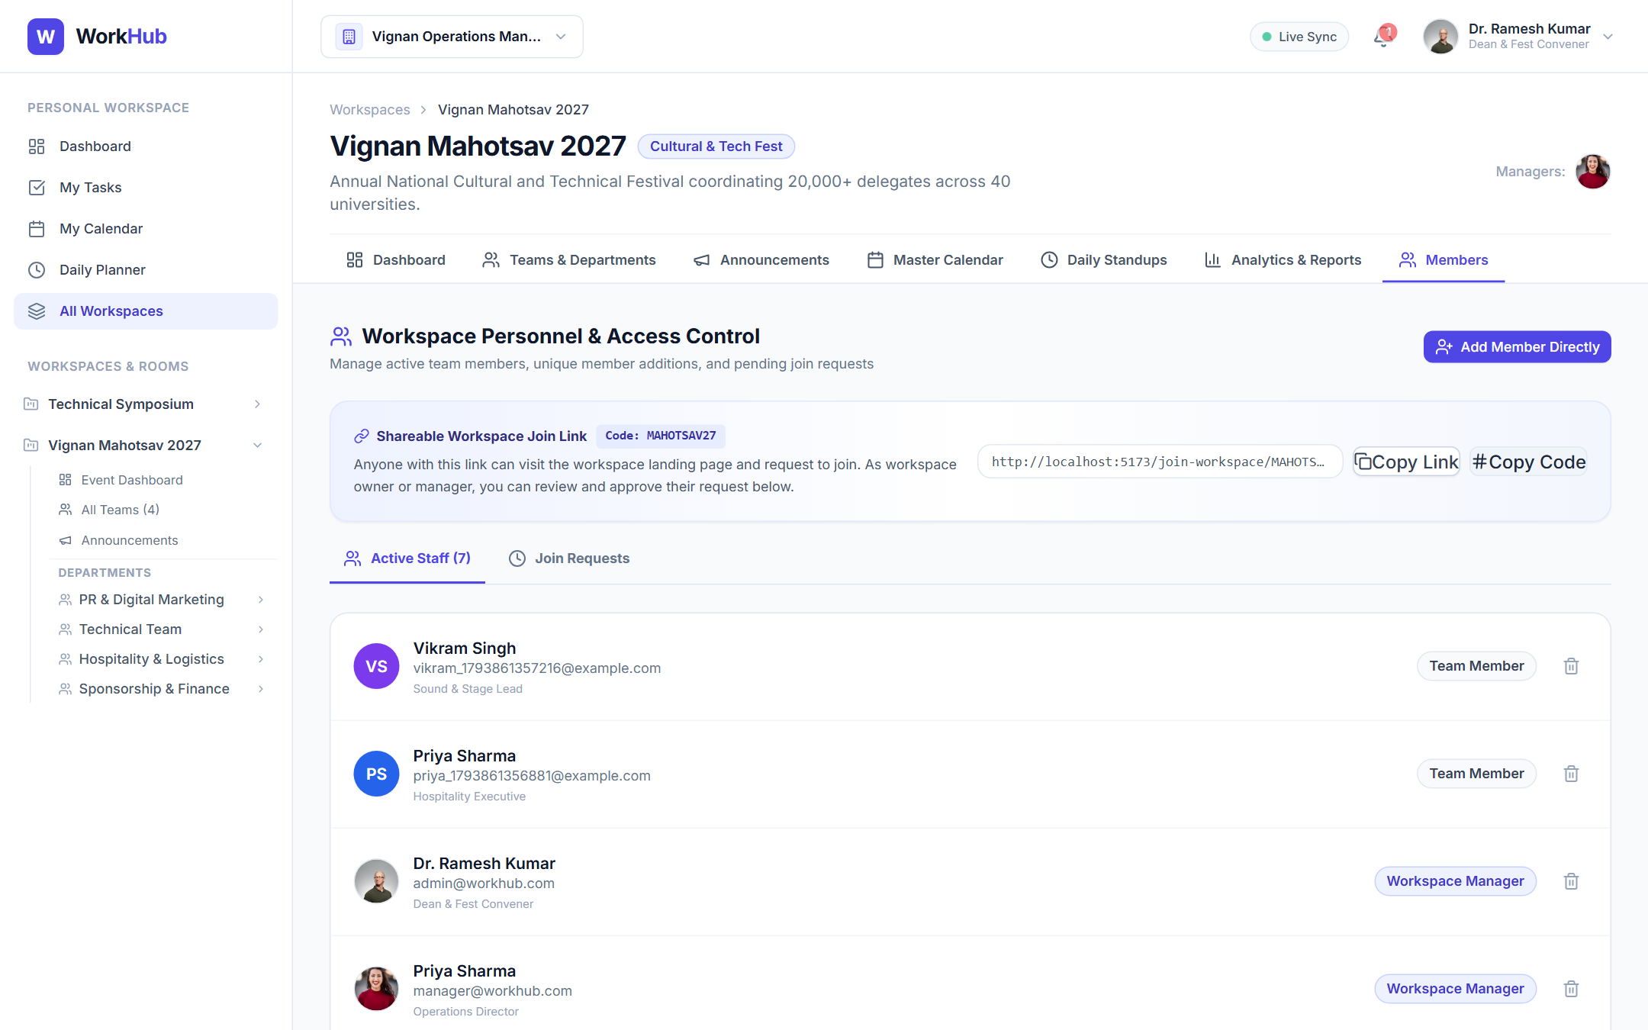
ACTUAL IMPLEMENTATION
Application Showcase: Event Operations & Personnel Management
Figure 5: Workspace Overview (Event KPIs, Quick Navigation & Activity)
Figure 6: Shareable Workspace Join Link & Staff Management Hub
WorkHub – Collaborative Team Workflow & Operations Platform
Final Capstone Submission

Slide 16
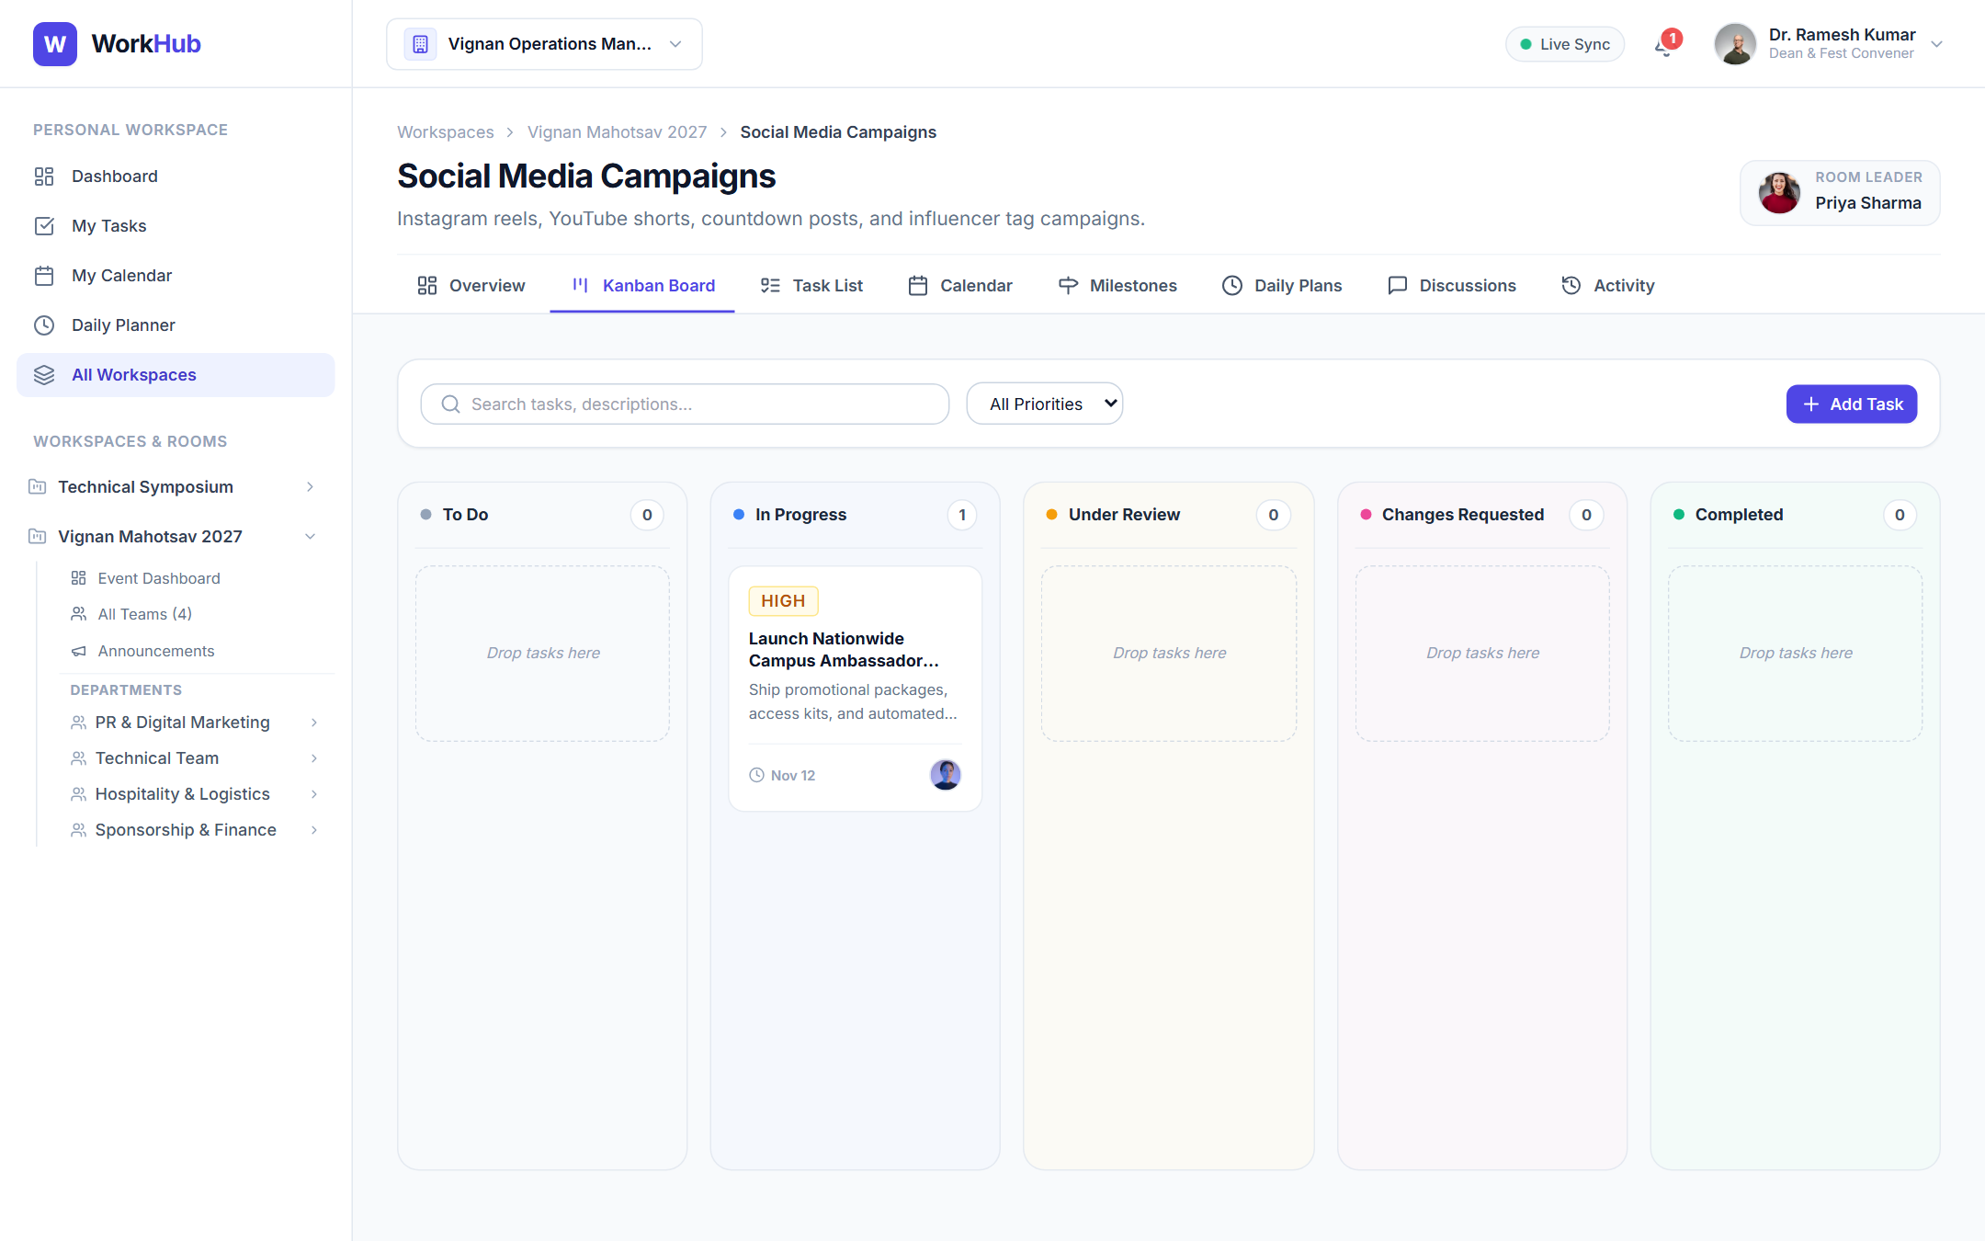
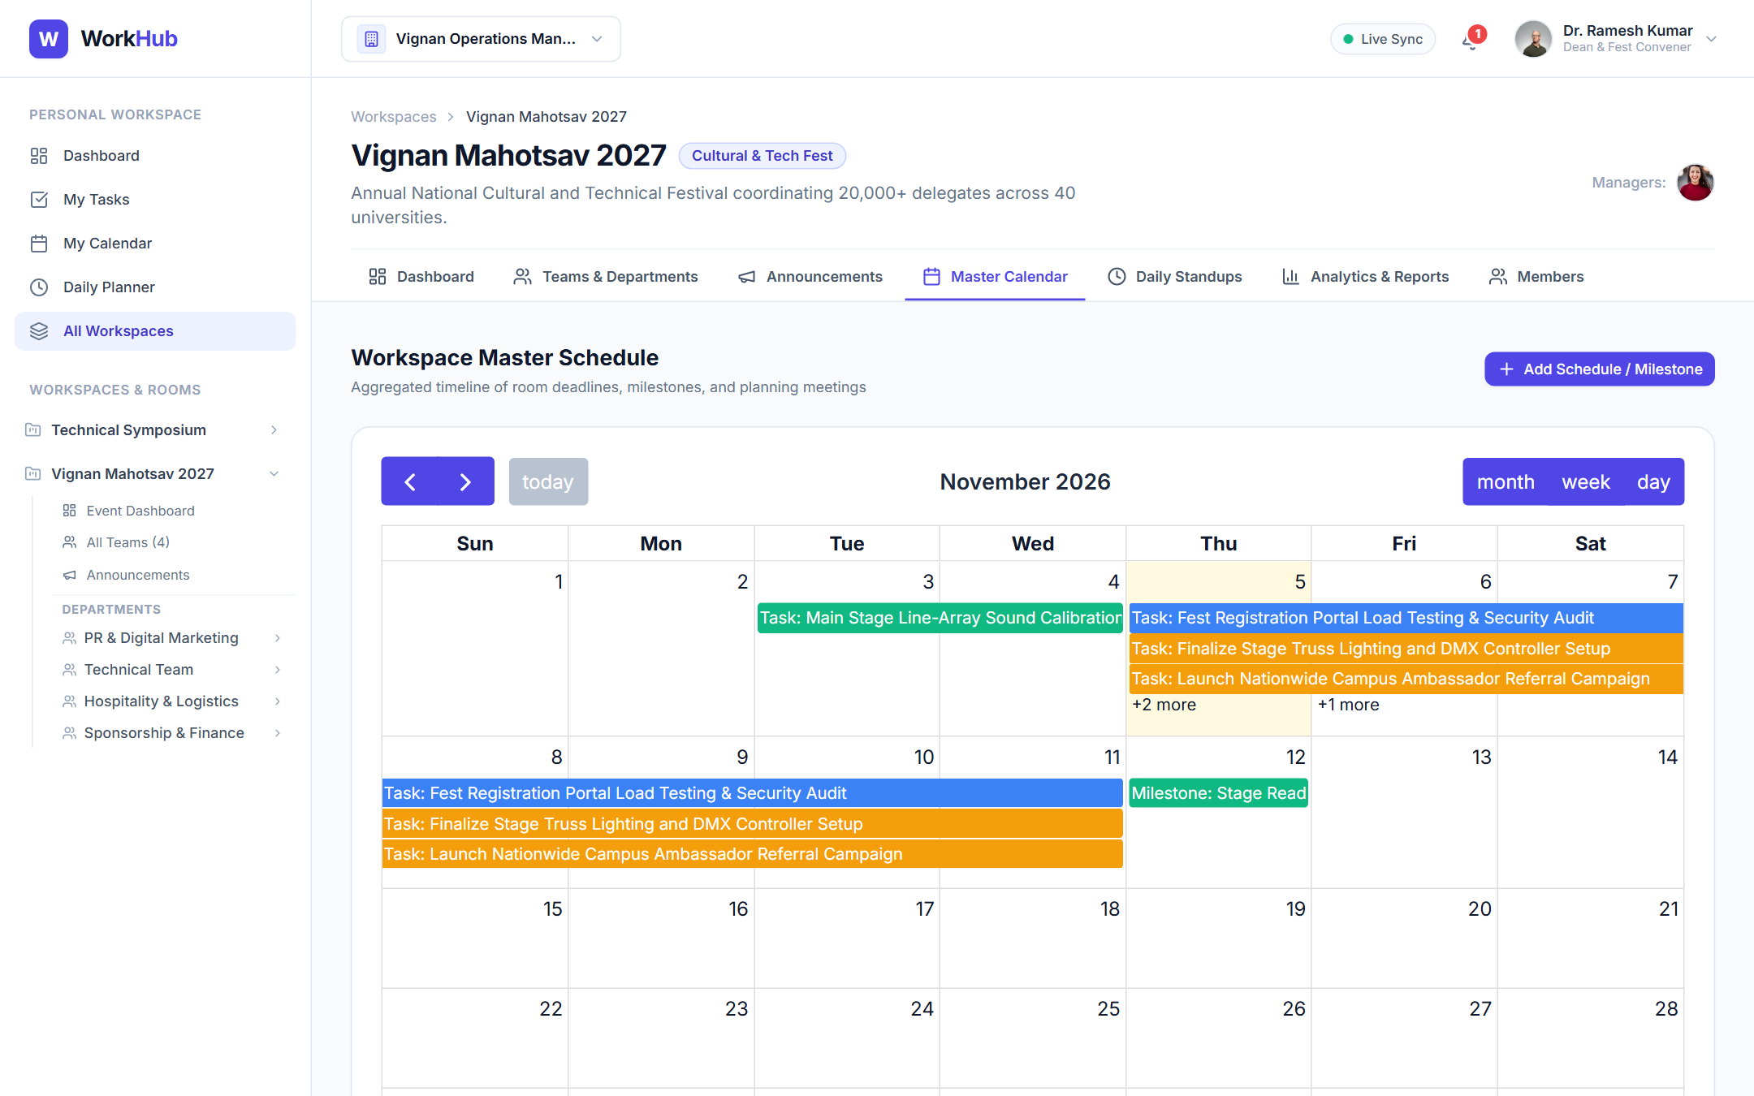
ACTUAL IMPLEMENTATION
Application Showcase: Collaborative Kanban Board & Master Calendar
Figure 7: Room Kanban Board with Multi-Collaborators & Subtask Badges
Figure 8: Master Event Calendar with Task Deadlines & Meeting Agendas
WorkHub – Collaborative Team Workflow & Operations Platform
Final Capstone Submission

Slide 17
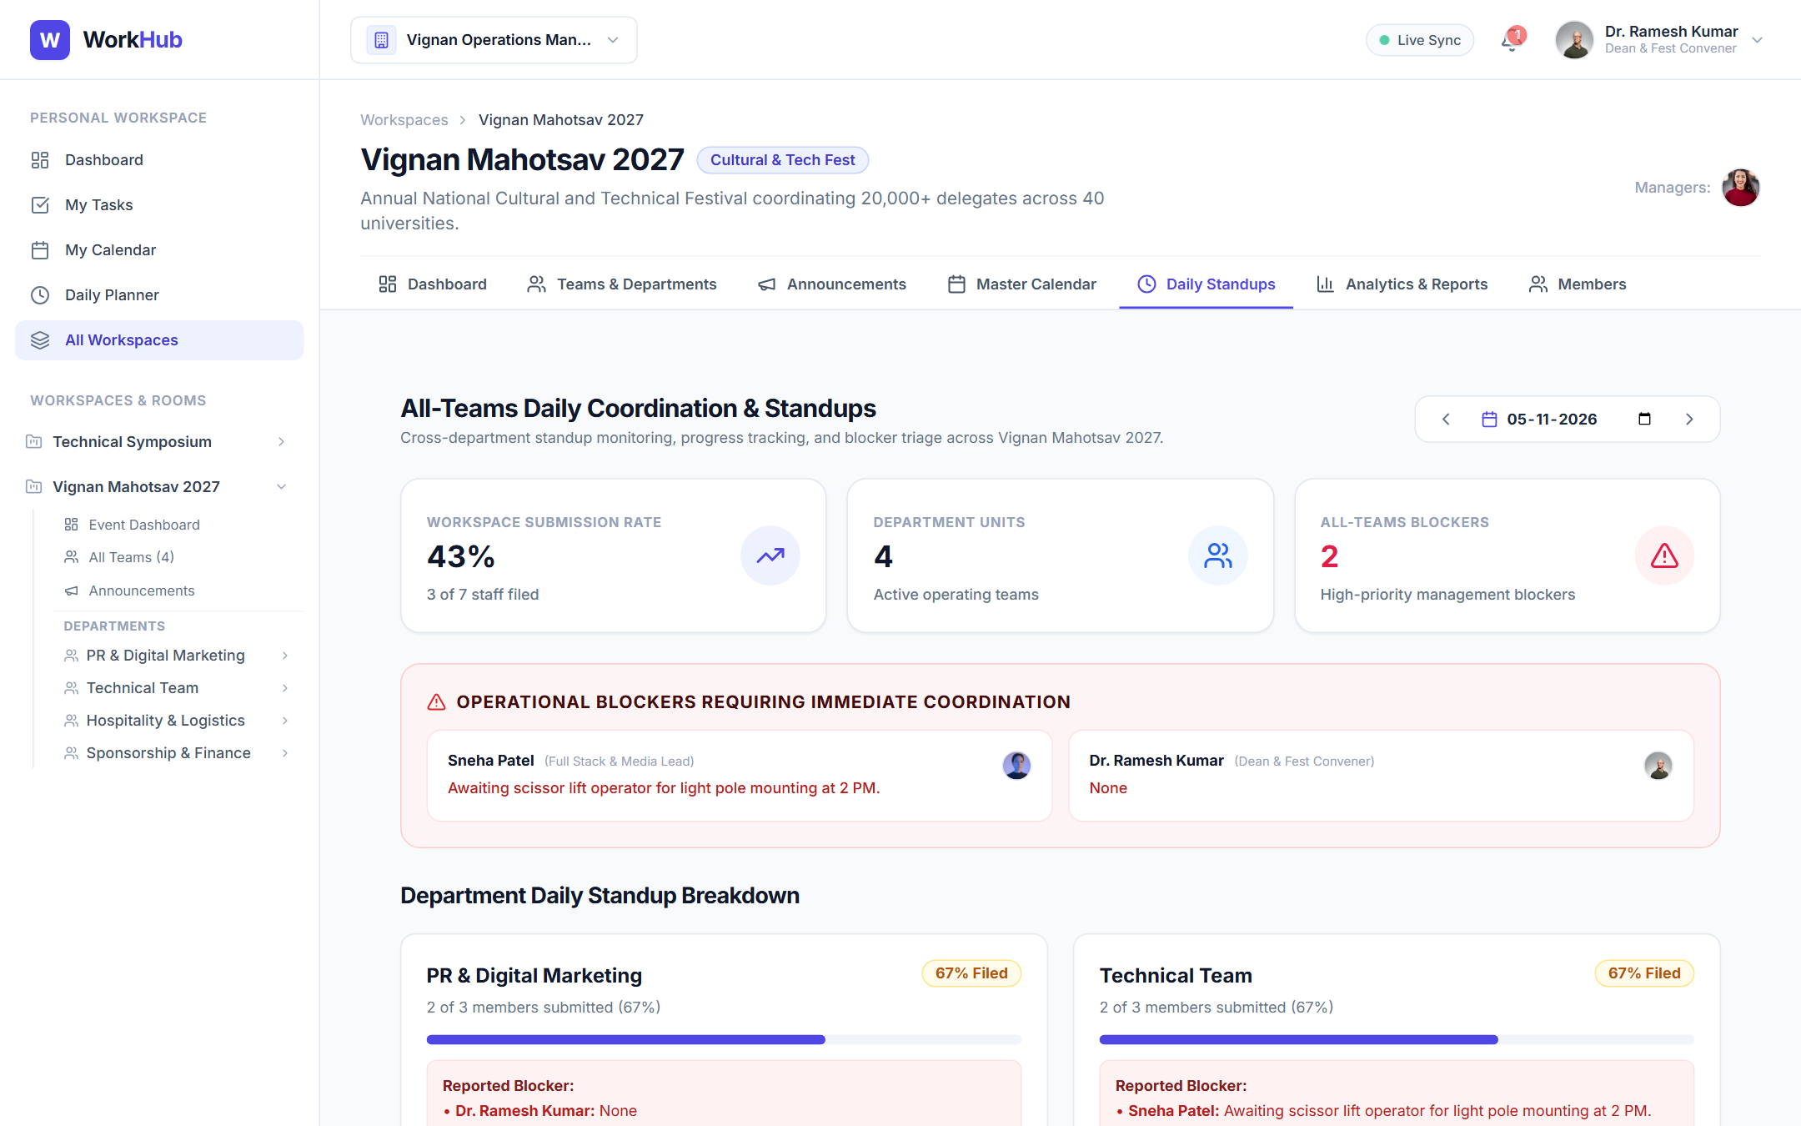
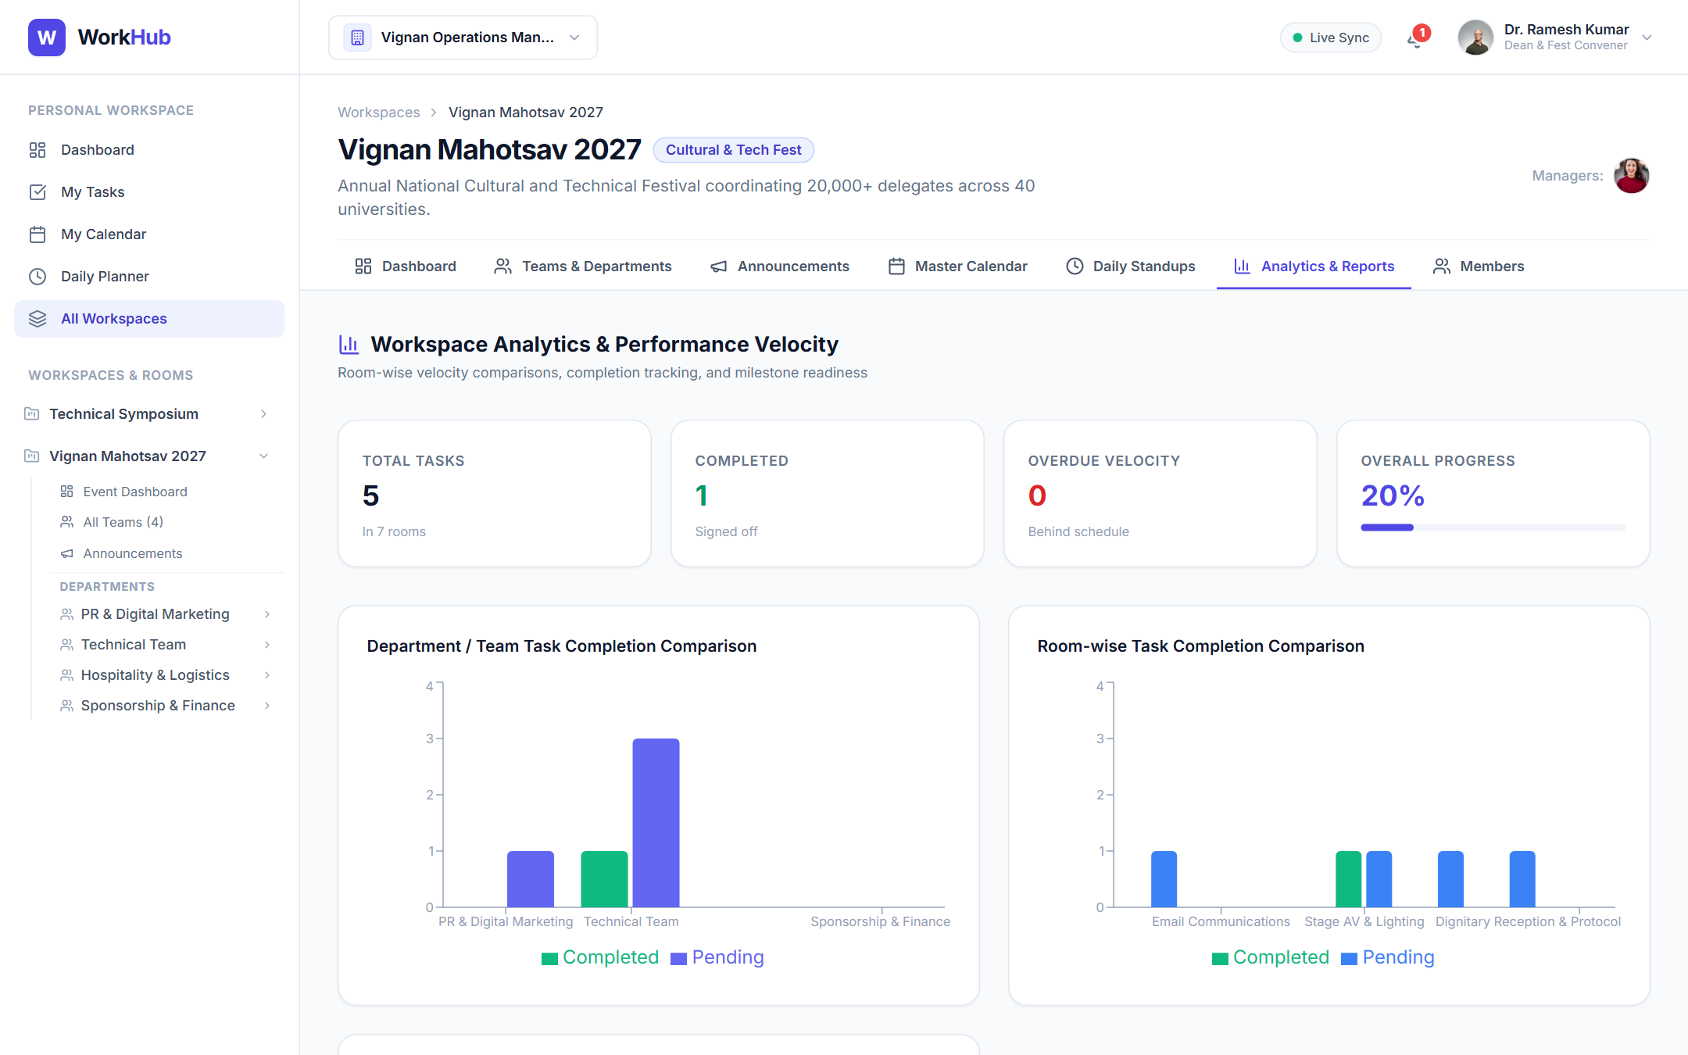
ACTUAL IMPLEMENTATION
Application Showcase: Standups & Operational Intelligence
Figure 9: All-Teams Consolidated Daily Standup & Blocker Matrix
Figure 10: Operational Reports, Milestone Burndown & Team Velocity
WorkHub – Collaborative Team Workflow & Operations Platform
Final Capstone Submission

Slide 18
QUALITY ASSURANCE
Automated Test Verification: 20/20 Test Suites Passing (100%)
TOTAL TESTS
TESTS PASSED
FAILED / SKIPPED
EXECUTION TIME
20
20 (100%)
0
11.8s
✓ 1. Health Check & DB Ping
✓ 11. Multi-Scope FullCalendar Sync
✓ 2. Admin Login & JWT Issuance
✓ 12. Operational Analytics & Velocity
✓ 3. Session Verification (/auth/me)
✓ 13. Live Notification Streaming
✓ 4. Workspace Portfolio Listing
✓ 14. Daily Work Planner & Tomorrow Plans
✓ 5. Team Department Metrics
✓ 15. All-Teams Blocker Summary
✓ 6. Team Roster & Permissions
✓ 16. Suggestions & Proposals Triage
✓ 7. Team Calendar & Task Aggregation
✓ 17. Threaded Room Discussions
✓ 8. Announcements Publishing & Broadcast
✓ 18. Workspace Onboarding: Search API
✓ 9. Collaborative Rooms Isolation
✓ 19. Invite Link & Join Request Flow
✓ 10. Kanban Task Status Pipeline
✓ 20. Direct Add by Unique Member ID
WorkHub – Collaborative Team Workflow & Operations Platform
Final Capstone Submission

Slide 19
DEPLOYMENT
Production Cloud Deployment Architecture
FRONTEND DEPLOYMENT
BACKEND DEPLOYMENT
DATABASE CLOUD
Vercel Platform
Render Web Service
MongoDB Atlas
High-availability React Single Page Application deployed with automatic edge caching, HTTPS, and SPA client routing rewrites via vercel.json.
Containerized Node.js Express service running REST endpoints and Socket.IO engine with automated health-checks and zero-downtime rolling deploys.
Distributed M0 cloud cluster with automated daily snapshots, multi-region replication, and IP access list whitelist configuration for Render.
Framework: Vite React
Root: client
Environment: VITE_API_URL
Runtime: Node.js 20+
Root: server
Start: npm start
Cluster: cluster0.etprdfz.mongodb.net
DB: workhub
Protocol: mongodb+srv://
WorkHub – Collaborative Team Workflow & Operations Platform
Final Capstone Submission

Slide 20
FUTURE ROADMAP
Conclusion & Future Enhancements Roadmap
Capstone Objectives Achieved
Future Roadmap & Extensions
• Delivered full-stack MERN WorkHub platform without synthetic mock data or shortcuts.
• Gantt Chart & Critical Path Dependency Visualizer for event milestone scheduling.
• Implemented full 4-tier operational hierarchy (Org → Workspace → Team → Room).
• Offline Progressive Web App (PWA) caching for zero-connectivity field operations.
• Engineered all 3 collaborative member onboarding workflows (Link, Unique ID, Search).
• SMS & WhatsApp Webhook notifications for urgent stage and logistics announcements.
• Verified with 20 passing integration test suites and 0 Vite compilation warnings.
• Granular Sub-Organization Billing & Multi-Campus University federation.
WorkHub – Collaborative Team Workflow & Operations Platform
Final Capstone Submission

Slide 21
Thank You!
WorkHub – Team Workflow & Event Operations Management System
Ready for Live Demonstration & Technical Q&A
GitHub Repository: https://github.com/namitha-koduru/WorkHub.git
Technology: MongoDB • Express.js • React.js • Node.js

