Slide 1
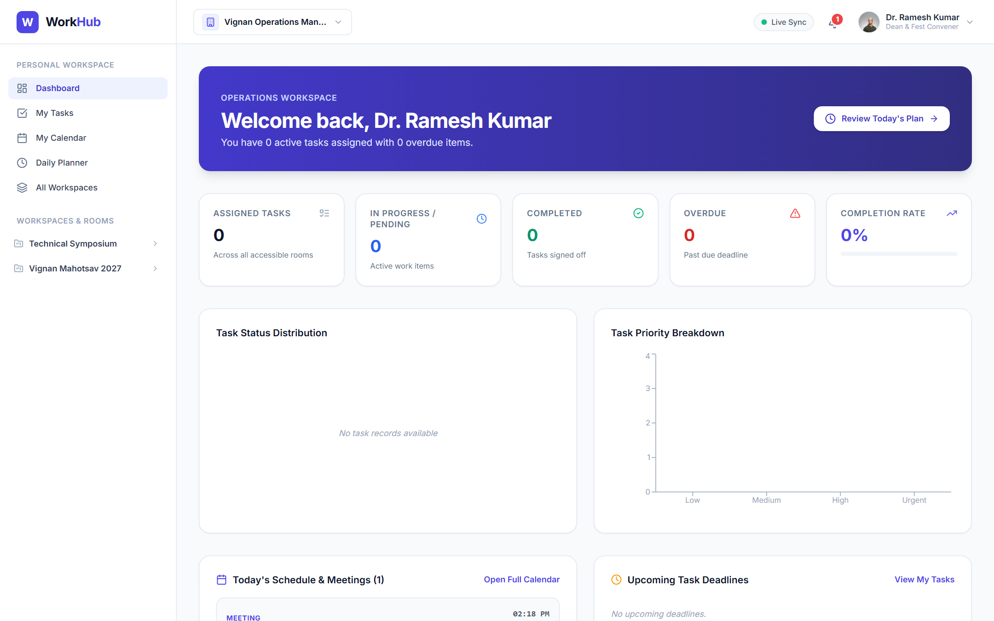
Team Workflow & Event Operations Management System
W
WorkHub Platform
A Full-Stack MERN Collaborative Work Management Platform for Enterprise Event Portfolios, Departments & Operations
DELIVERABLE
TECH STACK
DATABASE
ARCHITECTURE
Final Capstone Project
MERN Stack (Zero AI)
MongoDB Atlas & Local DB
Org → Workspace → Team → Room

Slide 2



Executive Summary & Project Scope
PROJECT OVERVIEW
WorkHub is an integrated, collaborative operations management platform built to coordinate large-scale events, department workflows, and cross-functional teams from initial concept to completion.
The Real-World Scenario
True Collaborative Focus
Zero AI / Strict Determinism
Institutions organizing mega events (e.g. Vignan Mahotsav 2027 with 15,000+ participants) require seamless synergy across 10+ teams: Logistics, Stage AV, Sponsorship, PR, and Hospitality.
Moves beyond single-user to-do lists. WorkHub provides real collaborative rooms, departmental standups, synchronized master calendars, and multi-collaborator review pipelines.
Engineered as deterministic, production-grade enterprise software with strict 5-tier RBAC, audit trails, and data isolation between workspaces and rooms.

Slide 3
Challenges in Modern Event & Work Operations
NEED FOR WORKHUB
01
02
Fragmented Communication Channels
Lack of Hierarchical Visibility
Teams rely on unstructured WhatsApp groups, disconnected emails, and loose notes, causing critical deadlines and responsibilities to fall through the cracks.
Event coordinators and workspace managers cannot see department progress, room task bottlenecks, or overdue deliverables without manual, tedious daily check-ins.
03
04
Static, Dead-End Spreadsheets
Rigid Member Onboarding
Traditional Excel/Google sheets lack real-time accountability, status workflows, subtask checkpoint tracking, and live audit trails for approvals.
Existing systems either expose global data or force rigid administrative manual account creation rather than flexible invite links, unique IDs, and request workflows.

Slide 4




The WorkHub Operations Engine
SYSTEM INNOVATION
Structured 4-Tier Hierarchy
Streamlined Collaboration
Accountability & Daily Sync
Flexible Member Access
Organization level governance
Independent workspace portfolios
Department / Team operational squads
Isolated rooms for specific execution channels
Multi-collaborator assigned tasks
Drag & drop Kanban board pipeline
Leader review and change request cycles
Live comments and suggestion triage
Daily planner (Today WIP & Tomorrow Plan)
Department daily update inspection
Workspace-wide blocker triage table
FullCalendar multi-level aggregation
Shareable workspace invite links
Direct add by Unique Member ID (WH-XXXXXX)
Directory search & join request approval
Fine-grained 5-tier RBAC authorization

Slide 5



Organization → Workspace → Team → Room
ARCHITECTURE
LEVEL 1 · GLOBAL GOVERNANCE
Multi-tenant foundation hosting global policies, organization settings, executive leaders, and multiple concurrent workspaces.
Organization
Top-Level Entity (e.g. Vignan University)
LEVEL 2 · PROJECT / EVENT SCOPE
Self-contained project environment containing master event calendars, overall progress metrics, announcements, and department standup summaries.
Workspace
Event Portfolio (e.g. Vignan Mahotsav 2027)
LEVEL 3 · DEPARTMENTAL UNIT
Autonomous departmental units with assigned Team Leaders, mandate checklists, department schedules, discussion forums, and daily updates inspection.
Team / Department
Functional Squad (e.g. PR, Tech Team, Logistics)
LEVEL 4 · EXECUTION CELL
Focused working spaces with Kanban boards, multi-assignee task workflows, subtask checkpoints, milestones, room discussions, and activity history.
Room / Channel
Execution Area (e.g. Stage Sound & Lighting)

Slide 6
5-Tier Role-Based Access Control (RBAC)
SECURITY & GOVERNANCE
1
Organization Owner
Total governance, organization provisioning, org settings, archive/delete workspaces.
Enterprise
2
Organization Admin
Create workspaces, invite organization members, assign managers, access all event portfolios.
Organization
3
Workspace Manager
Create teams/departments, post announcements, review all-teams daily standups, approve join requests.
Workspace
4
Team Leader
Create collaborative rooms, allocate room members, review member daily updates & team suggestions.
Department
5
Team Member
Execute assigned tasks, complete subtask checkpoints, submit review requests, post daily plans.
Room

Slide 7




MERN Technology Stack (Zero AI)
TECHNICAL FOUNDATION
FRONTEND
BACKEND
DATABASE
REAL-TIME
React 18 + Vite 6
Node.js + Express.js
MongoDB + Mongoose 8.x
Socket.IO Engine
Single-page application with component architecture, fast HMR bundling, and production asset optimization.
RESTful API server with modular controllers, centralized error handling, and robust middleware stack.
Document-oriented database with normalized collections, indexed schemas, and relational references.
Bi-directional WebSocket communication for real-time room status updates and notifications.
CORE LIBRARIES
CORE LIBRARIES
CORE LIBRARIES
CORE LIBRARIES
Tailwind CSS, TanStack Query v5, FullCalendar, Recharts, Lucide React, Axios
Zod validation schemas, JWT, bcryptjs, Helmet, Cookie-Parser, Morgan logging
Local MongoDB daemon + MongoDB Atlas cloud cluster support with failover
Room-scoped broadcasts, real-time sync status indicators in Header

Slide 8
Full-Stack System Architecture & Data Flow
SYSTEM ARCHITECTURE
Client Layer (Browser)
API & Gateway Layer
Data & Storage Layer
React 18 SPA + Vite
Node.js + Express.js
MongoDB & Cloudinary
AuthContext & SocketContext
JWT Authentication & Cookies
17 Normalized Mongoose Models
TanStack Query Server State Cache
5-Tier RBAC Middleware Guard
Unique Member & Invite Code Hooks
Protected App / Workspace Layouts
Zod Request Body Schema Validators
MongoDB Atlas Cloud Cluster
REST / JSON
& WSS
Mongoose
Driver
FullCalendar & Recharts Renderers
15 Modular REST Domain Controllers
Local MongoDB Failover Support
Axios Interceptors with Credentials
Socket.IO Event Dispatcher
Audit Trail & Activity Logs

Slide 9
Database Design: 17 Normalized Collections
DATA ARCHITECTURE · 12 CORE COLLECTIONS SHOWN
Users
Organizations
Workspaces
Teams
name, email, memberId (WH-XXXXXX), password, role, title, avatarUrl
name, slug, logoUrl, createdBy
organizationId, name, slug, inviteCode (INV-XXXXXX), managers, status
workspaceId, organizationId, name, slug, leader, members, responsibilities
Rooms
Tasks
Schedules
DailyPlans
workspaceId, teamId, name, slug, leader, members, status
roomId, workspaceId, title, assignees, status (5 tiers), priority, checkpoints
workspaceId, teamId, roomId, title, startTime, endTime, type, attendees
userId, teamId, date, accomplishments, inProgress, tomorrowPlan, blockers
Approvals
WorkspaceJoinRequests
Announcements
ActivityLogs
taskId, workspaceId, submittedBy, reviewer, status (APPROVED/CHANGES)
workspaceId, userId, status (PENDING/APPROVED/REJECTED), message
workspaceId, teamId, title, content, priority (URGENT/NORMAL), author
organizationId, workspaceId, actor, action, entityType, entityId

Slide 10



Collaborative Onboarding Workflows
MEMBER ADMISSION
METHOD 1
METHOD 2
METHOD 3
Shareable Invite Link
Direct Add by Unique ID
Explore, Search & Join
/join-workspace/:codeOrId
Member ID: WH-XXXXXX
Discovery Directory
Workspace owners share a clean invitation link with an invite code (e.g. MAHOTSAV27). Visitors view the event brief and managers, and send a request to join.
Every registered user has an indexed, unique Member ID. Workspace owners can immediately add users by their ID or email without invitation link dependency.
Members search active workspaces by title, category, or code. Live status badges indicate membership, pending status, or one-click request submission.
BENEFIT
BENEFIT
BENEFIT
Fast viral distribution across student & faculty bodies
Instant addition with automatic organization enrollment
Self-service discovery with manager approval gatekeeping

Slide 11
Task Review & Approval Lifecycle
WORKFLOW PIPELINE
1
2
3
4
5
TO DO
IN PROGRESS
UNDER REVIEW
EVALUATION
COMPLETED
Task Allocation
Work Execution
Approval Submission
Leader Decision
Audit Log & KPI
Manager or lead creates task, sets assignees, checkpoints, priority, and deadline.
Collaborators execute deliverables, check off subtask items, and post work progress.
Assignee submits task for review with delivery notes and verification attachments.
Leader reviews submission: Approves to Completed or Requests Changes with feedback.
Task verified, activity audit logged, workspace & room velocity metrics updated.
Approve moves the task to Completed; Request Changes sends it back to the assignee with feedback.

Slide 12



Daily Planner, Standups & Future Planning
OPERATIONAL SYNC
INDIVIDUAL CONTRIBUTOR VIEW
DEPARTMENT LEADER INSPECTION
EXECUTIVE MANAGER OVERSIGHT
Daily Planner
Team Standups
All-Teams Summary
/daily-planner
/teams/:id/daily-updates
/workspaces/:id/daily-standups
Record today’s completed milestones
Detail current work-in-progress tasks
Draft tomorrow’s prioritized work plan
Flag operational blockers and dependencies
Filter standups by team member and date
Track individual accomplishment logs
Identify bottlenecks and delayed tasks
Propose course corrections in team discussions
Comprehensive cross-department status matrix
Total submission compliance count
Critical blocker triage table across teams
Live export and report generation

Slide 13
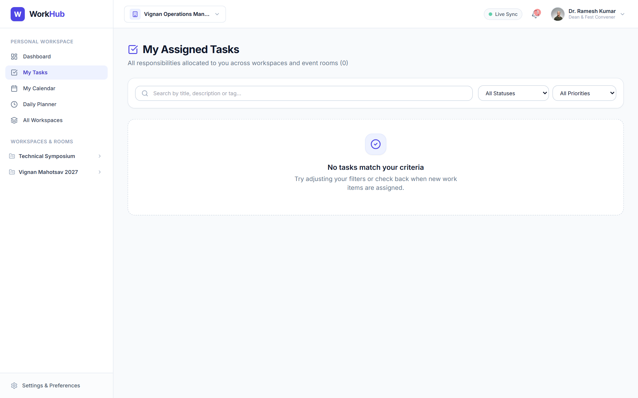
Executive Dashboard & Task Hub
APPLICATION SHOWCASE
Figure 1: Personal Dashboard with Recharts KPI Visualizers & Recent Activity
Figure 2: Unified Cross-Workspace Task Responsibility List

Slide 14
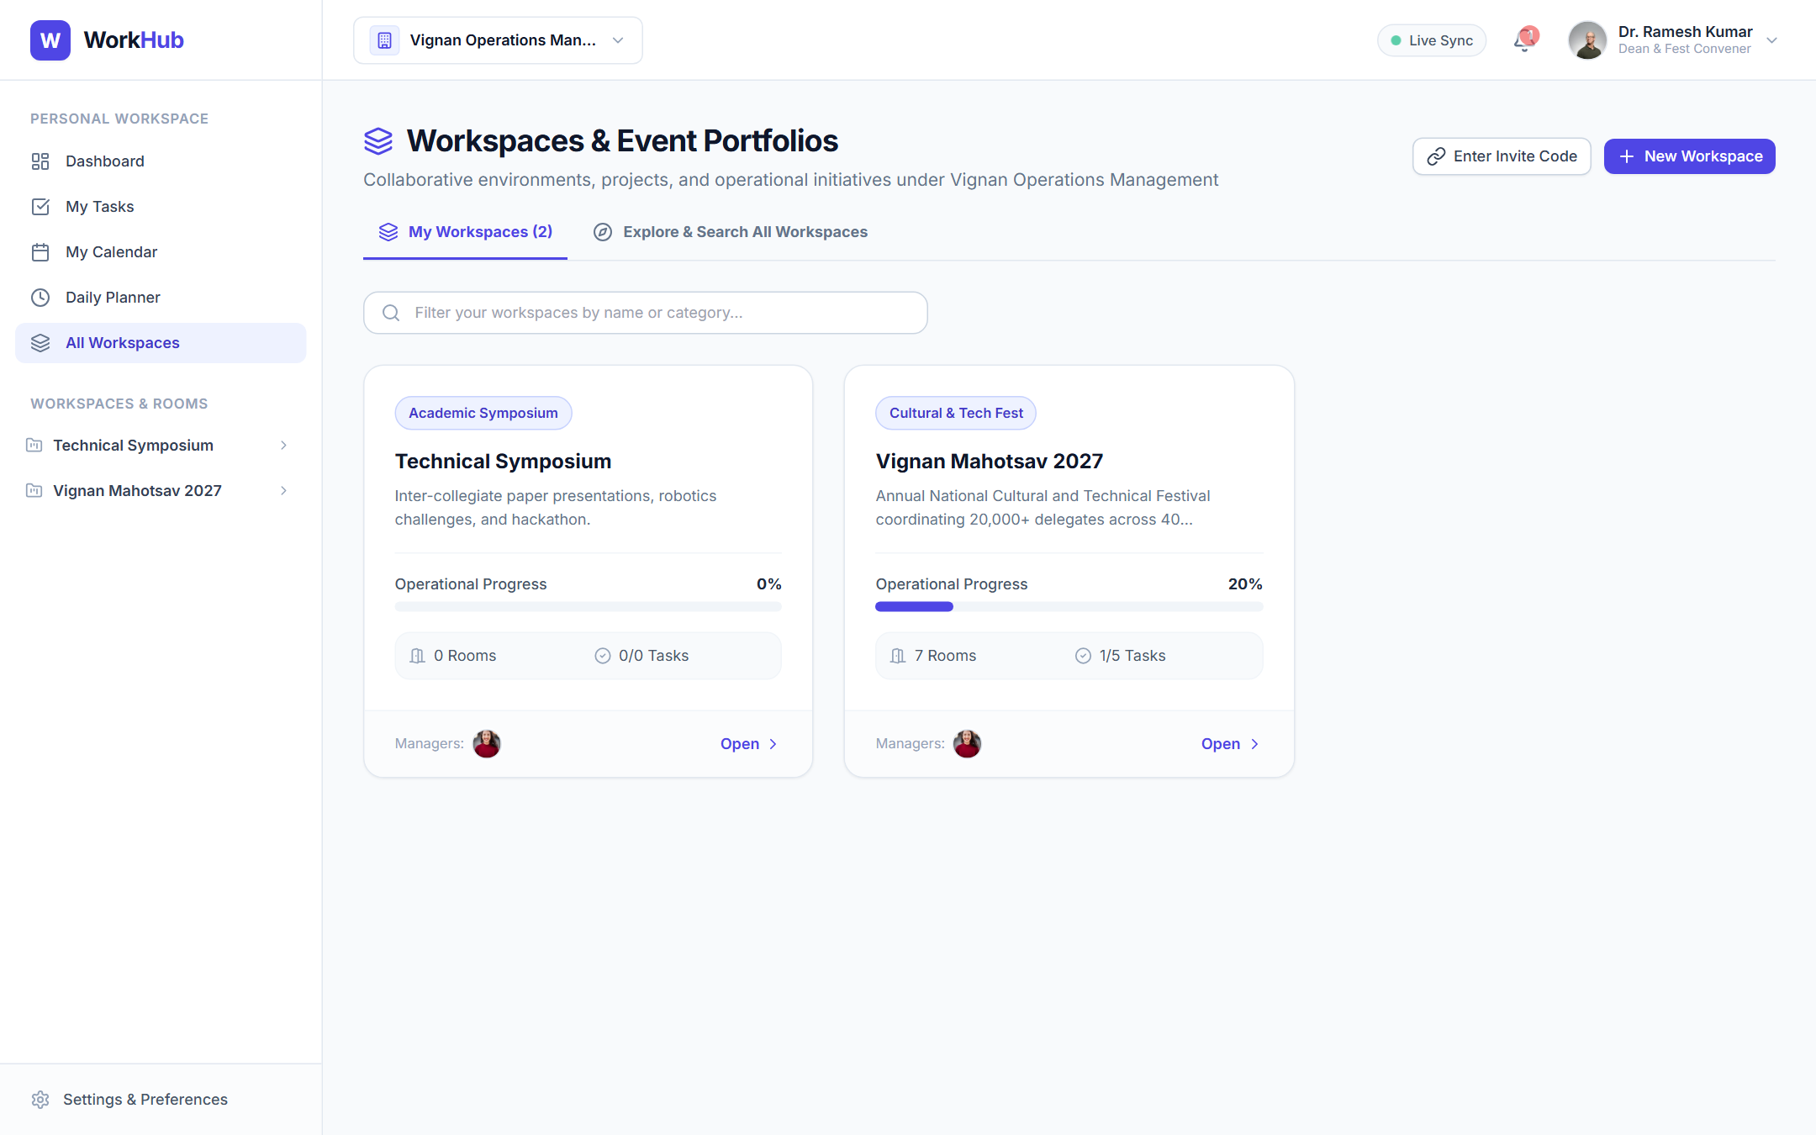
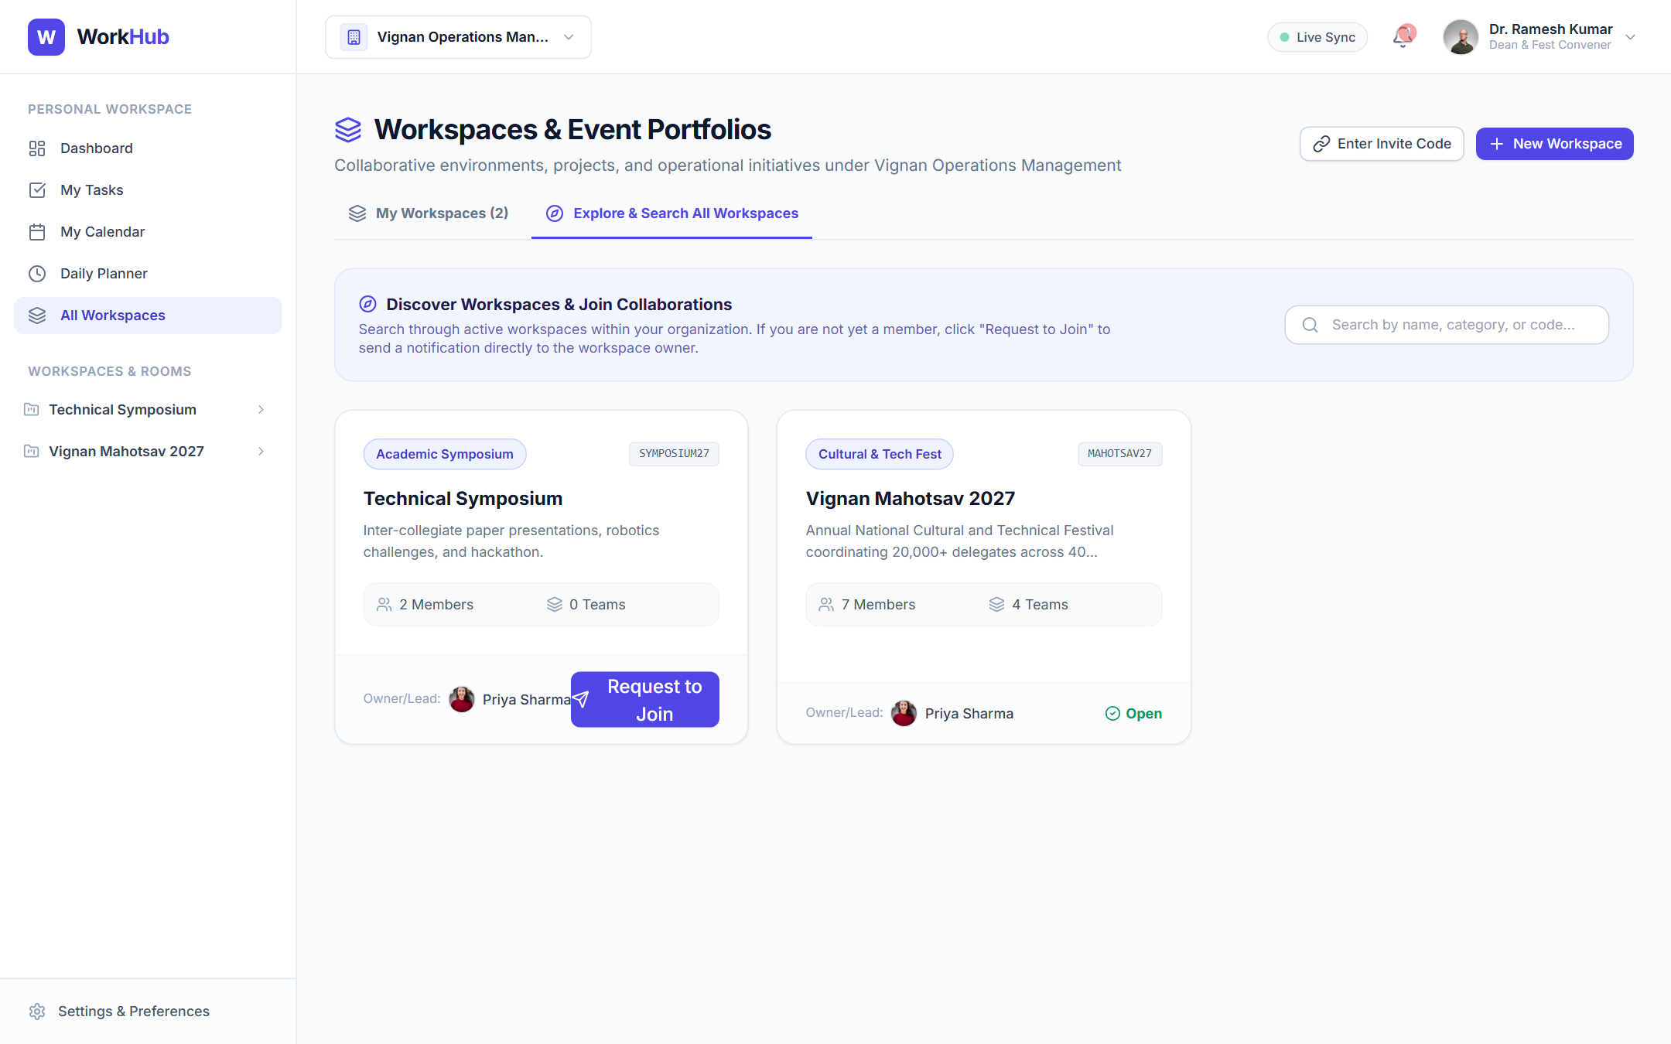
Workspaces & Onboarding Discovery
APPLICATION SHOWCASE
Figure 3: Active Workspaces Directory (Portfolio & Progress Cards)
Figure 4: Explore & Search Workspaces with Live Join Request Triggers

Slide 15
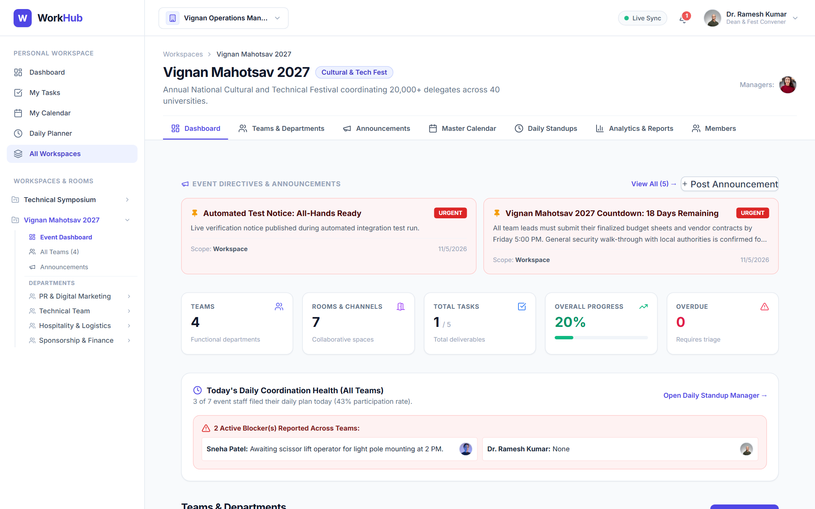
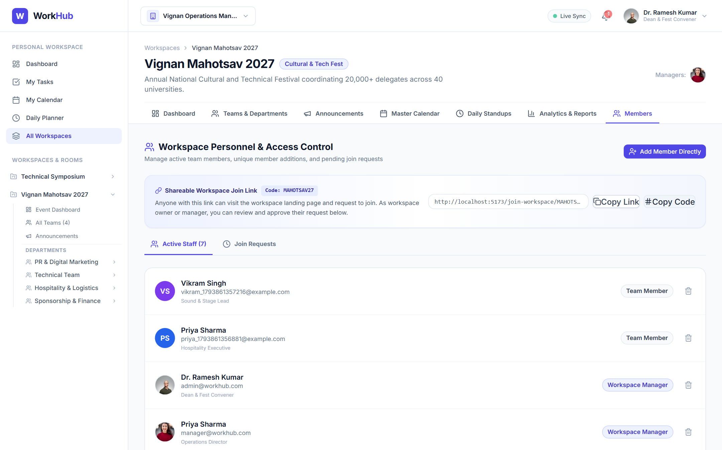
Event Operations & Personnel Management
APPLICATION SHOWCASE
Figure 5: Workspace Overview (Event KPIs, Quick Navigation & Activity)
Figure 6: Shareable Workspace Join Link & Staff Management Hub

Slide 16
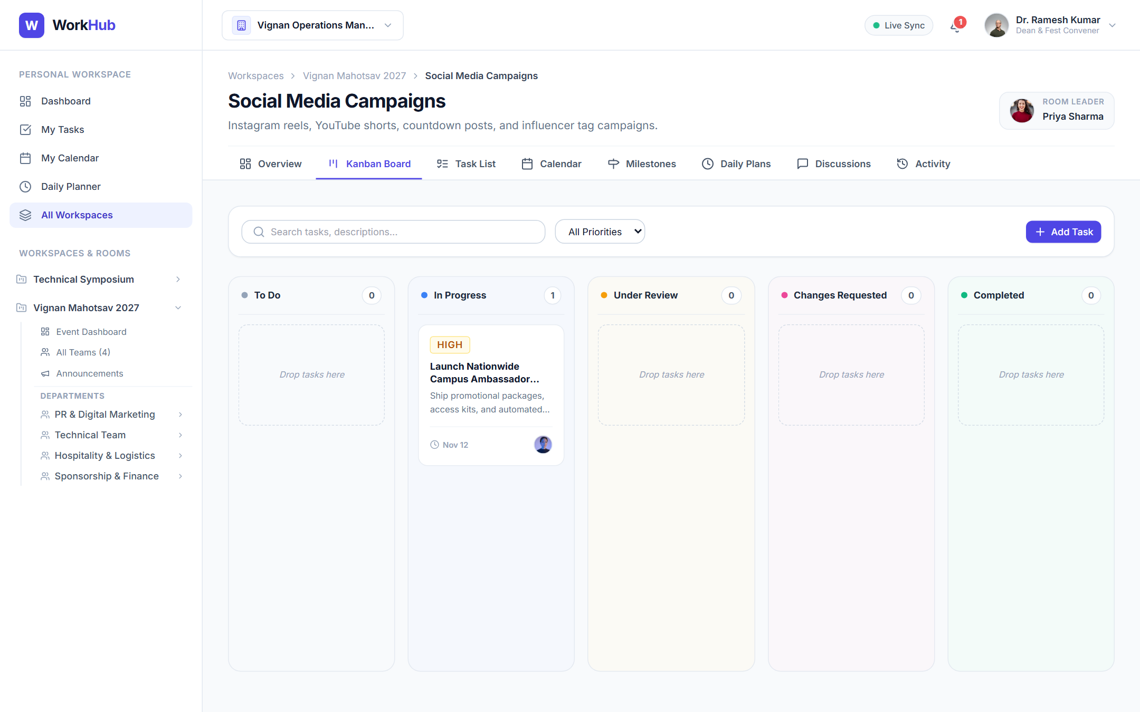
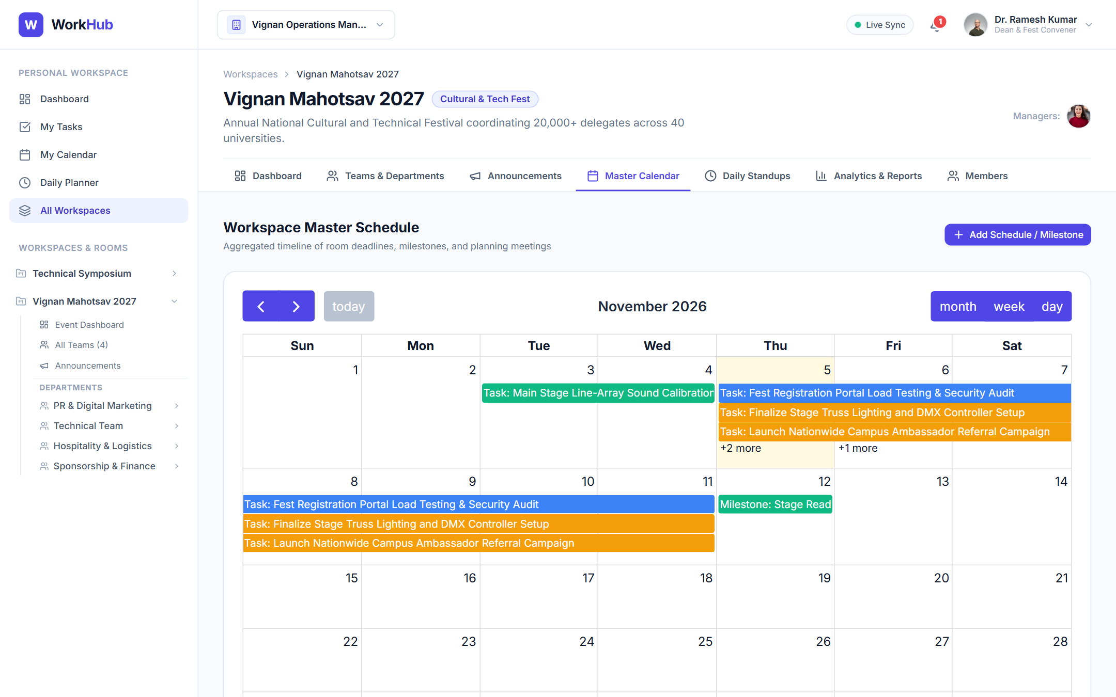
Collaborative Kanban Board & Master Calendar
APPLICATION SHOWCASE
Figure 7: Room Kanban Board with Multi-Collaborators & Subtask Badges
Figure 8: Master Event Calendar with Task Deadlines & Meeting Agendas

Slide 17
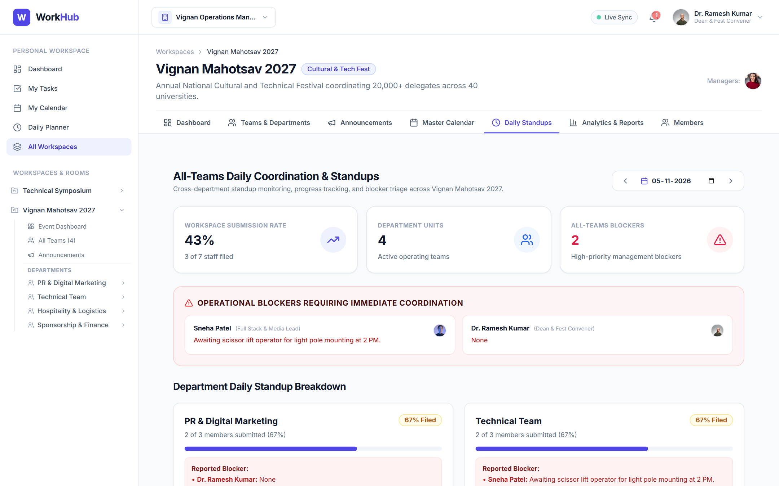
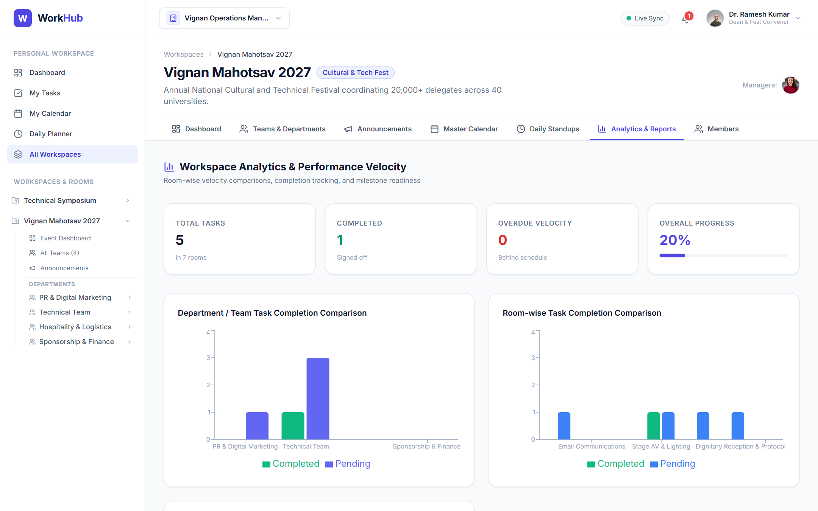
Standups & Operational Intelligence
APPLICATION SHOWCASE
Figure 9: All-Teams Consolidated Daily Standup & Blocker Matrix
Figure 10: Operational Reports, Milestone Burndown & Team Velocity

Slide 18
Automated Tests: 20/20 Suites Passing (100%)
QUALITY ASSURANCE
TOTAL TESTS
TESTS PASSED
FAILED / SKIPPED
EXECUTION TIME
20
20 (100%)
0
11.8s
✓ 1. Health Check & DB Ping
✓ 2. Admin Login & JWT Issuance
✓ 3. Session Verification (/auth/me)
✓ 4. Workspace Portfolio Listing
✓ 5. Team Department Metrics
✓ 6. Team Roster & Permissions
✓ 7. Team Calendar & Task Aggregation
✓ 8. Announcements Publishing & Broadcast
✓ 9. Collaborative Rooms Isolation
✓ 10. Kanban Task Status Pipeline
✓ 11. Multi-Scope FullCalendar Sync
✓ 12. Operational Analytics & Velocity
✓ 13. Live Notification Streaming
✓ 14. Daily Work Planner & Tomorrow Plans
✓ 15. All-Teams Blocker Summary
✓ 16. Suggestions & Proposals Triage
✓ 17. Threaded Room Discussions
✓ 18. Workspace Onboarding: Search API
✓ 19. Invite Link & Join Request Flow
✓ 20. Direct Add by Unique Member ID

Slide 19


Production Cloud Deployment Architecture
DEPLOYMENT
FRONTEND DEPLOYMENT
BACKEND DEPLOYMENT
DATABASE CLOUD
Vercel Platform
Render Web Service
MongoDB Atlas
High-availability React Single Page Application deployed with automatic edge caching, HTTPS, and SPA client routing rewrites via vercel.json.
Containerized Node.js Express service running REST endpoints and Socket.IO engine with automated health-checks and zero-downtime rolling deploys.
Distributed M0 cloud cluster with automated daily snapshots, multi-region replication, and IP access list whitelist configuration for Render.
Framework: Vite React
Root: client
Environment: VITE_API_URL
Runtime: Node.js 20+
Root: server
Start: npm start
Cluster: cluster0.etprdfz.mongodb.net
DB: workhub
Protocol: mongodb+srv://

Slide 20


Conclusion & Future Enhancements Roadmap
FUTURE ROADMAP
Capstone Objectives Achieved
Future Roadmap & Extensions
Delivered full-stack MERN WorkHub platform without synthetic mock data or shortcuts.
Gantt Chart & Critical Path Dependency Visualizer for event milestone scheduling.
Implemented full 4-tier operational hierarchy (Org → Workspace → Team → Room).
Offline Progressive Web App (PWA) caching for zero-connectivity field operations.
Engineered all 3 collaborative member onboarding workflows (Link, Unique ID, Search).
SMS & WhatsApp Webhook notifications for urgent stage and logistics announcements.
Verified with 20 passing integration test suites and 0 Vite compilation warnings.
Granular Sub-Organization Billing & Multi-Campus University federation.

Slide 21

Thank You!
W
WorkHub – Team Workflow & Event Operations Management System
Ready for Live Demonstration & Technical Q&A
GITHUB REPOSITORY
https://github.com/namitha-koduru/WorkHub.git
Technology: MongoDB • Express.js • React.js • Node.js

