Slide 1

Serverless Social Media Analytics using AWS Kinesis
Mikkilineni Namitha (2210030074)
Under the esteemed guidance of
Ms. P. Sree Lakshmi
Assistant Professor,
Department of Computer Science and Engineering

Slide 2
Project Overview
Social media platforms produce large volumes of real-time data that are challenging to process and analyze efficiently using traditional methods.
The aim is to develop a serverless analytics pipeline with AWS Kinesis to stream, process, and analyze social media data in real time.
Enables organizations to monitor trends, sentiment, and engagement instantly, supporting faster and smarter decision-making.

Slide 3
Services Used
Amazon Kinesis: Ingests real-time social media data.
AWS Lambda: Processes data and triggers analysis.
Amazon S3: Stores raw and processed tweet data.
Amazon Comprehend: Performs sentiment analysis.
Amazon QuickSight: Dashboards and visualizations.
IAM: Manages secure access between AWS services.

Slide 4
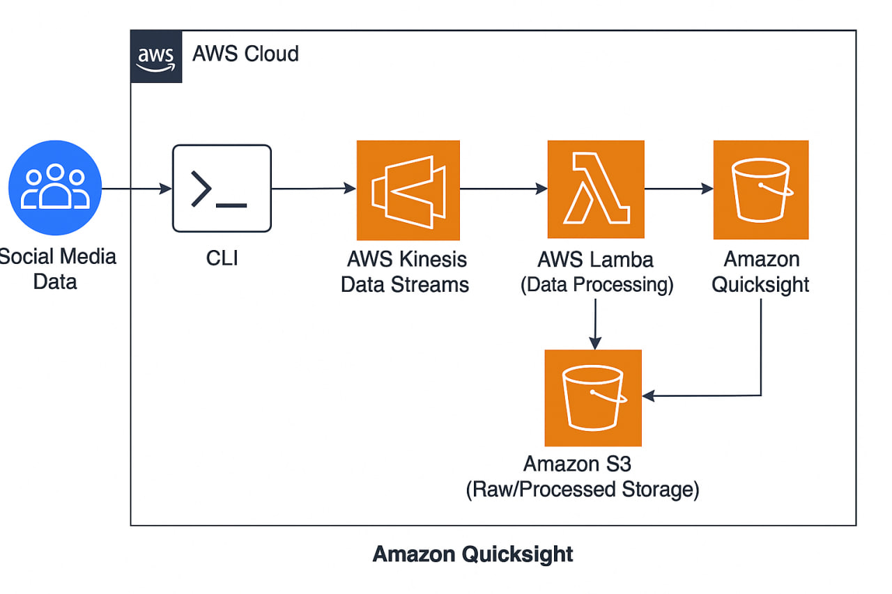
Flow Diagram

Slide 5
Implementation Process
Created Kinesis data stream.
Sent social media data using Python script.
Lambda function stores data in S3.
IAM roles configured.
Second Lambda does hashtag and sentiment analysis.
QuickSight connected to S3 for dashboard creation.

Slide 6
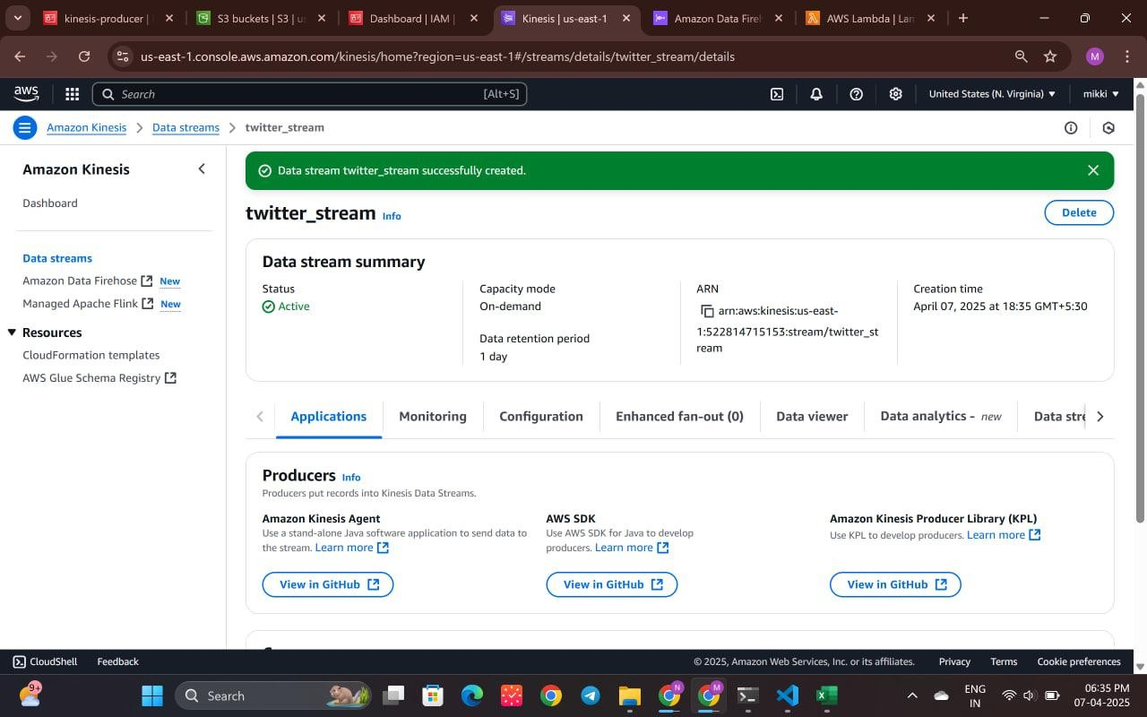
Created Kinesis data stream

Slide 7
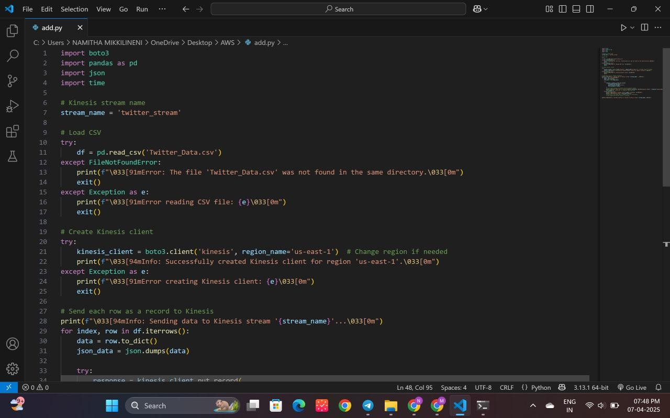
Sent social media data using Python script

Slide 8
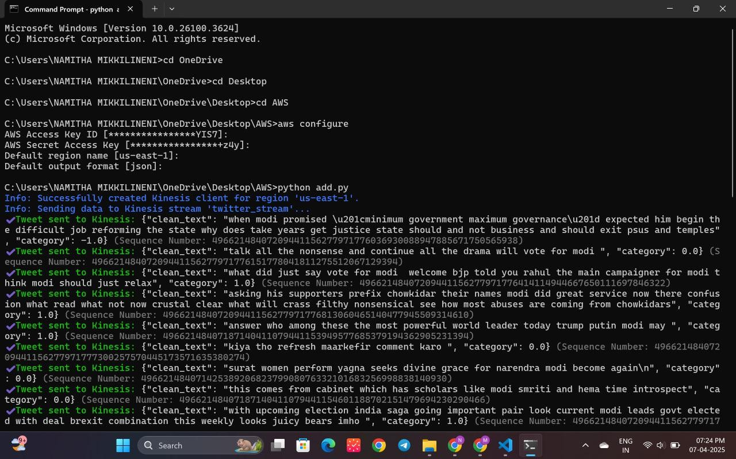

Slide 9
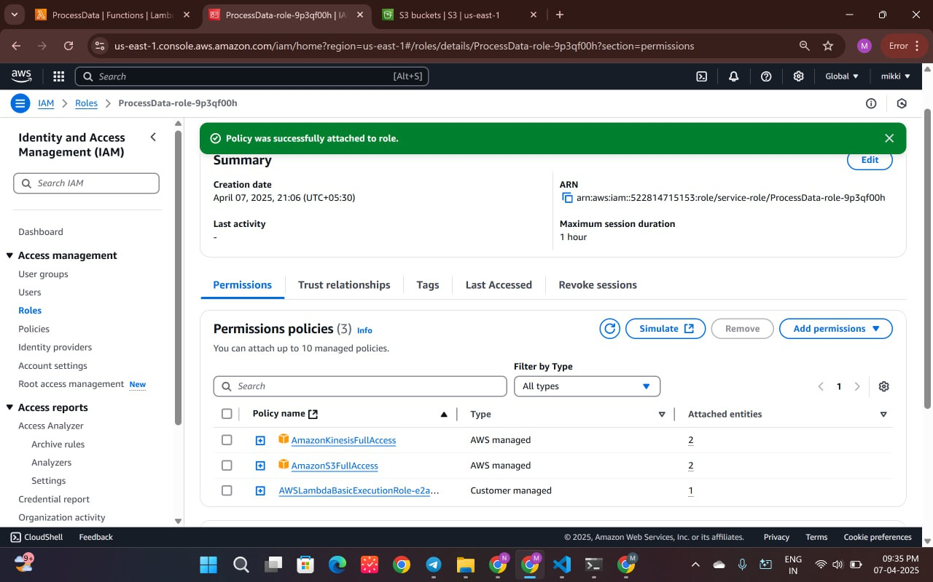
IAM roles configured for the lambda role

Slide 10
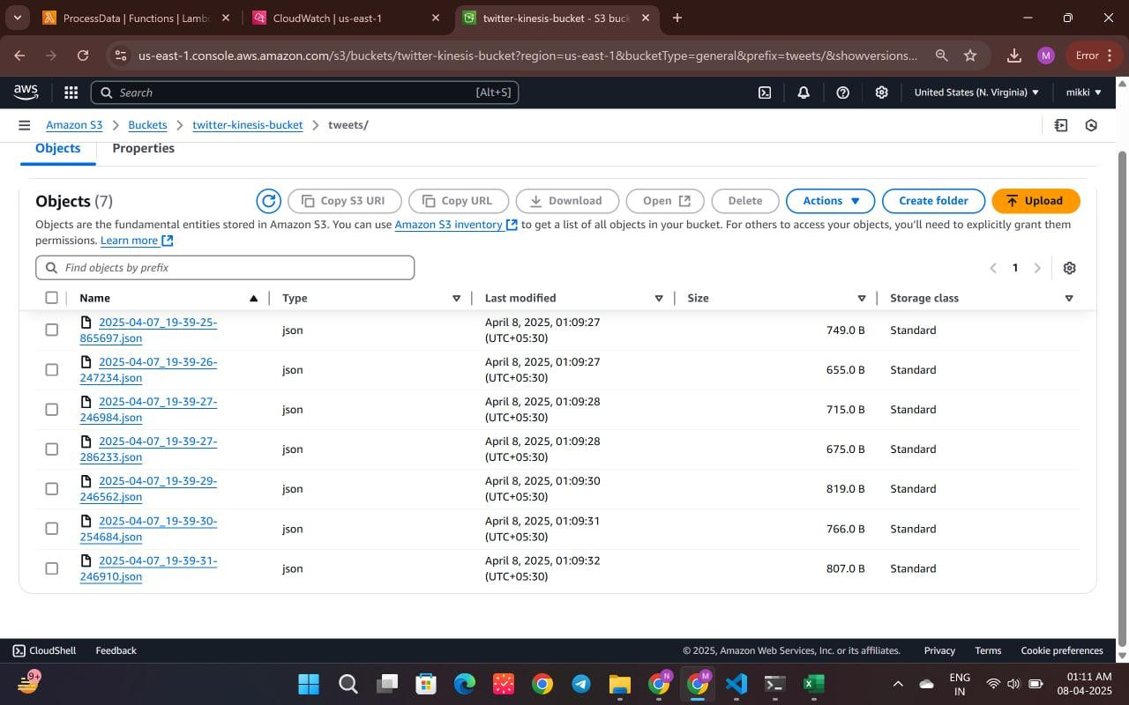
Lambda function stores data in S3 and perform sentiment analysis

Slide 11
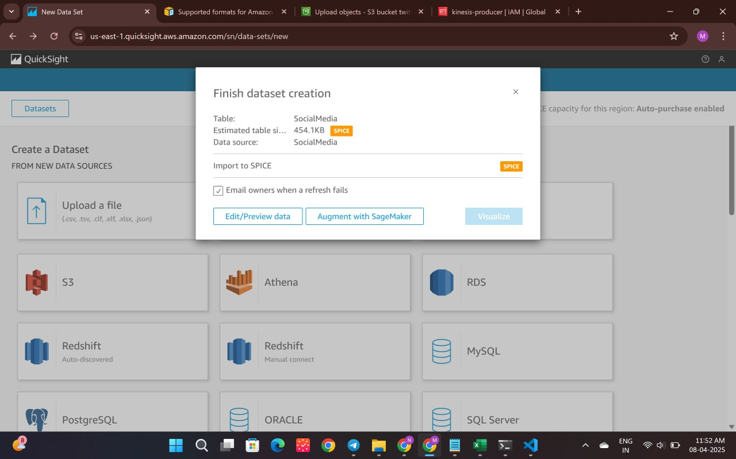
QuickSight connected to S3 for dashboard creation.

Slide 12
Key Features and Functionality
Serverless pipeline for real-time analytics.
Hashtag and sentiment extraction.
Event-driven automation via AWS Lambda.
Dashboards for trending topics and tweet stats.

Slide 13
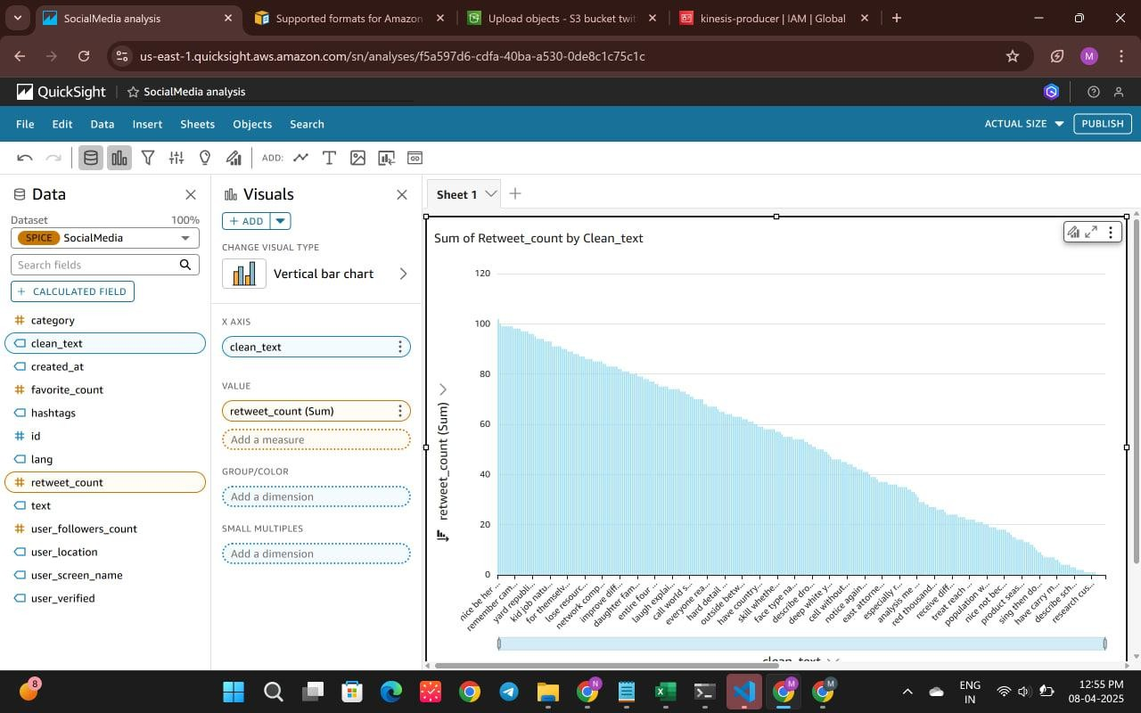
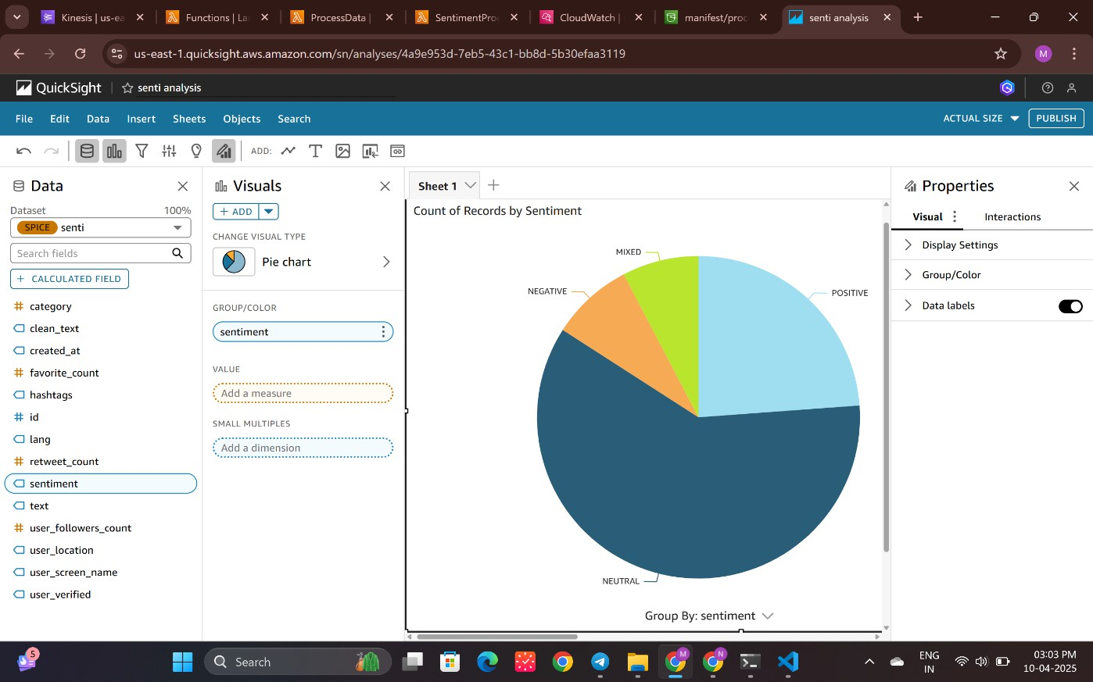
Results and Outputs

Slide 14
Challenges and Solutions
Challenges:
• IAM permission management
• Unstructured tweet data parsing
Solutions:
• Used predefined roles and policies
• Leveraged Amazon Comprehend for NLP

Slide 15
Learnings & Takeaways
Practical skills: AWS Lambda, Kinesis, S3, IAM, Comprehend
Serverless architecture and event triggers
Debugging with CloudWatch
Structured real-time data flow and processing

Slide 16
Future Scope
Integrate live Twitter API for real deployment
Add DynamoDB for advanced querying
Implement cost optimization strategies
Include AI for anomaly/spam detection

Slide 17
References
AWS Lambda Developer Guide:
https://docs.aws.amazon.com/lambda/latest/dg/welcome.html
Amazon Kinesis Documentation
https://docs.aws.amazon.com/ru_ru/kinesis/
Amazon Simple Storage Service Documentation
https://docs.aws.amazon.com/s3/?icmpid=docs_homepage_featuredsvcs
AWS IAM Documentation:
https://docs.aws.amazon.com/IAM/latest/UserGuide/introduction.html
Configuring settings for the AWS CLI
https://docs.aws.amazon.com/cli/latest/userguide/cli-chap-configure.html
Amazon QuickSight Documentation
https://docs.aws.amazon.com/quicksight/

Slide 18
THANK YOU

