Slide 1
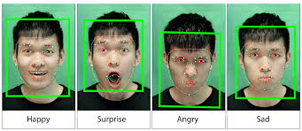
Face Emotion Recognition
2210030123 - Kesamreddy Poojitha,
2210030133 - Sharikar Sneha,
2210030074- Mikkilineni Namitha,
2210030070 - Bethireddy Deekshitha,
2210030177- D. Gayathri Aneesha

Slide 2
Introduction to Face Emotion Recognition
Definition of Face Emotion Recognition (FER)
Overview of how FER works
The role of facial expressions in emotion detection

Slide 3
Importance and Applications
Real-time emotion detection in security and surveillance
Customer service (sentiment analysis)
Healthcare and therapy
Education (adaptive learning systems)
Human-Computer Interaction (HCI)

Slide 4
Key Technologies Involved
Computer Vision
Machine Learning and Deep Learning
Convolutional Neural Networks (CNNs)
Face Detection and Feature Extraction Techniques

Slide 5
Techniques Used for Face Emotion Recognition
- Traditional Approaches:
• Haar Cascades
• Support Vector Machines (SVM)
- Deep Learning Approaches:
• CNN-based models
• Transfer Learning (e.g., VGG16, ResNet)
• Recurrent Neural Networks (RNNs)

Slide 6
Challenges in Face Emotion Recognition
- Variability in facial expressions across cultures
- Real-time processing demands
- Lighting conditions and image quality
- Subjectivity in emotion interpretation
- Dataset biases

Slide 7
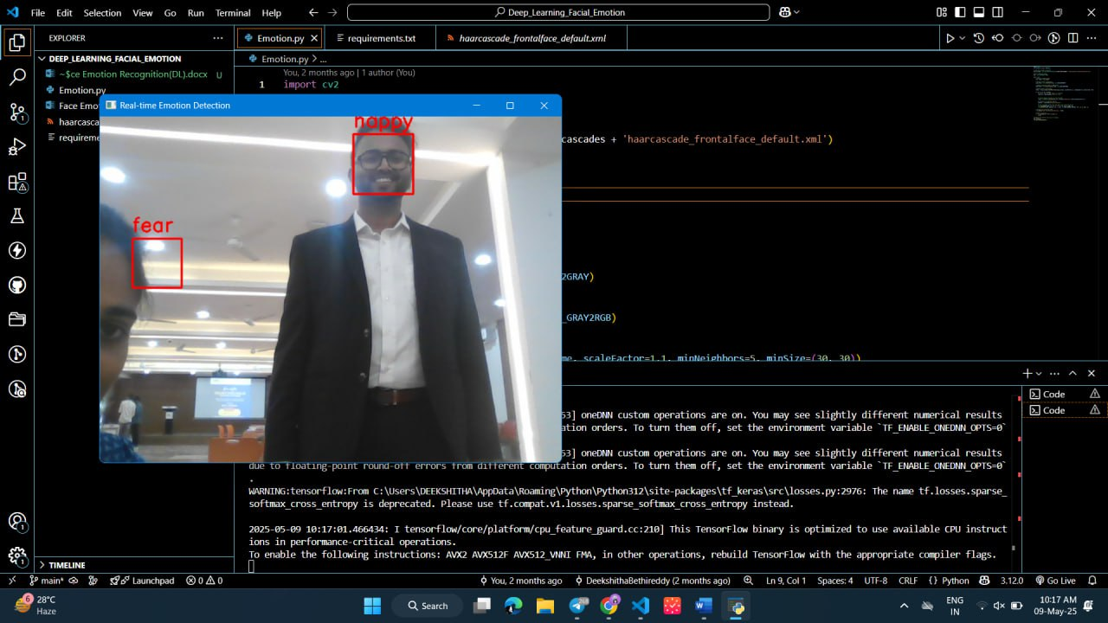
Outcome
- Summary of results and observations
- Performance of the implemented model

Slide 8
Conclusion
- Summary of key points
- Future directions (e.g., multi-modal emotion recognition, ethical considerations)
- The impact of FER on human-computer interactions and society

