Slide 1
Digital Portfolio
STUDENT NAME: NAMITHA K
REGISTER NO AND NMID: 24132030500122025/
asanm20324132030500122025
DEPARTMENT: BCA
COLLEGE: SRI ARAVINDAR ARTS AND SCIENCE COLLEGE/ ANNAMALAI UNIVERSITY

Slide 2
STUDENT DIGITAL PORTFOLIO The project is a simple online portfolio for Namitha.k The website introduces Namitha show her skill(like python HTML css ect).display her certificates and mention his interests in sports such as football. Key section: 1.Introduct and cv download 2.About me(education and intrests) 3.Skills displayed with icons 4.Certificate with details 5.Sports interstes 6.Contact information(email,whatsapp,github) The fortfolio is usefull to share her profile achievement .

Slide 3


AGENDA
Problem Statement
Project Overview
End Users
Tools and Technologies
Portfolio design and Layout
Features and Functionality
Results and Screenshots
Conclusion
Github Link
3/21/2024 Annual Review

Slide 4

PROBLEM STATEMENT Students find it hard to present their skills, achievements, and projects in a proper way using paper resumes. A digital portfolio will help them show their talents in an organized and attractive form.

Slide 5

PROJECT OVERVIEW This project is a web-based portfolio system where students can add their details like education, skills, projects, and certificates. It helps students share their profile easily with teachers, recruiters, and companies.

Slide 6

WHO ARE THE END USERS? Students – to create and update their portfolio. Recruiters – to check student skills and projects. Teachers/Mentors – to evaluate student growth. Colleges – to promote student profiles.

Slide 7

TOOLS AND TECHNIQUES Frontend: HTML, CSS, JavaScript / React Backend: Node.js / PHP / Python Database: MySQL / MongoDB Hosting: GitHub Pages / Netlify / Vercel

Slide 8
POTFOLIO DESIGN AND LAYOUT
Home page – Student intro and photo
About – Education and background
Skills – Technical & soft skills
Projects – Details with links/screenshots
Achievements – Awards & certificates
Contact – Email, LinkedIn, GitHub
Resume – Downloadable PDF
8

Slide 9
FEATURES AND FUNCTIONALITY Simple and responsive design Easy to update details Resume download option GitHub /LinkedIn links Public sharable portfolio link

Slide 10
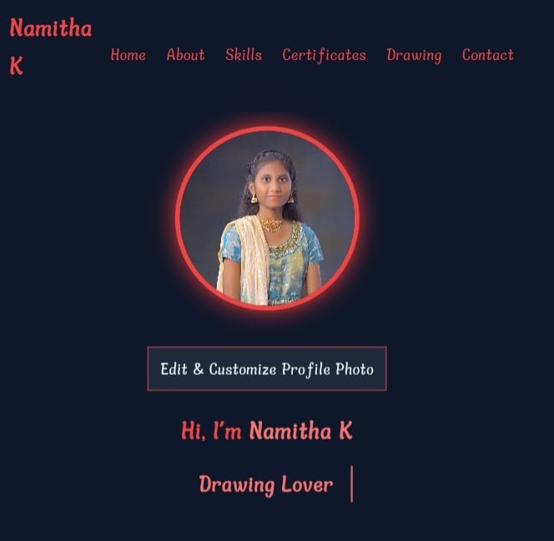

RESULTS AND SCREENSHOTS
3/21/2024 Annual Review
10

Slide 11
CONCLUSION The project helps students showcase their skills and achievements digitally. It is easy to share, professional, and useful for recruiters.
11

