Slide 1


Department of Electronics and Communication Engineering
Generative AI-Based Synthesis of Single-Stage BJT Amplifiers with Gain Validation
Team Details
Sl.no | Name | USN | Roll.no
1. | Namit Patil | 01FE24BEC405 | 105
2. | Karaveerappa malligawad | 01FE24BEC404 | 104
3. | Geerish Hosamani | 01FE24BEC403 | 103
Guided under: Prof. Ramesh Tabib
Department of Electronics and Communication Engineering

Slide 2
Introduction
Analog amplifier design requires manual calculations and expert knowledge.
BJT amplifiers operate in three configurations: Common Emitter (CE), Common Collector (CC), and Common Gate (CG).
Each topology follows different gain equations and design rules.
Traditional design methods are time-consuming and prone to human error.
Generative AI — specifically Conditional GANs — can automate the synthesis of component values.
This system takes user inputs (gain, Vcc, config) and outputs RC, RE, RG, Vout, waveform and schematic.
Department of Electronics and Communication Engineering

Slide 3
Problem Statement
Traditional Design Challenges:
Proposed Solution:
Requires expert-level knowledge of BJT biasing.
Involves repetitive manual calculations.
Different topologies require different equations.
Significant time investment per design iteration.
High probability of human error.
Automated intelligent design using Conditional GAN.
Instant component generation from user requirements.
Topology-aware gain validation built-in.
Automatic waveform and circuit schematic output.
Department of Electronics and Communication Engineering

Slide 4
Dataset Description
Features:
Configurations:
Dataset Stats:
Config
Configs: CE / CC / CG
CE — Common Emitter
Gain
Target: Gain, RC, RE, RG
Vcc
CC — Common Collector
Format: CSV
Vout
RC
CG — Common Gate
Split: Train / Test
RE
RG
Department of Electronics and Communication Engineering

Slide 5
System Architecture
User Input
(Gain, Vcc, Config)
Conditional GAN
Generated Parameters
(RC, RE, RG, Vout)
Gain Validation
Waveform Output
Circuit Diagram
Department of Electronics and Communication Engineering

Slide 6
Generator Architecture
Input
Generator
Network
(Fully
Connected
Layers)
Output
Noise Vector (z)
Config (CE/CC/CG)
Gain
Vcc
Vout
RC (Ω)
RE (Ω)
RG (Ω)
▶
▶
Architecture: Linear → BatchNorm → LeakyReLU → Linear (output)
Department of Electronics and Communication Engineering

Slide 7
Discriminator Architecture
Input
Discriminator
Network
(Fully
Connected
Layers)
Generated Params
(RC, RE, RG, Vout)
Condition
(Gain, Vcc, Config)
Output:
Real / Fake
▶
▶
Architecture: Linear → LeakyReLU → Dropout → Linear → Sigmoid
Department of Electronics and Communication Engineering

Slide 8
Training Details
Parameter | Value
Epochs | 120
Batch Size | 64
Optimizer | Adam
Learning Rate | 0.0001
Loss Function | Binary Cross Entropy (BCE)
Framework | PyTorch
Device | CPU (Google Colab)
Department of Electronics and Communication Engineering

Slide 9
Topology-Aware Gain Equations
CE — Common Emitter
RC = Collector resistor
RE = Emitter resistor
High gain applications
Av = RC / (RE + 25/Ic)
Inverting amplifier. High voltage gain.
CC — Common Collector
RE = Emitter resistor
Gain ≈ 1 (buffer stage)
High output impedance drive
Av = RE / (RE + 25/Ic)
Unity gain (≈1). Used for impedance matching.
CG — Common Gate
RC = Collector resistor
25 = Thermal voltage term
RF / high-freq applications
Av = RC / 25
Non-inverting. Low input impedance.
Department of Electronics and Communication Engineering

Slide 10
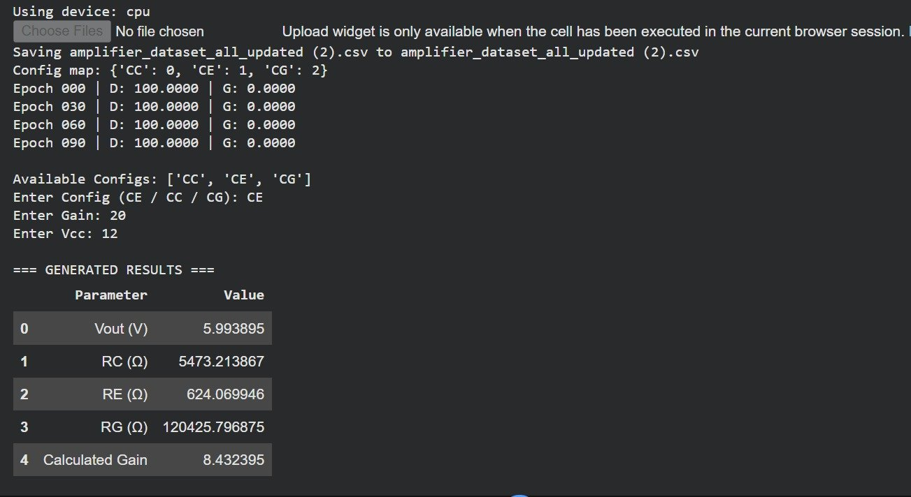
Generated Results — Colab Output
Input: Config = CE | Gain = 20 | Vcc = 12V
Department of Electronics and Communication Engineering

Slide 11
Gain Validation Results
Config | Target Gain | Generated Gain | Status
CE | 20 | 8.43 | Generated
CC | 5 | ~1.0 | Buffer
CG | 15 | RC/25 | Validated
Note: Gain validation uses topology-specific equations. Output is recalculated from generated RC, RE, RG values.
CE Example Vout = 5.99V | RC = 5473Ω | RE = 624Ω | RG = 120426Ω
Calculated Gain = 8.43
Training Progress D Loss converges to 100 | G Loss converges from 0
Epoch 0→30→60→90 logged
Department of Electronics and Communication Engineering

Slide 12
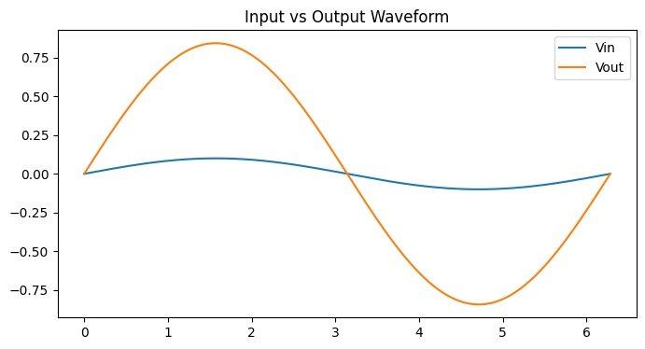
Waveform Output
Input vs Output Waveform — CE Configuration (Gain = 20, Vcc = 12V)
Vin — Small input signal Vout — Amplified output with phase inversion (CE)
Department of Electronics and Communication Engineering

Slide 13
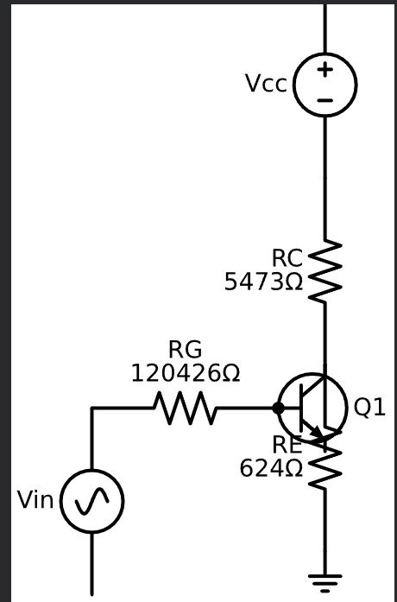
Generated Circuit Diagram — CE Configuration
Vcc = 12V Supply voltage
RC = 5473Ω Collector resistor
RE = 624Ω Emitter resistor
RG = 120426Ω Base resistor
Q1 NPN BJT transistor
Vin Input signal source
Department of Electronics and Communication Engineering

Slide 14
Advantages
Fully Automated
Fast Design
Topology Aware
No manual calculations required. Component values generated instantly.
Reduces design time from hours to seconds.
Supports CE, CC and CG with correct gain equations per topology.
Gain Validation
Auto Circuit
Built-in gain recalculation verifies output correctness.
Auto-generates schematic diagram using Schemdraw library.
Department of Electronics and Communication Engineering

Slide 15
Conclusion
Successfully designed a topology-aware Conditional GAN for BJT amplifier synthesis.
Automatically generates component values (RC, RE, RG, Vout) from user-defined gain, Vcc, and configuration.
Produces verified waveform output and auto-generated circuit schematic.
Dramatically reduces manual design effort and eliminates human calculation errors.
Supports all three BJT configurations: CE, CC, and CG with correct topology-specific gain validation.
Department of Electronics and Communication Engineering

Slide 16
THANK YOU
Department of Electronics and Communication Engineering

