Slide 1
Instacart Market Basket Analysis
Data Analytics and Mining Assignment
GROUP 11
Arvind Ramadurai – 17210378
Roshan Nambiar – 17211877
Namit Singhi – 17211318
Vinay Datta - 17211404

Slide 2

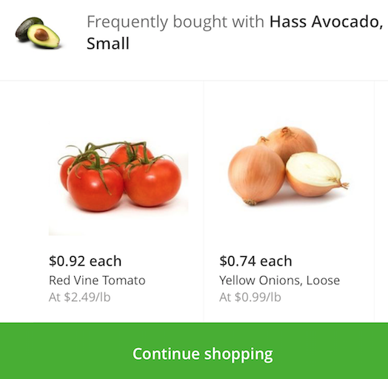
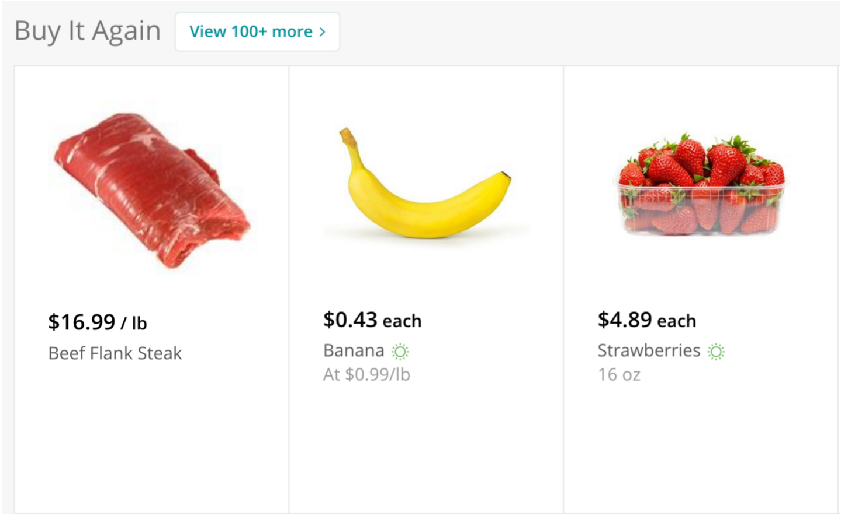
Objective
Our task is to predict which items will be reordered on the next order and to give recommendations to the customer
Data:
3.4 million grocery orders, distributed across 6 csv files
Dataset of orders with their IDs and timestamp of their purchase along with the customer ID and reorder details(yes/no)
Separate datasets for product categories and the aisles in which they are present

Slide 3
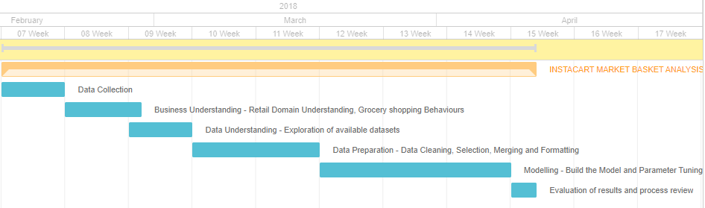
Project Timeline

Slide 4
Datasets
aisles.csv - Aisle Name and IDs
departments.csv - Department Name and IDs
order_products__prior.csv - Previous order content for customers
orders.csv - Evaluation set, order hour of day, days since prior order
products.csv - Product name, department, aisle and product ID
order_products__train.csv - Training data of order details

