Slide 1
Marker Algorithm with ML oracle
唐樂文

Slide 2
Program structure
main.py : program entry point
maker_algorithm.py
ml_oracle.py
testcase.py : for testing
train.csv : training data set

Slide 3
Environment And Pagkages
Python3.8
Numpy
pandas
Sklearn
Pyprobables (library for probabilistic data structures)

Slide 4
ML Oracle
Model :DecisionTreeClassifier
Predict a file Heavy or not
Features using: 1.update_year 2.file type, 3.is_in_homepage
If the file is a Heavy hitter -> go to hash table
If not heavy -> go to Count Min Sketch
ml oracle : a program using ML to give useful information

Slide 5
How to decide a heavy item?
It depends on the application situation, for example a book shop
And using some of the useful information from the situation
To decide a book is a best seller or not, may consider the price, publish date, categories like comedy, fantasy
Books like textbooks, very old books should not consider as a best seller

Slide 6
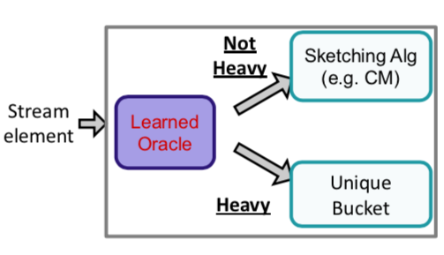
CountMinSketch
For Counting Frequency
The CountMinSketch
A simple hash table
Stores the frequency information in these two data structures for later prediction of unmarked elements
Learned oracle prevent the collision probability for heavy items

Slide 7
Marker Algorithm
For classic marker Algo. : it evict a element randomly
Improved Marker Algo. :
evict an element whose has lowest possible will appear in next round(the lowest frequency)
counting estimated frequency for each element
Using a hash table avoid heavy element collision from Count Min Sketch
Using Machine Learning to predict a element whether a heavy hitter

Slide 8
Improved Marker vs classical Marker
How to test?
Test : using identical 200 requests for both algorithm, count their miss time
Compare the cache miss time of these two algorithms
Algorithm | Evict method
Classical Marker | random
Improved Marker | ml method

Slide 9
Testcase
Our input are files
We simulate a very simple web site situation, which include :
a) home page : most visits
b) not home page (all other pages) : fewer visits
Testcase :
2 types: a) home page files, b) non home page files
randomly creates 200 requests to the cache : 70% requests from home page files, 30% from non-home-page files

Slide 10
Experiment Result
1000 times of experiment, get the average miss count
 | Random method | ML oracle method
Average Miss Count | 43.927 | 40.768

Slide 11
Latest Result
Increasing the total number of tests didn’t affect the experiment.
Increasing the cache size and the number of non heavy item (the percentage of fewer visits pages in all pages), under this situation, the Improved marker has showed its performance is better than the origin marker algorithm.
In conclusion: the result of a caching algorithm is related to 1) the cache size, 2) the input size, 3) input types
Whether a caching algorithm is the best one depends on the situation. The ML oracle method will result an impressive performance in the circumstance that relatively having a huge number of non heavy items.

Slide 12
The code
Github: https://github.com/namkolgnottw/MarkerAlgorithmWithMachineLearning

Slide 13
Reference
1. LEARNING-BASED FREQUENCY ESTIMATION ALGORITHMS (Chen-Yu Hsu, Piotr Indyk, Dina Katabi & Ali Vakilian )
2. PPT: MIT 6.890: Learning-Augmented Algorithms (Piotr Indyk)

