Slide 1
West Nile Virus Prediction
GA DSI 22
Greg NK
Nura Oscar

Slide 2
TABLE OF CONTENTS
01
02
03
04
OVERVIEW
Data
Background & Objectives
Cleaning & EDA
Modeling & Analysis
Conclusion & recommendations
Summary & evaluation
on each & Final model
Cost benefit analysis

Slide 3
01
SECTION
Background & Objectives

Slide 4
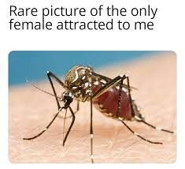
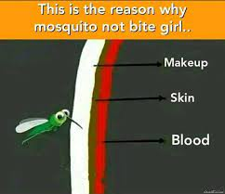
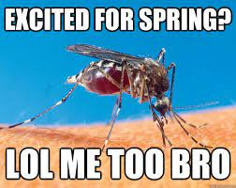
Background
West Nile Virus in city of Chicago
Chicago Department of Public Health
Most commonly spread to humans through infected mosquitos.

Slide 5
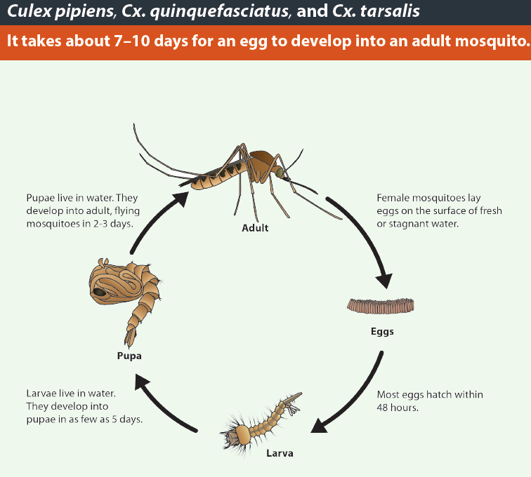
Life cycle of Culex species

Slide 6
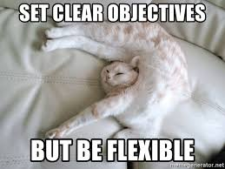
Objectives
Prediction
Best model to predict locations of outbreaks
Data
Weather, traps & spray
Cost-benefit Analysis
On the spraying of pesticide on different locations

Slide 7
02
SECTION
Data Cleaning & EDA

Slide 8

Data Cleaning
Train Dataset
Traps, mosquito species, date
Weather Dataset
Missing values in various representations
Take the average of 2 stations

Slide 9
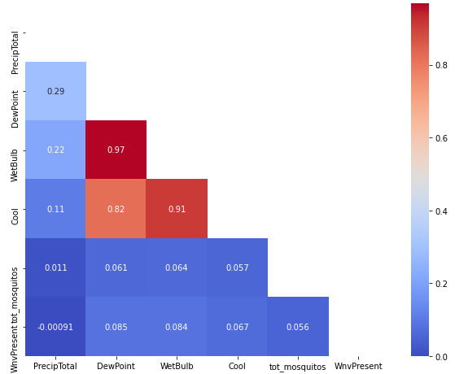
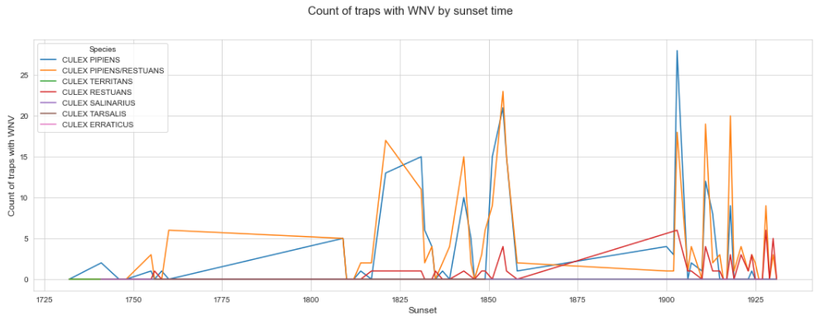
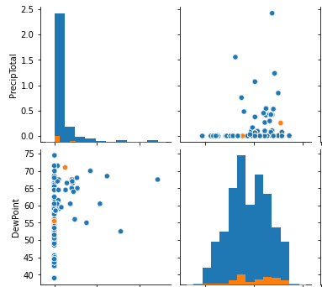
Exploratory Data Analysis
Heatmap
Pairplot
Line plot
Features
Selection
Engineering

Slide 10
Final Dataset Preparation
Outside research
Rolling and Lagging
Through experimentation
Lag some weather features by 1 up to 10 days
Use each set of merged dataset and ran logistic regression
Roll range of 2 to 6 days
Impact of climate variables
Temperature, humidity and rain
Culex lifecycle

Slide 11
Final Dataset Preparation
Scaling
Final Dataset
Train/test sets
Standard & SMOTE
Lasso
Further drop features
166 features

Slide 12
03
SECTION
Modeling & Analysis

Slide 13
Intermediate Objective: Predict probability of West Nile Virus Present
Challenge:
Imbalance dataset
Solution:
Oversampling / Undersampling?
SMOTE (Oversampling)
Metric:
ROC_AUC Score

Slide 14
Modeling Process
Special Note on the process:
Train –Test – Split FIRST!!!
PIPELINE FROM Imblearn when using GridSearchCV
Standard Scaler, SMOTE and Model inside imblearn Pipeline
Scale before SMOTE

Slide 15
Models
Baseline ROC AUC score: 0.5
KNN
Random Forest
Naïve bayes
Kaggle score: 0.53941
Kaggle score: 0.729
Kaggle score: 0.71312
Decision tree
Logistic regression
Kaggle score: 0.60934
Kaggle score: 0.73467

Slide 16
Evaluation
Most Important Features | Coefficients
Average Temperature Rolling 6 days | 2.755
Average dew point Rolling 2 days | 0.978
Total precipitation for 24hr period (rolling 5 days) | 0.726
Total precipitation for 24hr period (rolling 2 days) | 0.610
Average station pressure (inches of HG) | 0.501
Feature Engineering Important!!!

Slide 17
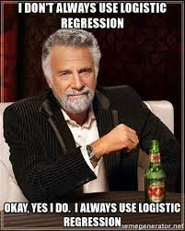
Logistic Regression
- VotingClassifier for top 3 models - Do more feature engineering
Possible Further Improvements
Kaggle Score:
0.73467

Slide 18
04.1
SECTION
Cost-benefit analysis

Slide 19
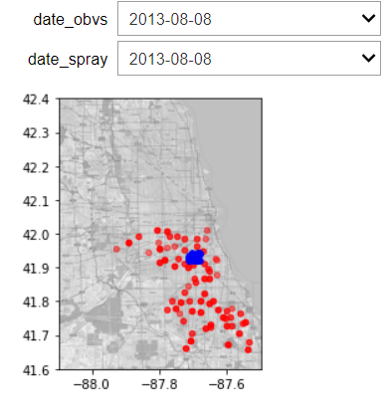
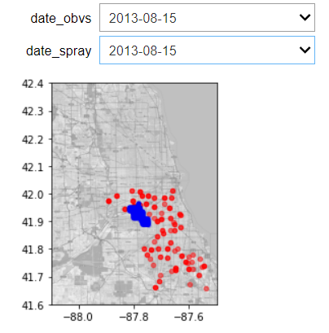
Spraying EDA
Spraying occurred on 10 distinct dates (2 in 2011 and 8 in 2013)
Spraying occurs in the late evening/ at night
Spraying is done on only a concentrated area as compared to the observation areas
Spraying area in blue
Traps in red

Slide 20
Designing ‘test and control’
We segregate areas into spray and non-spray areas.
(Test) Spray areas: traps within 0.05 latitude and longitude of spraying
(Control) Non spray areas: all other traps
We observe the mean number of mosquitos and WNV rate per trap before and after spraying.
- We use 10 days before and after in view of a mosquito’s complete life cycle
Observe the differences and see if any conclusions can be drawn
Spray Area
Non-spray area

Slide 21
Results show spraying has little effect
Spray Date: 7 September 2011
Time Period | Location | Avg Num Mosquitos | WNV Rate
Before Spray | Non Spray | 5.9 | 0.02
After Spray | Non Spray | 4.9 | 0.02
Before Spray | Spray | 7.0 | 0.10
After Spray | Spray | 4.7 | 0.03
Spray Date: 5 September 2013
Time Period | Location | Avg Num Mosquitos | WNV Rate
Before Spray | Non Spray | 16.9 | 0.18
After Spray | Non Spray | 15.3 | 0.14
Before Spray | Spray | 48.4 | 0.35
After Spray | Spray | 33.7 | 0.28
Spray Date: 8 August 2013
Time Period | Location | Avg Num Mosquitos | WNV Rate
Before Spray | Non Spray | 15.6 | 0.08
After Spray | Non Spray | 15.4 | 0.11
Before Spray | Spray | 12.8 | 0.15
After Spray | Spray | 14.6 | 0.16
Even though some dates seem to show significant reduction in number of mosquitos and the WNV rate
Others showed that the reduction wasn’t significant as compared to the control
(control WNV rate decreased by ~22% while spray areas reduced by ~20%)
Some dates even showed spray areas with an increased number of mosquitos and WNV rate

Slide 22
$21,000
0.73
$1,191,811
How can we generalise a CBA?
Average cost of per WNV case reported in the US
Our accuracy in predicting presence of WNV
Chicago gov budget allocated to Environmental Health in 2013

Slide 23
We can generalise a guide for calculation
Potential economic impact
1
Accuracy of prediction
1
Efficacy of
spraying
Mosquito
Infection
Rate
Population
Density
Cost of
spraying
<
X
$21,000
X
X
X
Cost of spraying with
Margin for error

Slide 24
We can generalise a guide for calculation
Potential economic impact: $1,050,000
$500,000
1/0.73
1/0.65
1
Accuracy of prediction
1
Efficacy of
spraying
Mosquito
Infection
Rate
Population
Density
Cost of
spraying
<
X
$21,000
X
X
X
0.5%
10,000
Cost of spraying with
Margin for error: $1,053,740

Slide 25
04.2
SECTION
Conclusion & recommendations

Slide 26
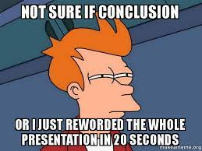
Conclusion
Our proposed equation to calculate the cost and benefit of spraying
The total cost of spraying only slightly above the potential economic impact of not spraying

Slide 27

Recommendations
There are other "cheaper" ways
Chicago budget in 2013 showed $9,000,000 dedicated to community engaged care.
Education, policy and service
Report on dead birds & tall grass

Slide 28
THANKS!
Do you have any questions? 1MoreProjectToGo@almostfree.com
+2353535
generalassembly.com
Please keep this slide for attribution

