Slide 1

Open Dota Mobile Client
Group 8

Slide 2
Members
Nguyễn Hoàng Minh
Lê Hoài Nam
Nguyễn Duy Nghĩa
Lê Quang Minh
Nguyễn Viết Minh Đức

Slide 3
Table of contents
01
03
02
04
Introduction
Activities
Function and purpose
Roles and Duties overview
Demo
05
Functionally
Architecture
Optimization
Main Components and figures
Ui Overall status

Slide 4
01
Introduction

Slide 5
Function:
Provides mobile access to Dota 2 stats and match history.
Tracks performance metrics like win rates, hero stats, and match analysis.
Includes hero builds
Enables users to review past games and track improvement

Slide 6
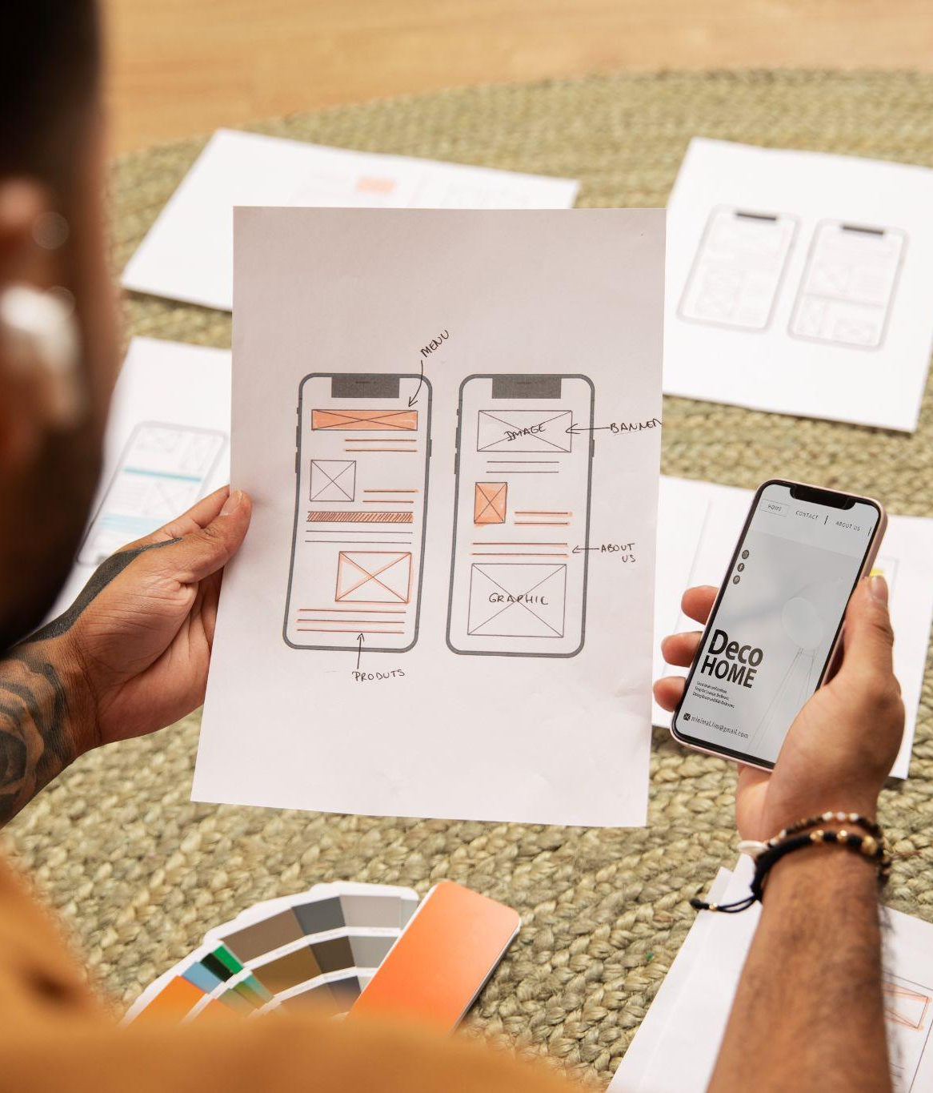
Purpose:
Convenient access to stats and performance on the go.
Instant updates on match results and leaderboards..
Keeps players informed on competitive matches and the pro scene.

Slide 7
02
Architecture
Main Components and figures

Slide 8
Main
Home
My Profile
Search
App introduce
Show user's profile
Searching players' name and match history
Favourite
Setting
Following and tracking another players
Changing theme's color

Slide 9
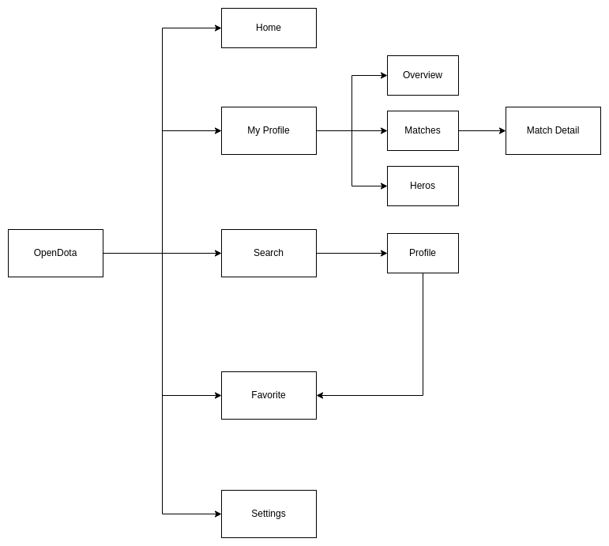
Figures

Slide 10
03
Activities
Roles and Duties overview

Slide 11
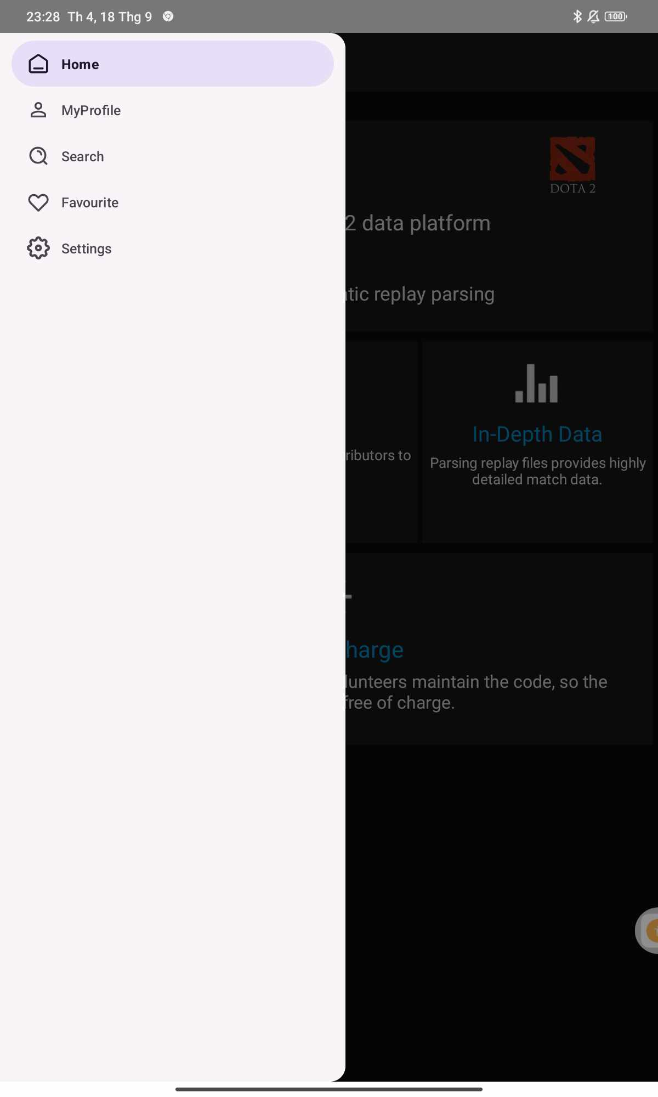
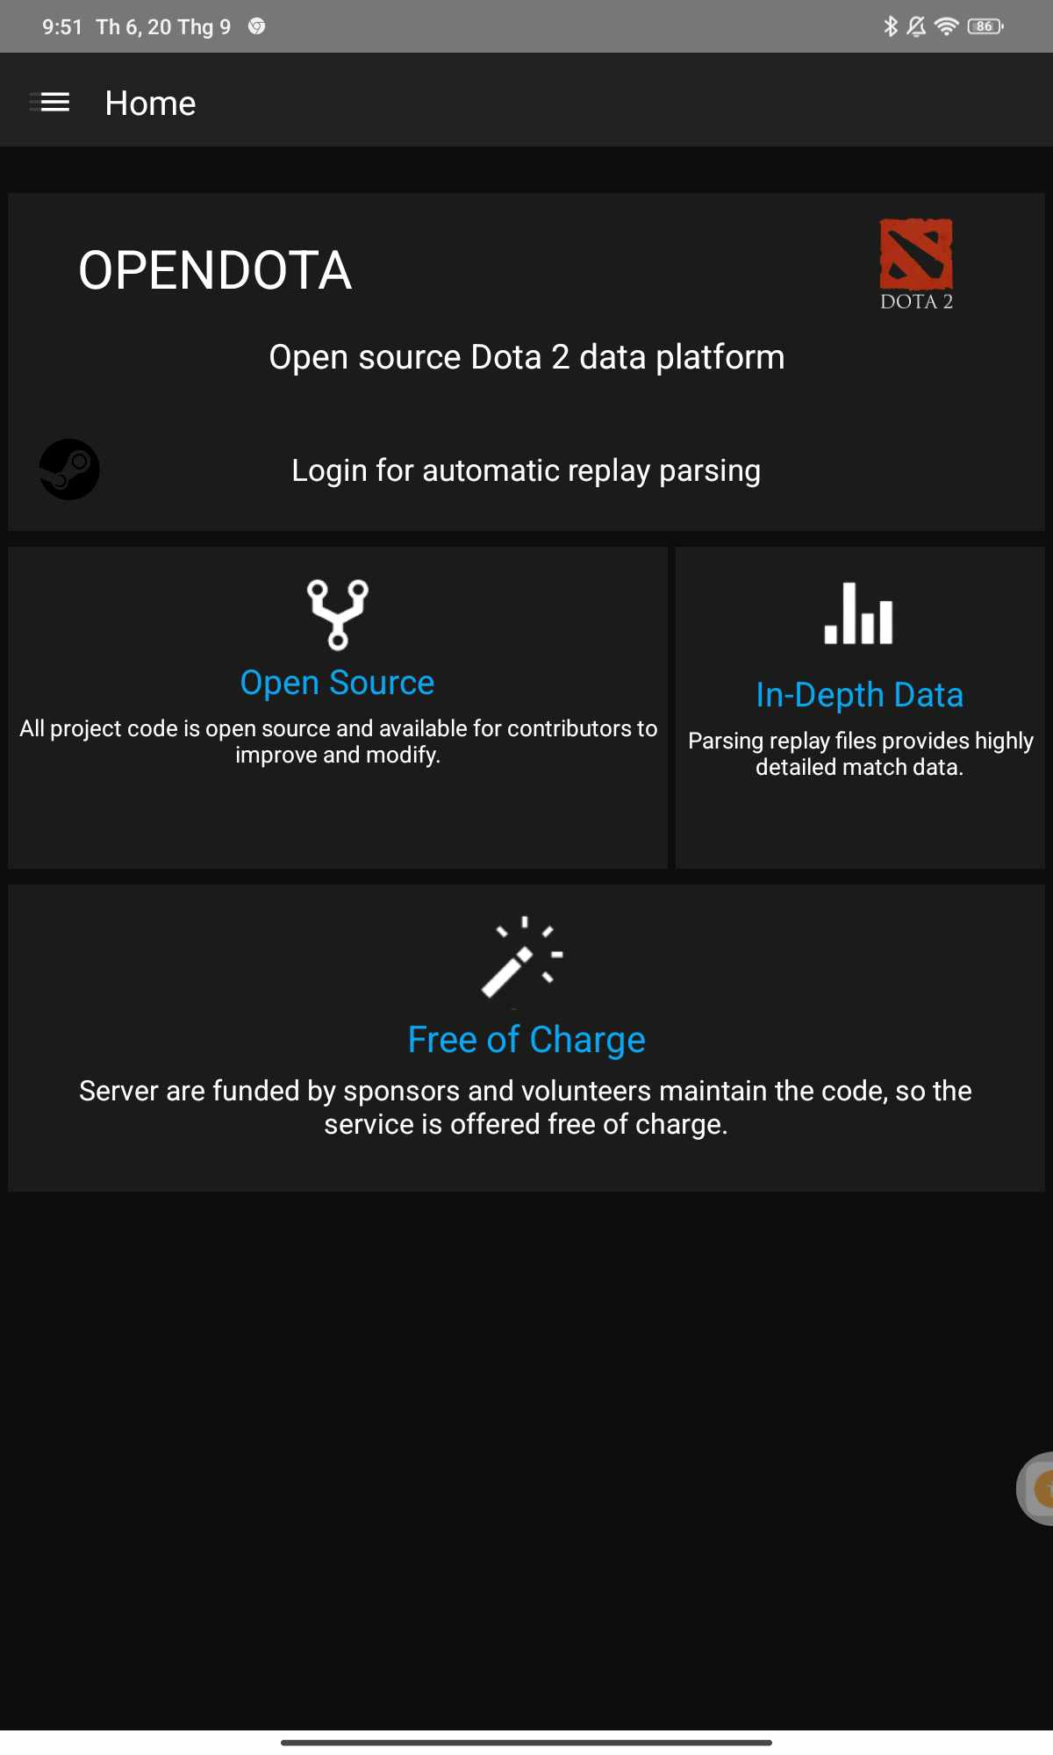
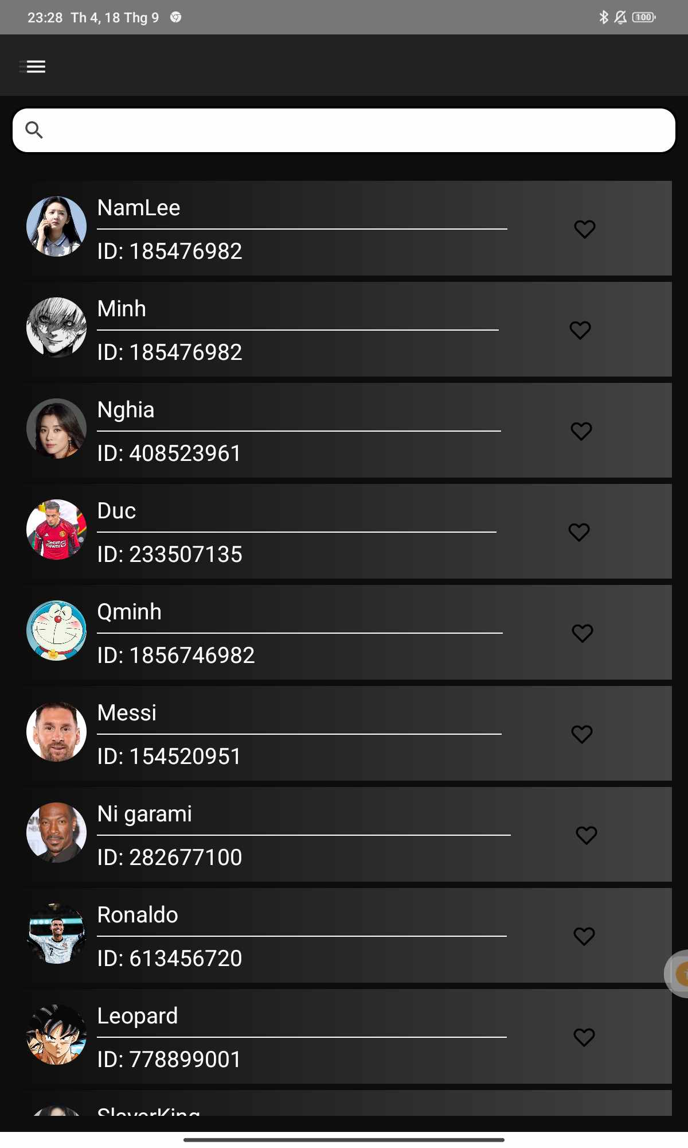
Menu
Home
Search

Slide 12
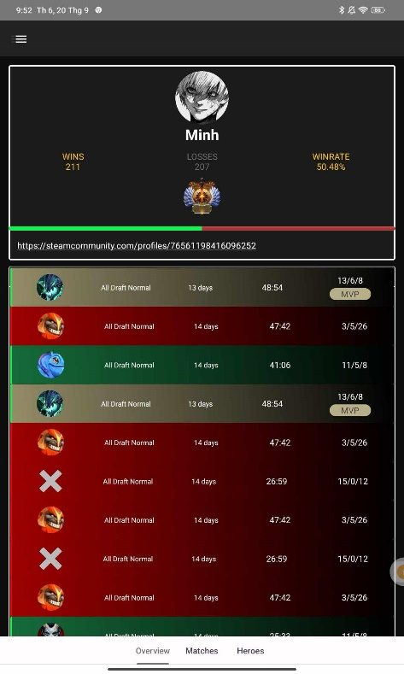
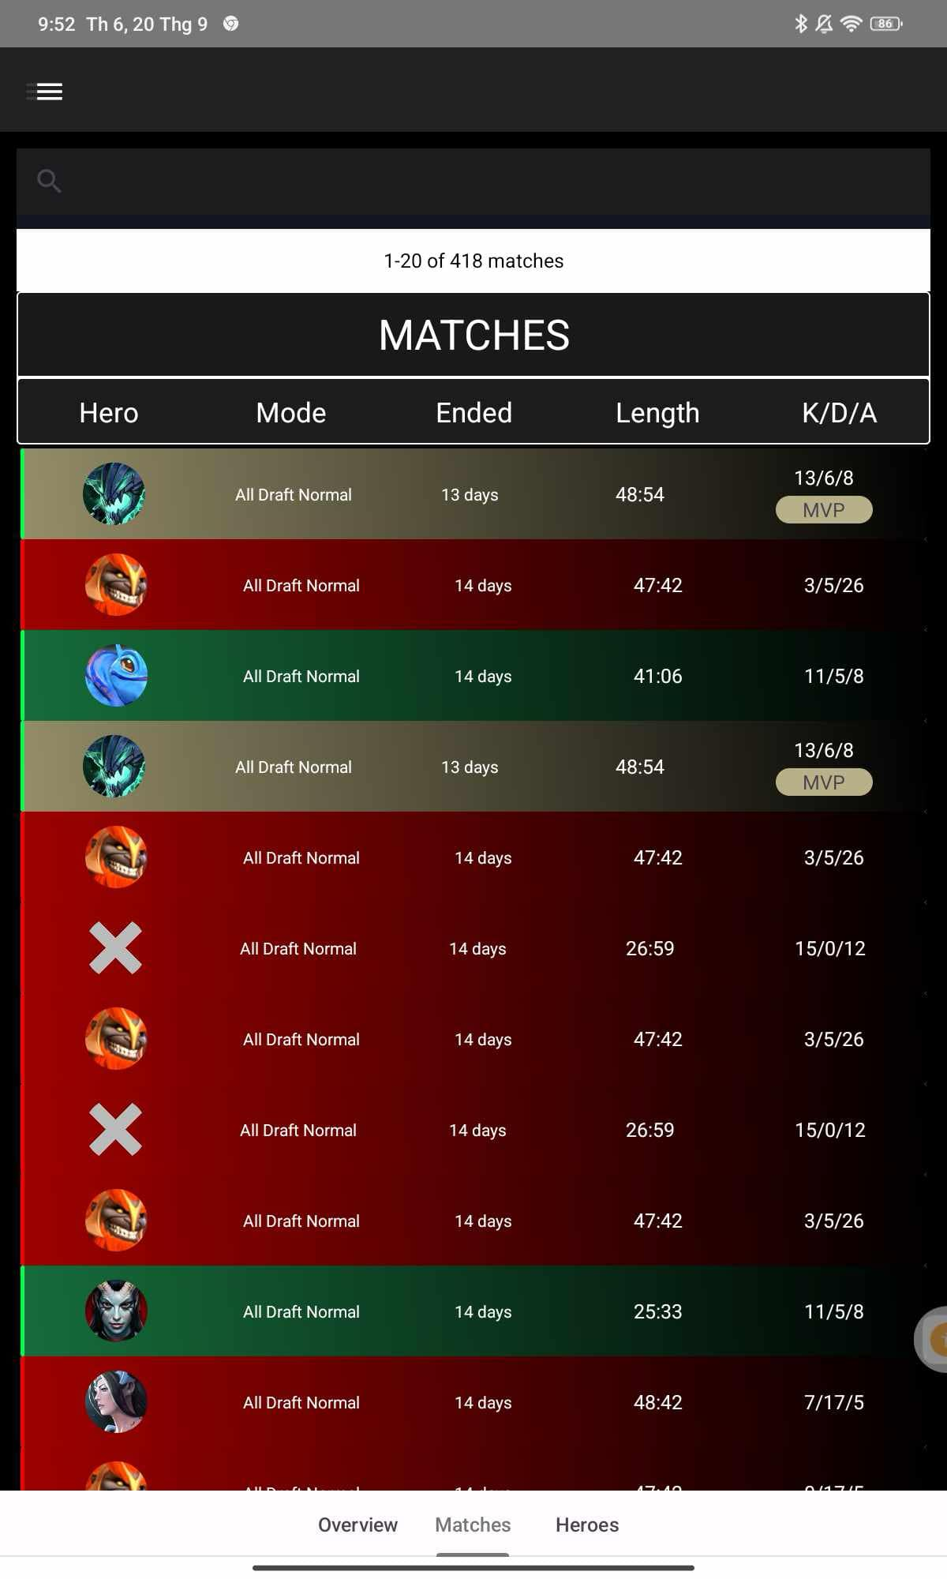
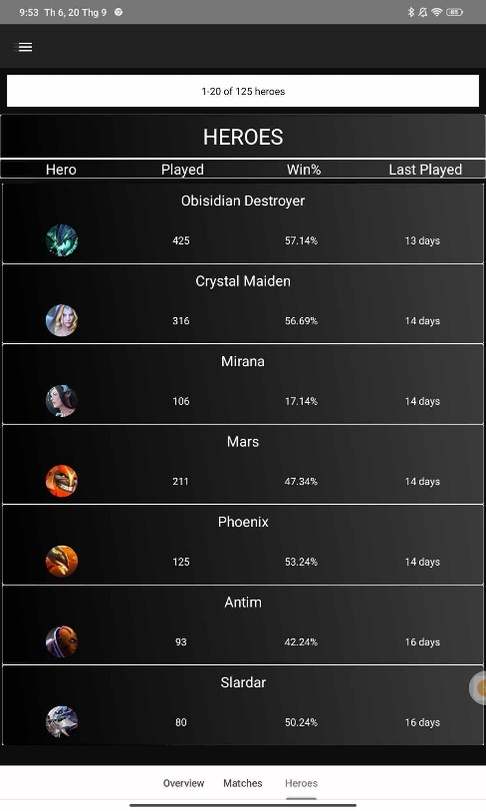
My profile

Slide 13
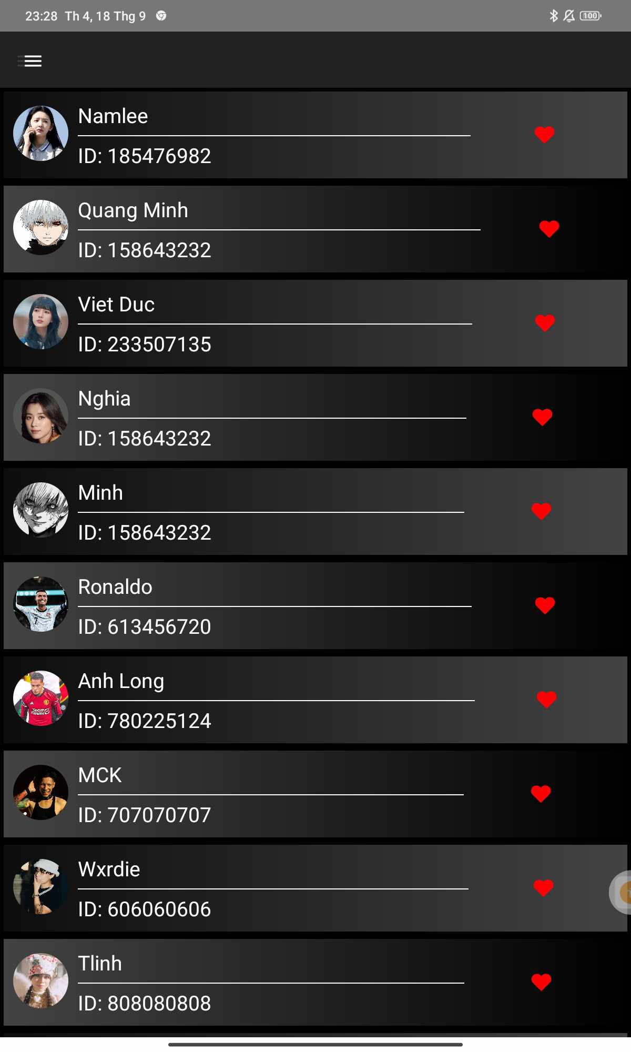
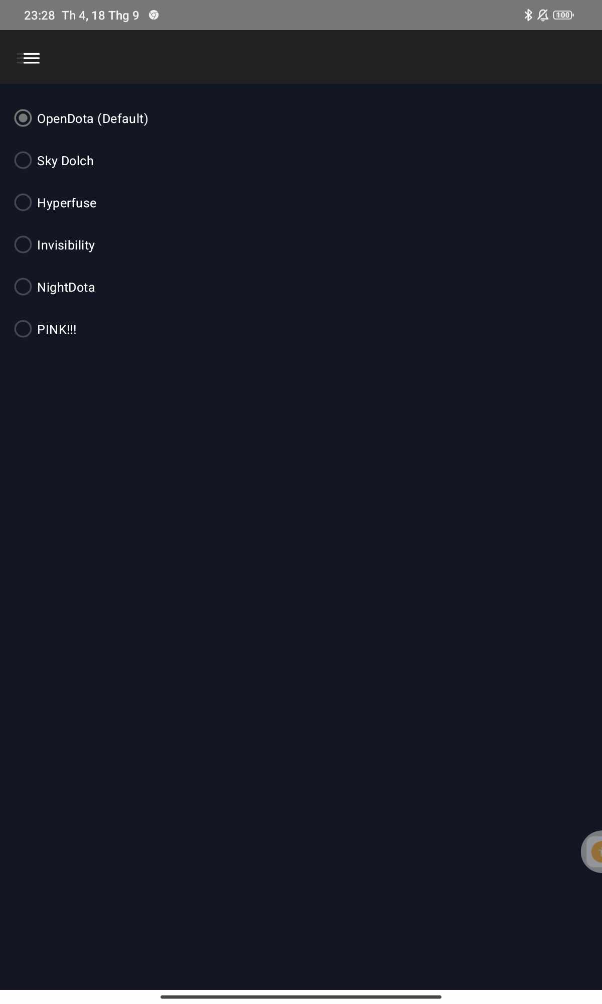
Favourite
Setting

Slide 14
04
Optimization
UI Overall Status

Slide 15

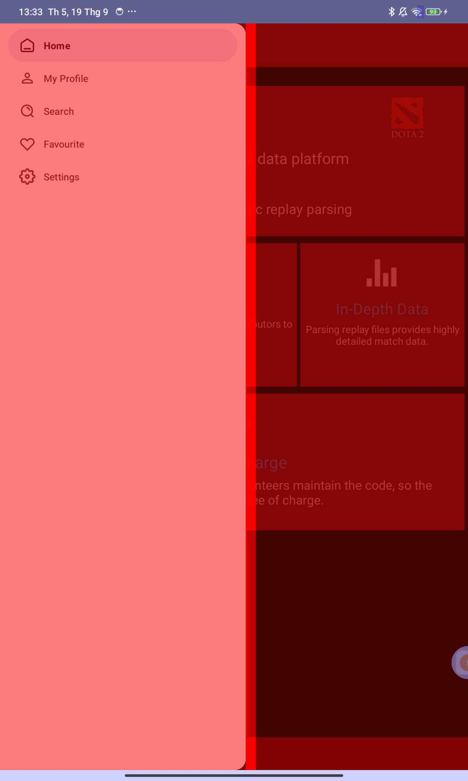
UI overdraw status

Slide 16
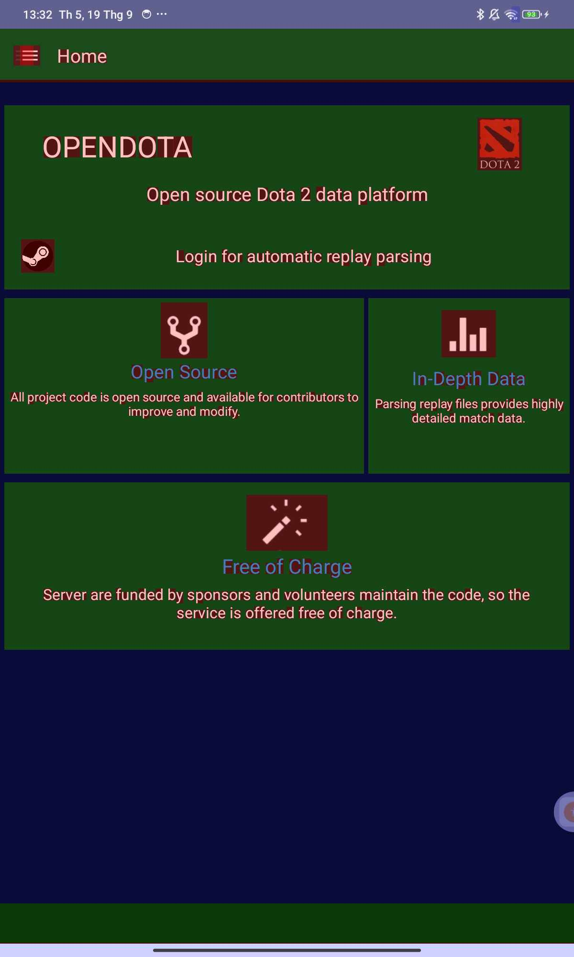
UI overdraw status

Slide 17
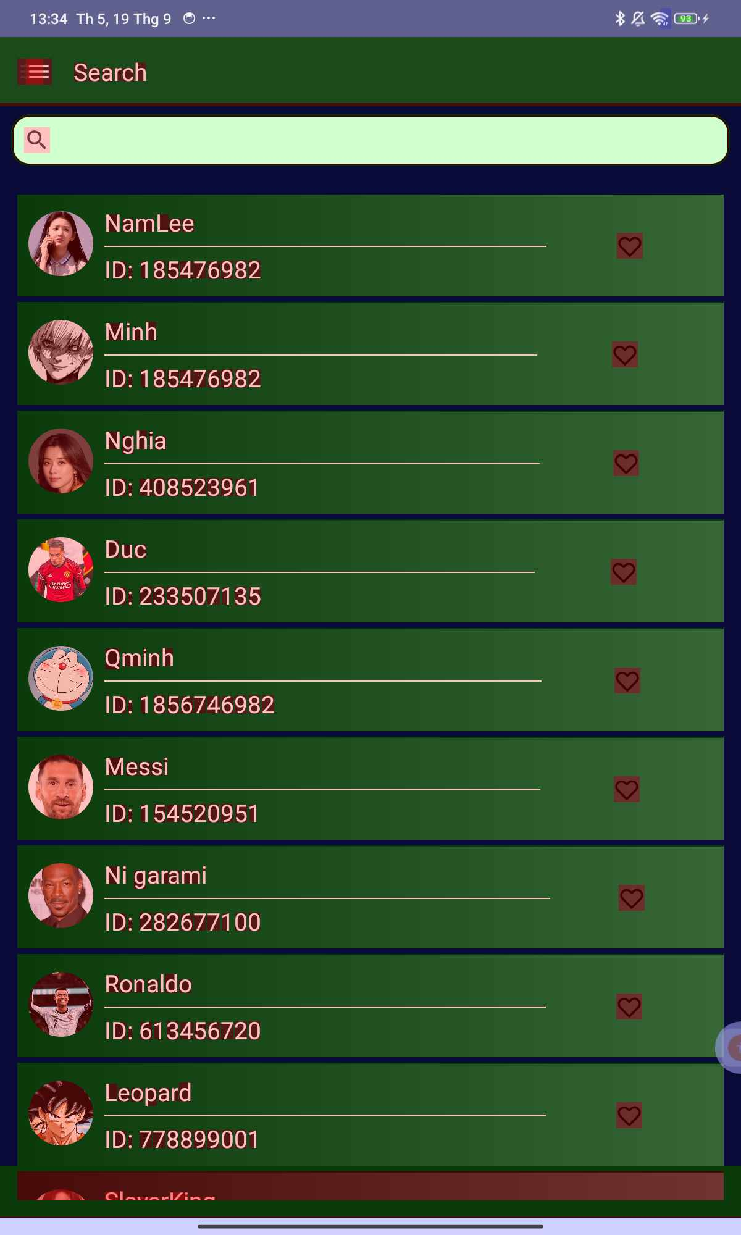
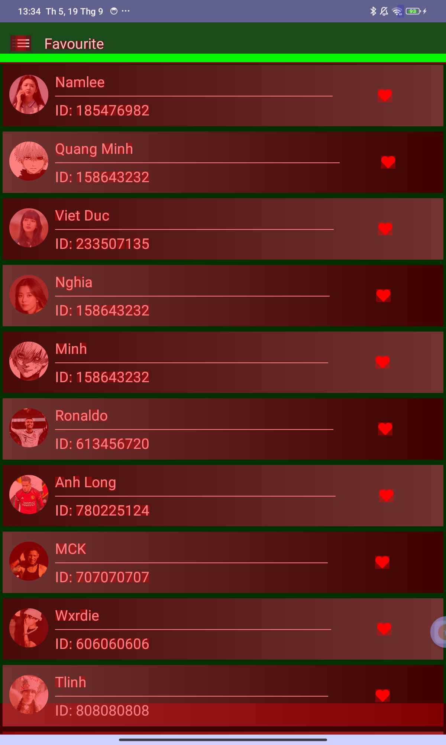
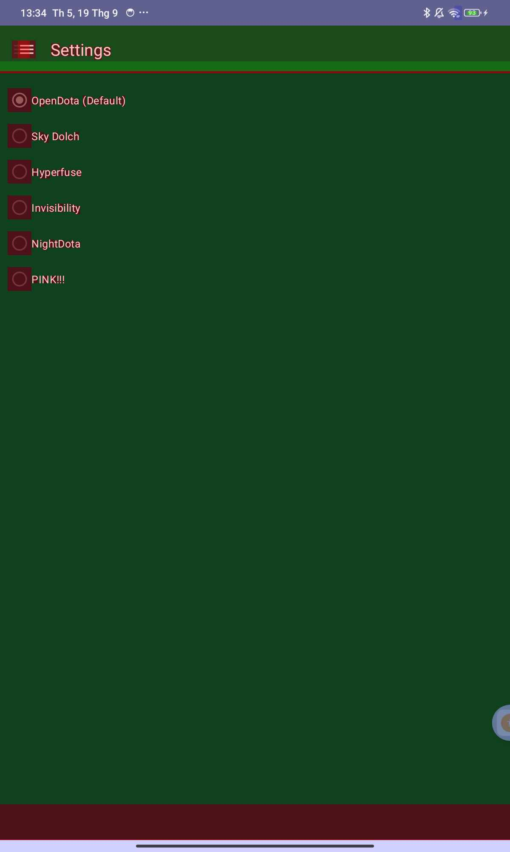
UI overdraw status

Slide 18
Demo running app
05

Slide 19
Thank you for listening !

