Slide 1
Session 1: a) Submitting an ideal IND package b) Impurity Assessments – ICH Q3A-D & ICH M7
Presenter: Tim McGovern
White Oak Regulatory Tox, LLC
February 23, 2026

Slide 2
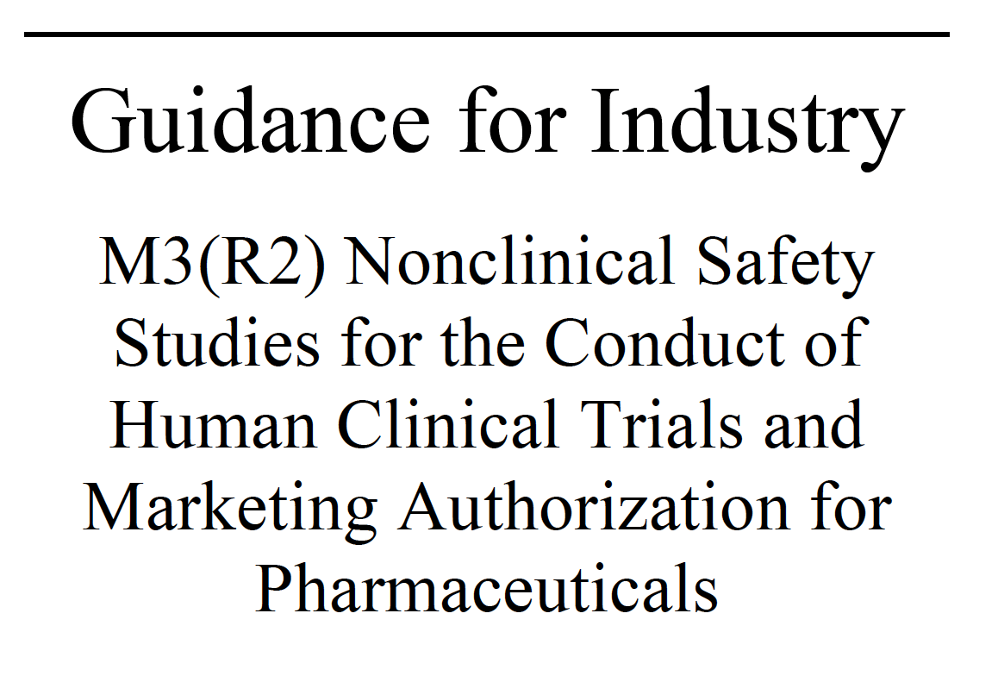
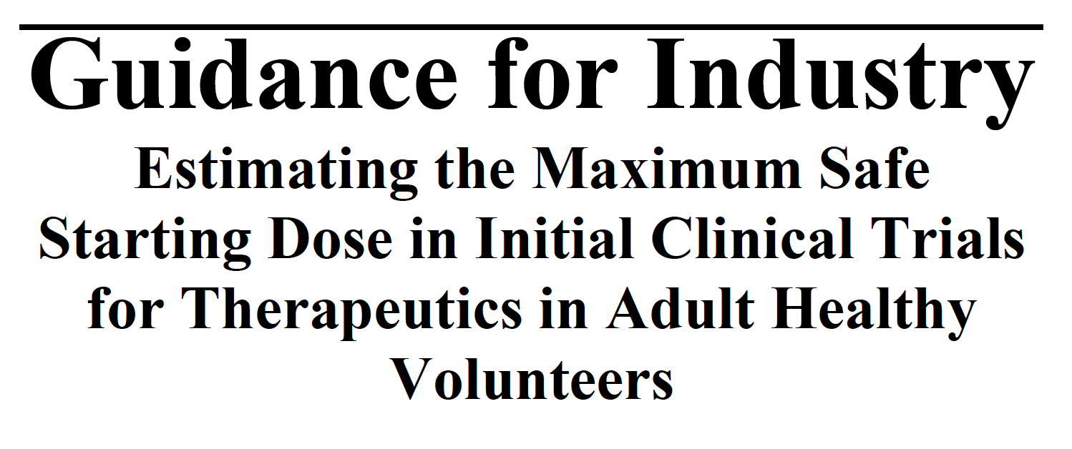
1a) Submitting an ideal IND package
Key nonclinical guidances for reference
  ICH M3(R2) – 2010
  FDA Guidance – Estimating the Maximum Safe Starting Dose in Initial Clinical Trials for Therapeutics in Adult Healthy Volunteers - 2005

Slide 3
Submitting an ideal IND package
To start:
Ideally, hold Interact and/or preIND (Type B) meeting to discuss issues with FDA review division
Interact meeting: “novel products and development programs that present unique challenges”
  Choice of appropriate models or toxicology studies
preIND:
  Ability to get initial confirmation on plans and available data

Slide 4
preIND meeting(s)
Get initial confirmation on plans/study results
  CMC
  Nonclinical
  Clinical
Goal: identify issues that may hinder development and provide guidance to facilitate the IND opening clinical trial and development program
  Include specific questions to solicit key feedback from FDA review team
  Helps to ensure a complete IND application, avoid unnecessary nonclinical studies, and prevent a clinical hold

Slide 5
FDA review team:
Clinical reviewer (medical officer)
Pharmacology/toxicology reviewer
Product quality reviewer (CMC)
Clinical pharmacology reviewer
Statistical reviewer
Regulatory project manager
Division director, deputy director and team leaders for each discipline
30-day timeframe to review and decide on proposed clinical trial
  Actual available review time is much less

Slide 6
Studies recommended by ICH M3(R2) to support FIH IND submission:
Key studies:
  Pharmacodynamics (in vitro/in vivo)
  Safety pharmacology (hERG, CV, CNS, Respiratory)
  ADME: in vitro metabolism and protein binding
  Pharmaco/toxicokinetics in nonclinical tox test species
  General toxicology – sufficient duration vs clinical (usually 2- to 4-week duration)
  Genotoxicology
    In vitro mutation supports single dose; additional clastogenicity assay for multiple dose
    Complete battery to support Phase 2
If warranted:
  Local tolerance (usually integrated in general tox studies)
  Special studies: phototox, immunotox, unique metabolites, impurities

Slide 7
Some key nonclinical review questions:
Single dose or multiple dose studies needed?
  Are the treatment durations and clinical exposures covered?
What are the target organs?
Is there a dose-response for adverse findings?
What are the Maximum Tolerated Dose (MTD) and No Observed Adverse Effect Level (NOAEL)/ No Observed Effect Level Doses (NOEL)?
What is the maximum recommended start dose?
  See FDA guidance on identification of MRSD
Is the effect reversible and/or monitorable?
  Reversibility does not impact the NOAEL dose but, along with monitorability, can support dosing beyond NOAEL

Slide 8
Some common reasons for a clinical hold:
Appropriate studies were not conducted
Nonclinical study designs were flawed
  Insufficient number of animals
  Inadequate endpoints evaluated
  Study duration not appropriate to support clinical trial duration
  Evaluated doses do not cover intended human exposures
    body surface area for FIH dosing; typically AUC-based later
NOAEL was not identified
The observed toxicities and associated exposure margins present an unacceptable clinical safety risk (ie, NOAEL exposure < clinical)

Slide 9
Some not uncommon pitfalls
Expected studies with API not conducted
  Adequate duration? Two species?
Draft reports submitted without signed pathology report
No NOAEL identified
  FDA does not always agree with study report conclusion
No target organ toxicity identified
Proposed clinical (start) dose not supported by nonclinical data (eg, NOAEL)
  generally addressed via Division/Sponsor communication
Novel excipient not adequately assessed
Lack of SEND data reports (when warranted)
Impurities not adequately assessed (esp potentially genotoxic impurities; more later)

Slide 10
Questions?

Slide 11

1b) Impurity Evaluation Topics
ICH Q3A
ICH Q3B
ICH M7(R2)
  Nitrosamines
ICH Q3C(R9)
ICH Q3D(R1)

Slide 12
Relevant ICH Guidances/FDA MAPP
ICH Guidance Q3A(R2)/B(R2) - Impurities in Drug Substances/Products
  Late stage/marketing applications
  Qualification thresholds (QTs)
  General guidance of how to qualify above the QT
ICH M3(R2) – Nonclinical Safety Studies for the Conduct of Human Clinical Trials and Marketing Authorizations of Pharmaceuticals
FDA MAPP 5017.2 Rev 1 (2018) – Establishing Impurity Acceptance Criteria as Part of Specifications for NDAs, ANDAs, and BLAs Based on Clinical Relevance

Slide 13
ICH Guidance Q3A(R2)/B(R2) –
Impurities in Drug Substances/Products
ICH Q3A/B: Guidances do not apply to new DS or DP used during the clinical research stages of development
In later stages of development, the QTs may be useful in evaluating new degradation products observed in new drug product batches prepared by proposed commercial process
However, ICH M3(R2)states:
  If specific studies are warranted to qualify an impurity or degradant, they are generally not warranted before Phase 3 unless changes result in a significant new impurity profile
  Appropriate qualification studies can be warranted to support phase 2 or later

Slide 14
ICH Guidance Q3A(R2)/B(R2) – Safety Qualification
Qualification: the process of acquiring and evaluating data that establishes the biological safety of an individual degradation product or profile at the levels specified
The level of any degradation product present in a new DS/DP that has been adequately tested in safety and/or clinical studies would be considered qualified

Slide 15
ICH Guidance Q3A(R2)/B(R2) – Thresholds
ICH Q3A (R2): drug substances

Slide 16
ICH Guidance Q3A(R2)/B(R2) – Thresholds
ICH Q3B (R2): drug products

Slide 17
ICH Guidance Q3A(R2)/B(R2) – Safety Qualification
Higher or lower levels may be appropriate based on scientific rationale and level of concern, including drug class effects and clinical experience
  e.g., mutagenic impurities (discussed later under ICH M7)
When QTs are exceeded,
  reduce level to less than or equal to QT
  support based on adequate data in the scientific literature
  consider conducting additional safety testing

Slide 18
ICH Guidance Q3A(R2)/B(R2) – Qualification
Any
known human
relevant risks^{d}?

Slide 19
ICH Guidance Q3A(R2)/B(R2) – Qualification

Slide 20
Safety qualification approaches in FDA OND
Some variations in approach exist based on internal (2024) survey*:
When impurity is present in batches used in nonclinical toxicology studies, one approach includes:
  Calculate impurity dose at NOAEL from nonclinical study
  Convert to HED (based on BSA)
  Compare to maximum human exposure
  Expect safety margin of at least 1X at NOAEL dose
*Presented at American College of Toxicology 2024 Annual Meeting

Slide 21
Safety qualification approaches in FDA OND
Other approaches include:
  Compare mg/kg doses (rather than HED, BSA)
  Expect safety margins of at least 2X at NOAEL dose
  When NOAEL dose does not provide adequate safety coverage and effects clearly API-related, consider safety margins at doses above the NOAEL

Slide 22
What about early clinical trials?
No guidances currently exist that address early phase clinical trials
  Recognized that manufacturing processes still being refined
  Uncertainty as to appropriate ways to address drug-related impurities
ICH M3(R2):
  If studies are warranted, generally these studies are not warranted before phase 3 unless there are changes that result in a significant new impurity profile (e.g., a new synthetic pathway, a new degradant formed by interactions between the components of the formulation).
  In these latter cases, appropriate qualification studies can be warranted to support phase 2 or later stages of development.
*Presented at American College of Toxicology 2024 Annual Meeting

Slide 23
Safety qualification approaches in FDA OND
When impurity is not present in API batches used in nonclinical toxicology studies or proposed specifications > Q3A/B QTs :
  Some review divisions have allowed for some flexibility above ICH Q3A/B QTs for early clinical development
    Recommend further refinement as development continues
  Others have relied on the Q3A/B QTs in absence of other accepted thresholds and request safety information to support levels > QTs

Slide 24
Safety qualification approaches in FDA OND
Overall, requests to provide additional nonclinical data are relatively infrequent
  Sponsors typically able to adjust their specifications when necessary
    Noted that behind scenes work often done on industry side prior to submissions to avoid potential regulatory pushback
  If a study is recommended, study duration can range from single dose extended study (pre-operative procedure) to 90 days (chronic administration)
  Generally, accept proposed species with sufficient justification
    rodent most common

Slide 25
Safety qualification approaches in FDA OND
Overall, requests to provide additional nonclinical data are relatively infrequent (cont’d)
  Generally, isolated impurity or enriched/degraded API is acceptable
  Dose groups: typically include 1 to 3 dose groups
  Animal #s: varies, some recommend standard #s as in general tox studies;
  Sex: usually male & female included
    Use of single sex accepted with justification

Slide 26
Role of clinical experience
When clinical experience is available, it can alleviate some concern with impurity exposures, assuming no concerning findings are observed
However, there are limits:
  Lack of histopathology to fully evaluate toxicity profile
  Clinical trials generally increase in duration for many indications
  Not a factor for first-in-human trials unless impurity was observed with other programs

Slide 27
Impurities that are also metabolites
ICH Q3A/B – impurities/degradation products that are also significant metabolites present in animal and/or human studies are generally considered qualified
However, the mere presence of a metabolite in an animal model usually not sufficient
  Demonstrate that sufficient levels generated in animals compared to maximum potential human exposure

Slide 28
Industry proposals for safety qualification
Various published proposals re safety qualification approaches and thresholds for early stages of clinical development
Harvey et al (2017) proposal was topic of discussion/break-out sessions at 2018 FDA meeting with BioSafe/DruSafe:
  General non-familiarity with proposal
  Wide variety of approaches applied
  No conclusion on Harvey et al proposal; needs further consideration
Subsequent related publications include:
  Hasselgren et al, 2024
  Graham et al, 2021
  Kenyon et al, 2024
  Mitra et al, 2021
  Slikkerveer et al, 2024

Slide 29
Perspectives on current industry evaluations/proposals
Generally, has not been an area of significant focus/perceived impact from FDA/OND review divisions
  Not a significant role in clinical hold decisions
  One case: animal lethality attributed to DS impurity identified in a pIND package
Industry evaluations/proposed best practices do add value
  Basis of Q3A/B QTs has been questioned; assessment confirms safety of 1 mg/day exposure
  Q3A/B provide limited to no guidance on
    Early clinical development considerations
    What represents an acceptable qualification approach based on general toxicity data

Slide 30
Perspectives on current industry evaluations/proposals
The proposed qualification thresholds (5 mg/day > 1 month and 20 mg/day for up to 1 month and 20 mg/day) seem reasonable based on the data assessment in the relevant publications for orally administered drugs.
  Further formal assessment needed (status?)
  Encourage interaction with review divisions on specific applications
As noted in Kenyon et al 2024, quality considerations should be taken into account as well as safety

Slide 31
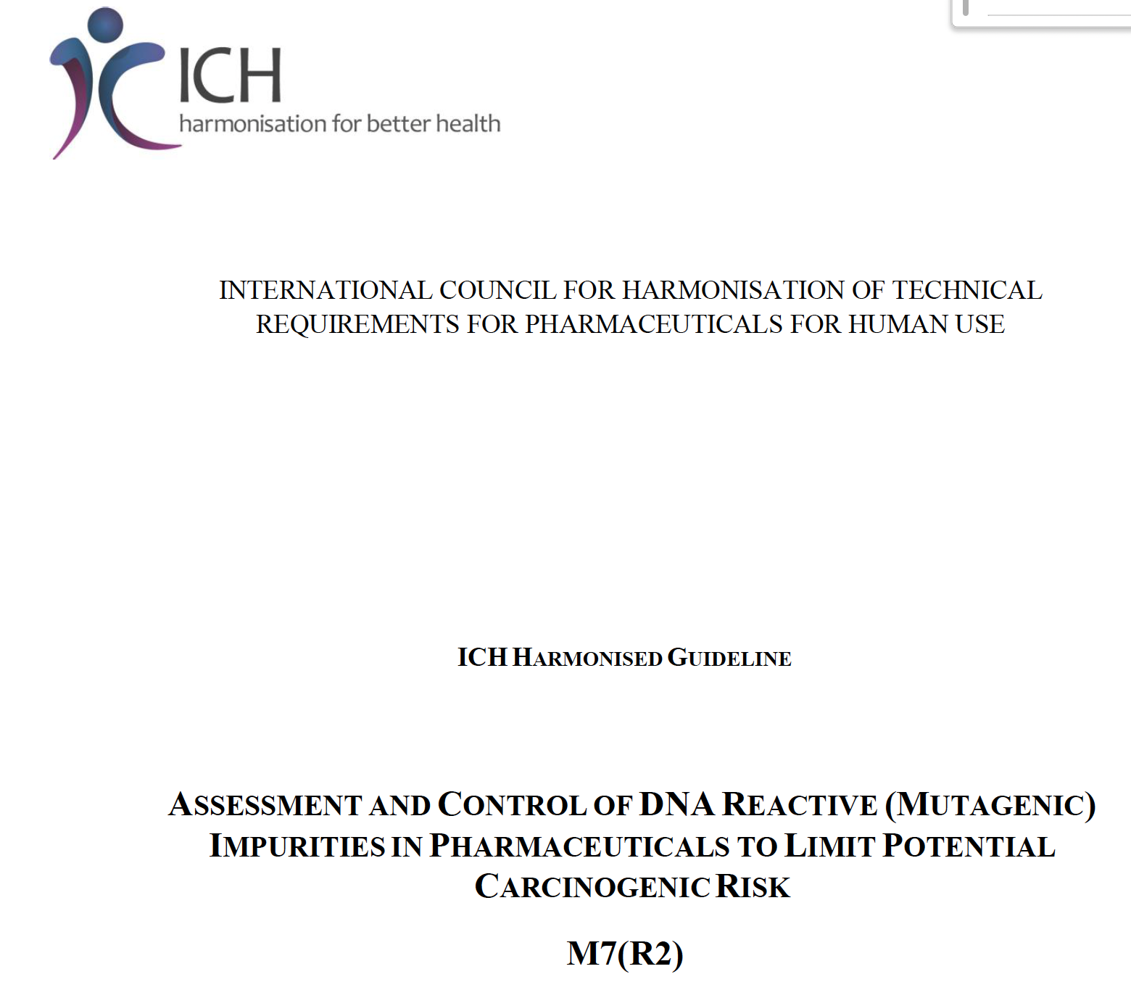
Impurity Evaluation Topics
ICH Q3A
ICH Q3B
ICH M7(R2)
  Nitrosamines
ICH Q3C
ICH Q3D

Slide 32
ICH M7(R2) – DNA reactive (mutagenic) impurities
From Q3A/B:
  Higher or lower levels may be appropriate based on scientific rationale and level of concern, including drug class effects and clinical experience
Regional guidances developed in early 2000’s to address mutagenic impurities
Eventual adopted as a topic for harmonization by ICH with both safety and quality aspects

Slide 33
ICH M7(R2) – Overview
M7 provides recommendations on how to assess and control mutagenic impurities
Recommends selecting potential impurities based on the risk of presence at relevant levels in the drug substance or drug product
Utilizes Structure Activity Relationship to assess and predict mutagenicity potential (Hazard Identification) and if warranted, control or determine risk (Risk Assessment)
Applies the concept of TTC (Threshold of Toxicological Concern) and classifies impurities into 5 classes based on mutagenicity and carcinogenicity
Applies LTL (Less-Than-Lifetime) limits based on duration of use providing a flexible and practical approach during clinical development and marketing
Outlines flexible ways to control mutagenic impurities, and a staged approach to documentation during development
Impurity monographs with identified Acceptable Intakes or Permissible Daily Intakes

Slide 34
ICH M7(R2) – Hazard Assessment
Actual and potential impurities are assessed for mutagenic hazards
Known mutagen - evaluate literature and databases
Structure of unknown mutagenicity - perform a computational toxicology assessment using (Q)SAR methodologies that predict bacterial mutagenicity
  Employ two complementary (Q)SAR systems (expert rule-based and statistical based)
  Apply expert knowledge to review outcomes if warranted
  Absence of structural alert is sufficient to conclude that impurity is of no concern, and no further testing is recommended

Slide 35
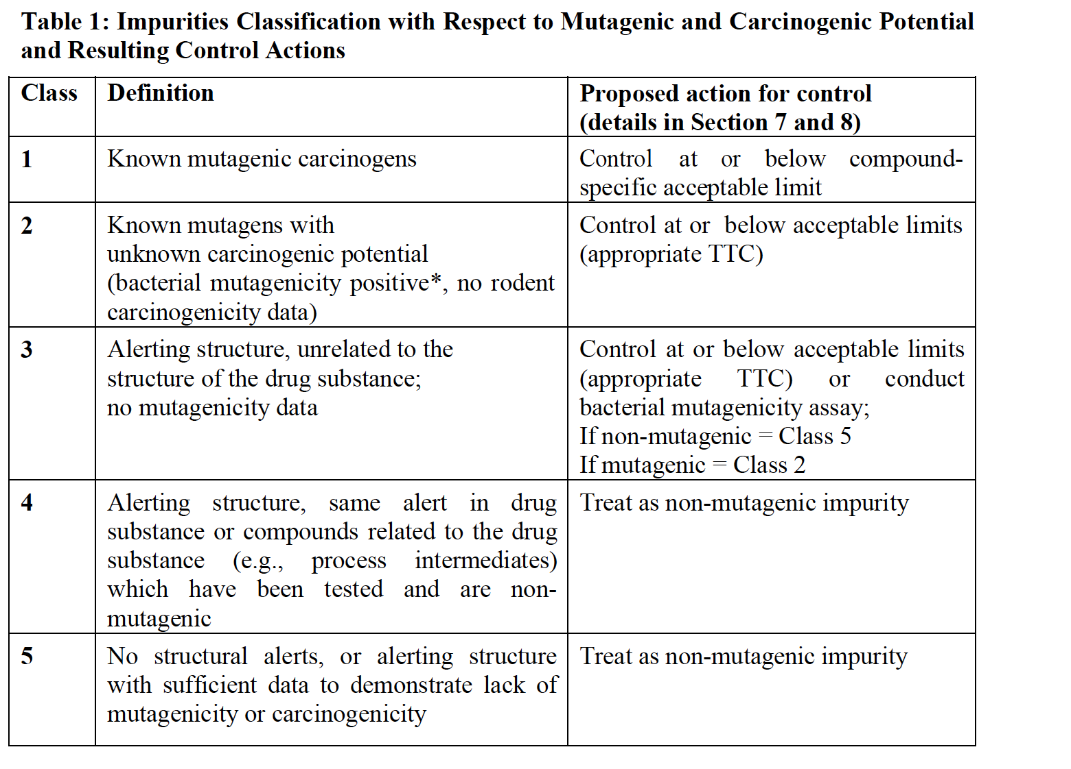

Slide 36
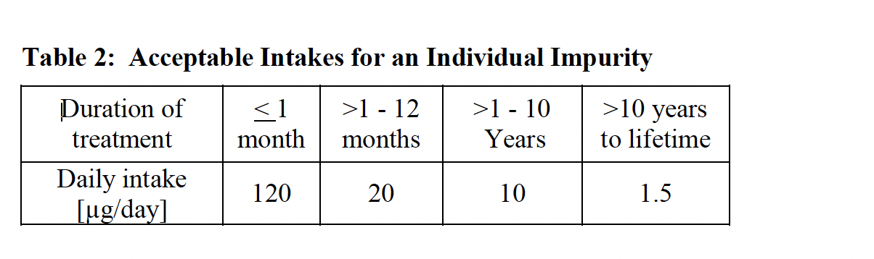
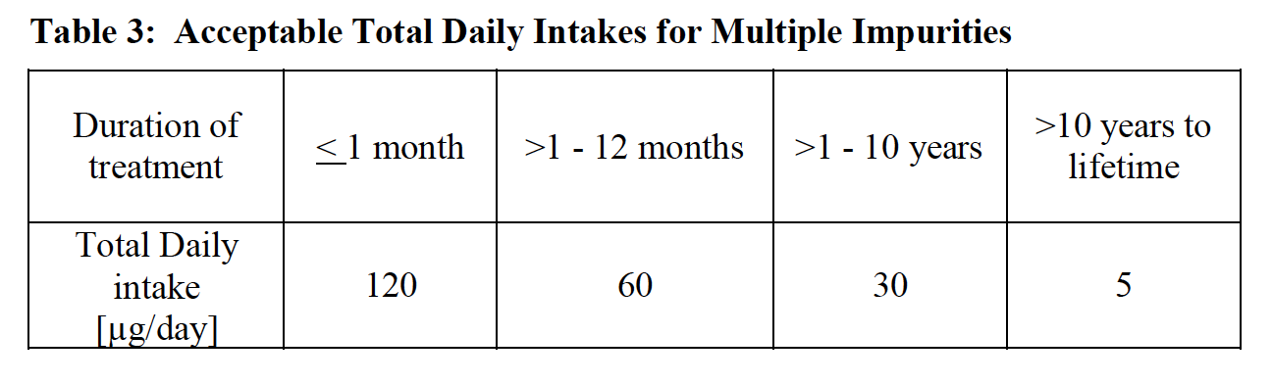
ICH M7(R2) – Hazard Assessment – LTL adjustments

Slide 37
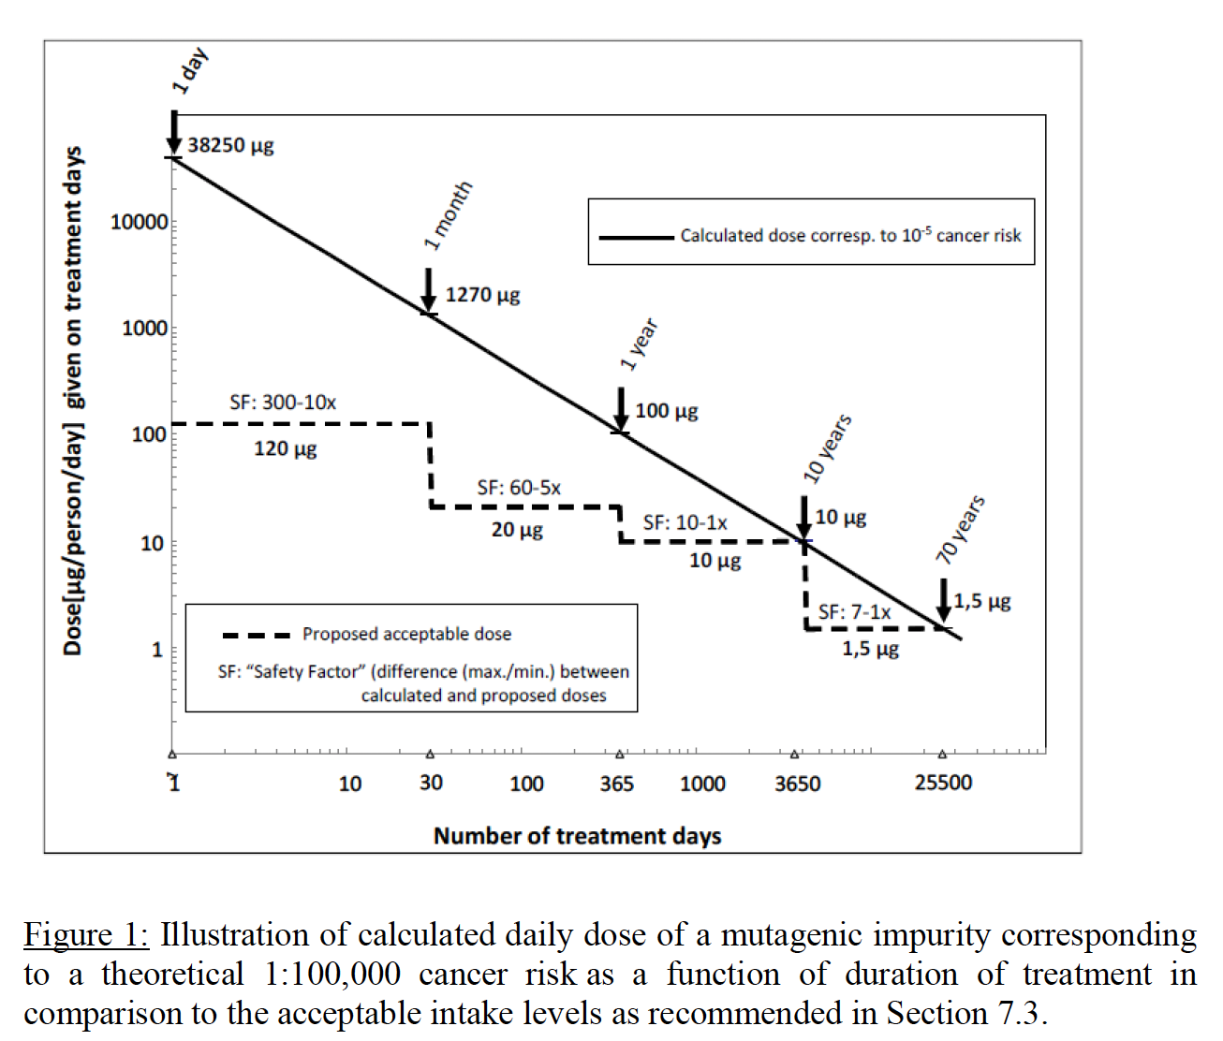
ICH M7(R2) – Hazard Assessment – LTL adjustments

Slide 38
ICH M7(R2) – Documentation & Timing
Phase 1 (1 to 14 days):
  Description of efforts to mitigate risks of mutagenic impurities focused on Class 1, and Class 2 impurities and those in the cohort of concern as outlined in Section 7 should be included
Phase 1 (> 14 days) and Phase 2a:
  Additionally, Class 3 impurities that require analytical controls should be included
Phase 2b and 3:
  A list of the impurities assessed by (Q)SAR should be included,
  Any Class 1, 2 or 3 actual and potential impurities should be described along with plans for control.
  The in silico (Q)SAR systems used to perform the assessments should be described.
  The results of bacterial mutagenicity tests of actual impurities should be reported.
Marketing Application:
  Results and description of (Q)SAR systems used and supporting information
  Ames mutagenicity study reports
  Justification for proposed specifications and approach to control (eg, purge factors)

Slide 39
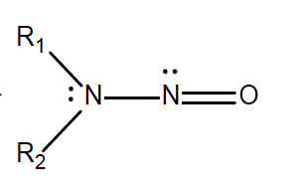
Nitrosamines – hot area since 2018
  ICH M7: Certain structural groups were identified to be of such high potency that intakes even below the TTC (1.5 ug/day) would theoretically be associated with a potential for a significant carcinogenic risk
  Referred to as the “cohort of concern”
    comprises aflatoxin-like-, N-nitroso-, and alkyl-azoxy compounds
    acceptable intakes for these high-potency carcinogens would likely be significantly lower than the acceptable intakes defined in this guideline
    a case-by-case approach using e.g., carcinogenicity data from closely related structures, if available, should usually be developed to justify acceptable intakes for pharmaceutical development and marketed products

Slide 40
Nitrosamines - Risk Assessment Considerations
Single or multiple nitrosamines detected in the drug product
  Analytical method sufficiently sensitive and validated
  Root cause investigation
  How many lots affected?
What is the acceptable intake (AI) limit for the nitrosamine in the drug product?
  Availability of nonclinical data?
  Identification of appropriate surrogate compound to enable a read-across

Slide 41
Nitrosamines - Risk Assessment Considerations
Medical necessity of approved drug product
  Are batch levels > AI limit
  Impact of drug recall on potential drug shortage
  Availability of therapeutic alternatives
Is Regulatory Discretion warranted? If so, to what level?

Slide 42
Nitrosamines - Risk (Safety) Assessment Considerations
Initial focus primarily on specific compound assessment or read across assessments to “robustly” tested nitrosamines (NDMA, NDEA, NPIP)
  Acceptable Intake determination for a given NA - time consuming
    Internal Agency assessment
    Discussion with other agencies (NITWG) to achieve harmonization
  Relatively few robustly tested options
  Most AI’s limits defaulted to NDEA or NDMA with some exceptions (eg, NPIP)
  Eventual “default” limit of 18-26.5 ng/day for NAs/Nitrosamine Drug Substance-Related Impurities (NDSRIs) with inadequate supporting data

Slide 43
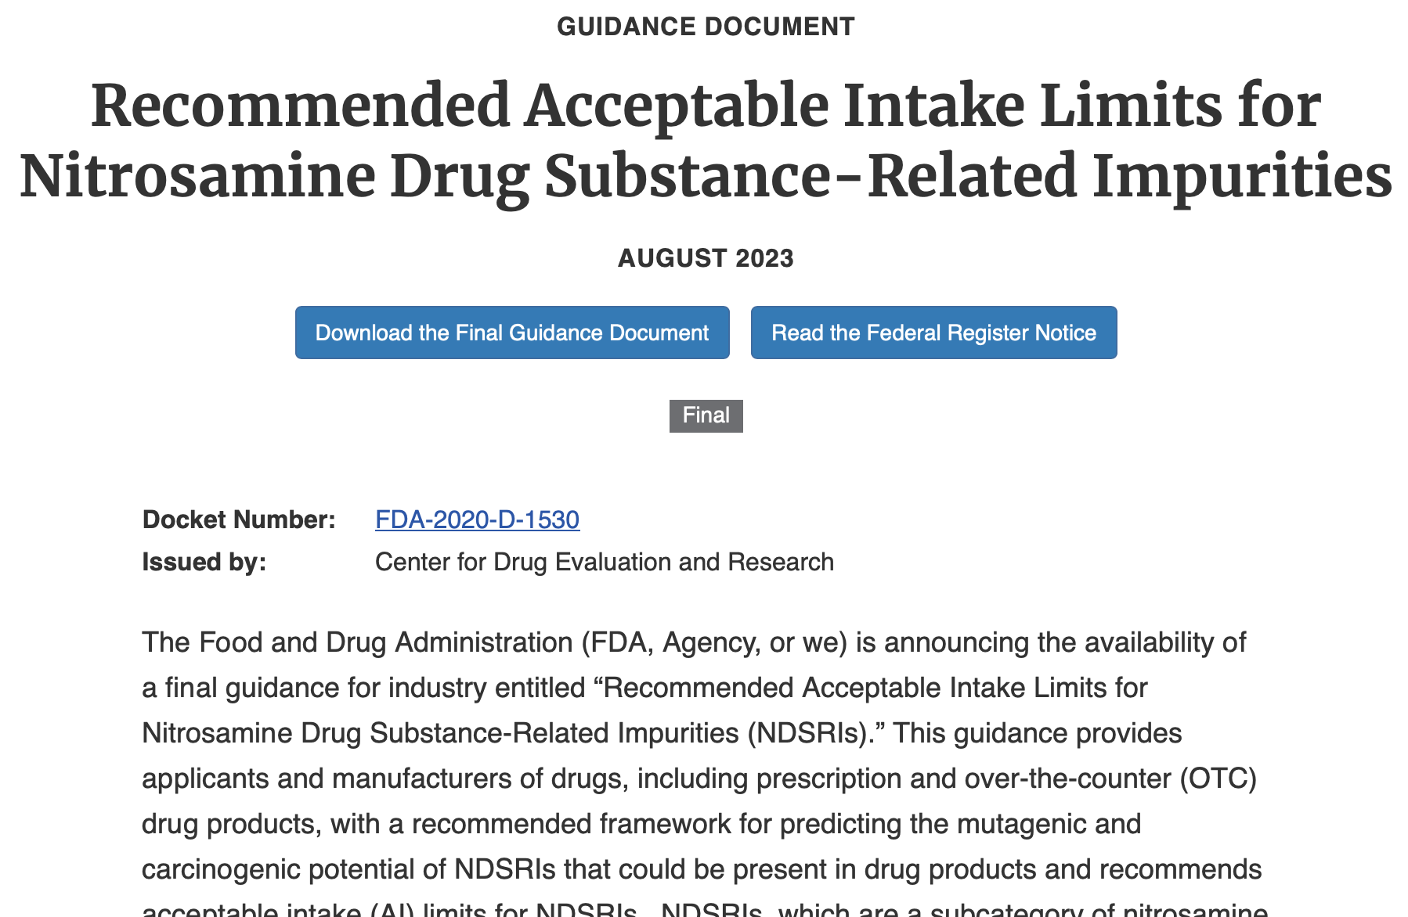
FDA published NDSRI Guidance and associated website in 2023 – periodically updated
https://www.fda.gov/regulatory-information/search-fda-guidance-documents/cder-nitrosamine-impurity-acceptable-intake-limits

Slide 44
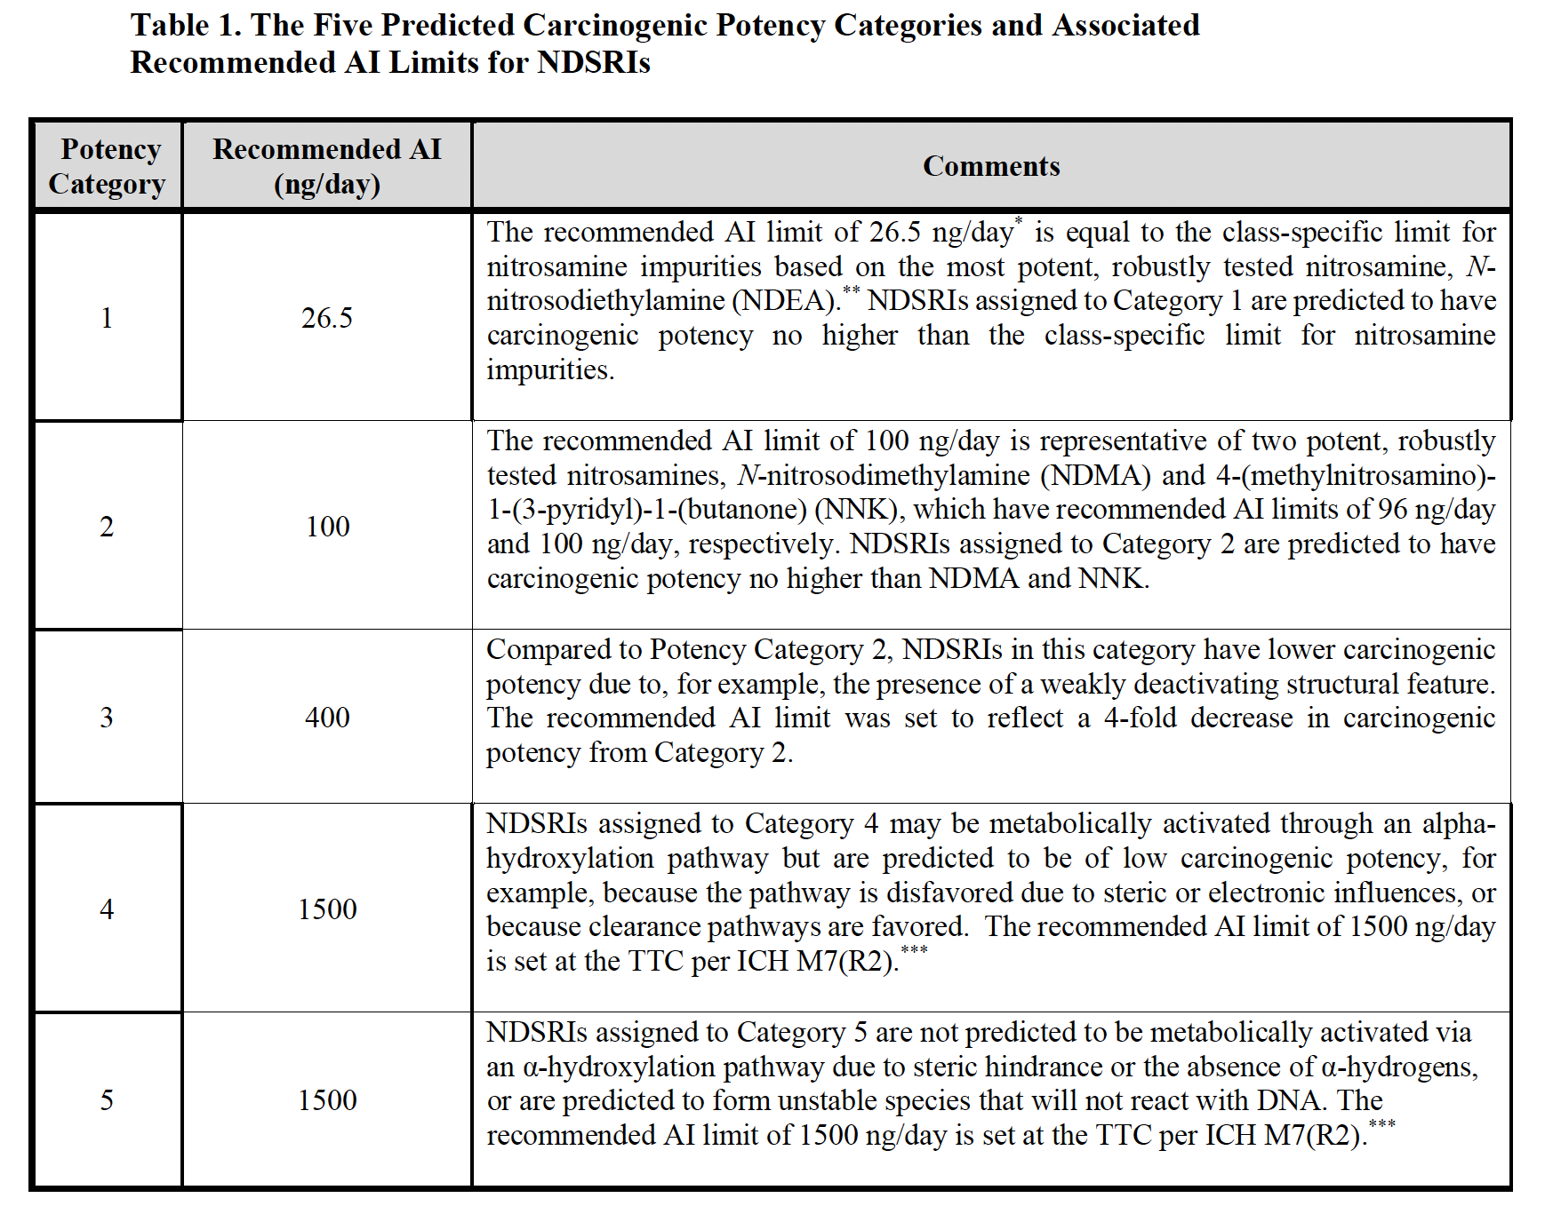
Introduction of the CPCA
Based on activating and deactivating structural features
Carcinogenic Potency Category Approach (CPCA) is a conservative approach
The science is evolving
May change over time as science advances and additional data are generated
FDA NDSRI Guidance, 2023
Notes:
Re change in CPCA: talk towards or include what the reg agencies may be looking to for changing criteria?
Table will be difficult for attendees to read so be sure to call out key specifics

Slide 45
Determination of alternative AI limits outside of the CPCA
Compound-specific (not common)
Testing-based – see following slides
Read across (surrogate) analysis
  time consuming and likely supports increasing only within range of one CPCA category to another
Regulatory activities involve some prioritization of efforts
  Consider observed levels in drug product
  If CPCA provides adequate coverage, consideration of alternative AI limits likely a reduced prioritization

Slide 46
Testing-based strategy
Negative testing results?
For proposal to support up to 1500 ng/day
  In US and other regions: negative Enhanced Ames Test (EAT)
  Additionally in US: in vitro metabolism data and mammalian cell assay
    Potential for future modification with publication of EAT study results
To support AI limits > 1500 ng/day
  Negative transgenic rodent mutation assay (e.g., Big Blue, MutaMouse assays)
Notes:
EAT: speak to it or mention here what it involves or how it differs from the standardly done Ames that also uses S9. Refer to Tetyanas talk for more detail

Slide 47
Testing-based strategy
  Most Drug Regulatory Agencies accept negative in vitro/in vivo dataset to categorize NA as “non-mutagenic impurity”
    Refer to ICH Q3A/B QTs
  FDA: could accept up to Q3A/B QTs but also considers observed levels in drug batches in setting specifications
    Residual concerns with polypharmacy and/or products with multiple impurities

Slide 48
Testing based strategy
Positive results?
  Generally, refer back to CPCA (or surrogate analysis if relevant)
  Note: Research ongoing with proposals to identify AI limits based on Benchmark Dose calculations from in vivo mutation assays or based on comparative potency to “anchor” compounds.
  See later discussion on ICH EWG plans

Slide 49
ICH M7: Less than Lifetime (LTL) Approach
Not currently accepted for NAs by regulators due to concerns with:
  High potency: tumor induction after single doses
  Potential to overwhelm DNA repair mechanisms
  Polypharmacy
  Limited exception: EMA specific carve out for approved products:
    Up to 3 yrs during “corrective and preventive actions”
    Factors of 6.7-13.3X can be applied to NAs in CPCA categories 1 to 4
  Ongoing efforts to assess NA data to support use of M7 LTL approach

Slide 50
Ongoing research initiatives to address data gaps
EMA-funded MutaMind consortium conducted at Fraunhofer Institute
FDA National Center for Toxicological Research
HESI GTTC Nitrosamines Research Project
Others
Focus on optimizing Ames assay and demonstrating potency correlations across in vitro and in vivo mutagenicity assays and carcinogenicity.
Further informed by 2023 FDA/HESI Research Roadmap Planning workshop to identify and prioritize research gaps

Slide 51
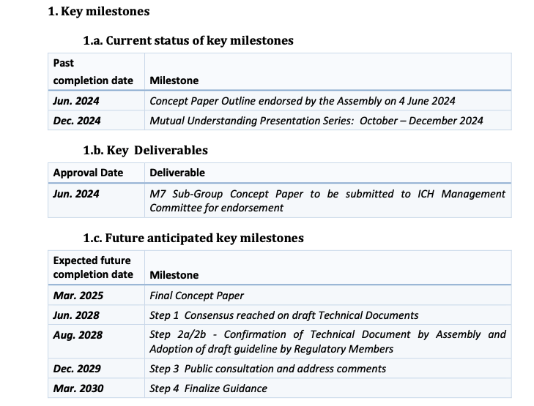
ICH M7 Sub-group: Risk Assessment and Control of Nitrosamine Impurities
ICH M7 Sub-group Work Plan as of March 2025

Slide 52
Nitrosamines - Risk Assessment & Timing
Focus has primarily been on previously approved products and new marketing applications & supplements
  FDA/Health Canada set August 2025 timelines for submission of risk assessments
  Modified to allow for updates of plans to address issues with timeline
Attention during clinical development has been case by case
  Based primarily on known concerns/previously established AI limits

Slide 53
Impurity Evaluation Topics
ICH Q3A
ICH Q3B
ICH M7(R2)
  Nitrosamines
ICH Q3C
ICH Q3D

Slide 54
ICH Q3C (R10) – Impurities; Residual Solvents
Original guidance finalized July 1997
Currently on 10th revision (R10) in maintenance cycle
Goal of ICH Q3C: To recommend Permitted Daily Exposure (PDE) levels of residual solvents in pharmaceuticals to ensure patient safety
  Recommends use of less toxic solvents and provides acceptable levels for some

Slide 55
ICH Q3C(R10) – Residual solvents
Background
  Organic volatile chemicals used or produced in manufacture of drug substances or excipients or in preparation of drug products
  Does not address solvents deliberately used as excipients
  No therapeutic benefit – should be removed to extent possible to meet specifications, GMP or other quality-based requirements.
    Drug products should contain no higher levels than can be supported by safety data

Slide 56
ICH Q3C(R10) – Residual solvents
General principles
  Permissible daily exposure (PDE): pharmaceutically acceptable intake of residual solvents (to avoid confusion of differing values for ADIs of the same substance).
Consider:
  Patients using medications to treat disease
  Life-time exposure not necessary for most products but may be appropriate as working hypothesis
  Solvents are unavoidable components in drug production
  Solvents should not exceed recommended levels (with exceptions)
  Supporting tox studies should use appropriate protocols

Slide 57
ICH Q3C(R10) – Residual solvents
Scope
  Solvents in drug substance, products and excipients
  Does not apply to potential new drug substances, excipients or drug products used during clinical research stages, nor to existing marketed drug products
  Applies to all dosage forms and routes of administration
  Higher levels may be acceptable in certain cases (short term administration - 30 d, or topical administration) with justification

Slide 58
ICH Q3C(R10) – Residual solvents
PDEs for ~ 60 commonly used solvents
  Includes supporting monographs in Appendices 4 and 5
Grouped in 3 categories
  Class 1: Solvents to be avoided (unacceptable toxicity; deleterious to environment)
  Class 2: Solvents to be limited (inherent, though less severe, toxicity)
  Class 3: Solvents with low toxic potential (PDEs of 50 mg/day or more), should be used where practical
  (Class 4): Solvents for which no adequate toxicological data are available; justification required
Periodic maintenance to include new solvents or revise previously identified PDEs based on new information – current R10 EWG

Slide 59
ICH Q3C(R10) – Class 1 Solvents
Class 1
  Known human carcinogens, strongly suspected human carcinogens, and environmental contaminants
  If unavoidable; use should be restricted (Table 1)

Slide 60
ICH Q3C(R10) – Class 2 Solvents
Class 2
  Non-genotoxic animal carcinogens or possible causative agents of other irreversible toxicity such as neurotoxicity or teratogenicity
  Solvents suspected of other significant but reversible toxicities
  Table 2 lists PDEs and associated concentration limits (ppm)

Slide 61
Class 2 - Setting concentration limits
Option 1: Concentration limits in Table 2 can be used
  Calculated using equation and assumes product mass of 10 g daily
  Concentration (ppm) = (1000 x PDE)/dose
  May be applied if daily dose is not known or fixed
  If all excipients, and drug substance meet limits in Option 1, components may be used in any proportion
  No further calculation necessary if daily dose does not exceed 10 g
  If > 10 g/day; consider under Option 2

Slide 62
Class 2 - Setting concentration limits
Option 2: Add amounts of residual solvent from each component of drug product
  The sum of amounts of solvent should be less than that given by the PDE
  Example: Acetonitrile (PDE 4.1 mg/day; 410 ppm per Option 1)

Slide 63
ICH Q3C(R10) – Class 3 Solvents
Class 3 (26 solvents listed)
  Solvents with low toxic potential to humans; no health-based exposure limit is needed
  No known human health hazard at levels normally accepted in pharmaceuticals
  No long-term toxicity or carcinogenicity studies for many; negative for genetox
  PDEs of 50 mg/day or more
  50 mg/day acceptable without justification; higher levels may be acceptable provided they are realistic in relation to manufacturing capability and GMP

Slide 64
ICH Q3C(R10) – Solvents with no tox data
Solvents for which no adequate toxicological data
  May be of interest to manufacturers
  No adequate tox data on which to base a PDE
  Manufacturers to supply justification for residual levels
  Examples:
    Isopropyl ether
    Methyltetrahydrofuran
    Methylisopropyl ketone
    1,1-dimethypropoane

Slide 65
ICH Q3C(R10) – PDE calculation
Methods for PDE calculation
  Assumes:
    100% systemic exposure regardless of route of administration
    50 kg human BW

Slide 66
ICH Q3C(R7) – PDE calculation
Uncertainty Factors
  F1: Extrapolation between species (2-12)
  F2: Variability between individuals (10)
  F3: Duration of tox studies (1-10)
  F4: Applied in cases of severe toxicity (non-genotoxic carc, neurotox, teratogenicity) (1-10)
  F5: Applied if NOEL not established (10 when only LOEL is identified)
Note: Reconsideration of UFs included in draft ICH Q3E discussions.
New UFs: F6 (route of exposure); F7 (use of read across approach)
Ideally, any changes will be consistent across Q3C, D, and E

Slide 67
Impurity Evaluation Topics
ICH Q3A
ICH Q3B
ICH M7(R2)
  Nitrosamines
ICH Q3C
ICH Q3D

Slide 68
ICH Q3D(R2) - Elemental Impurities
Goal of Q3D was to focus on developing harmonized safety-based limits (PDE) for elements
Original guidance (2014) – PDEs for parenteral, oral and inhalation routes of 24 EIs
(R2; 2022) included:
  Addendum 5 for inclusion of PDEs for cutaneous and transcutaneous routes
  Correction to Gold monograph due to error in PDE calculation
  Correction to Silver monograph parenteral PDE
    Originally based on human data; now based on adjustment of oral PDE
  Correction to Nickel monograph inhalation PDE due to transcription error

Slide 69
ICH Q3D – Elemental impurities
EIs grouped in 3 categories
  Class 1: human toxicants with little or no pharmaceutical use (Cd, Pb, As, Hg)
  Class 2: route-dependent human toxicants
    2A: high probability of occurrence
    2B: reduced probability of occurrence
  Class 3: Relatively low toxicities by oral route (PDEs > 500 ug/day); may require consideration for inhalation and parenteral routes

Slide 70
ICH Q3D – Elemental impurities
Includes supporting monographs in Appendix 2 and 3
Higher PDEs may be acceptable with justification
Develop PDEs by “alternate routes” by considering potential for local effects and comparing bioavailability versus oral route (if available)
  Allows for use of oral bioavailability data to derive PDEs for other routes: factors ranging from 1 to 100
Recommendations on Risk Assessment for presence of EI in drug product

Slide 71
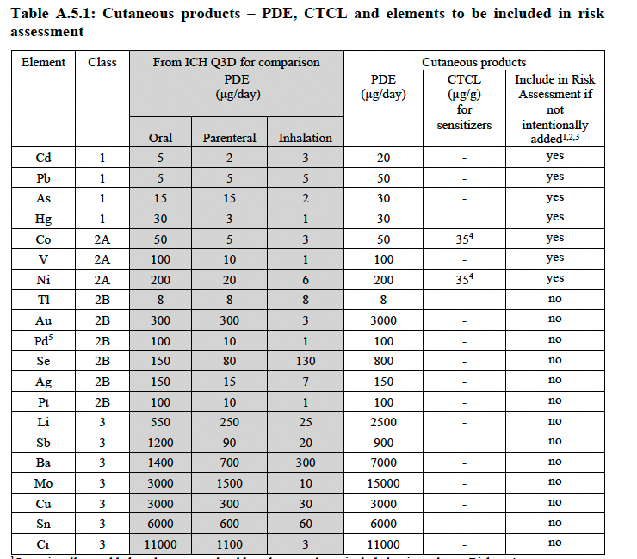
ICH Q3D – Elemental impurities (EIs)

Slide 72
FDA 2018 MAPP – for consideration
The MAPP is intended to clarify implementation of ICH guidances; not meant to provide additional guidance/recommendations

Slide 73
FDA 2018 MAPP - Background
MAPP provides guiding principles and approaches for establishing DS and DP impurity acceptance criteria for non-mutagenic impurities based on the consideration of clinical relevance
The principles guiding development of a specification can be impacted by the assessment of risk to safety and efficacy based on context of use, clinical experience.

Slide 74
FDA 2018 MAPP - Background
Impurity acceptance criterion can be supported by
  clinical data,
  nonclinical data (in silico, in vitro, and animal data),
  comparative product analysis (proposed vs approved),
  analytical precision of method and manufacturing process capability.
MAPP intends to clarify the types of data and information needed as well as limitations when establishing impurity acceptance criteria
Guided by consideration of clinical impact as opposed to manufacturing process capability to ensure clinical relevancy

Slide 75
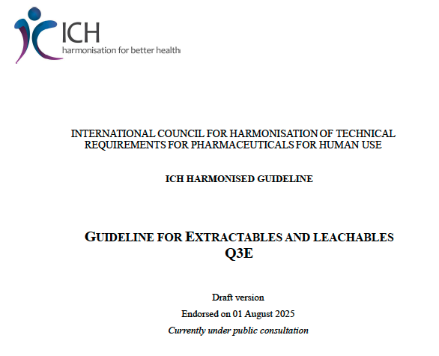
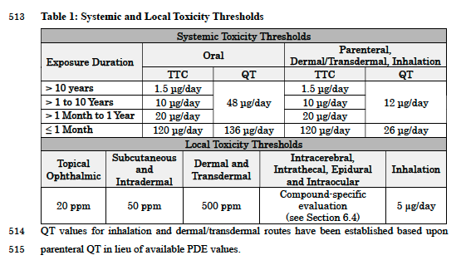
ICH Q3E (draft) – the new frontier

Slide 76
Thank you!
Questions?

Slide 77
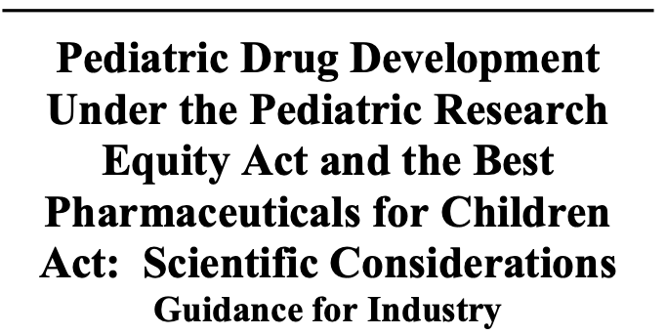
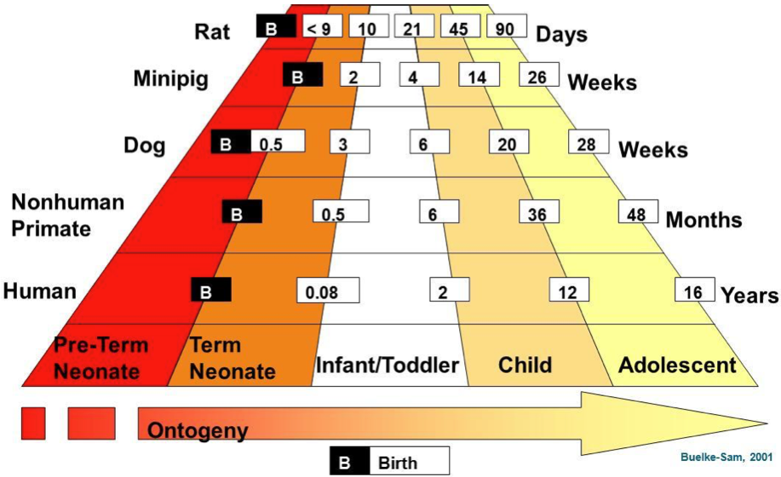

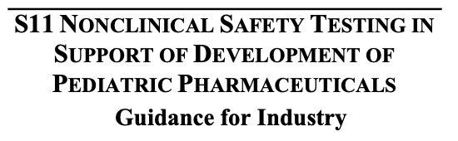
Topic 2:
Weighing Juvenile Toxicity Studies in support of Pediatric Development Programs

Slide 78
TOPICS
Regulatory framework for pediatric development
    (BPCA, PREA, RACE Act)
  iPSP milestones and FDA process
  Nonclinical contribution to prospect of benefit and safety evaluation
  Challenges presented by an uncertain MoA

Slide 79
Regulatory framework for Pediatric Development
2002: Best Pharmaceuticals for Children Act (BPCA)
Voluntary pediatric assessments via PPSRs & Written Requests for approved and unapproved indications linked to financial incentive (exclusivity extension)
2003: Pediatric Research Equity Act (PREA)
Required pediatric assessment for same indication being developed or approved in adults
‘Triggers’ include new API, indication, dosage form, regimen, and RoA
Orphan indications excluded
iPSPs, Deferrals, or Partial/Full Waivers
2020: RACE for Children ACT (Research to Accelerate Cures and Equity)
Required pediatric assessment for adult oncology drugs when molecular mechanism is ‘substantially relevant’ to pediatric cancer

Slide 80
PREA Regulatory milestones center around the iPSP
iPSP (initial Pediatric Study Plan) Submission
  ≤60 days following EoP2, or
  ‘as early as practicable’ before ph3 or ph2/3 combined
‘Materially Incomplete’
FDA Review: 90d from receipt
  Review Division consults with PeRC: A multidisciplinary committee, includes Pharm/Tox representation
WR to sponsor, 90d negotiation period
  Sponsor submits proposed ‘Agreed’ iPSP
FDA reviews submission ≤30d
Agreed PSP
  Amendments
NonAgreed PSP

Slide 81
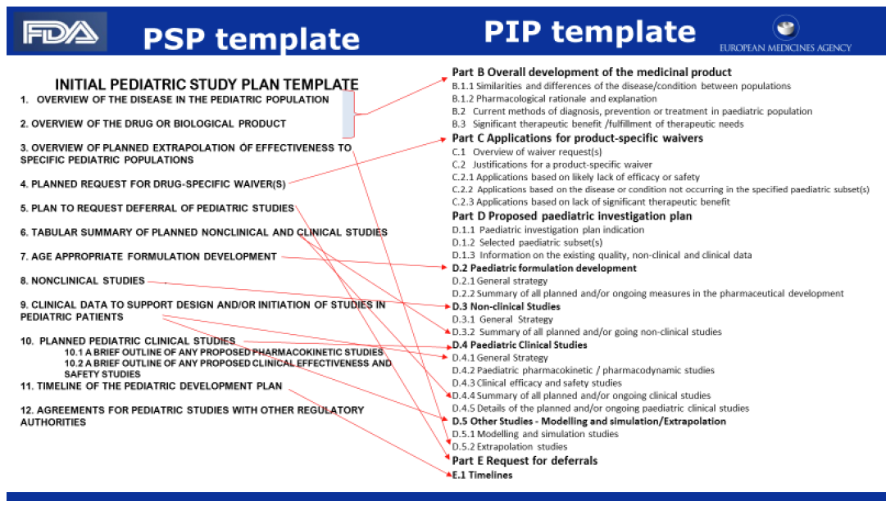


iPSP is similar to EMA’s PIP, but are separate documents
https://www.fda.gov/media/84944/download
FDA and EMA have Pediatric Cluster standing meetings to discuss PIPs and iPSPs
There is also a Nonclinical Pediatric Cluster that meets separately and less often to discuss nonclinical studies proposed or conducted for pediatric programs

Slide 82
NonClinical Section of iPSP template
Within 1-3 pages, include data from relevant nonclinical studies that support the use of the drug in proposed pediatric studies:
  Age range
  Dose
  Duration
'Relevant’ studies do not always equate with a juvenile animal study
Focus is typically on safety but including ‘proof of concept’ data, if available, is also looked for
ICH S11 guidance describes a WoE approach in determining the need for and scope of nonclinical studies to support safety for pediatric programs
In some cases, nonclinical studies can also contribute to or be the primary source of data demonstrating ‘prospect of benefit’

Slide 83
Prospect of Benefit: 21 CFR 50.52
(regulation pertaining to PREA statute)
Clinical investigations involving greater than minimal risk to children must present prospect of direct benefit to individual subjects (majority of NCEs/NBEs)
Any clinical investigation within the scope… may involve children as subjects only if the IRB finds that:
  There is a prospect of direct benefit to the individual child
  The risk is justified by the anticipated benefit
  The anticipated benefit/risk is at least as favorable as currently available therapies
No ‘standard’ for showing prospect of benefit
Absence of prospect of benefit risks a delayed pediatric program (in prior years, clinical holds were issued)

Slide 84
- How the agency weighs programs with poorly defined Mechanisms of Action (MoA) where target-based safety margins are unavailable [in juvenile/pediatric settings]? - Enveda
Potentially problematic for pediatric programs on 2 fronts
  Prospect of Benefit
  Safety evaluation

Slide 85
Prospect of Benefit
Derived from several sources:
  Clinical efficacy data with drug candidate in adult patients
  Prior pediatric experience with drug class
  Mechanism of Action data (drug affects cellular/molecular pathways well-recognized to contribute to disease)
  Animal disease models (if available and relevant)
Most persuasive and common submissions:
  Clinical efficacy data in adults + compelling mechanistic rationale
  Compelling mechanistic rationale + clinical safety data in adults/adolescents
A poorly defined MoA pushes evaluation of PoB toward empirical observation and totality of evidence:
Efficacy in adults with clear PK/PD relationship
Pathophysiological overlap in adult & pediatric disease
Improvement in translatable disease markers in relevant animal model of disease
Seriousness of condition and medical need additional considerations
Emphasis placed on assurance of safety given uncertainty of beneficial MoA

Slide 86
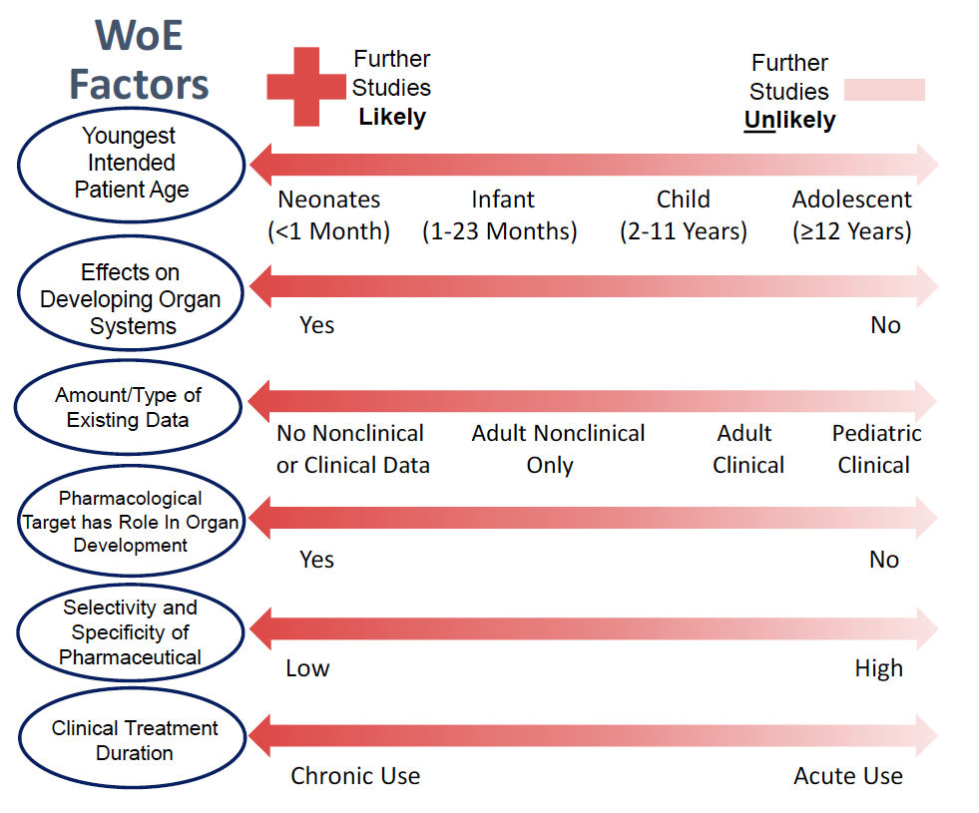
Nonclinical Safety Evaluation: How does FDA view the need for additional nonclinical studies in support of peds?
Per guidance, juvenile animal toxicology studies* are done on a ‘for cause’ basis.
  ..only when previous animal data and human safety data are judged to be insufficient to support pediatric studies.” –ICH M3R2
Per real-world experience, the threshold of ‘for cause’ varies across OND’s review divisions
*JAS
ICH S11

Slide 87
Nonclinical Safety Evaluation
Poorly defined MoA pushes the WoE factors in RED toward the left…. further studies are LIKELY
'For cause’ in this case is driven by uncertainty, not a specific developmental issue
‘Full’ juvenile toxicology design (≥Infants)
  Dosing PND4/7-PND80
  Standard toxicology endpoints
  Sexual development markers
  Behavioral, learning, memory
  Mating and EED
  Additional endpoints informed by adolescent/adult animal studies
or UNKNOWN
or UNKNOWN
or UNKNOWN
Notes:
WoE factors in RED presuppose knowledge of the drug’s target and mechanism of action.

Slide 88
NOAELs and Safety Margins supporting Pediatric studies
JAS will define NOAELs/LOAELs for growth/development, fertility, general toxicity
Application of NOAELs to dose setting depends on many factors, notably:
  Human relevance
  Mechanistic understanding of toxicity (e.g., target-related, off-target, unknown)
  Severity, reversibility, and monitorability of toxicity
As a ‘default’, the maximum clinical dose should not exceed the NOAEL
  (i.e., NOAEL = 1X MRHD_{p})
Multiple factors, including mechanistic understanding, influence movement from this default

Slide 89
Flexibility in applying safety factors to NOAELs in setting the Maximum Human Dose
Fraction of NOAEL
1X NOAEL
LOAEL
‘default’ max dose
Clinical exposure capped to some fraction of NOAEL
Poorly or unmonitorable severe toxicities (regardless of reversibility)
Severe toxicities/deaths with no premonitory signs or mitigating explanation
Absence of mechanistic understanding and human relevance of toxicity
Clinical exposures allowed to exceed 1x NOAEL
Toxicities defining LOAEL are:
Minimal (histological severity), AND
Monitorable, AND
Reversible, OR
Of limited translational value (e.g., species-specific, etc)
Supplemented with:
Mechanistic understanding/ precedent with drug class

Slide 90
Relation of the efficacious clinical dose to the nonclinical NOAEL
~Therapeutic Range
Clinical doses investigated in pediatric trials must offer prospect of benefit
(e.g., ‘going low and slow’ is generally not an acceptable approach)
100
80
Effect (%)
60
Viability of pediatric program in part depends where the anticipated efficacious clinical dose is situated with the nonclinical NOAEL
Non-supportive NOAEL
40
Supportive NOAEL
20
1
10
100
Dose or Exposure

Slide 91
Some challenges with a poorly defined MoA
‘FDA’s nonclinical reviewers regulate on toxicology, not pharmacology’…. this is partially true but an overgeneralization
GLP Toxicology data can define key toxicological thresholds that in most cases provides a ‘reasonably safe’ basis to initiate clinical trials, even if a drug’s mode of action is poorly defined. (21 CFR 312.23(a)(8)).
However, poorly defined MoA raises several challenges for nonclinical programs:
Identifying an efficacious dose to support trials in pediatric and advanced cancer patient populations
Interpreting toxicity data as on- or off-target events, or as human relevant/irrelevant events
Assessing WoE endpoints where MoA is a primary factor (e.g., carcinogenicity, DART, Immunotoxicity)
FDA’s nonclinical reviewers move to empirical assessment of safety:
Conservatively assume observed toxicities are human-relevant unless otherwise demonstrated
Apply conservative safety margins scaled to NOAEL-defining toxicities
Expectation for extensive secondary screens and ’complete’ batteries of toxicology studies

Slide 92
Strengthening program when MOA Is Poorly Defined
Clearly identify toxicity thresholds and demonstrate robust relation between exposure and toxicity
Provide broad secondary pharmacology profiling beyond Bowes 44
Consider human-based NAMs directed by toxicities observed in rodents/non-rodents to aid translation
Identify biomarkers that reasonably correlate with target engagement or track with an observed toxicity
Introduce conservative elements into clinical protocols (e.g., small dose escalations, sentinel dosing, etc)
FDA reviews of WR & PREA assessments publicly available
WR-PREA Access

Slide 93

Topic 3:
Weighing Efficiencies and Flexibilities in Toxicology Programs
NDA Approval

Slide 94

Regulatory Framework for Nonclinical Programs
FD&C ACT, Section 505 [21 USC 355(i)(1)]
(A) the submission to the Secretary, before any clinical testing of a new drug is undertaken, of reports, by the manufacturer or the sponsor of the investigation of such drug, of nonclinical tests of such drug adequate to justify the proposed clinical testing
‘....cell-based assays, organ chips/MPS, modeling, other nonhuman/human-based methods, animal tests’
21 CFR 312.23 IND Content and Format
312.23 (8)(i) & (ii): Pharmacology & Toxicology
(8) Pharmacology & Toxicology Information
Depending on nature of the drug and phase of investigation:
Adequate information about pharmacological and toxicological studies of the drug involving laboratory animals or in vitro, on the basis of which the sponsor has concluded that it is reasonably safe to conduct the proposed clinical investigations.
Absorption, distribution, metabolism, excretion
Acute, subacute, chronic toxicity tests
Reproduction, fetal development
Special toxicity, in vitro tests (case-specific)

Slide 95
FDA and ICH Guidances articulate current thinking on how to meet those scientific and regulatory expectations
General scope for a ‘traditional’ nonclinical program for a small molecule NME:
Pharmacology
Safety Pharm core battery
Short Term Tox
Genetic Tox
Limited ADME
Sub-chronic/ Chronic Tox
Completion of genetic tox battery
Carci SX protocols (if needed)
Repro Tox Studies Segs 1, 2, (3)
ADME, in vivo metabolites
Carcinogenicity Studies
Seg 3 repro tox (PPND)
Integration of all studies
FIH, Ph1
SAD/MAD
Phase 2
Phase 3
NDA
*Not shown are Special Tox studies which vary by drug and profile (e.g., mechanistic studies, photosafety, local tolerance, immunotox, abuse potential, impurity/metabolite testing, etc.)

Slide 96
Opportunity for Regulatory Flexibility…. with some risks
Every guidance includes language that allows risk- and science-based justifications for alternative or case-by-case assessment strategies…
This is regulatory flexibility- which is necessary and appropriate when interpreting and applying scientific data, but has its limits
Alternatives to ‘the norm’ can entail substantial scientific judgement, therein lies opportunity but also risk
As a generalization, regulatory risk increases as the nonclinical program deviates further and further from the ‘traditional’ program
Traditional Program & commonly applied efficiencies
Science-Based Alternatives
(mutually recognized)
High Deviation / High Risk

Slide 97
Traditional Programs: Pro’s and Con’s
ADVANTAGES | DISADVANTAGES
Clear & mutually recognized battery of studies submitted in a mutually understood timeline ‘Standard’ study designs and CRO resources, with well-honed and familiar endpoints Reasonable prediction of DRA’s interpretation and application of results Low regulatory risk (assuming proper species selection & well-conducted studies) Less need for: Interaction with DRAs Resources to develop WoE and justification for alternative approaches | With reasonable rationale, some studies are not warranted or have little scientific value (e.g., in vitro genetox with peptides) Data generated from non-essential or studies with a poor basis can lead one astray (e.g., false negatives & false positives) Opportunity cost of not exploring reasonably justified efficiencies (savings in time, money, animals, innovation)

Slide 98
Areas of efficiency: Safety Pharmacology
Safety Pharmacology (ICH S7A/S7B)
Core Battery ‘Traditional’ Approach Cardiovascular Safety (Standalone, non-rodent, telemetric, acute exposure) CNS Safety (Standalone, rodent, FOB, acute exposure) Respiratory (Standalone, rodent, whole body plethysmography)
Commonly Applied Efficiency: Integrate into toxicology and avoid stand-alone studies Cardiovascular: Telemetric assessment in 1 month non-rodent study CNS: FOB assessment in 1 month rodent study Respiratory: Quantitative or qualitative (with rationale) assessment in 1 month non-rodent study
Science-based rationale/high deviation: Omit telemetry in CV assessment Cardiovascular battery: CIPA, including hERG Human iPSC-Cardiomyocyte MEA study (arrhythmic potential) Snap-shot ECG in non-rodent GLP toxicology study (no telemetric methods) Accompanied by risk-based rationale, e.g., class precedent, low/no systemic exposure *active area of discussion for S7A revision

Slide 99
Areas of efficiency: General Toxicology
GLP Toxicology Study Duration ICH M3(R2)
‘Traditional’ Approach, small molecules 2wk/1 month to support SAD/MAD 3 month tox for ≤3 month clinical trials 6/9 month for >3 month clinical trials
(Semi)Common Applied Efficiency: Omit 3m or consolidate into fewer stand-alone studies One month supports SAD/MAD, 6/9 month supports rest of clinical program Acceptable to FDA but carries risk for sponsor Less information on toxicological dose-response and progression of findings NOAEL may decrease with duration, and fall below LD of chronic study Targeted clinical dose/exposure may change, risking nonclinical coverage Recovery period best done in the 1 month study One month supports SAD/MAD, 6/9 month includes a 3 month interim sac Complicates study design (e.g., #/sex/group) and still locked into chosen doses

Slide 100
Areas of efficiency: General Toxicology
GLP Toxicology Study Scope ICH M3(R2)
‘Traditional’ Approach for small molecules 2 species, rodent and non-rodent
High Deviation / High Risk Two species toxicology remains a foundational expectation for small molecules, even if both species are not pharmacologically relevant (rare) Potential scenarios for one species tox: Cytotoxic drugs with known MoA Dose-limiting, species-specific intolerance in rodent or non-rodent Minor modifications to a well-characterized drug Bridging-type product changes (e.g., RoA, formulation) ‘Legacy’ or DESI drug re-introduced into development

Slide 101
Areas of efficiency: Developmental & Repro Toxicology (DART)
DART Timing ICH S5(R3)
‘Traditional’ Approach for small molecules 2 species, rodent and non-rodent FEED/EFD to support Phase III PPND to support NDA submission
Science-Based Rationale to defer/waive studies Definitive EFD may be waived or deferred EFD toxicity is anticipated based on class/mechanism and positive prediction from alternative assay (e.g., WEC) Positive and relevant outcome in a preliminary EFD Patient population attributes can influence timing or need for conducting the complete battery Pediatrics, post-menopausal women, hospitalized settings, some SDLT and most S9 indications

Slide 102
Areas of efficiency: Carcinogenicity
Carcinogenicity Assessments ICH S1A, S1B(R1)
‘Traditional’ Approach for small molecules One long term study in a rodent (2yr rat default) One supplemental in vivo study (i.e., 6m TgRas or 2yr mouse)
Science-Based Rationale, WoE S1BR1 Addendum WoE assessment argument that 2yr rat study would not add value to assessing carci potential based on currently available data When successful, the 2yr rat study is waived. In some cases, the mouse study is also waived. Requires 6 month chronic rat toxicology data Benefits from building WoE early in program (e.g., secondary screening, target safety assessment, metabolite profiling, etc) Requires DRA concurrence on proposal, currently successful in half of cases Patient population and medical need considerations can warrant proposals to conduct carci assessments as a PMR Rare diseases with unmet medical need a common situation

Slide 103
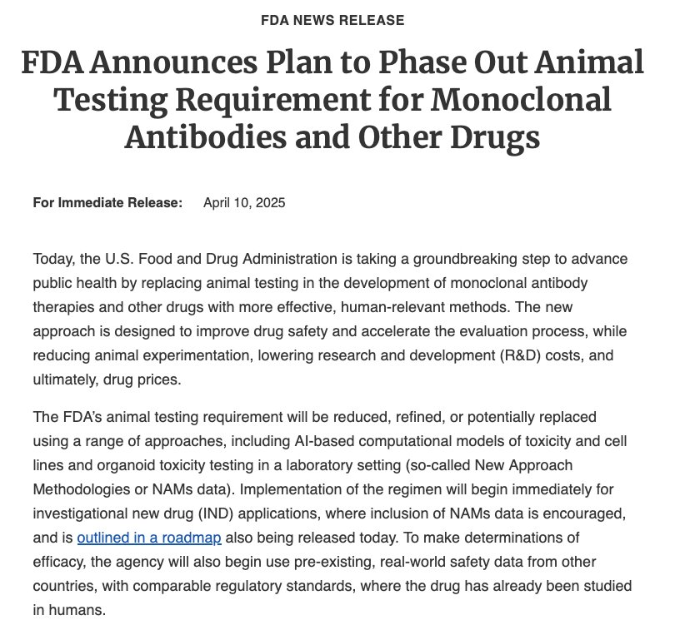
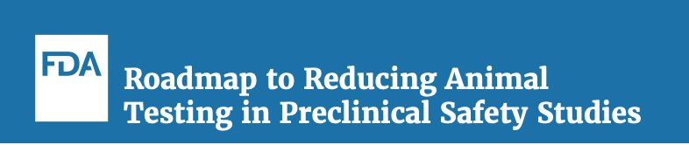
Perspective: Weighing Efficiencies and Flexibilities in Toxicology Programs
Predictable
Low regulatory risk
Case-by-case
High regulatory risk
Traditional Program & common efficiencies
Science-Based Alternatives
High Deviation / High Risk
2026 & moving forward:
Here’s a good place to operate*
*Not all DPTs regulate similarly!

Slide 104
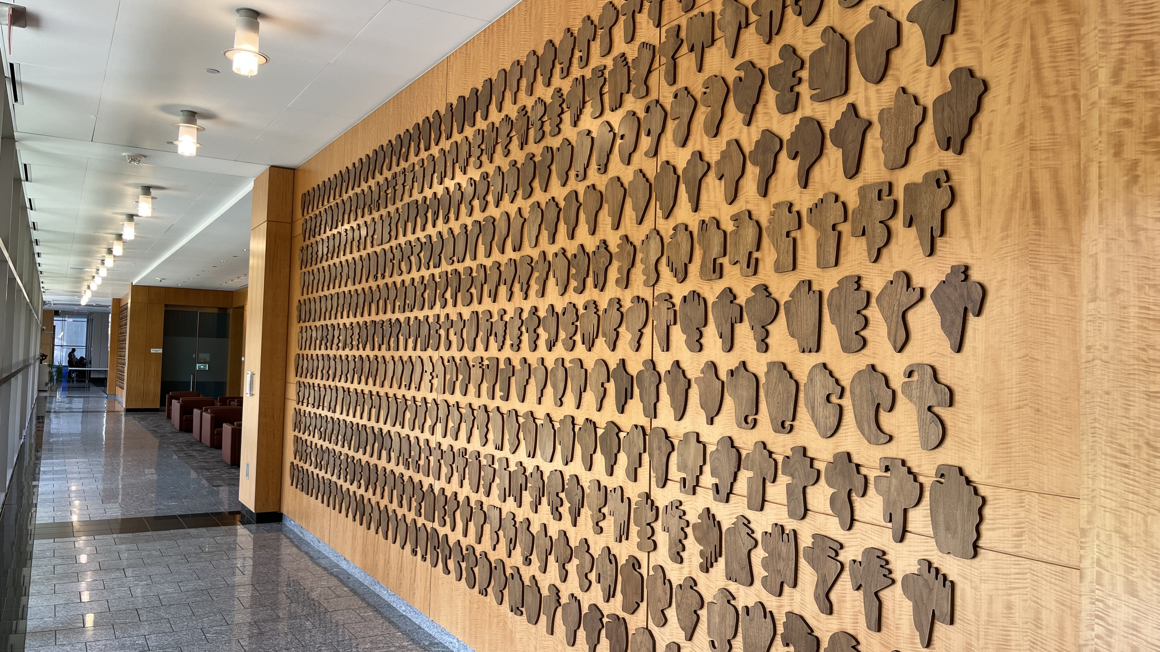
THANK YOU FOR THE INVITATION!

