Slide 1
https://www.next-mp.in
How Do you choose next-MP for your constituency in India.
India: Biggest Democracy in the World
Democracy: By the people & for the people through RIGHT representatives (Mp,MLA,ZP).

Slide 2
Everyday we see
one or the other politician just complaining on others as corrupt or looters & they have proof, then why they are not submitting those proofs to Police or Department & proceed with action.
Because they want to use only when they need for their family or personal sake.
They don’t bother about any ethics or principles or followers.

Slide 3
Will you look for, Candidate Work or Their???
Caste or Religion
Party or Party Prime Minister Candidate
Money & Power
Gifts & Freebies
Fake Promises or Fake Dreams

Slide 4
To Make bright Nation
Choose your Place right Candidate then automatically group of right people will choose qualified best leader(PM) among them.
Otherwise If bad corrupt local candidates are chosen ,then obviously leader also one among the same corrupt.
Even leader is great(Even Sansyasi) but group is corrupt then definitely corruption will be at its peak.

Slide 5
How to Choose the Best, The Problem?
Identify & Analyze the History of Work Done.
Share the knowledge & discuss with Others to understand the reality.
Even-though many people know the corruptions of candidates & just talking in backdoor or hiding due fear of their safety.
Solution : https://www.mp24.in Everyone can share their secrets without sharing their identity.

Slide 6
Cost Expenditure
2019 LokSabha election, More than 60000 Crore
Average of 100-150 crore for each constituency.
This all money will be collected in one or the other way of Tax only.
That too they will be competing at 2 places or existing MLA => Mp or Party Jump (Horse Trading-)
Each Candidate average spending is 50 crore, how he gets that much in returns.
Definitely not by his pocket or not by prompt earning. So voters please understand the importance & choose right candidate.

Slide 7
Measurement in 12 Key factors(KPI)
Administration & Transparent Politics
Quality of Government Hospital & Health sector
Government School & Colleges Development
Existing Industry Development
New Industry Bringing & Development
Employment Creation For local
Roads & Infrastructure Development
Government Public Transport & Facilities
Agricultural Support
Environment Safety
Riots & Safety
Family & Caste Politics

Slide 8
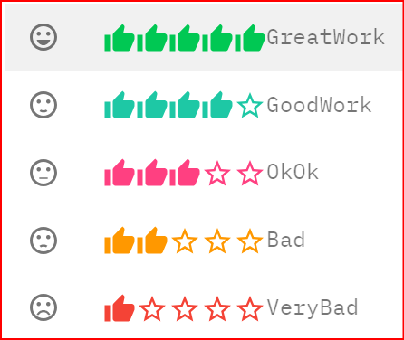
5 Ratings for each Key factor(KPI)

Slide 9
MP/MLA gives Donation, How?
Example: They give donation of 10 lakh to get name & votes for Temple/Masjid/Church/Community Hall.
Opposite side they will loot commission of crores.
So voters cant ask when they have already taken by begging.
This is known to everyone, still all keeping quiet.
So stop begging, Act wisely on your rights only in right way and make nation corruption free.

Slide 10
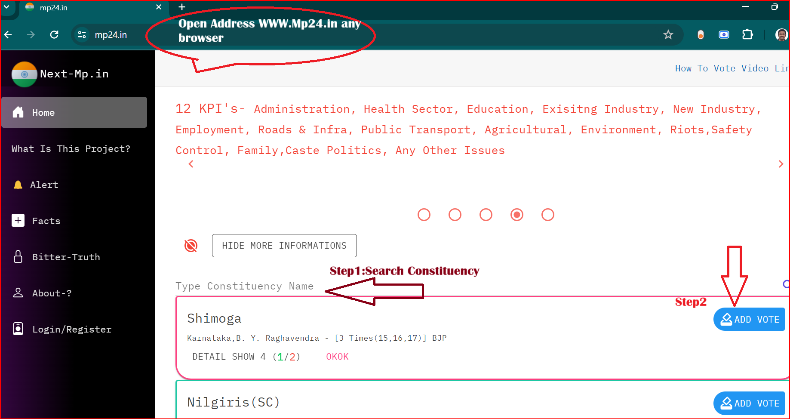

Slide 11
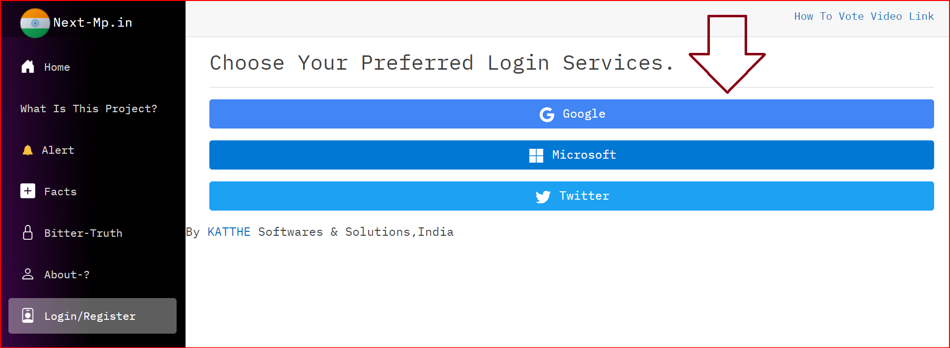

Slide 12
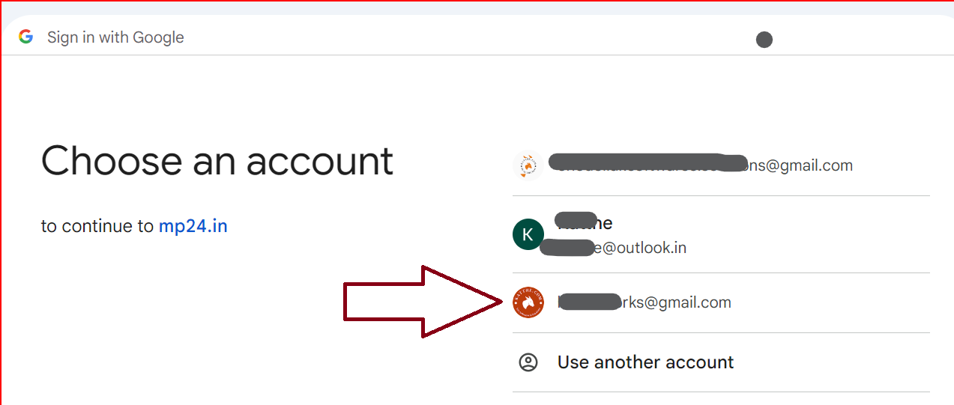

Slide 13
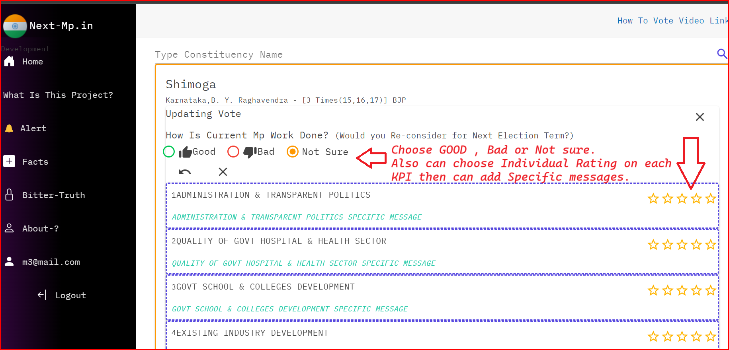

Slide 14
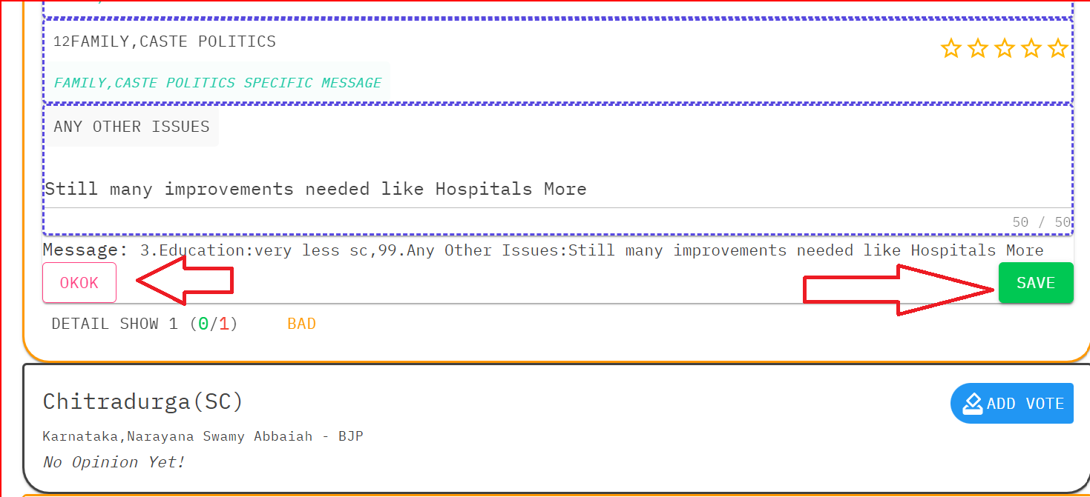

Slide 15
Note:
SomeTimes website may go down or slow, please be patient it will be recovered soon.
Also to make easy to all kind of users website can be accessed by using any of the below names(URL) in all browsers(Mobile & Desktop)
https://www.mp24.in
https://www.next-mp.in
https://www.samsad.in
Still if any issue or Suggestions please write to us through email
KATTHE@OUTLOOK.IN

