Slide 1


KATTHE TECHNOLOGIES
Who We Are?
“KATTHE”: Derived from Kannada word(ಕತ್ತೆ) for “Donkey” Symbolizing loyalty and hard work.
Project1: SmartTown.in Centralized –Specific-Town Based –Easy-Self Controllable System & replicable

Slide 2
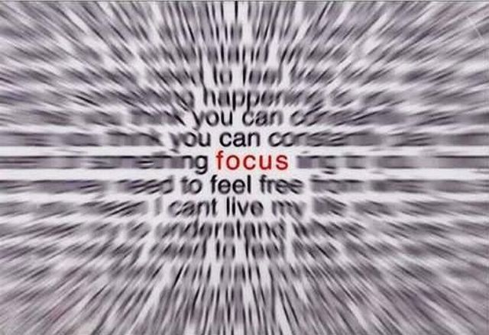

FOCUS
What are our Focus?
Transparent & Corrective Systems Using Technology:
Commercial and non-commercial applications.
Proper Utilization of Existing Resources
Simple & Social Awareness wrt Technology
Educating Through Direct channels, Social media, Schools and colleges.
Direct Contribution to Needy People:
Connecting options for Giver ⬄Needy
Non-Standard Requirements addressing in right effective way
Building Self Growing with Recovery & Replicable Systems
Sandboxed & Cost effective by avoiding Unnecessary inclusions

Slide 3

Our Projects (Few)
What Projects We Are Doing?
SmartTown.in (MVP1 Almost Ready):
Connects every part of a town, including local businesses, shops, feedback, ratings, government news, services, especially Rusting resources highlight
Addresses the limitations of existing platforms for small local businesses.
Hennu.in(Ideation):
Dedicated to girl/women safety & empowerment
UnWell.in (MVP1 ready):
Making health and medicines affordable for everyone (currently non-commercial).
ConnecTogether(Ideation):
Platform which connects all Freelancers & Industries for Non-standard / Customization works on top of existing.
…

Slide 4


Office & Team
Where is Our Office & Team?
Registered office:
Bhadravathi,Karnataka,India
Core Architect:
Madhusudhan V
Worked with Multiple International Key projects
Ex Employee of Wipro,Tcs,Dxc,Adlib,RSI..
Connecting by Many: Global contributors & Freelancers
Non-Technical Contributions:
Housewives, Handicaps, Retired Experts & Individuals, Students, Teachers, Press-Reporters, Freelancers, Government Employees

Slide 5


Core Technologies
What are Core Technologies?
Mostly Web technologies for easy connectivity with offline support.
Microsoft Technologies, with support from Google & Amazon
Open-source regular research and contribution by which utilizing those to client requirements.
Expansion with Artificial Intelligence

Slide 6

Contact Us
How to Reach Us, For More Discussion ?
Email: Katthe@Outlook.in or Katthe@Katthe.com
Company: https://www.Katthe.com
Project1:https://www.SmartTown.in
Phone: +91-9482696525

