Slide 1
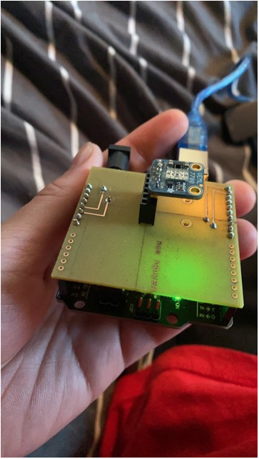
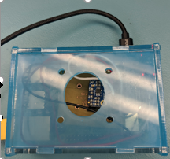
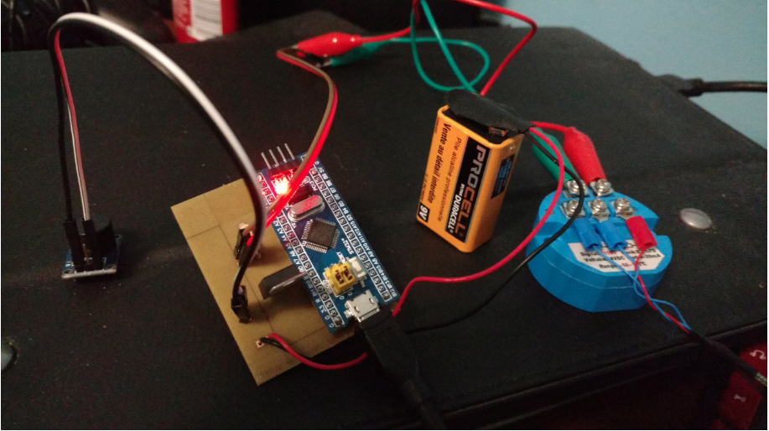
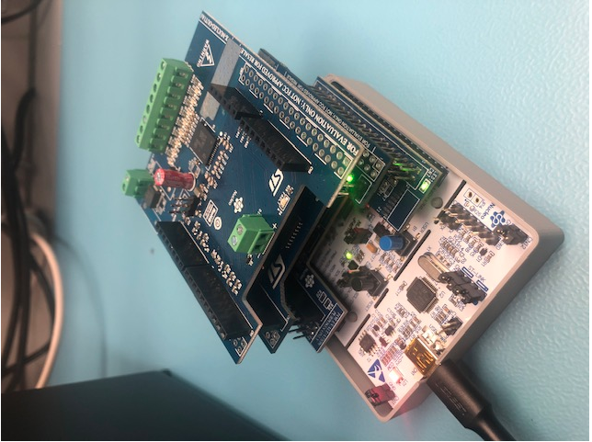
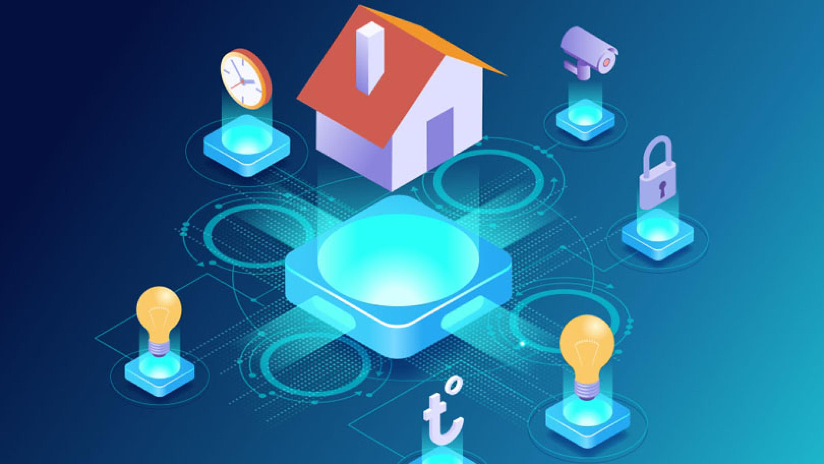
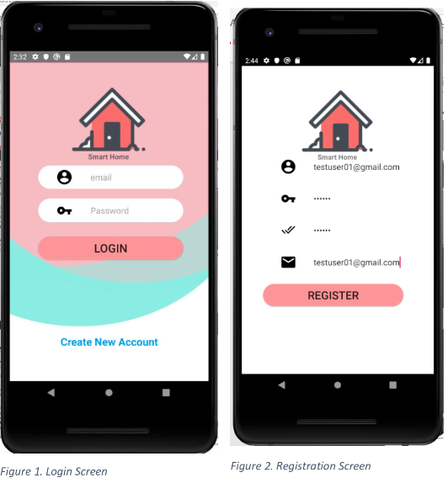
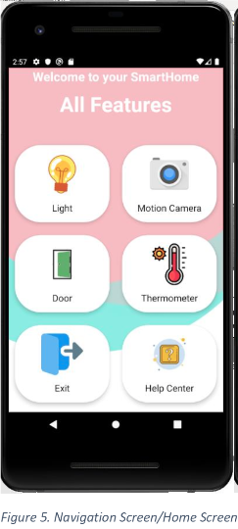

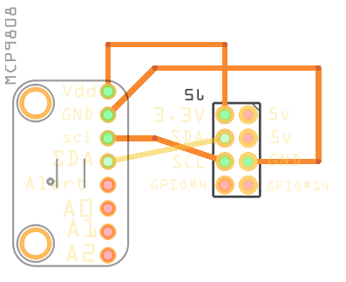
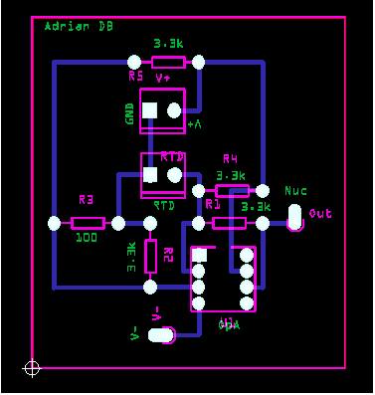
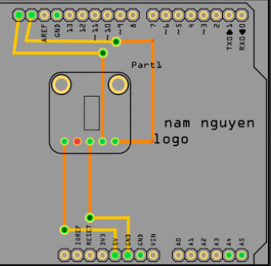


Smart-Home
Nam Nguyen, June Patrick Dacaya, Adrian De Braga and Bao Quy Diep Faculty of Applied Sciences & Technology, Humber College
INTRODUCTION
Nowadays, smart home technology is getting popular. Modern and new technologies are coming out every day in order to support people. Smart-Home application could help people to have an overview and control their house in an efficient way. The structure of Smart-Home application consists of sensor and application layer. The sensor gets the primitive data from the house that monitored by using various sensor and user input. Then the primitive data is stored in the database. The application layer displays the database that users request for. There are some advantages that users have when they use the Smart-Home app. First one is energy efficiency; user can adjust the thermostat of their house on their way home to control the temperature so when they get home, they don’t feel cold in the house. That is about energy efficiency. Secondly, Smart-Home helps to save energy and money. When people leave the kitchen without turning the light off, the light will turn itself off. So, no more energy will be wasted. In addition, it helps the home owners have more security about their house. When people walk out of their house and five minutes later, they don’t remember if they lock the door so they can open the app and check it then lock it easily. The Smart-Home system will also to monitor solar panel activity and its history.
METHOD
This project will focus on integrating the Smart-Home hardware component and mobile application into a working system.
There are 3 major components for this project.
• Hardware Component which include the programming platforms, sensors and the Printed Circuit Board (PCB).
• Mobile Application created using Android Studio.
• Real-time database with Firebase.
The major parts for our hardware components will be sensors/effectors and the platform we will be programming the components.
One of the major components for the project will be the Wi-Fi PLC (Programmable Logic Controller). The PLC compose of 4 components:
Nucleo-401RE which acts as a CPU where it runs a STM32 microcontroller chipset. Nucleo-401RE will process the input/output of the PLC and decide what to do with it.
X-Nucleo-PLC01A1 is an I/O stackable device. It has 8 conditional inputs which runs through a CLT01-38SQ7 chip and 8 conditional outputs that runs through VNI8200XP monolithic 8-channel driver.
X-Nucleo-OUT01A1 is another stackable component which process digital I/O signals. This chip can operate between 10.5 to 33 volts which is required for one of the temperature sensors we will be using.
X-Nucleo-IDW01M1 is stackable component that will deal with IoT connection. It is an 802.11 b/g/n compliant Wi-Fi expansion module.
For the temperature, we need MCP9808 sensor to measure the temperature. We also need a platform that is Raspberry to run a C program to read the temperature. In addition, to power up the raspberry we use the SD card to load the OS and then insert into the Raspberry Pi. Then using the Ethernet to USB cable and Ethernet cable to display in Remote Desktop Connection through Raspberry IP address. For the PCB, there are two 2x8 pin sockets required to hook up the sensor and raspberry.
We have the RTD PT100 which is another temperature sensor that will be connected to the PLC. For this to work we would need four resistors for a Wheatstone bridge design, a power supply with the capability of at least 24v.(https://www.divize.com/techinfo/4-20ma-calculator.html) Also some headers to connect the components too. We will also use an OpAmp set as a subtractor, so we would need two more resistors. If the signal is really small, we would need to suggest using an instrumentation amplifier which would require two more OpAmps and a few more resistors.
In addition to Light Sensor, we are going to use the VEML7700 Lux sensor to measure the lux sensitivity in the environment. In order to have this sensor fully functional, we also need an Arduino as a platform to a program that read the data gathered from the sensor. Most light sensors just give you a number for brighter/darker ambient lighting. The VEML7700 makes your life easier by calculating the lux, which is an SI unit for light. You'll get more consistent readings between multiple sensors because you aren't dealing with some unit less values.
Another component we are trying to add into the current project is the raspberry pi camera. We will be using a 5MP Raspberry Pi camera which will capture images, store it into the database and display the images into the mobile application
Safety precautions:
Use safety glasses during soldering process.
MCP9080_PCB RTDPt100_PCB
VEML7700_PCB
RESULTS
The mobile application we are building now is the Smart-Home application; it will connect sensors and interactive functional devices of a home with an app and a database. This application will give the user control and overview of their home, various sensors and devices are planned such as ones for the temperature, camera, lighting, door and ventilation/ac of the house. These will in turn feedback data to the user through a database, in effect the user will have full control and overview of these sensors and devices and in turn control of their home.
Features of our project:
· Control up to four home appliances wirelessly (expandable based on free IO pins)
· As the android application is password protected, it automatically adds security to your home as it can be controlled by the user only
· Databases will be store on Firebase
Potentially, the project will include the following attributes and design as for the application side of the project in the following sequence from startup:
A login screen which will feature a logo of a house & security related symbol and our team name
Log in screen will employ the typical login and password functionality tied to the database
A menu which will contain the following tabs
• Temperature – showing the temperature of the location of the sensor
• Lighting – control and observe the status of lighting
• Added solar panel monitoring - If the house has a solar panel installed, then homeowners will be able to monitor their solar panel through the mobile application.
• Help/About – will be a link to a website describing user functionality and contact info
The design will be as simple as possible for the user. We use menu buttons, text views and various other android studio functionalities. The UI should provide audible and visual alerts and notifications to the user to any changes in the system of the house which will persist until the user sees them as a measure of security and consistency.
When a user registers for a new account in the app, the user information will be stored and sync in the cloud immediately. The users then can access their information through any devices, web or mobiles. Each user has different data in their database and also, they have different types of access.
The Smart-Home mobile app is made using Android Studio. We used Java as programming language on developing the app as well as used Object Oriented Programming techniques. We then incorporate the application with a real-time database, Firebase where the data, user information, and variable values are stored.
PRINTING
Physical components:
VEML7700 MCP9808
RTD PT100
Wi-fi PLC
.
CONCLUSIONS
The interaction between our Android Application Smart-Home and the sensors are only through an mobile device. We hope to expand our Application to a website, therefore, customers can have a variety of choices when it comes to controlling their house.
Also we want to extend our app to IOS user.
AIM
It is an Internet of Things (IoT) capstone project that uses a distributed computing model of a smart phone application that was developed in the previous months and will be constantly updated, it will support database access via the internet to read and display data as well as control various functionalities for example: turning the lights off. It will incorporate closely with an enterprise wireless (capable of storing certificates) connected embedded system prototype with a custom PCB for sensors we provide: luminosity sensor, temperature sensor, and camera as well as an enclosure (3D printed/laser cut) for the project. The project will be documented via an OACETT certification acceptable technical report that will have a minimum of 9000 words. We will not be doing a CSA testing for this project because we are only making a prototype of a bigger project.
Here are our prototype specification,
Mobile Application Specification:
• Developed using Android Studio
• Supports API version 21 (Lollipop)
• Supports database connectivity
• Internet Connection
Database Specification:
• Firebase database
• Real-time database
• NoSQL functionalities
Hardware Specification:
• PCB will be developed/organized using Fritzing.
• Custom PCB will be printed in our Prototype Laboratory
• Enclosure will be printed in our Prototype Lab or a 3D printing company.
• Should not be left unattended
• Assembled in our classroom
Login screen to Menu
ACKNOWLEDGEMENTS
Special thanks to Kim Nhat Huynh – our collaborator at Alpha Laboratory for providing us with the opportunity of working on this project.
Special thanks to Mr.Kristian Medri – our professor at Humber College for assisting us with any problems occurred
Database will be stored in Firebase
.

