Slide 1

Demonstration of operations on
stack, queue, list
Nguyen Huu Nam 20210630
Vu Tuan Minh 20210597
Vu Nhat Minh 20214919

Slide 2
Problem statement
Stack, queue, list are basic data structures in computer science.
In this project, we design a program to display and explain some basic operations: create, insert, sort, find, delete on these structures.

Slide 3
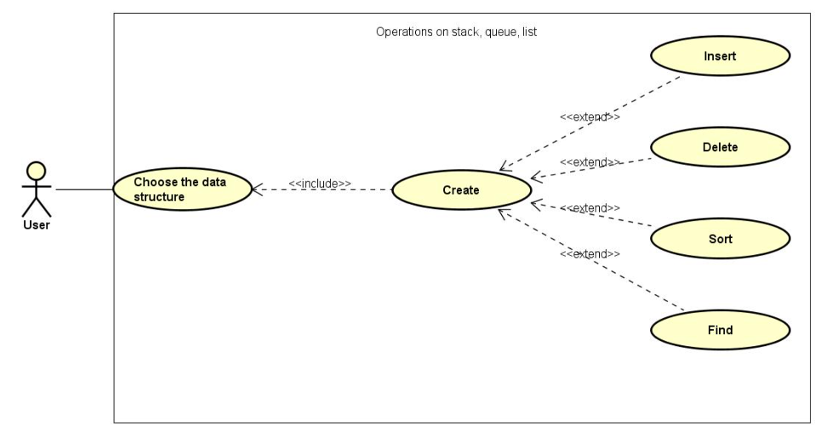
Use case diagram

Slide 4
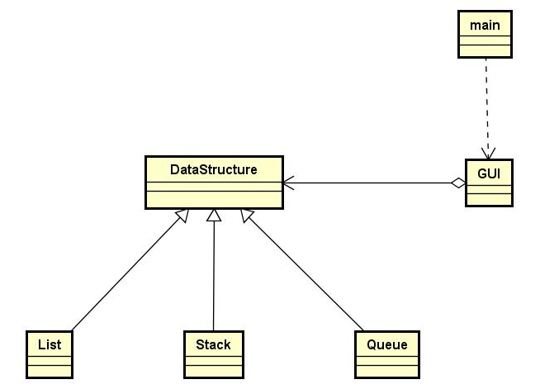
General class diagram

Slide 5
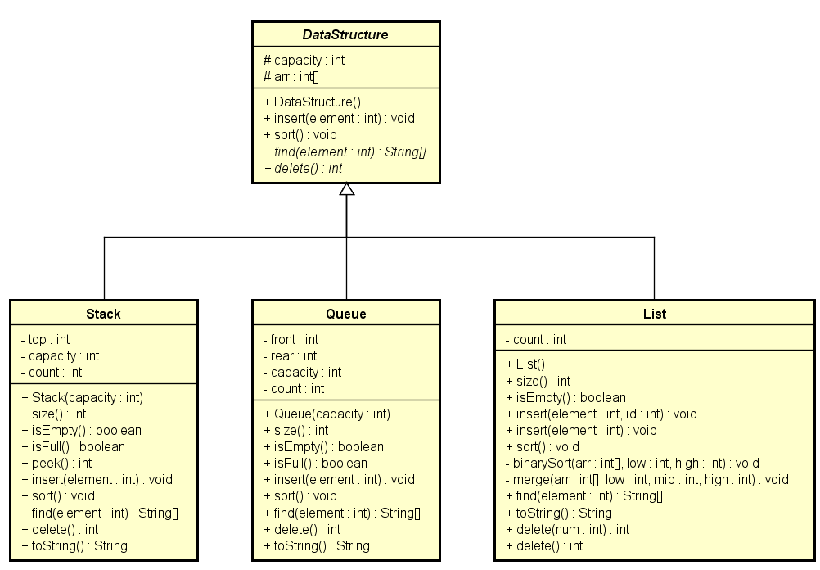
Data structure package

Slide 6
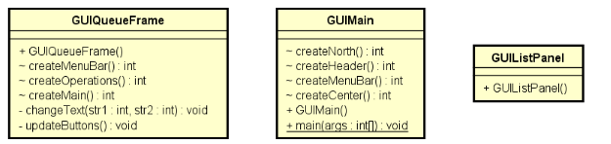
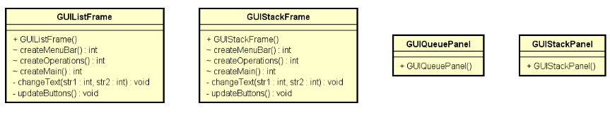
GUI package

Slide 7
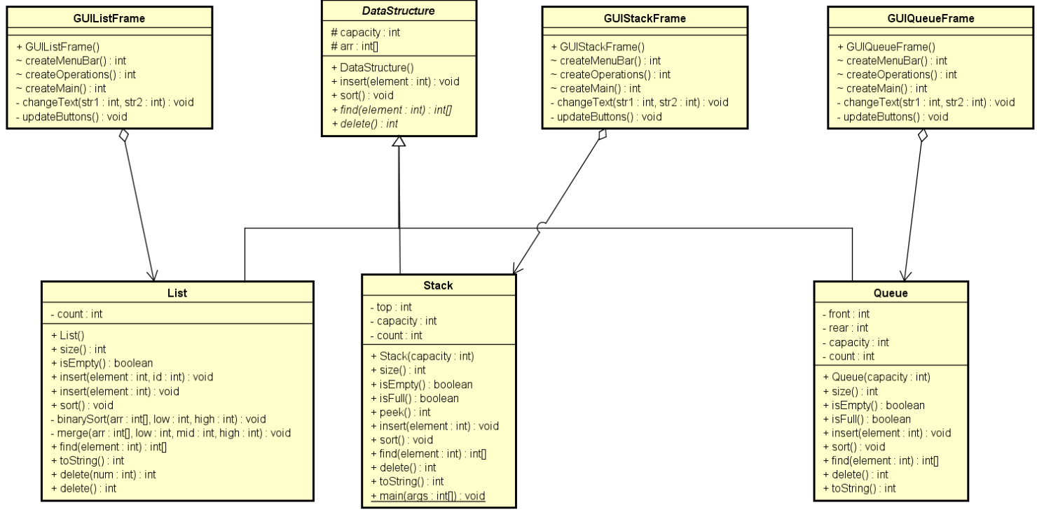
Data structure & GUI

Slide 8
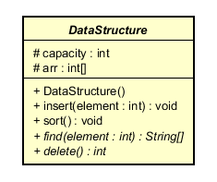
Encapsulation & Abstraction
Encapsulation:
Private attributes
No getter and setter
Abstraction:
Use abstract class DataStructure

Slide 9
Inheritance & Polymorphism
Inheritance:
List, stack, queue inherits DataStructure
GUI main, frame inherits JFrame
GUI panel inherits JPanel
Polymorphism:
List, stack, queue provide
implementation of abstract
methods from DataStructure

Slide 10
References
Idea for general structure of the program: OOP Lab exercises – AIMS Project.
Idea for queue implementation: https://www.geekforgeeks.org/introduction-and-array-implementation-of-queue/
Idea for the Help menu: https://docs.oracle.com/javase/tutorial/ui/swing/components/textfield.html

Slide 11
THANK YOU !

