Slide 1
ESD LAB · UNIVERSITY OF SOUTH CAROLINA
NANO Dashboard
Team Q&A · Use cases, data source, REDCap and MATLAB integration
AUTHOR
PROJECT
DASHBOARD
Namit
NANO Study · NIH R01
esd-lab-namo.pages.dev
20 May 2026

Slide 2
AGENDA
What we will cover in five minutes
Q1
Q2a
Team use of the dashboard
Current data source
How I envision leadership, coordinators, RAs, and analysts using the live SPA in their weekly workflow.
Why the live site is on synthetic demo inputs today and how to confirm the data_source chip.
Q2b
Q2c
REDCap experience and wiring
MATLAB integration options
Production REDCap pull, push and audit modules already in the repo, ready for the API token.
Three clean patterns for the densely sampled signals the team manages in MATLAB.
NANO Dashboard · Team Q&A · May 2026
Agenda
2

Slide 3
QUESTION 1
One pane of glass for the whole NANO team
My vision: the dashboard is where every role lands first. Thirty seconds to see where we stand against the R01 plan and what is blocking the next decision.
1
PI + Co-Investigators
2
Data Coordinator + RAs
Overview · ESD Lab Site · Impact
Data Quality · Cohort Table
Weekly leadership snapshot. Enrollment vs targets, five KPI cards, public dissemination, recent publications and stories.
Missingness bar, QC flag cards, queries per event, REDCap audit log, surrogate participant table for the queries call.
3
Co-I O'Reilly + Biostat
4
Everyone
Pipeline · ML Performance · Trajectories
Reading Library
13 step SVG, architecture animation, ROC + CI, SHAP, subgroup sensitivity, trajectory CI bands, intercept and slope tables.
Auto indexed PDFs from ESD Lab readings/. Searchable cards, category chips, latest-update stats. No more email threads.
NANO Dashboard · Team Q&A · May 2026
Q1 · Use cases
3

Slide 4
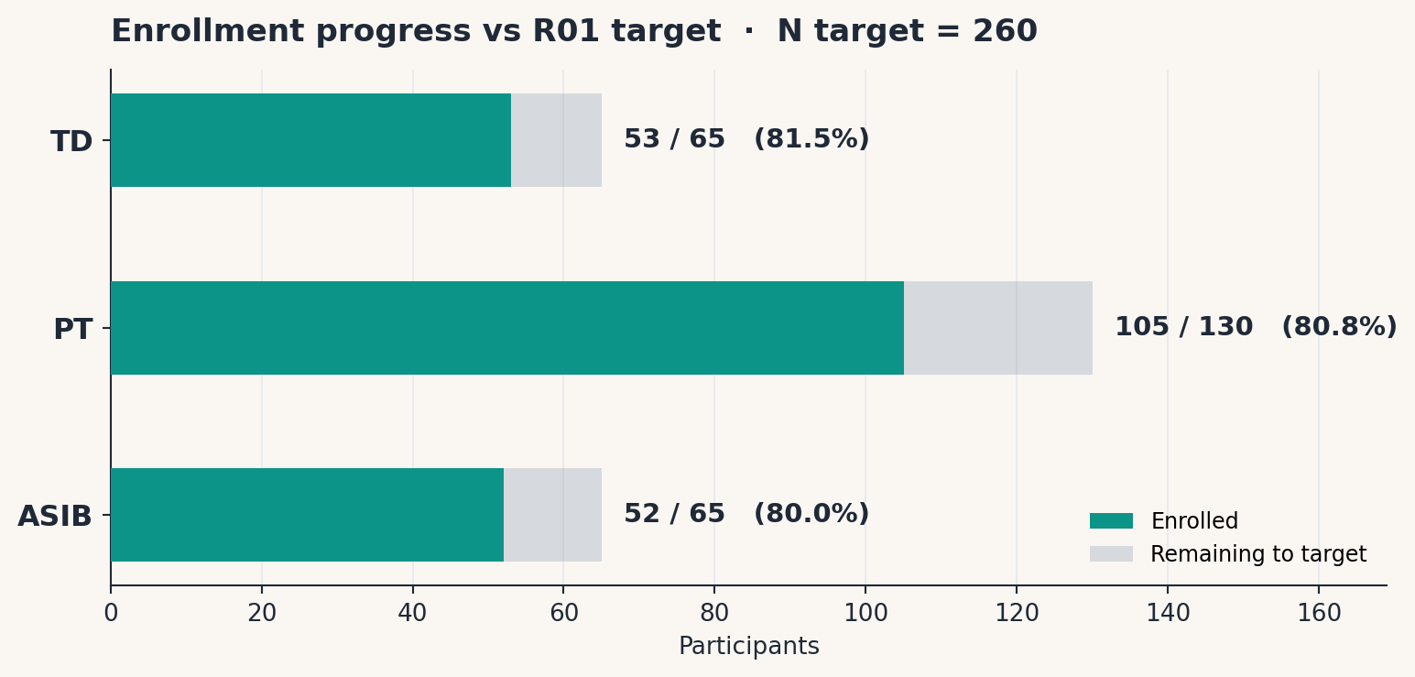
QUESTION 1
What the dashboard currently shows
260
210
80.8%
9
R01 target N
Currently enrolled
Progress to target
Sections on one page
NANO Dashboard · Team Q&A · May 2026
Q1 · Snapshot
4

Slide 5
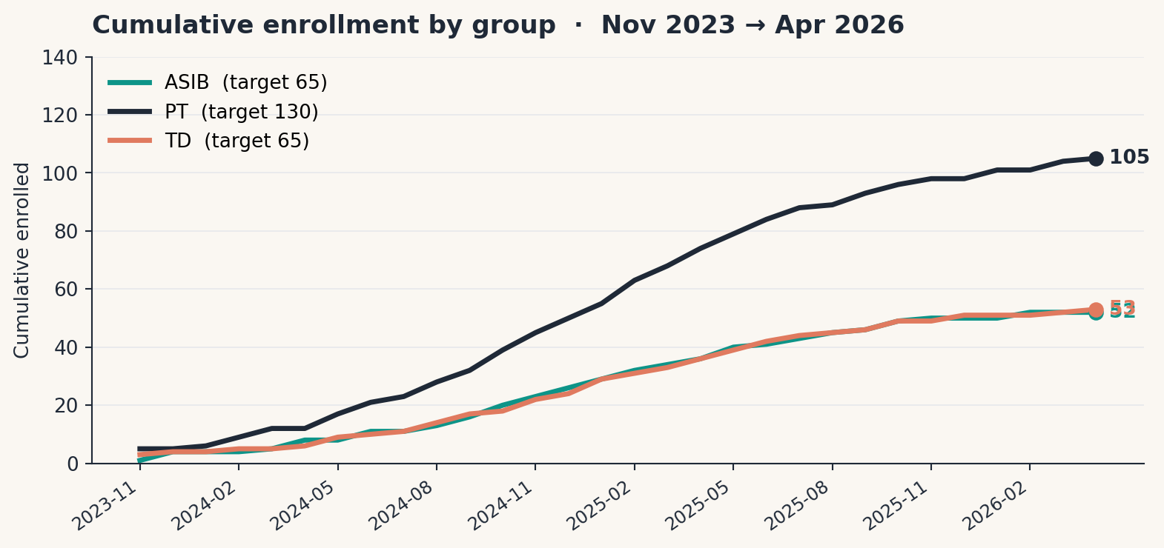
QUESTION 1
Cumulative enrollment, our weekly leadership panel
WHAT THIS PANEL ANSWERS
Are we on pace against the R01 plan?
Which group is dragging the cohort?
Did recent recruiting changes move the curve?
Should we shift outreach toward ASIB or TD?
Same view powers the leadership weekly and the IRB progress report.
NANO Dashboard · Team Q&A · May 2026
Q1 · Enrollment
5

Slide 6
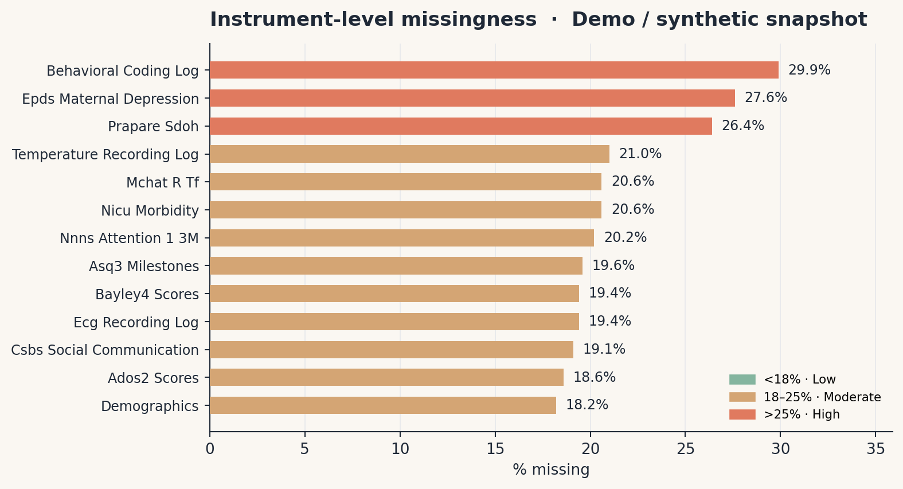
QUESTION 2A
Yes, the live site is on synthetic demo data today
EVIDENCE FROM THE PAYLOAD
dashboard/data/dashboard_data.json
"meta": {
"generated_at": "2026-05-18T22:00:45",
"data_source": "repo_demo_inputs", ← synthetic
"study": { "name": "NANO Study", "n_target": 260 }
}
Why synthetic right now: the runtime falls back to generate_synthetic_dashboard_data.py whenever the USC secure mount is unavailable, so the UI and the readings library still render cleanly while we are in the demo phase.
Same schema, both paths. The day we point at live REDCap, the dashboard swaps source without any UI change.
NANO Dashboard · Team Q&A · May 2026
Q2a · Data source
6

Slide 7
QUESTION 2B
Yes, I have worked with REDCap. Pipeline is in the repo.
Once your team issues the API token, this is a single config flip from synthetic to live.
redcap_pull.py
redcap_push.py
redcap_audit.py
redcap_r_pull.R
PyCap · paginated longitudinal export · event filter
Validated record import back into REDCap
Daily diff and change-log capture
R sibling using REDCapR for the R analysts
FOUR JS HOOKS ALREADY DEPLOYED · redcap/hooks/
auto_complete_dob.js
flag_missing_ecg.js
participant_id_validator.js
visit_completion_checker.js
NIGHTLY CRON
scripts/redcap_daily_sync.py → build_dashboard_data.py
Set REDCAP_API_TOKEN and NANO_DATA_ROOT in .env. The data_source chip flips from synthetic_demo to redcap_live on the next run.
NANO Dashboard · Team Q&A · May 2026
Q2b · REDCap
7

Slide 8
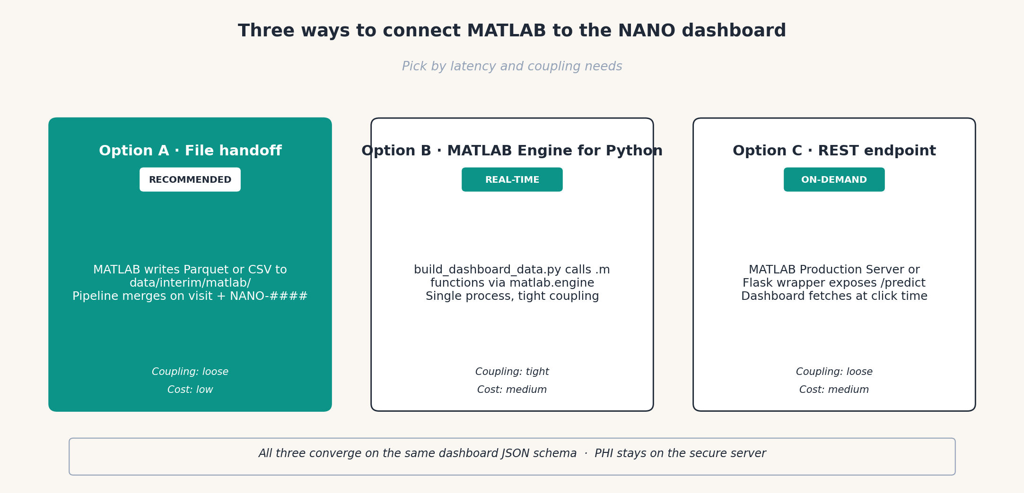
QUESTION 2C
Three clean ways to wire MATLAB in
NANO Dashboard · Team Q&A · May 2026
Q2c · MATLAB options
8

Slide 9
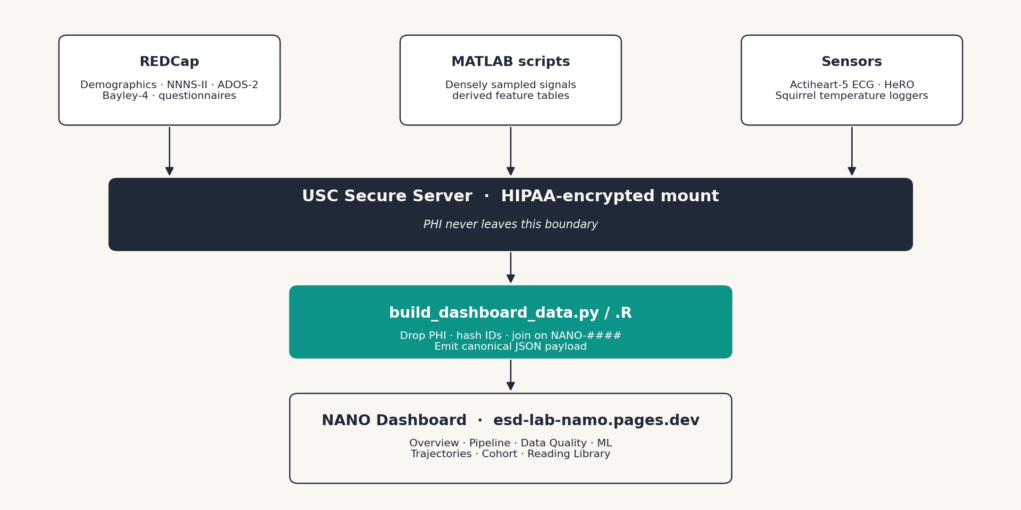
QUESTION 2C · RECOMMENDED
Treat MATLAB as an upstream producer
WHY THIS WORKS
Parquet native in MATLAB R2022a+
No glue code on the MATLAB side
Same merge key: NANO-#### + event
Dashboard stays language-agnostic
PHI never leaves the secure mount
Can layer Engine API later if a click needs real-time MATLAB output
MATLAB: parquetwrite('/secure/data/interim/matlab/hrv_dense.parquet', T) · Python merge picks it up on next make dashboard-refresh
NANO Dashboard · Team Q&A · May 2026
Q2c · Option A · Recommended
9

Slide 10
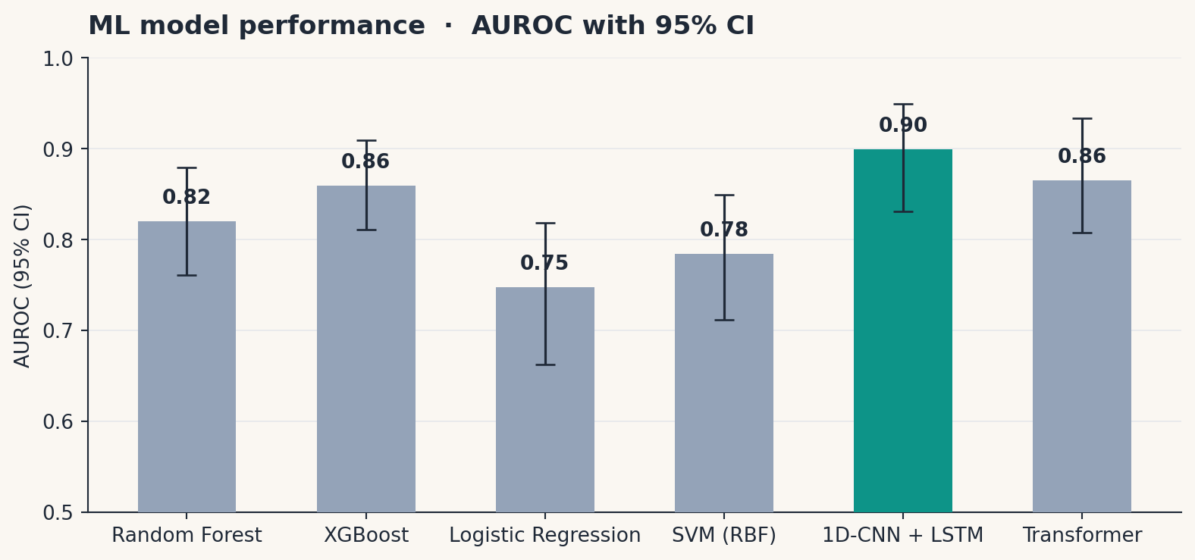
BONUS
What ML Performance looks like on live data
WHAT THIS PANEL ANSWERS
Are our models any good?
Are the CIs tight enough?
Which model wins for which outcome?
Where is SHAP placing the weight?
Synthetic values shown. Will refresh nightly from models/_metrics.json.
NANO Dashboard · Team Q&A · May 2026
Bonus · ML preview
10

Slide 11
NEXT STEPS
What unlocks live data and MATLAB merge
01
02
03
04
05
REDCap API token
Dry run + first live build
MATLAB handoff folder
Nightly cron
Tag MATLAB outputs
PI issues the token. I drop it into .env as REDCAP_API_TOKEN. Set NANO_DATA_ROOT to the secure mount.
python redcap/api/redcap_pull.py --dry-run, then make dashboard-refresh. Watch the data_source chip flip.
Agree on data/interim/matlab/ as the output folder. Parquet preferred. CSV acceptable.
Schedule scripts/redcap_daily_sync.py. Dashboard refreshes overnight without manual touch.
Outputs carry visit event key + NANO-#### surrogate so the three-stream merge stays clean.
RECAP
Dashboard is the operational pane of glass for every role on the team.
Currently on synthetic demo data. data_source: repo_demo_inputs.
REDCap pull, push, audit, hooks and cron are already in the repo. Need the API token.
MATLAB: write Parquet to data/interim/matlab/. Merge step picks it up automatically.
NANO Dashboard · Team Q&A · May 2026
Next steps
11

Slide 12
Thank you
Questions, opinions, edge cases welcome.
LIVE DASHBOARD
OPERATOR VIEW
REPO
https://esd-lab-namo.pages.dev/
https://esd-lab-namo.pages.dev/overview
github.com/namo507/ESD-Lab-USC
Namit · ESD Lab · 20 May 2026

