Slide 1
Introduction to Machine Learning

Slide 2
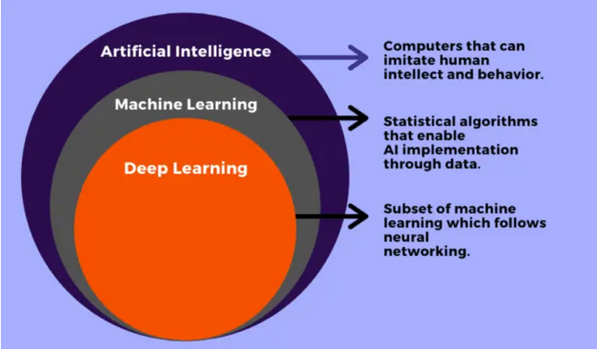
AI vs ML vs DL

Slide 3
AI (Artificial Intelligence)
1) Artificial Intelligence is basically the mechanism to incorporate human intelligence into machines through a set of rules(algorithm).
2) AI is the broader family consisting of ML and DL as it’s components.
3) The efficiency of AI is basically the efficiency provided by ML and DL respectively.
4) Examples – Amazon’s Alexa, Siri,
ML (Machine Learning)
1) ML is the study that uses statistical methods enabling machines to improve with experience
2) ML is the subset of AI.
3) Less efficient than DL as it can’t work for longer dimensions or higher amount of data.
4) Examples – Car Price Prediction, Diabetes Prediction
DL (Deep Learning)
1) DL makes use of Neural Networks(similar to human neurons) to imitate functionality just like a human brain.
2) DL is the subset of ML.
3) More powerful than ML as it can easily work for larger sets of data.
4) It attains the highest rank in terms of accuracy when it is trained with large amount of data.
5) Examples- Image Classification, Image De-noising etc.

Slide 4
Supervised Learning
1) Supervised learning is the learning of the model where with input variable (say, x) and an output variable (say, Y) and an algorithm to map the input to the output. i.e. Y= f(x)
2) The basic aim is to approximate the mapping function (mentioned above) that when there is a new input data (x) then the corresponding output variable can be predicted.
3) It is called supervised learning because the process of learning (from the training dataset) can be thought of as a supervisor who is supervising the entire learning process. Thus, the “learning algorithm” iteratively makes predictions on the training data and is corrected by the “supervisor”, and the learning stops when the algorithm achieves an acceptable level of performance.
4) It is called supervised because data is labelled (y column is present).
5) Examples of Supervised learning algorithms - Regression and Classification.

Slide 5
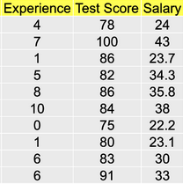
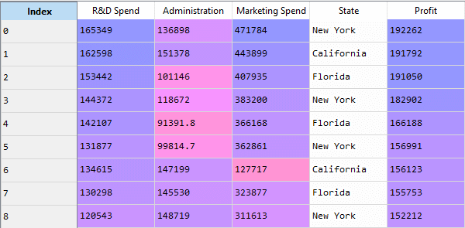
Regression Examples
1) In Regression problems, the target variable is continuous in nature

Slide 6
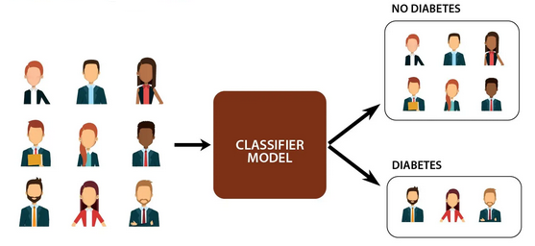
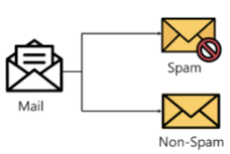
Classification Examples
1) In Classification problems, the target variable is categorical in nature

Slide 7
Prediction Pipeline
Feature Engineering
Split data into train & test data
Select appropriate ML Model
Fit model on training data
Derive Predictions on test data
Data
Retrain Model
Tune Model Parameters
Generate Performance metrics

Slide 8
Unsupervised Learning
1) Unsupervised learning is where only the input data (say, X) is present and no corresponding output variable is there.
2) The main aim of Unsupervised learning is to model the distribution in the data in order to learn more about the data.
3) It is called so, because there is no correct answer and there is no such supervisor (unlike supervised learning). Algorithms are left to their own devises to discover and present the interesting structure in the data.
4) It is unsupervised as data is not labelled.(y column is not present)
5) Examples of Unsupervised learning algorithms - Clustering and Dimensionality Reduction.

Slide 9
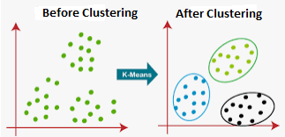
Clustering Examples

