Slide 1
Applications of Statistical Modeling: Module #1, Lecture #1 Course Overview; Multilevel Modeling Concepts
Instructor: Brady T. West
Email: bwest@umich.edu
Office: 4118 ISR (734-647-4615)

Slide 2
Course Overview
Welcome to SURV 617 / SURVMETH 687!
We will begin today with a detailed overview of the course syllabus, available on the Canvas site for the course

Slide 3
Prerequisites
Applied statistical methods
Univariate and multivariate distributions
Multiple regression
Logistic regression
Model diagnostics/interpretation
Maximum likelihood estimation, (weighted) least squares estimation
Hypothesis testing
Applied sampling methods

Slide 4
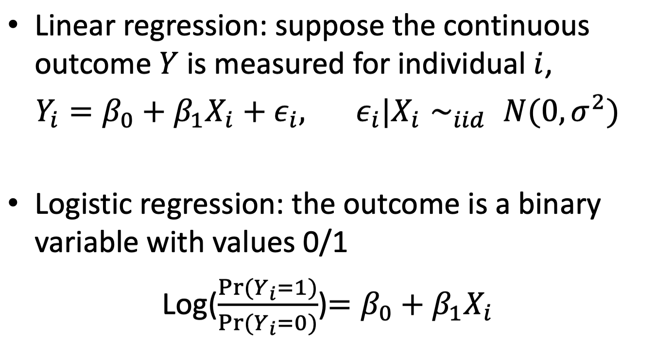
Given those prerequisites, you should remember that…

Slide 5
Recommended Readings
Regression and Other Stories, Andrew Gelman, Jennifer Hill, Aki Vehtari, 2020, Cambridge press.
Accessible at https://avehtari.github.io/ROS-Examples/
Data Analysis Using Regression and Multilevel/Hierarchical Models, Andrew Gelman and Jennifer Hill, 2006, Cambridge press.
Feel free to raise questions and comments about these readings at any point!

Slide 6
The ESS Data

Slide 7
The European Social Survey (ESS) Data
Data were collected in face-to-face interviews from a national sample of 1,703 adults in Belgium
Variables include respondent ID, interviewer ID, and 22 variables measuring attitudes and opinions of the respondents on various topics
Also included are final respondent weights (based on a complex sample design), along with interviewer-specific response rates (percentage scale)
Available in SAS, SPSS, Stata, and R formats on Canvas

Slide 8
Key Motivating Issues
Account for interviewer effects:
Measure interviewer variation
Include interviewer-specific covariates
Adjust for complex sample design features
Incorporate survey weights
Key point: observations are not independent and share some similar characteristics
Example of clustered data, where clusters are indicated by interviewer IDs

Slide 9
Multilevel Modeling

Slide 10
Multilevel Modeling
Multilevel models are regression models that include random effects associated with either:
Randomly Sampled Clusters of units of analysis (in cross-sectional studies; e.g., census blocks)
Randomly Sampled Subjects, measured repeatedly (in longitudinal / repeated measures studies; e.g., volunteers for a clinical study)
Both Clusters and Subjects (in clustered longitudinal data sets; e.g., HRS)

Slide 11
What Are Random Effects?
Random effects are random variables that allow the coefficients in a regression model to randomly vary depending on the cluster or subject under study
For this reason, multilevel models are also known as:
Random coefficient models
Varying coefficient models
Subject-specific models
Hierarchical linear models (reflecting the data hierarchy of a clustered or longitudinal data set)
Mixed-effects models (reason will become apparent soon)

Slide 12
Random Effects, cont’d
Because they are random variables, we need to define a probability distribution for the random effects → multilevel models have additional parameters to estimate!
In many cases, clusters or subjects are not randomly sampled based on a probability sample design; we assume that they are a random subsample from a larger population (e.g., survey interviewers)

Slide 13
Example Model Specification
Consider the following model for a continuous dependent variable Y, measured on person i within cluster j:
Fixed effects
Random effects
Error

Slide 14
Example Model Specification, cont’d
The fixed effects are what you probably know from prior classes as regression coefficients or regression parameters
These are unknown constants defining relationships between predictors and dependent variables that we wish to estimate
The random effects are random variables; we therefore need to define their distributions!

Slide 15
Example Model Specification, cont’d
The following are examples of commonly assumed distributions for the random effects and random error terms (see McCulloch and Neuhaus, 2011):
Variance-covariance Matrix of Random Effects (D)
Errors independent of random effects (?)

Slide 16
Multilevel (or Hierarchical) Specification
An alternative way of specifying this model that some analysts prefer (used by the HLM and MLwiN software):
Level 1:
Level 2:
When combined, we have the same model!
Random coefficients (not parameters!)

Slide 17
Why the Hierarchical Specification?
This specification clearly defines the role of covariates measured at higher levels in multilevel models
View each Level 2 equation for a random coefficient as an intercept-only regression model (where the DV is a random coefficient)!
We try to explain variance in the random effects by adding the fixed effects of Level-2 covariates to these models!

Slide 18
Why the Hierarchical Specification?
For example:
Fit a model, and compute the estimated variance of the random intercepts:
Include a fixed effect of subject gender in the model (assume a longitudinal study):
Now, ; we explained 50% of the variance in the intercepts with gender!

Slide 19
Matrix Specification
Matrix specification is important for understanding how models are estimated
Conditional on a set of random effects, we have the following distribution for the vector of observations on subject (or cluster) j:
Variance-covariance matrix of random errors
Design matrix of covariates
(Smaller) Design matrix of covariates
Fixed effects vector
Random effects vector

Slide 20
Implied Marginal Model
Marginally, averaged across all random effects, we have the following distribution:
Note where the marginal variances and covariances of observed values come from!
Vector of expected means for subject (or cluster) j
Marginal variance-covariance matrix of observations on subject (or cluster) j

Slide 21
Implied Marginal Model
Important Observations:
A multilevel model implies the marginal model
When we include random effects in a model, the variances of the random effects in D need to be positive (i.e., the D matrix is positive definite)
We could also fit the implied marginal model without random effects, and estimate parameters describing the covariances of the observations (more flexible); no longer a mixed model, but allows for negative within-cluster correlations

Slide 22
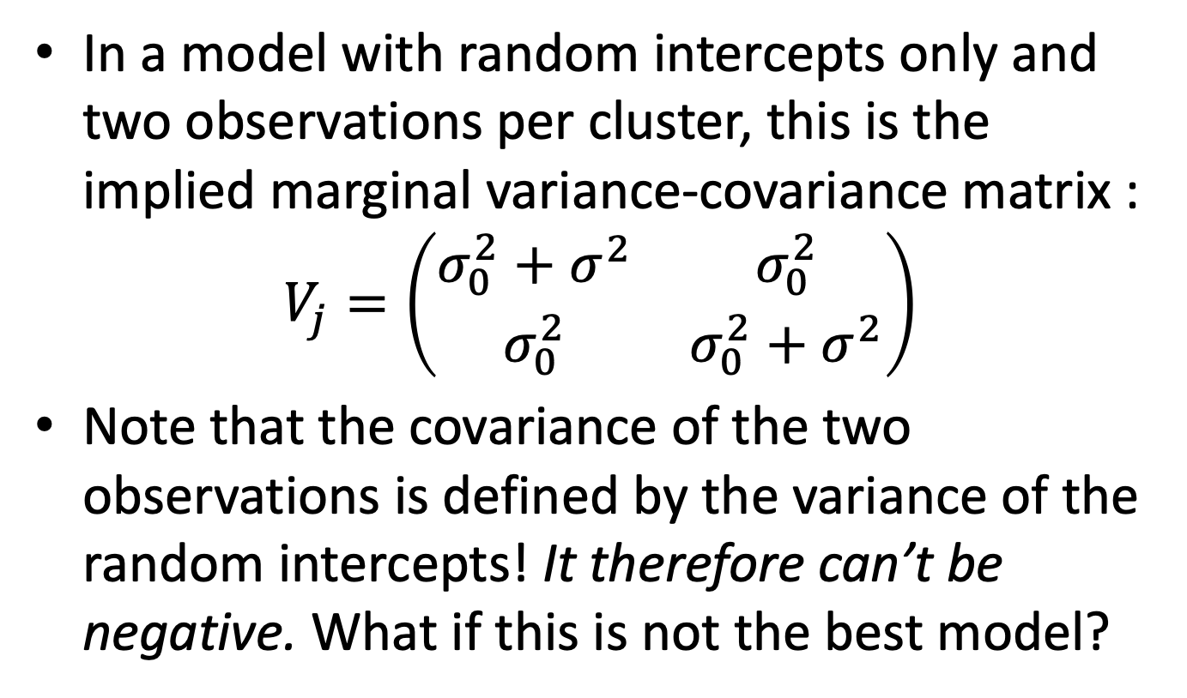
Implied Marginal Model: Example

Slide 23
Implied Marginal Model: Example
In these cases, the software will complain that you are trying to estimate a variance component which is negative, or set the component equal to zero
As a solution, you can fit the implied marginal model, rather than the multilevel model with random effects, which in this case would have a compound symmetry structure for the random errors, allowing for negative covariances among the random errors
We can no longer talk about the random effects in this case, however, or refer to this as a mixed model

Slide 24
Aliasing
We also have to be careful about aliasing when specifying models, which leads to the case where parameters cannot be uniquely identified in estimation; don’t over-specify the model!
For example, we would not be able to include random intercepts and allow the random errors to have a compound symmetry structure (we are modeling the same covariance twice!!!)
In this case, there would be infinitely many solutions for the parameter estimates, and the software will complain during estimation

Slide 25
Review!
Multilevel model: mixed effects (fixed and random), conditional specification
Marginal model: variance-covariance matrix
Equivalent specifications:
Conditional: random intercept only
Marginal: covariance matrix with compound symmetry structure and positive correlation
Parameters of interest (to be estimated): fixed effects, variances, and covariances

Slide 26
Model Building
Generally two strategies used in practice:
Top-down Strategy
Start with fully-specified model, including all fixed effects of interest
Identify “optimal” variance-covariance structures for random effects and random errors
Eliminate non-significant fixed effects
Re-consider variance-covariance structures

Slide 27
Model Building, cont’d
Step-up Strategy (Variance Explanation)
Start with an “empty” or “unconditional” model, with only a random intercept (and possibly random error)
Add Level-1 predictors to explain variance in the random errors, and possibly allow their effects to randomly vary
Add Level-2 predictors to explain variance in random effects at Level 2, possibly allowing their effects to vary at higher levels
Add Level-3 predictors…

Slide 28
Modeling Practice
Model specification, clear notation!
Model estimation
Coefficients (or fixed effects) and their variances
covariance parameters
Model comparison
Hypothesis testing
Information criteria
Model diagnostics
Model interpretation: Inference/prediction

Slide 29
Estimation of Model Parameters
Multilevel models are generally estimated using some form of maximum likelihood estimation. The basic idea:
Form the likelihood function, or the probability of the observed data, assuming independent subjects / clusters denoted by j:
f is the probability density function for a given dependent variable defined by the marginal model (e.g., multivariate normal), and theta = the variance-covariance parameters
For some models (generalized linear mixed models), the likelihood first needs to be approximated

Slide 30
Estimation of Model Parameters
Next, use iterative mathematical methods (e.g., Newton-Raphson) to find the parameter estimates that maximize the (approximate) likelihood. Two strategies:
ML estimation. Estimate the variance-covariance parameters first (define the fixed effects as a function of the covariates and the marginal variance-covariance matrix in the likelihood), and then use generalized least squares (GLS) to estimate the fixed effects:
Restricted ML estimation (REML). Same idea, but account for the loss of degrees of freedom from estimating the fixed effects first, then use GLS

Slide 31
REML vs. ML
Distinction important for normal outcomes
REML estimation is generally the default for normal outcomes, as it results in unbiased estimates of covariance parameters
ML estimation is better for testing fixed effects (more on this later…), but results in biased estimates of covariance parameters
Be careful to recognize the default of the software that you are using!

Slide 32
Variance Estimation
Variance estimates for the estimated fixed effects can be computed using standard GLS results (biased, but why?):
Variance estimation for the estimated covariance parameters is not nearly as straightforward; can be based on the Hessian matrix, which is a by-product of the maximum likelihood estimation process; requires asymptotic (large-sample) assumptions
Many authors now advocate Bayesian approaches for estimating the variance of covariance parameters (or for making inference more generally); see West and Ellliott (2014)

Slide 33
Hypothesis Testing
When fitting multilevel models, many hypothesis tests regarding the parameters are based on comparisons of competing models
Reference model: A “full” or “saturated” model containing all parameters of interest; different from the null model where only intercepts are included
Nested model: A “reduced” model, where some of the parameters in the reference model are constrained to zero

Slide 34
Likelihood Ratio Tests
Compared to the reference model, does fitting the nested model substantially drop the likelihood (or make the observed data seem less likely)?
Likelihood Ratio Tests: -2 ML log-likelihoods
Fixed Effects
Covariance Parameters

Slide 35
Likelihood Ratio Tests for Fixed Effects
Simple idea, but assumes “large” sample of clusters and “large” samples within clusters
Null hypothesis: selected fixed effects are all equal to zero (not important predictors)
Test statistic: difference in final -2 ML log-likelihoods between nested and reference models (nested model has some fixed effects set to zero)
Refer difference to chi-square distribution with q degrees of freedom, where q is difference between two models in number of fixed effects estimated

Slide 36
Likelihood Ratio Tests for Covariance Parameters
If null hypothesis does not specify that a covariance parameter is equal to the boundary of its parameter space (e.g., a variance is equal to zero):
Same approach as for fixed effects, using REML
If testing that a variance is equal to zero (e.g., the variance of a given random effect):
Compute test statistic, but refer to approximate mixture of chi-square distributions
Examples of this approach will be provided
Not widely implemented in software…

Slide 37
Approximate t-tests
Tests of null hypotheses that individual parameters are equal to zero: divide estimate by estimated standard error, and refer statistic to a given t distribution or N(0,1)
When using t distributions, degrees of freedom are only approximate, because we use an estimate of the marginal variance-covariance matrix when computing standard errors (failure to account for this uncertainty leads to bias!); many possible methods
Not recommended for covariance parameters, but still produced by some software

Slide 38
Approximate F-tests
Same basic idea as for t-tests, only extended to multiple parameters
Same issues with approximate degrees of freedom (some software does not even compute these approximate tests!)
Similar to likelihood ratio tests, useful for testing hypotheses about multiple parameters (e.g., fixed effects associated with a categorical predictor)

Slide 39
Other Testing Methods
The exact null distribution of the likelihood ratio test statistic for variance components (in models with random intercepts only) has been derived by other researchers, and an R routine enables simulations from this null distribution (used by West and Olson, 2010)
Will be demonstrated in next lecture
Bayesian approaches to inference are also possible (see West and Elliott, 2014)

Slide 40
Information Criteria (IC)
IC are used to compare competing models that don’t have a clear nesting relationship
AIC, BIC, other adjusted versions; penalize for number of parameters being estimated
“Smaller is better”: decision criterion
No clear winner has been demonstrated in the literature to date; best to compare models based on multiple criteria

Slide 41
Model Diagnostics
We need to check whether distributional assumptions for the model are satisfied before interpreting a “final” model
Important diagnostic analyses to consider:
Examine standard (Q-Q, fitted-residual, etc.) plots of “conditional” studentized residuals, which account for predicted values of random effects (EBLUPs) and are scaled by the estimated SD of the residuals
Examine influence diagnostics for both individual observations and higher-level clusters (SAS farthest along, but not many software options at this point)
Examine Q-Q plots for predicted values of random effects (EBLUPs), to check for normality and outliers

Slide 42
Why Are Diagnostics Important?
Tests of significance and other forms of inference based on probability models all rely on various distributional assumptions
If these assumptions are violated, the methods used to make inferences may also be invalid (e.g., non-normal residuals → p-values should not be used to test hypotheses)
We may see interesting patterns; consider the famous case of the BISON DATA in R (Canvas)!
http://www4.stat.ncsu.edu/~stefansk/

Slide 43
Predicted Random Effects: EBLUPs
Empirical Best Linear Unbiased Predictors of the random effects in a model
Keep in mind that we do not estimate random effects (they are random variables); we estimate their variances and covariances
We can compute their predicted values based on our data:
We can also compute a variance-covariance matrix for these predictions, for testing

Slide 44
Intraclass Correlation Coefficients
ICCs are measures describing the homogeneity of responses within a cluster (or within a subject) that we can estimate
Two-level models, random intercepts only:
Three-level models, random intercepts only:

Slide 45
Missing Data
While multilevel models are great for analyzing unbalanced data sets (due to missing data or unbalanced study designs), we do make assumptions about missing data
Missing data are assumed to be missing at random (MAR); that is, conditional on the other variables in a model, observations with missing data are only randomly different from observations without missing data
Important to include as many relevant covariates for an outcome as possible to make this plausible

Slide 46
Centering Continuous Covariates
Recall that the intercept in a model is the expected value of the outcome when all covariates are zero (this may not be realistic!)
This interpretation is especially important when we fit models allowing the intercept to randomly vary across subjects/clusters
It’s generally a good idea to center continuous covariates, either at the overall mean or the cluster-specific mean of the covariate, to make the intercept more interpretable

Slide 47
Sample Size Considerations
Simulations suggest that for cross-sectional studies, at least 30 clusters are needed with at least 30 observations per cluster (30/30) to have reliable parameter estimates in multilevel models
Rules vary: 20/50, 50/20, 10/100, 100/10
Generally close to 1,000 observations needed
For longitudinal studies, better to use software / simulations; simulations are good practice in general!
www.umich.edu/~bwest/almmussp.html
Having many clusters with only one observation can lead to estimation problems

Slide 48
Thinking Ahead…
In the next class, we will focus on various software procedures that are capable of fitting multilevel models, and how to use them
Please take a careful look at the assigned readings for next week
Please think about possible team members and a data set for the final project!

