Slide 1
Applications of Statistical Modeling: Module #1, Lecture #3 Multilevel Modeling Application: Interviewer Effects in the European Social Survey
Instructor: Brady T. West
Email: bwest@umich.edu

Slide 2
Lecture Overview
Today, we’ll begin with a review of interviewer effects; some of this may be new, and you may have seen some of it in other classes
We’ll then turn to applications involving the European Social Survey (ESS) data, estimating interviewer variance for selected survey variables and interpreting the results
We’ll also discuss how to fit the models using selected software procedures

Slide 3
Interviewer Effects
Classically viewed as a type of measurement error specific to an interviewer
Determinants of Intra-Interviewer Correlations (“rho-int”); see West and Blom (2017, JSSAM)
Computerization (ACASI/SAQs); correlations expected to be negligible
Telephone (smaller) vs. Face-to-face (larger)
Items? Open vs. closed, or Factual vs. attitudinal; not many differences
Controlled feedback and probing…
Interviewer experience / training? Interviewer behaviors / non-verbal signs?
Demographics of interviewers and respondents
Different recruitment of different types of cases (West and Olson, 2010); argument against measurement error hypothesis

Slide 4
Variance Inflation
As the sizes of workloads increase, effective sample size is reduced, even for small values of intra-interviewer correlations
Workload could be reduced by hiring more interviewers, but…
Wouldn’t that cost more?
Better to reduce rho-int as much as possible through training, supervision, and good questionnaire design principles

Slide 5
Multilevel Modeling Approaches
In recent years, methodological studies have taken advantage of multilevel modeling techniques to study interviewer variance
Effects of individual interviewers j (M_{j}) on survey measures y for respondent i are treated as random:
In most applications, variance in the true values (X_{i}) and the random errors (e_{ij}) are combined into the error variance term, and a fixed intercept is used

Slide 6
Multilevel Modeling Approaches
Advantages:
Capable of handling unbalanced workloads across interviewers (some models require equal workloads!)
Capable of including interviewer-specific covariates in an effort to explain variance across interviewers
Capable of allowing interviewer variance to vary depending on the type of interviewer (e.g., CAPI vs. CATI)
Models with crossed random effects enable studies of the contributions of areas and interviewers to overall variance (e.g., O’Muircheartaigh and Campanelli, 1998)
Example: interviewers work in multiple randomly sampled PSUs, and we wish to disentangle interviewer and PSU effects

Slide 7
Multilevel Modeling Approaches
Assuming that interviewers were randomly sampled from some hypothetical super-population of interviewers (the assumption needed to treat effects as random), we can compute “rho-int” (the intra-interviewer correlation) for a given survey measure as follows:
We can thus indirectly test whether rho-int is zero by performing appropriate tests for the interviewer variance component ( )

Slide 8
Interviewer Effects in the ESS (Refer to the R Markdown file)
We will now consider examples of estimating interviewer effects in the European Social Survey (ESS) Data, to illustrate multilevel modeling and diagnostics
We will begin by using multilevel models to estimate the interviewer variance components for selected variables
We will then try to explain any interviewer variance by using the interviewer-specific response rates (which could indicate interviewer-specific nonresponse bias)
We’ll focus on R and go through the code and output in great detail; Stata code is on the following slides
We’ll then consider a random coefficient model

Slide 9
Random Intercept Model: Stata Code
mixed pplhlp || intnum: , variance reml
* note: mixture-based LRT is automatic!
predict int_eblups, reffects
collapse int_eblups, by(intnum)
qnorm int_eblups, ytitle(EBLUPs of Random Interviewer Effects)
predict st_resid, rstandard
qnorm st_resid
* note: add interviewer-level covariate
mixed pplhlp int_rr || intnum: , variance reml

Slide 10
Random Coefficient Model: Stata Code
mixed pplhlp trstplc ||
intnum: trstplc,
covariance(unstruct)
variance reml
LRT needs to be done manually. Only automatic for random intercept models.

Slide 11
Three Questions!
Suppose that we have n groups/clusters of units:
Assuming no other covariates, what are the potential options for modeling the effects of the clusters?
What is the difference between an ordinary regression model and a multilevel regression model?
What if we have covariates both for Level 1 and Level 2?

Slide 12
Ordinary versus Multilevel Regression
Ordinary regression: a reference category and n-1 indicators
Mean structure changed
Multilevel regression: n indicators
Variance structure changed
Better for many groups and small sizes
Flexible to expand
Borrow information across groups: partial pooling

Slide 13
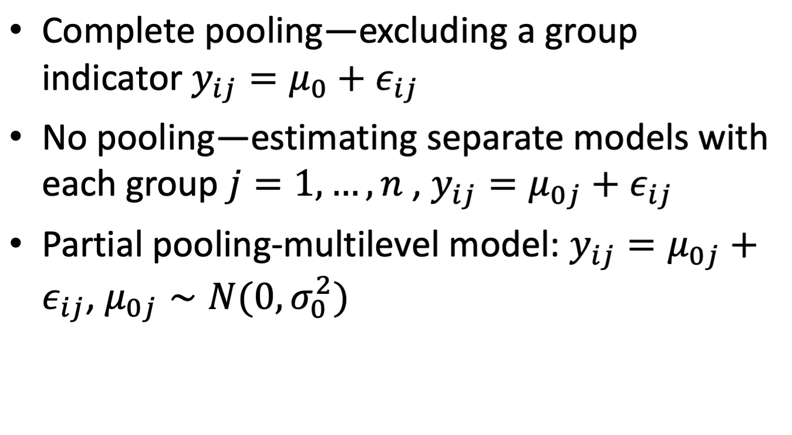
Partial Pooling without Predictors:

Slide 14
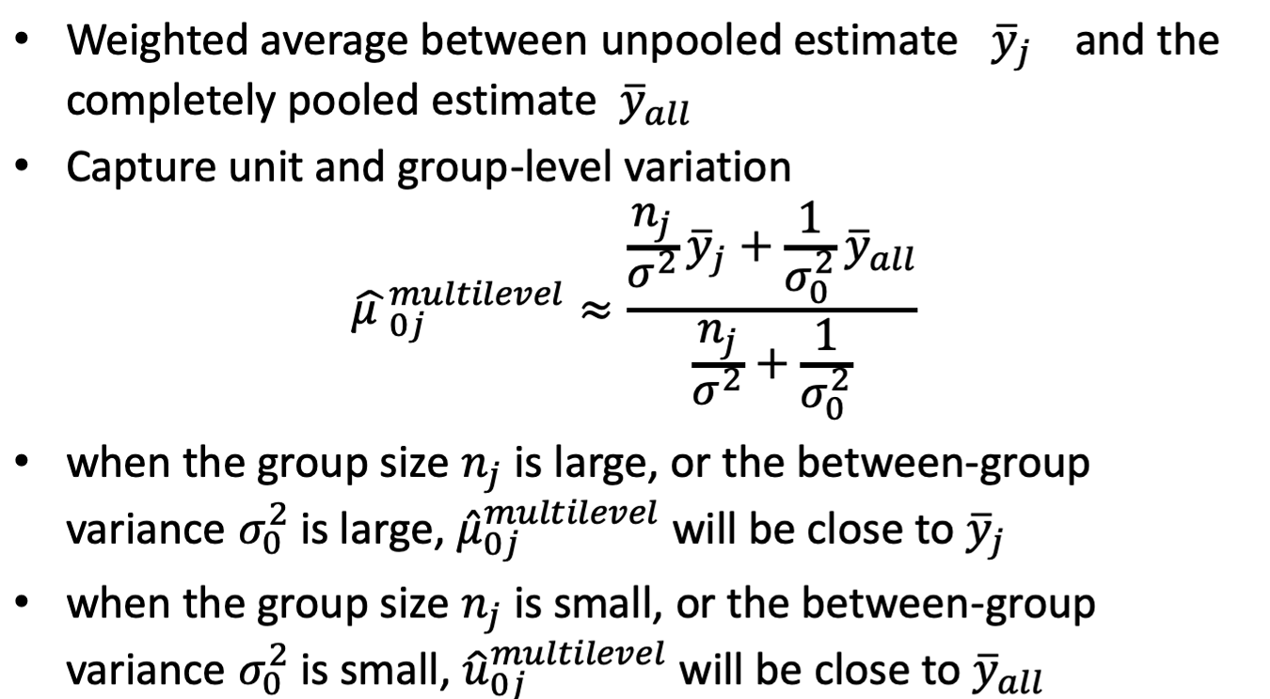
Partial-pooling Estimates

Slide 15
Adding Predictors
Multilevel model with random intercepts and slopes:
Combine as:

Slide 16
Panel Surveys with Complex Sample Designs
Consider panel surveys with a complex initial sample designs (stratification, cluster sampling, weighting)
Repeatedly measure the initially sampled units at multiple follow-up waves
Next week, we will introduce design-based and model-based approaches to account for:
Correlation of repeated measurements
Complex sampling features
Different patterns of nonresponse

Slide 17
Some Final Thoughts
Importantly, we would make the same inferences regardless of the software used
“Automatic” mixture-based LRTs of variance components and intra-interviewer correlations are generally available, for random intercept models
Some amount of work may be required for diagnostics in each package, but it is important to always consider them

Slide 18
Your Analysis Projects
Be creative! Do some data exploration, and try to find some interesting patterns in your data…
Try a random coefficient model! Not a lot of research considers between-cluster variance in regression coefficients…important for longitudinal data
Try to explain variance in the residuals and the random effects! Consider aggregating L1 variables…
Carefully consider model diagnostics!
Be careful and clear with your interpretations

