Slide 1
Welcome to SURV/SURVMETH 720 ! Total Survey Error & Data Quality 1
Class 1
August 25, 2025

Slide 2
Today’s Agenda
Diverse perspectives on survey research
Overview of TSE framework

Slide 3
Today’s Agenda
Diverse perspectives on survey research
Overview of TSE framework

Slide 4
Diverse perspectives on survey research

Slide 5
Different Uses of Survey Data
Those who describe characteristics of a finite population at a point in time (“Describer”).
Those who look for causes and correlates of phenomena in society (“Modeler”).

Slide 6
Different Perspectives on Error
Those who focus on sampling error and those who focus on non-sampling error.
Sampling statisticians : focus on errors that arise because only a subset of the population is measured.
Data collection and substantive experts : focus on addressing nonresponse and measurement problems.

Slide 7
Different Goals with Respect to Survey Error
Efforts to measure errors
Measurer : design a nonresponse bias study with an intensive data collection protocol
Efforts to reduce errors
Reducer : improve response rates by changing visit protocols
I find myself to be in either/both camps depending on the situation, e.g., https://www.demographic-research.org/volumes/vol50/32/50-32.pdf

Slide 8
Differences between Statistical and Social Science Approaches
Statistics offers models and procedures to estimate and adjust for survey errors
Social science offers theories for causes of human behavior producing errors, and possible ways to address the errors
Again, I am in both ‘camps’ depending on the situation

Slide 9
Today’s Agenda
Diverse perspectives on survey research
Overview of TSE framework

Slide 10
What do you mean by the phrase “data quality” ?

Slide 11
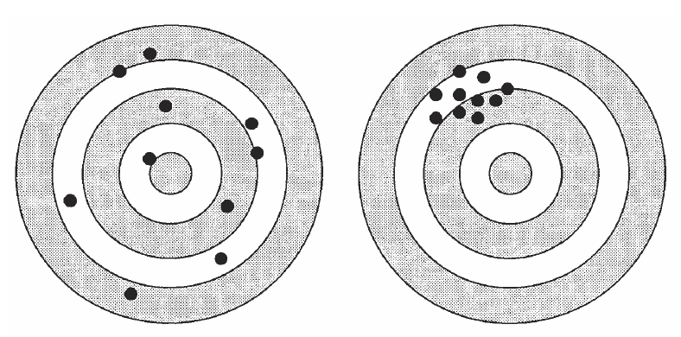
Design 1
Design 2
What would you choose ?

Slide 12
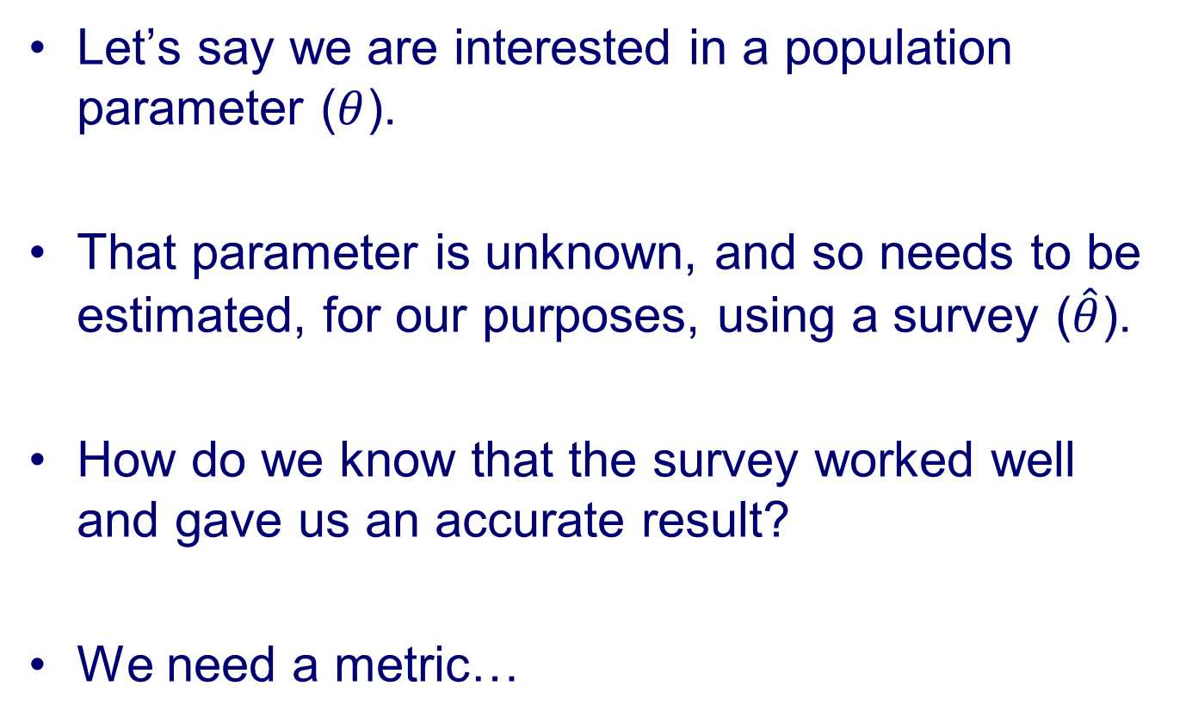
Building Intuition about “Survey Error”
Let’s say we are interested in a population parameter ($θ$).
That parameter is unknown, and so needs to be estimated, for our purposes, using a survey ($\hat{θ}$).
How do we know that the survey worked well and gave us an accurate result?
We need a metric…

Slide 13
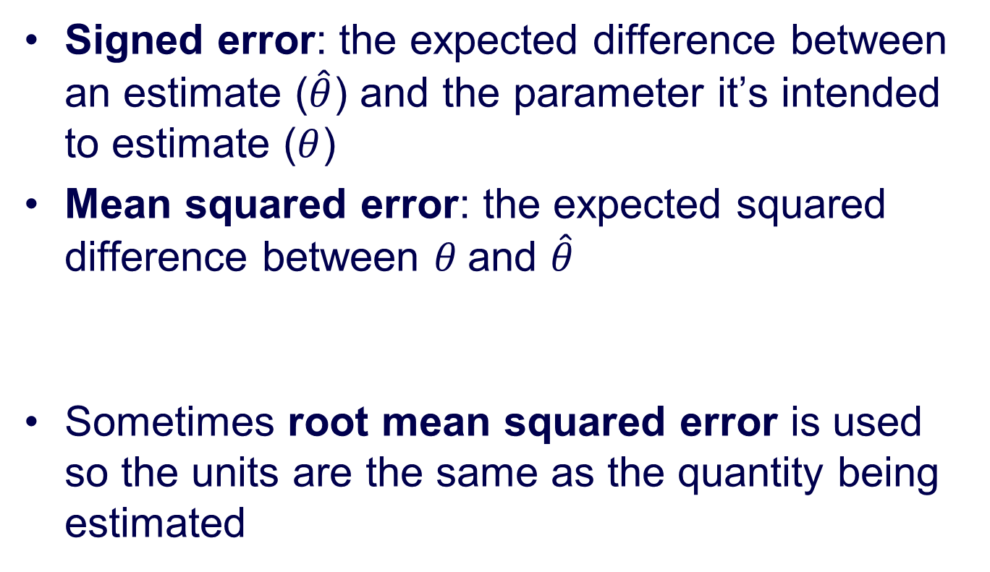

Numeric Representations of Accuracy
Signed error: the expected difference between an estimate ($\hat{θ}$) and the parameter it’s intended to estimate ($θ$)
Mean squared error: the expected squared difference between $θ$and $\hat{θ}$
Sometimes root mean squared error is used so the units are the same as the quantity being estimated
$$MSE={E\left(\hat{θ}−θ\right)}^{2}$$

Slide 14
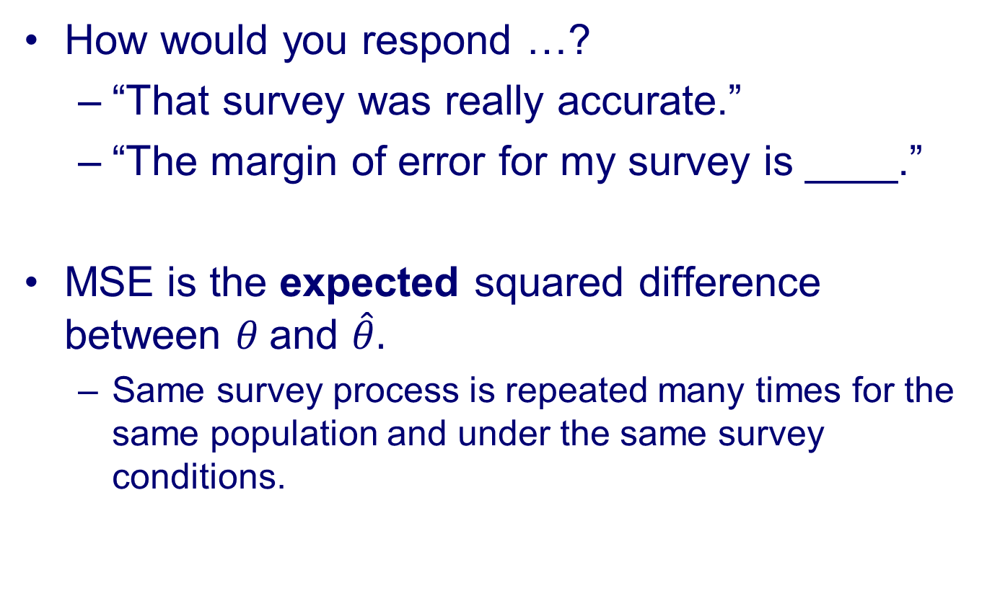
Survey error…
How would you respond …?
“That survey was really accurate.”
“The margin of error for my survey is ____.”
MSE is the expected squared difference between $θ$and $\hat{θ}.$
Same survey process is repeated many times for the same population and under the same survey conditions.

Slide 15
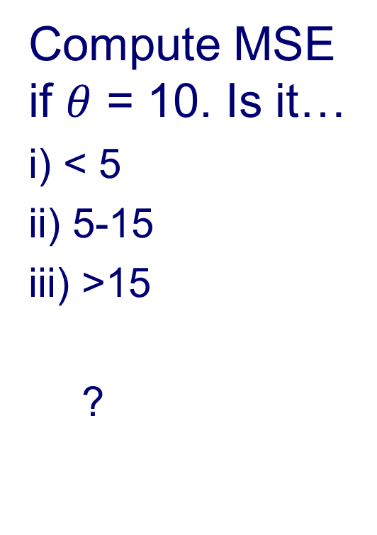
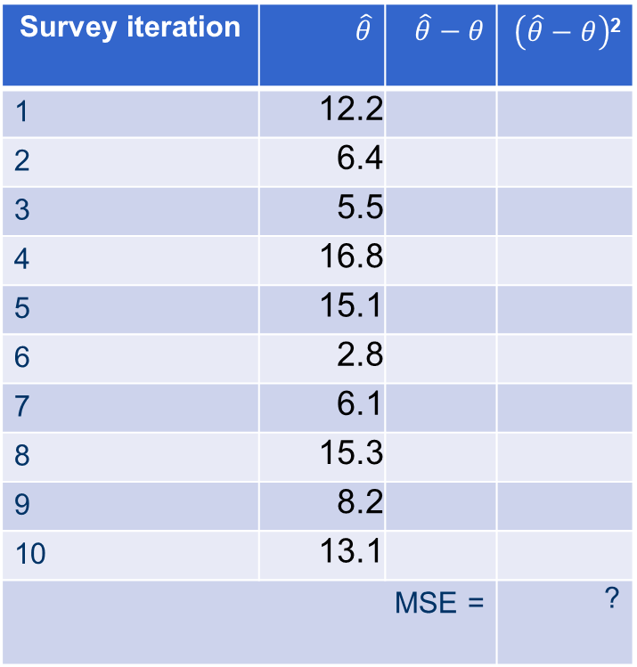
Compute MSE if $θ$ = 10. Is it…
i) < 5
ii) 5-15
iii) >15
?
Survey iteration | $\hat{θ}$ | $\hat{θ}−θ$ | $\left(\hat{θ}−θ\right)$²
1 | 12.2
2 | 6.4
3 | 5.5
4 | 16.8
5 | 15.1
6 | 2.8
7 | 6.1
8 | 15.3
9 | 8.2
10 | 13.1
MSE = |  |  | ?
Biemer and Lyberg (2003)

Slide 16
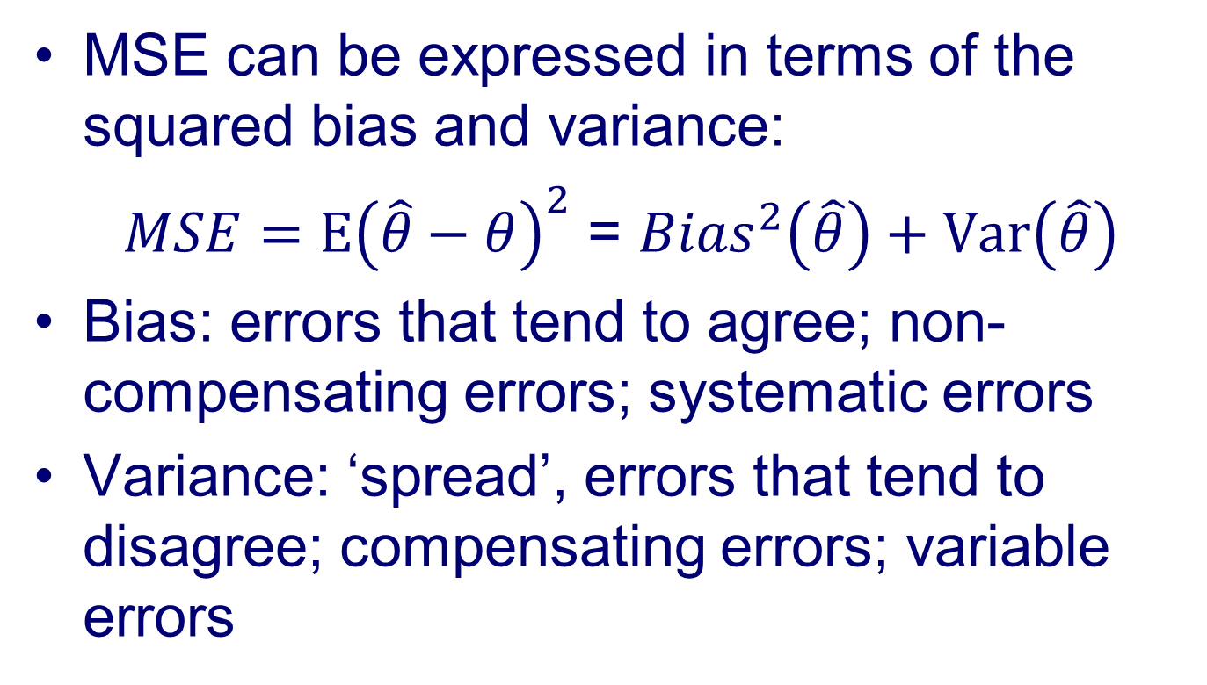
MSE…
MSE can be expressed in terms of the squared bias and variance:
$MSE={E\left(\hat{θ}−θ\right)}^{2}$ = ${Bias}^{2}\left(\hat{θ}\right)+Var\left(\hat{θ}\right)$
Bias: errors that tend to agree; non-compensating errors; systematic errors
Variance: ‘spread’, errors that tend to disagree; compensating errors; variable errors

Slide 17
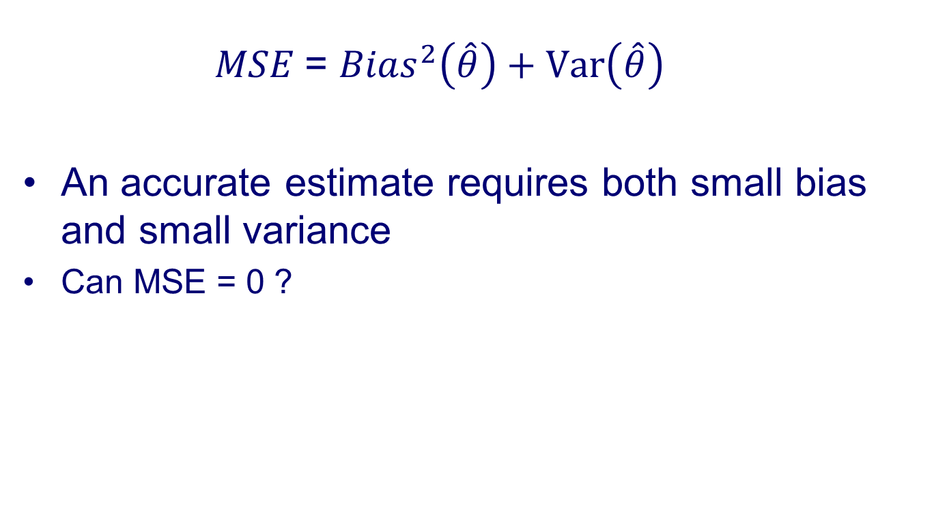
MSE cont’d
$MSE$= ${Bias}^{2}\left(\hat{θ}\right)+Var\left(\hat{θ}\right)$
An accurate estimate requires both small bias and small variance
Can MSE = 0 ?

Slide 18
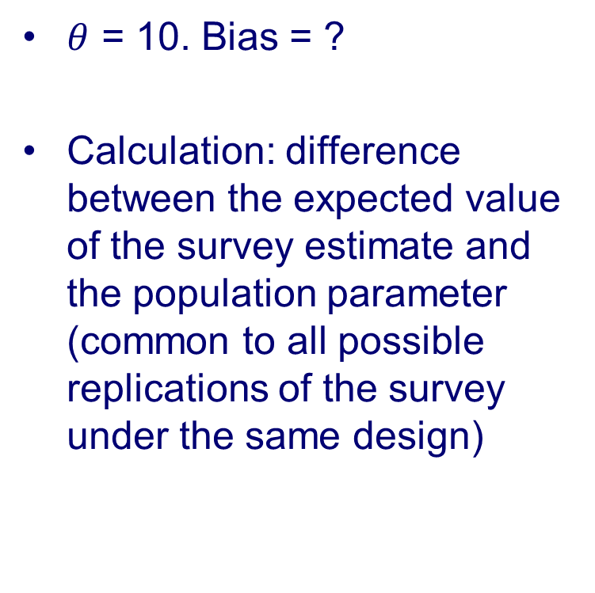
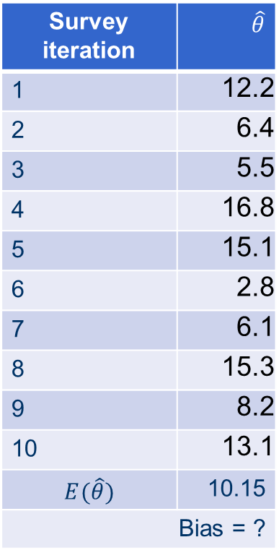
$θ$ = 10. Bias = ?
Calculation: difference between the expected value of the survey estimate and the population parameter (common to all possible replications of the survey under the same design)
Survey iteration | $\hat{θ}$
1 | 12.2
2 | 6.4
3 | 5.5
4 | 16.8
5 | 15.1
6 | 2.8
7 | 6.1
8 | 15.3
9 | 8.2
10 | 13.1
$$E(\hat{θ})$$ | 10.15
Bias = ?

Slide 19
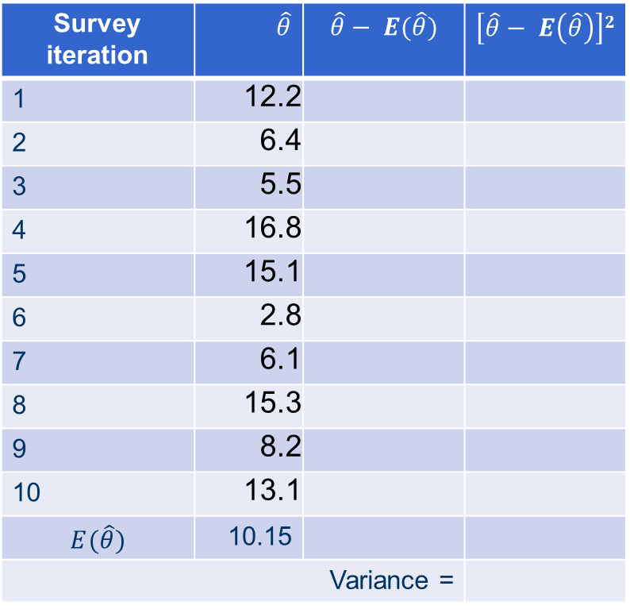
variance = ?
Calculation: average squared difference between each survey estimate (over conceptual replications) and the expected value of the survey estimate
Survey iteration | $\hat{θ}$ | $$\hat{θ}− E(\hat{θ})$$ | $$\left[\hat{θ}− E\left(\hat{θ}\right)\right]2$$
1 | 12.2
2 | 6.4
3 | 5.5
4 | 16.8
5 | 15.1
6 | 2.8
7 | 6.1
8 | 15.3
9 | 8.2
10 | 13.1
$$E(\hat{θ})$$ | 10.15
Variance = |  | Variance =

Slide 20
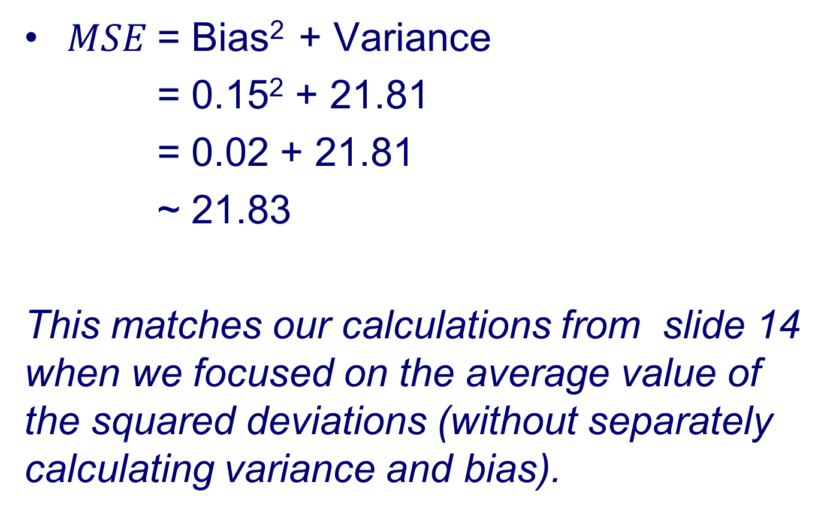
MSE Calculations
$MSE$= Bias² + Variance
= 0.15² + 21.81
= 0.02 + 21.81
~ 21.83
This matches our calculations from slide 14 when we focused on the average value of the squared deviations (without separately calculating variance and bias).

Slide 21
MSE Approximations
MSE is seldom used, in part, because estimation is difficult.
Also, estimation requires replication with same essential survey conditions.
Combining error information for two or more error components (that one can estimate given the data at hand)
Typically: estimate of bias from one error source such as nonresponse plus estimate of sampling variance for one iteration of a survey

Slide 22
“It is not to be inferred from the foregoing material that there are grounds for discouragement or that the situation is entirely hopeless with regard to
the attainment of useful accuracy. My point is that the accuracy supposedly required of a proposed survey is frequently exaggerated—is in fact
often unattainable—yet the survey when completed turns out to be useful in the sense of helping to provide a rational basis for action.”
- Deming, 1944

Slide 23
Approximations of MSE are Still Useful
To compare the accuracy of alternative data collection/estimation methods
To optimize the allocation of resources for the survey design (especially to reduce nonsampling error)
To provide information to data users regarding the quality of reported estimates

Slide 24
Building Intuition about “TSE”
Let’s say we want to optimally allocate available resources to minimize MSE for our estimate
increase sample size? respondent incentives? improve IWER training?
Need way of decomposing error into component parts so can target major sources of error
An error framework is useful…

Slide 25
TSE is a conceptual framework describing statistical error properties of sample survey statistics (Groves and Lyberg, 2010)
TSE refers to the accumulation of all errors that may arise in the design, collection, processing, and analysis of a survey” (Biemer, 2010)
The TSE paradigm provides a theoretical framework for optimizing surveys by maximizing data quality within budgetary constraints. (Biemer, 2010)
The TSE paradigm is a valuable tool for understanding and improving survey data quality because it summarizes the ways in which a survey estimate may deviate from the corresponding parameter value. (Biemer 2016)

Slide 26
TSE is the sum of all the myriad ways in which survey measurement can go wrong (Smith, 2005)
The total survey error approach is often discussed in terms of a trade-off between survey errors and costs. However, a broader statement of this approach emphasizes the several different types of survey error, inevitable survey-related effects, and the full set of cost, time, and ethical considerations that constrain research (Weisberg, 2009)
The TSE approach emphasizes the trade-offs that must be made in trying to minimize those possible errors within the constraint structure of the available resources (Lyberg and Weisberg, 2016)

Slide 27
TSE…
Basic concept goes back as far as 1944 (Deming, ASR paper).
TSE links survey steps to major error sources.
TSE applicable to design, implementation, and evaluation phases of a survey.

Slide 28
Different Categories of Errors
Kish (1965) : Sampling vs. Nonsampling
Groves (1989): Observation vs. Non-observation
Lyberg and Weisberg (2016) : correlated vs uncorrelated errors
Groves et al. (2004): Measurement vs. Representation

Slide 29
TSE Diagram
Measurement
Representation
Target Population
Construct
Sampling Frame
Measurement
Sample
Response
Respondents
Edited Response
Post-survey Adjustments
Survey Statistic
Groves et al. (2004)

Slide 30
Representation
Target Population
Coverage Error
Failure to include all elements of the target population in the sampling frame
Coverage
Error
Sampling Frame
Sampling Error
Sample
Nonresponse Error
Respondents
Adjustment Error
Post-survey Adjustments

Slide 31
Representation
Target Population
Coverage
Error
Sampling Frame
Sampling Error
Failure to include all elements of the target population
Sampling Error
Sample
Nonresponse Error
Respondents
Adjustment Error
Post-survey Adjustments

Slide 32
Representation
Target Population
Coverage
Error
Sampling Frame
Sampling Error
Sample
Nonresponse Error
Failure to measure all selected sample members
Nonresponse Error
Respondents
Adjustment Error
Post-survey Adjustments

Slide 33
Representation
Target Population
Coverage
Error
Sampling Frame
Sampling Error
Sample
Nonresponse Error
Respondents
Adjustment Error
Arises from post-survey statistical adjustments (weighting, imputation, tabulation)
Adjustment Error
Post-survey Adjustments

Slide 34
TSE Diagram
Measurement
Representation
Target Population
Construct
Coverage
Error
Validity
Sampling Frame
Measurement
Sampling Error
Measurement Error
Sample
Nonresponse Error
Response
Respondents
Processing Error
Adjustment Error
Edited Response
Post-survey Adjustments
Survey Statistic

Slide 35
Measurement
Construct
Validity
Extent to which the measure reflects the target construct
Validity
Measurement
Measurement Error
Response
Processing Error
Edited Response

Slide 36
Measurement
Construct
Validity
Measurement
Measurement Error
Measurement Error
Extent to which the response reflects the “true” value.
- Interviewer
- Respondent
- Instrument
- Mode
Response
Processing Error
Edited Response

Slide 37
Measurement
Construct
Validity
Measurement
Measurement Error
Response
Processing Error
Arises from processing activities that follow data collection (data entry, editing, coding)
Processing Error
Edited Response

Slide 38
Measurement
Representation
Target Population
Construct
Coverage
Error
Validity
Sampling Frame
Measurement
Sampling Error
Measurement Error
Sample
Nonresponse Error
Response
Respondents
Processing Error
Adjustment Error
Edited Response
Post-survey Adjustments
Survey Statistic

Slide 39
There could be more/different error sources in your application.

Slide 40
Group activity
Conceptually, can all sources of error that are normally associated with bias also be associated with variable error?
i) Yes
ii) No

Slide 41
Group Activity - Instructions
1. Go to: https://bit.ly/720_2025_Class1
2. Find the slide corresponding to your breakout room number
3. Introduce yourselves and write your names on the slide
4. You will have 10 minutes for this activity
5. Designate a volunteer who could speak about the slide when your group is called

Slide 42
Building Intuition about “Quality”
“I have designed and implemented a survey that produces very accurate estimates.”
Is this enough ?

Slide 43
“Fitness of Use” of Survey Statistics
Dimension | Description
Accuracy | Degree to which error is minimized
Relevance | Degree to which it meets the real needs of users
Timeliness | Delay between the reference point and the date it becomes available
Coherence | Degree to which it is consistent over time and can be successfully brought together with other information
Accessibility | Ease with which it can be obtained
Interpretability | Availability of metadata and other supplemental information necessary to interpret and utilize it
Brackstone (1999)

Slide 44
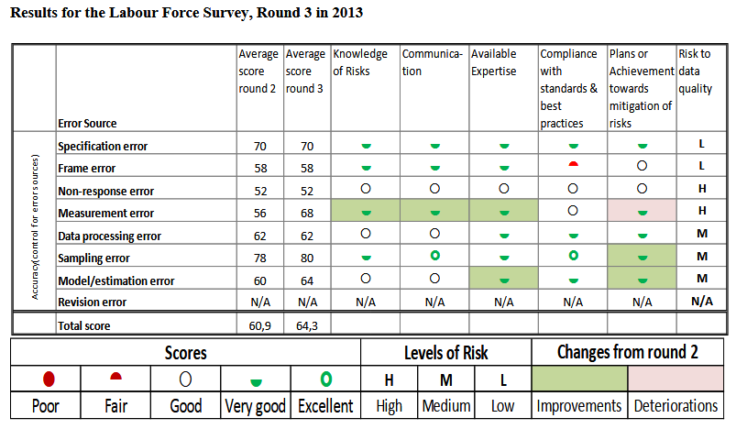
A System for Product Improvement, Review and Evaluation, ASPIRE Statistics Sweden
https://www.scb.se/contentassets/edf20d31969940249b04d67cebcd5f73/ov9999_2020a01_br_x99br2101.pdf
Related concept: “Quality profile”

Slide 45
Recap
TSE paradigm…
Part of the broader concept of Total Survey Quality (or even Total Research Quality)
Focuses on accuracy, that is, reducing MSE

Slide 46
Weaknesses of the TSE Framework
1. Exclusions of key quality concepts
Notably the relevance to the user
2. Diagrammatic representation might give an impression of independence of error sources
3. Lack of routine measurements
error/quality profiles are useful but rare
empirical estimation of errors is hard to achieve (but can make use of ‘effect generalizability’.); large design burden.

Slide 47
Weaknesses of the TSE Framework…
4. Does not define acceptable error thresholds
5. Ineffective influence on professional standards
- press releases by many survey organizations rarely mention anything beyond sampling errors (if that)

Slide 48
Strengths of the TSE Framework
1. Decomposition of errors
- nomenclature for different components
2. Separation of phenomena affecting statistics in different ways
- measurement vs. representation issues
- variance vs. bias
- provides way to evaluate alternative data collection procedures (trade-offs, resource allocations)
3. Conceptual foundation of the field of survey methodology
subfields defined by errors

Slide 49
Next Class (Sep 8; enjoy the upcoming long weekend)
Topic: Costs and coverage of target population
Reading Assignment
Questions?

