Slide 1
PSID Crisis Module: What the Optimized Design Delivers
Validated portfolio metrics from the final ranked questionnaire workflow
The final module keeps the questionnaire inside the 30-minute field constraint while preserving the highest-value, most portable crisis questions.
52 -> 28
29.17 / 30 min
Candidate questions narrowed to deployable module
Selected module duration under hard interview cap
2.452 / 7.809
14 recommendations
Average / maximum Pi enhanced-priority score
Documentation-backed outputs: 6 generic core + 8 crisis-specific
Selection outcome: 28 questions retained from 52 ranked candidates, consuming 97.2% of the 30-minute ceiling without exceeding it.
Sources: psid_artifact_summary.json and generate_psid_artifacts.py

Slide 2
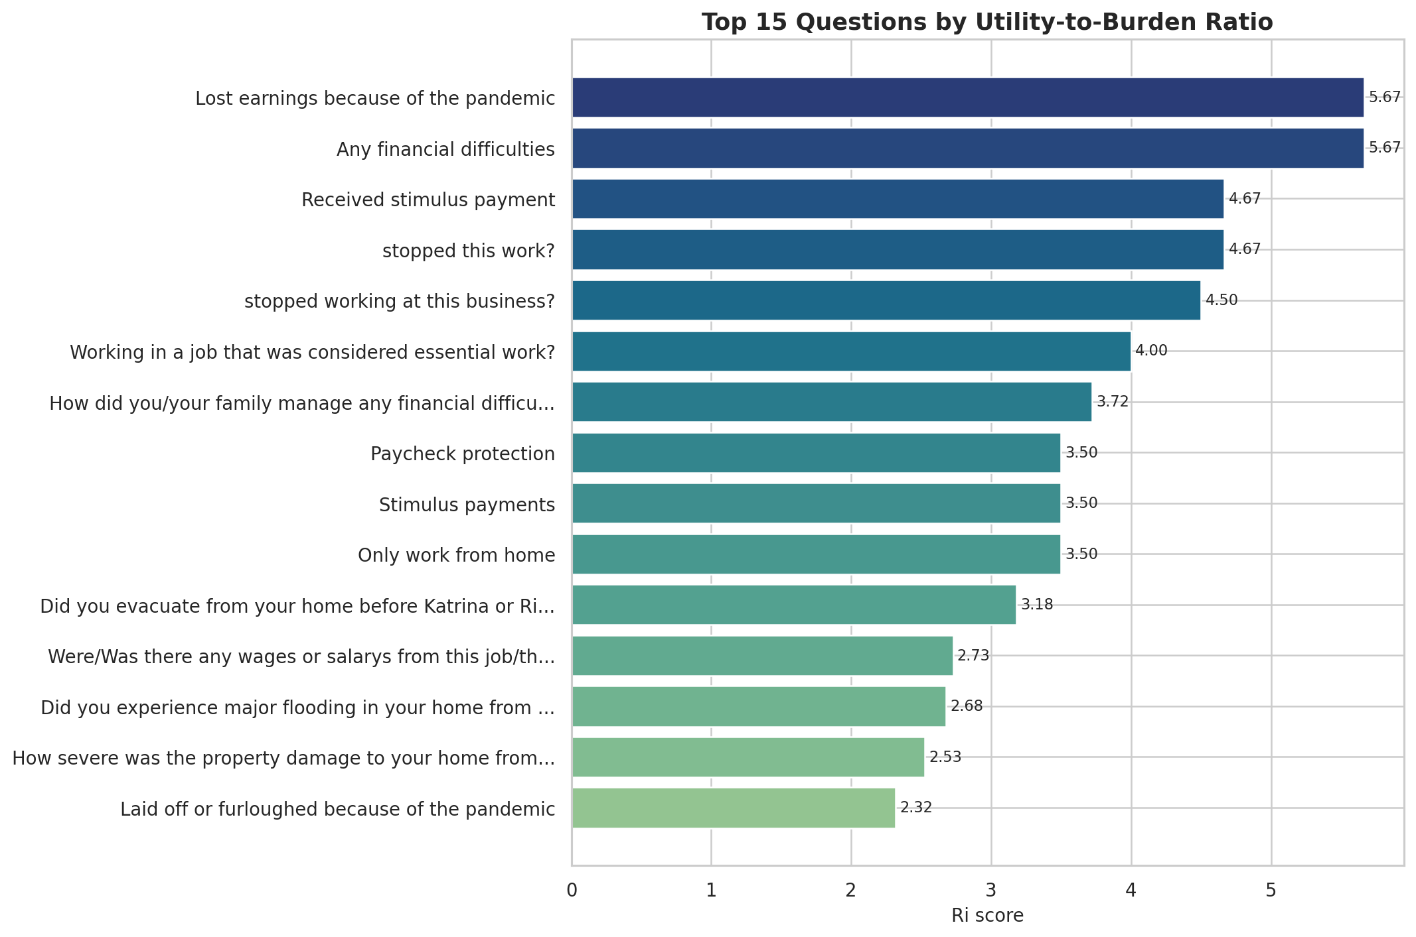
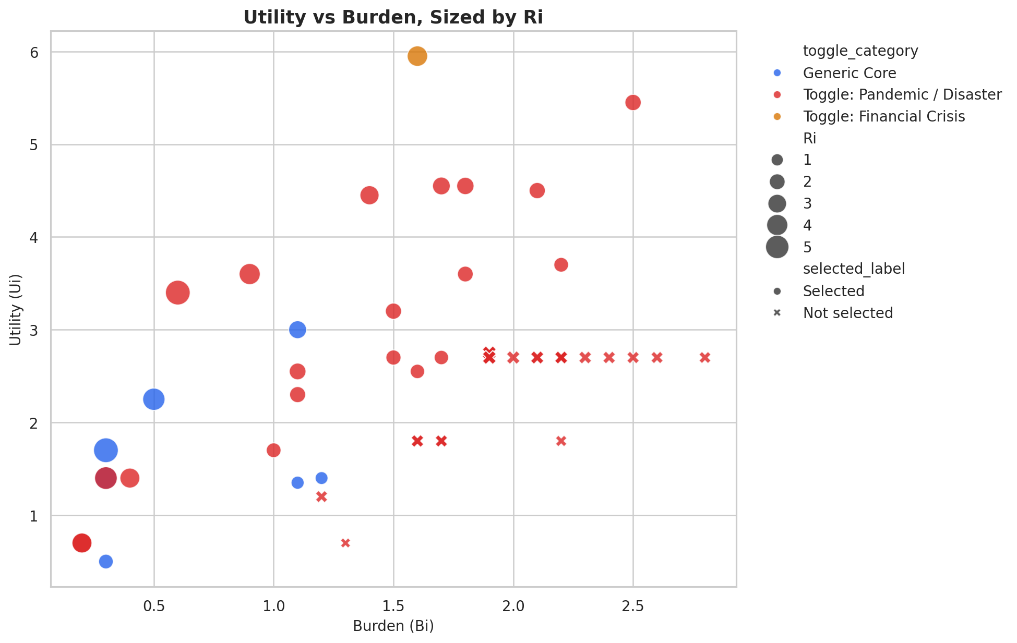
Highest-Value Questions and the Utility-Burden Tradeoff
The charts use the generated PNG artifacts directly to preserve the validated visual output
Top-ranked questions by baseline utility-to-burden ratio
Utility vs burden profile across the integrated crisis corpus
Upper-left positions indicate better questions: higher utility and lower respondent burden. Larger bubbles reflect stronger ranking scores.
Embedded visuals: fig_top_ranked_questions.png and fig_utility_vs_burden.png

Slide 3
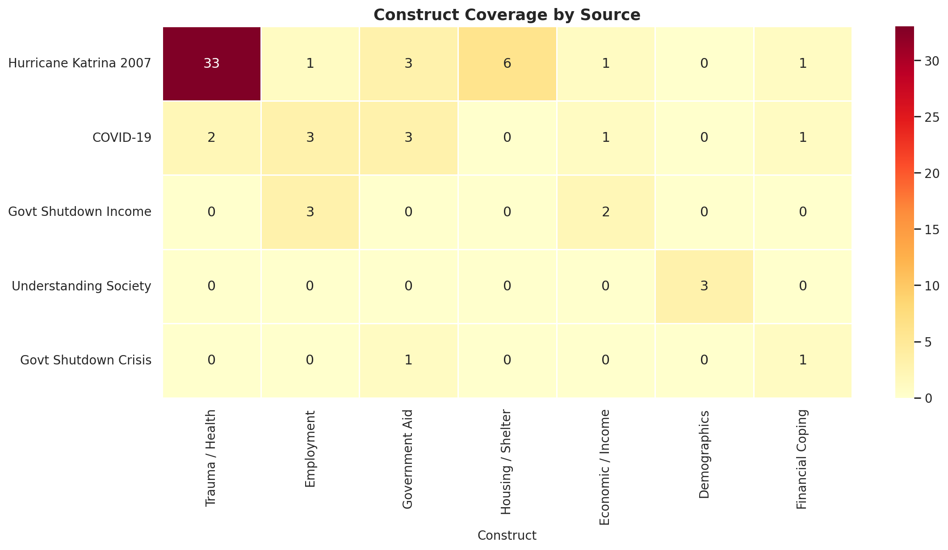
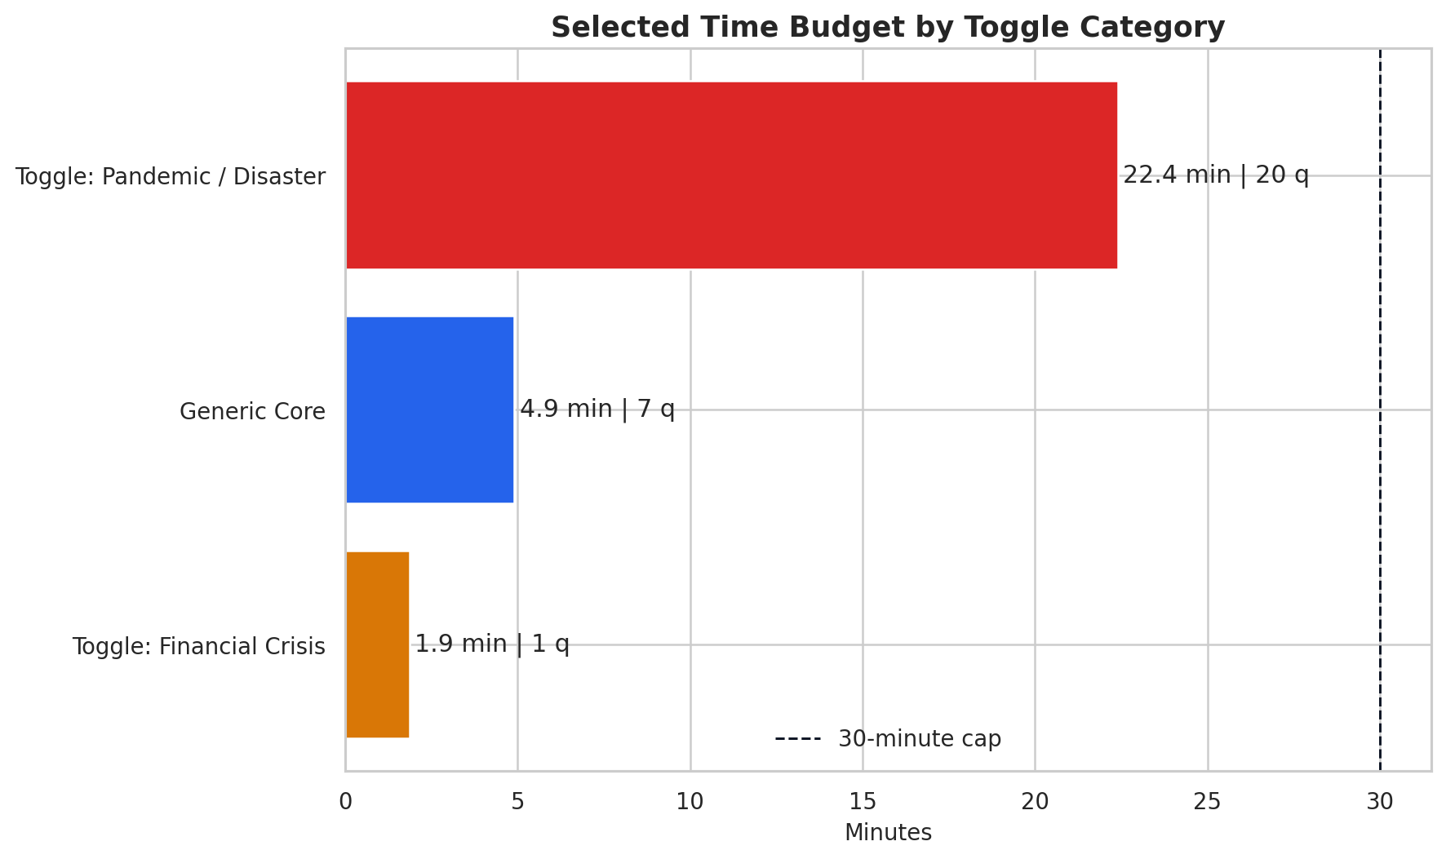
Coverage Across Constructs, Sources, and Time Budget
Three complementary views show breadth of coverage, source integration, and budget discipline
Construct coverage by source
Selected source contribution
Hurricane Katrina 2007: 13 selected
COVID-19: 8 selected
Govt Shutdown Income: 3 selected
Understanding Society: 3 selected
Govt Shutdown Crisis: 1 selected
Time budget by toggle category
Embedded visuals: fig_construct_heatmap.png and fig_time_budget.png

Slide 4
Metrics That Are Easy to Explain to Stakeholders
The workflow balances interpretability, deployability, and evidence-backed recommendations
Core performance metrics
Simple interpretation
Recommendation outputs
52 total ranked questions; 28 selected for the deployable module.
29.17 selected minutes versus 68.95 minutes for the full corpus.
Average Ri: 2.079; maximum Ri: 5.667.
Average Pi: 2.452; maximum Pi: 7.809.
Ri answers a basic question: how much thematic value do we get per unit of burden?
Pi improves that score by rewarding rarer wording, richer construct coverage, and deployable phrasing while penalizing redundancy.
The selected module is near the cap because the workflow fills the available interview time with the highest-priority items first.
6
Generic-core recommendations
8
Crisis-specific recommendations
Each recommendation is linked to documentation-backed patterns and supported by the highest-scoring matching questions in the corpus.
Metrics derived from psid_artifact_summary.json and recommendation generation in generate_psid_artifacts.py

Slide 5
Computational Model Architecture
From raw PSID source material to deployable, evidence-backed questionnaire artifacts
1. Data Input
2. NLP Processing
3. Augmented Scoring
4. Selection Engine
5. Artifact Output
5 PSID-related sources
52 integrated candidate questions
Authoritative base CSV for ranking
Keyword parsing and tagging
Construct extraction
Question-level feature assembly
TF-IDF rarity
Cosine redundancy penalty
Construct richness and portability bonus
Rank by Pi descending
Greedy fit to 30-minute cap
Deployable wording and recommendations
Final CSV with 25 columns
Dashboard data payload
PNG figures, report HTML, notebook outputs
Enhanced priority formula
Construct priority weights
Pi = U* / [Bi x (1 + 0.65 x redundancy)] U* = U x (1 + 0.32 x idf + 0.24 x construct + 0.12 x richness + portability)
Trauma/Health 0.58 Housing/Shelter 0.55 Government Aid 0.48 Financial Coping 0.45 Employment 0.42 Economic/Income 0.40 Demographics 0.14
Implemented in generate_psid_artifacts.py via build_all() with TF-IDF, redundancy control, and recommendation generation

