Slide 1


STAKEHOLDER SUMMARY
Bot detection and gift-card decisions
Which caregiver responses are real, which need a second look, and who should be paid.
1,956 responses reviewed
Caregiver Acceptability Study · Infant Autism Screening · September 2026
Notes:
Frame the meeting: this deck covers only the final conclusions of the bot screen and what they mean for gift-card payments. The full method and diagnostics live in the bot detection review deck.

Slide 2

WHERE THE DATA CAME FROM
Two study databases, one shared check
Every response in both databases went through the same screen, so the two are directly comparable.
VERIFIED DATABASE
LEGACY DATABASE
177
1,779
responses
responses
– Recruitment was confirmed by the study team
– 131 fully completed responses became the human reference point
– Used as the trusted benchmark for normal behaviour
– Older, open recruitment with no identity confirmation
– This is where nearly all the suspicious activity sits
– Screened with the same rules, not assumed bad
WHAT WE CONFIRMED FIRST
Response counts matched the expected totals, the same survey questions line up across both databases, and every extract was saved with a checksum so the review can be repeated and audited.
Source: table_12_api_cache_inventory.csv, table_13_field_intersection.csv, table_16_trust_tier_counts.csv
Notes:
The verified database is the yardstick. Because we know those people are real, their timing and answering behaviour defines what normal looks like. Everything else is measured against it.

Slide 3
HOW RESPONSES ARE SCREENED
Ten automatic checks on every response
The checks are fixed and rule-based. The same response always gets the same result, with no human judgement in the scoring.
HARD CHECKS · SERIOUS PROBLEMS
SOFT CHECKS · WORTH A LOOK
R1
Finished the whole survey faster than any real caregiver
R3
One section finished unusually fast
R2
Raced through the main attitudes section
R4
Same answer repeated down a whole block
R5
Answer pattern is an exact copy of another response
R6
Several responses arrived in one rapid burst
R8
Family answers contradict each other
R7
Written comments are near-copies of another response
R9
Background details are not possible as given
R10
Failed the built-in survey fraud question (verified database only)
Each threshold comes from the 131 confirmed-real caregivers, not from a guess. The speed limits are 11.57 minutes for the full survey and 7.85 minutes for the attitudes section.
R10 is a validation signal only. It never decides a response's tier or a payment on its own.
Source: table_14_fraud_rule_definitions.csv, table_15b_rule_counts_by_project.csv
Notes:
Two things worth stressing. First, no check uses demographic information as evidence of a bot. Second, R5 never fired anywhere, so we found no exact duplicate answer patterns in either database.

Slide 4
HOW THE CHECKS ADD UP
One hard problem, or two soft ones
A single check never condemns a response. Tier 1 needs a hard problem; everything below is graded by how many soft signals stack up.
Tier 1
Tier 2
Tier 3
Tier 4
Confirmed invalid
High suspicion
Uncertain
Pass
Any one hard check fired
Two or more soft checks fired
Exactly one soft check fired
Nothing fired at all
R1, R2, R5, R8 or R9
2+ of R3, R4, R6, R7
1 of R3, R4, R6, R7
No rules triggered
WHY IT IS BUILT THIS WAY
– Tier 1 is the only group that can lose a payment, and even then not automatically.
– Tiers 2, 3 and 4 stay eligible; they differ only in how much checking happens first.
Source: table_16_trust_tier_counts.csv, table_36b_tier1_rule_combo_summary.csv
Notes:
The tier system replaced a simple bot-or-not label. That was a deliberate decision: a binary label forces a wrong answer on the borderline cases, which is exactly where the money is at stake.

Slide 5
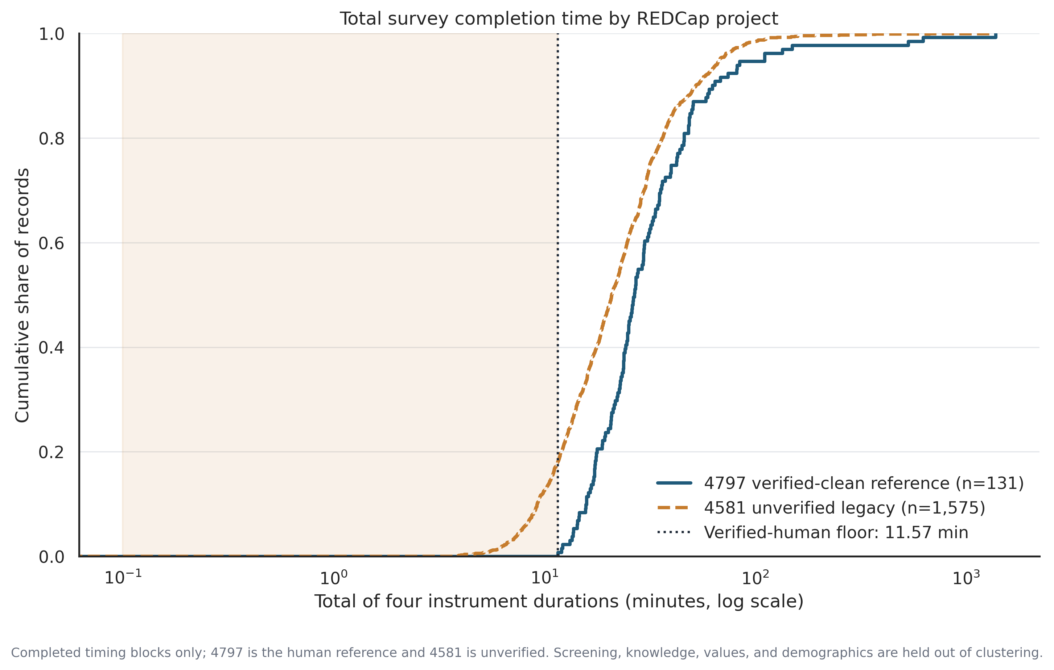
THE EVIDENCE BEHIND THE SPEED LIMIT
Real caregivers never finish this fast
The speed limit was set by real caregivers, not chosen by us. Not one confirmed-real response fell below it.
– Every confirmed-real caregiver took at least 11.57 minutes.
– In the legacy database, a visible group finishes well under that floor.
– That gap is what the two hard timing checks, R1 and R2, are measuring.
– Because no real caregiver was below the line, these two checks flagged no confirmed-real person at all.
Source: figure_7_timing_ecdf.png
Notes:
The shaded area is below the human floor. The verified line simply does not enter it, while the legacy line does. This is the single clearest picture of why the screen works.

Slide 6
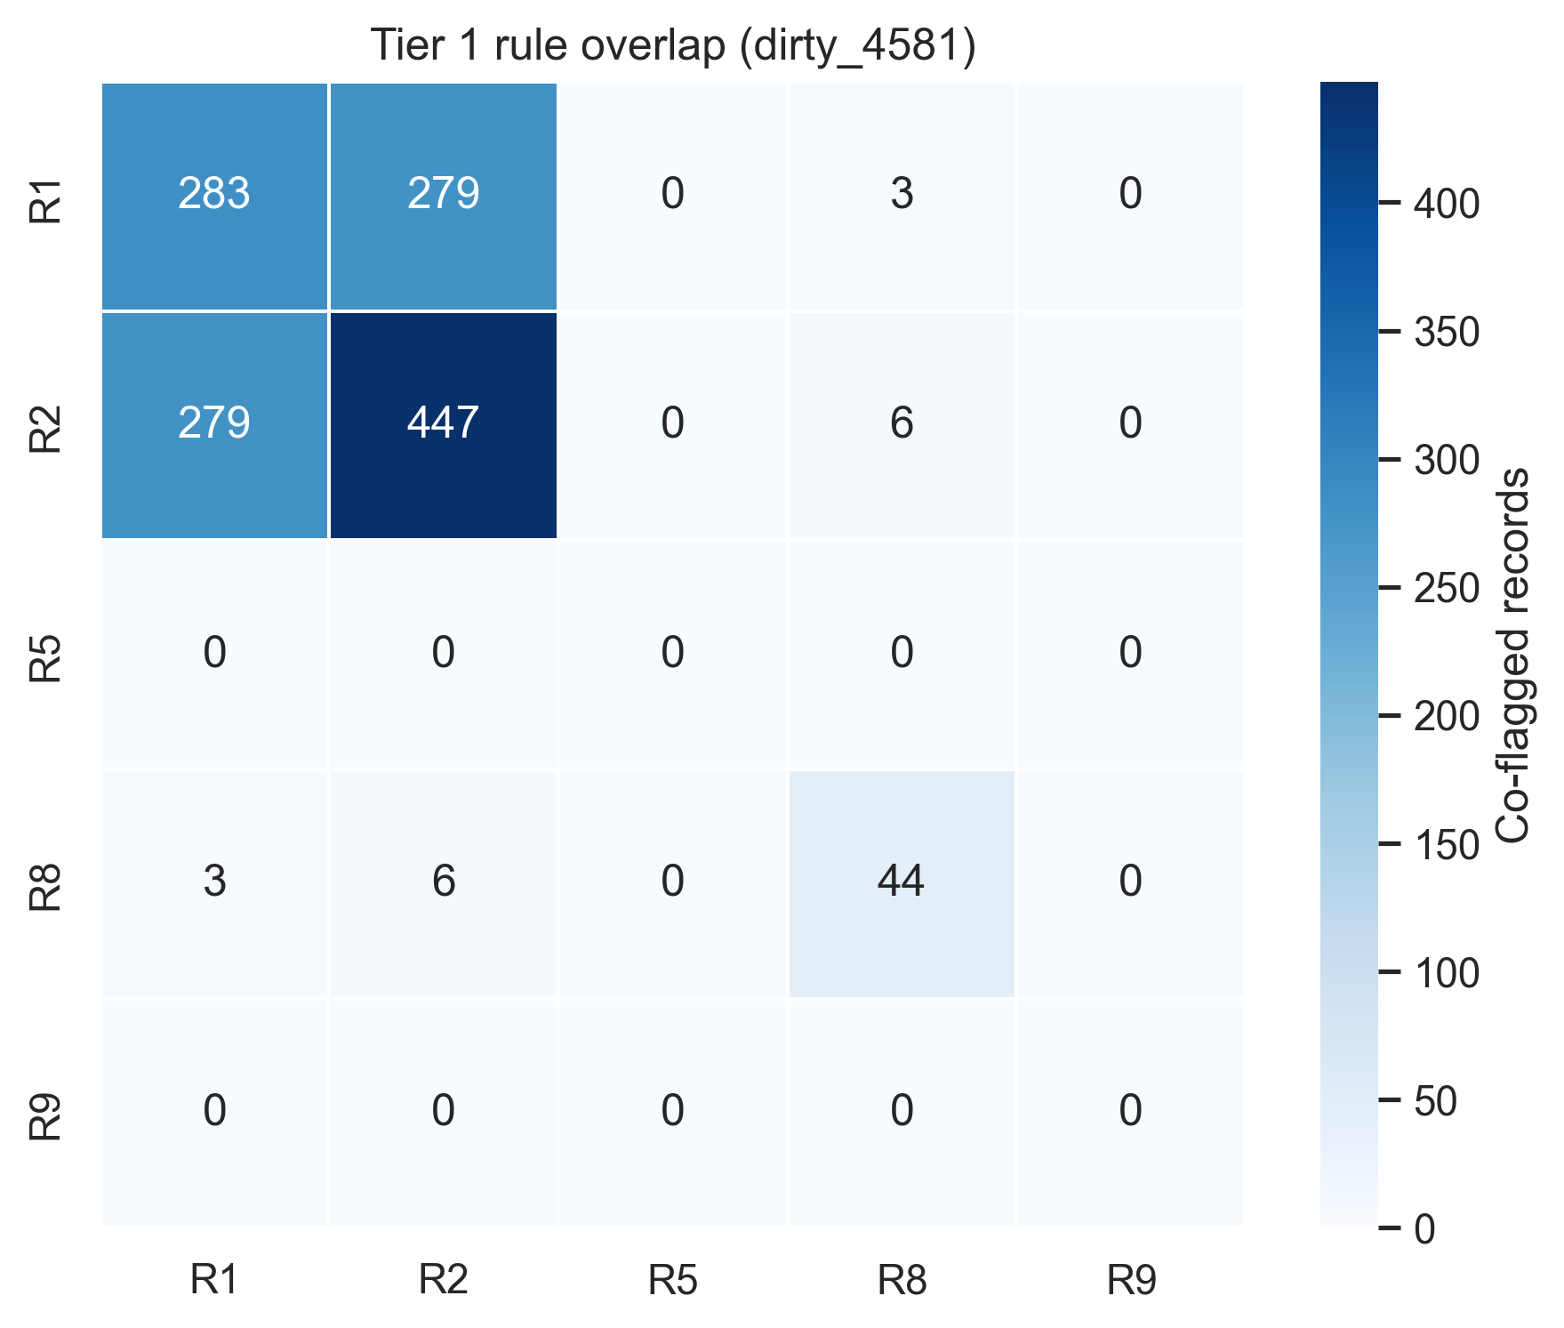
WHAT THE SERIOUS FLAGS LOOK LIKE
Most hard flags are about speed, not deception
The great majority of serious flags are two timing checks firing together. Contradictory answers are rare, and copied responses never appeared at all.
– 279 responses tripped both timing checks, and for 276 of them that was the only serious problem.
– Only 44 showed contradictory family answers.
– Not one response in either database was an exact copy of another.
– Only 6 combined a contradiction with a speed problem, and those are the strongest cases.
Reading the chart: "dirty_4581" is the legacy database. The diagonal is how often each check fired; off-diagonal cells are two checks firing on the same response.
Source: figure_22_tier1_overlap_heatmap.png
Notes:
This matters for tone. Speed alone is suspicious but not proof; a contradiction plus speed is much harder to explain away. That distinction drives the payment policy.

Slide 7
THE RESULT
Where all 1,956 responses landed
Six responses are confirmed automated. Just over half need a human to look before any money moves.
223
679
1,048
6
11.4%
34.7%
53.6%
0.3%
Clean pass
Likely real
Needs review
Confirmed bots
No check fired at all.
Pay now.
One soft signal only.
Approve for payment.
Hold until a person
adjudicates.
Withhold payment
and block.
THE HEADLINE NUMBER
902 responses are provisionally eligible for a gift card, which is 46% of everything collected. That splits sharply by database: 97% of the verified project clears, against 41% of the legacy project.
Source: table_43_master_summary.csv, table_40_final_showcase_summary.csv
Notes:
Read the two ends first. Only six responses are confirmed automated, so this is not a story about mass fraud. The real workload is the middle: 1,048 responses that a person has to clear before payment.

Slide 8
THE DECISION
Who gets paid, and who does not
Pay everyone the screen cannot fault. Hold, do not refuse, anything uncertain. Refuse only on combined evidence.
SITUATION
ACTION
GIFT CARD
TIER 4
Pass
Pay
Nothing flagged at all
TIER 3
Conditional pass
Pay
One soft signal only
TIER 1
Conditional pass
Pay unless overridden
One hard flag on its own
TIER 2
Review queue
Hold
Two or more soft signals
TIER 1
Review queue
Hold
Two hard flags, speed only
TIER 1
Auto-exclude
Do not pay
Three or more hard flags
TIER 1
Auto-exclude
Do not pay
Contradiction plus a speed flag
Guiding principle: a single rule hit never declares a bot on its own.
Source: table_37_bot_declaration_policy.csv, table_38_dirty4581_review_queue.csv, table_39_dirty4581_giftcard_eligible_provisional.csv
Notes:
The policy is deliberately generous at the top and strict only at the bottom. Withholding a gift card from a real caregiver is a worse outcome for the study than paying a small number of bad responses, so the borderline cases go to a person rather than being refused.

Slide 9
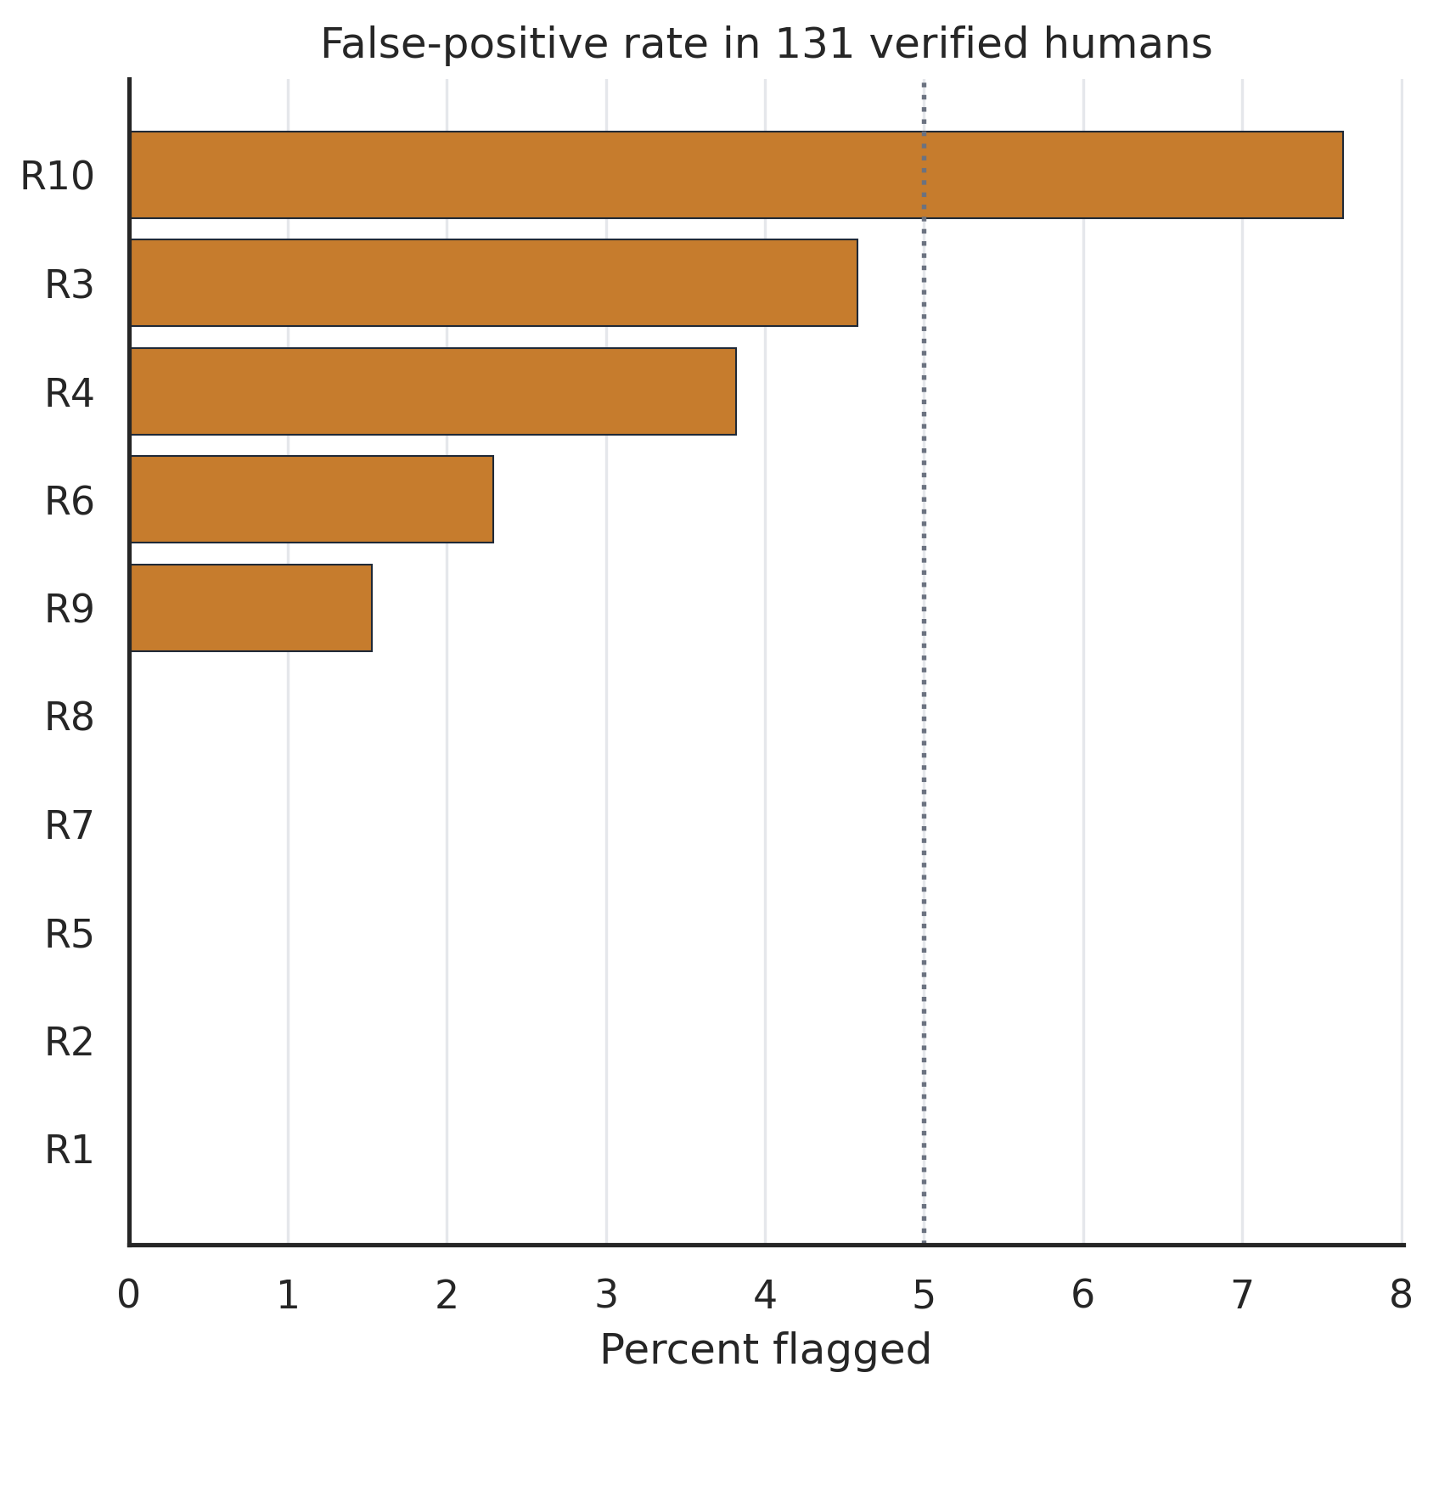
WHAT TO KEEP IN MIND
Three honest limits on these numbers
The screen is deliberately cautious. It is good at clearing real people and does not claim to catch every bot.
Real people are rarely flagged
No confirmed-real caregiver was flagged by the speed, duplicate or contradiction checks. The soft checks touched at most 4.6% of them, so a small number of genuine caregivers do land in the review queue.
We cannot state a true bot rate
A model suggested most of the legacy database separates from the verified one, but recruitment and survey changes explain part of that. We are not reporting a bot percentage, and some bots almost certainly passed.
The review queue is real work
1,048 responses wait on human adjudication, and 1,043 of them are in the legacy database. Until a person works that list, most payment decisions are provisional rather than final.
Not one confirmed-real caregiver was flagged by the speed, duplicate or contradiction checks. No check uses demographic information as evidence of a bot.
Source: table_15_rule_false_positive_rates.csv, table_17_contamination_identifiability.csv, table_30_decision_summary.csv
Notes:
If asked for a bot prevalence, the honest answer is that these data cannot identify one. The two projects differ in recruitment period and survey version as well as authenticity, so any separation estimate mixes those causes together.

