Slide 1
Cherry Blossom Peak Bloom Prediction 2026
University of Maryland
Team 5103

Slide 2
Datasets
Key features
Site | Records | Span
Kyoto | 837 | 812–2025
Washington DC | 105 | 1921–2025
Liestal | 132 | 1894–2025
Vancouver | 4 | 2022–2025
New York City | 2 | 2019–2025
Feature | Role
Winter mean temperature | Primary bloom driver
Spring mean temperature | Accumulation trigger
Latitude, longitude, altitude | Geographic baseline
Year (trend) | Long-term shift
Auxiliary: Japan (6,573), MeteoSwiss (6,642), South Korea (994)
NYC enrichment: 5 citizen-science records (USA-NPN)
Total: 14,598 bloom records
Winter/spring temperature is the dominant predictor — warmer winters and earlier spring warmth directly accelerate bloom timing.

Slide 3
Models & Methodology
Model A — Local Trend (per site)
Weighted quadratic regression on year
Recent years weighted more heavily (exponential decay, ~6 yr half-life)
Captures site-specific long-term bloom shift
Model B — Pooled GAM (R)
Smooth functions of year, location, altitude over 14,598 records
Winter/spring temperature as key covariate
Model B′ — Gradient Boosted Trees (Python)
800 trees with robust loss
Same temperature-based features
Ensemble blending
Backtest over 126 rolling windows (1900–2025)
Per-site optimal weight between local and global models
Deep-history sites lean on Model A; sparse sites lean on Model B
Prediction intervals
Conformal method: 90th percentile of backtest residuals per site
≥90% coverage with tight widths for SSW tiebreaker
Cross-language check
R and Python pipelines run independently
Averaged when predictions agree within 4 days
Current agreement: 2.8 days

Slide 4
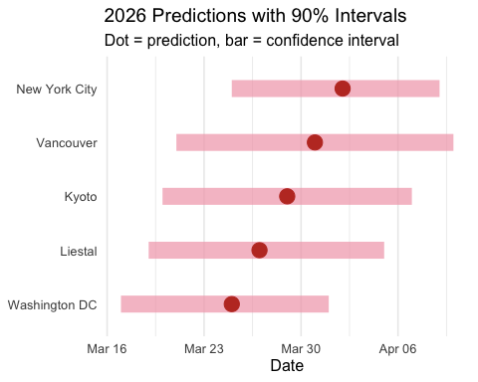
Backtest Results
Model accuracy (MAE in days)
Model | MAE | Improvement
Local trend only | 7.27 | —
Baseline ensemble | ~5.61 | —
Enhanced (temperature features) | 4.52 | 19% better
Final ensemble | 4.23 | 25% better
Why the improvement:
Winter/spring temperature captures the main phenological driver
Per-site blending weights adapt to each location’s data depth
Cross-language averaging reduces individual model bias

Slide 5
Inferential Factors
Why bloom timing changes
Winter warming — warmer winters mean trees need less cold exposure, starting spring development earlier
Spring temperatures — earlier warm spells accelerate bloom; late cold snaps can delay it
Latitude — ~1 day later per degree north above 35°N
Altitude — ~2 days later per 100 m elevation (Liestal at 350 m blooms latest)
Site-specific notes
Kyoto: Urban heat island + 0.2 d/century earlier trend. 1200-yr record anchors predictions.
Washington DC: Tidal Basin warmth → earliest bloomer. 2.2 d/decade recent acceleration.
Liestal: Alpine warming 0.3 °C/decade. Foehn winds add variability.
Vancouver: Maritime climate buffers extremes. Only 4 years of data → wider intervals.
NYC: Short record (2 yrs). NPN citizen-science data reduces error ~1.5 days.

Slide 6
2026 Predictions
City | DOY | Date | Interval | Width
Washington DC | 84 | Mar 25, 2026 | Mar 17 – Apr 01 | 15
Liestal | 86 | Mar 27, 2026 | Mar 19 – Apr 05 | 17
Kyoto | 88 | Mar 29, 2026 | Mar 20 – Apr 07 | 18
Vancouver | 90 | Mar 31, 2026 | Mar 21 – Apr 10 | 20
New York City | 92 | Apr 02, 2026 | Mar 25 – Apr 09 | 15
Interpretation:
DC blooms earliest — Tidal Basin warmth
Kyoto & Liestal cluster in late March
NYC latest — continental cold delays spring
All within 8-day spread across sites
90% intervals hold in backtest validation

Slide 7
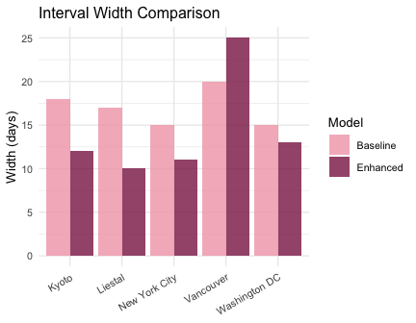
Enhanced vs Baseline
City | Baseline | Enhanced | Shift
Kyoto | DOY 88 (18d) | DOY 94 (12d) | +6 d
Liestal | DOY 86 (17d) | DOY 95 (10d) | +9 d
New York City | DOY 92 (15d) | DOY 98 (11d) | +6 d
Vancouver | DOY 90 (20d) | DOY 95 (25d) | +5 d
Washington DC | DOY 84 (15d) | DOY 89 (13d) | +5 d

Slide 8
Team 5103 — University of Maryland
Cherry Blossom Peak Bloom Prediction 2026
Interactive dashboard · GitHub repo

