Slide 1
Metadata Integrity &
Tampering Detection
in GIS Data
3-PILLAR APPROACH
🔐 HMAC-SHA256
Cryptographic Hash Engine
🧠 Semantic NLP
CE432: Geographical Information System | IIT Kanpur | Group 3
14-Rule Consistency Checker
Ankit Kumar (230152) · Kanika Sharma (230524) · Shivesh Shukla (230978)
Instructor: Dr. Salil Goel | Maj. Gen (Dr.) B. Nagarajan | April 2026
🤖 ML Anomaly
Isolation Forest + One-Class SVM
A QGIS Plugin for Forensic Metadata Tampering Detection

Slide 2
The Silent Threat: GIS Metadata Tampering
Why metadata integrity matters in geospatial workflows
GIS metadata is the identity card of a spatial dataset — recording coordinate system, spatial extent, author, scale, and data quality. Any unauthorized modification, even a single changed field, can corrupt downstream analysis with no visual warning on the map.
🌊 Flood Mapping
⚖️ Land Records
🛡️ Defence GIS
Changed CRS shifts flood boundaries by 100s of metres — placing evacuation zones in wrong locations
Falsified bounding box or CRS misattributes land ownership in cadastral systems
Altered spatial reference can trigger diplomatic crises from border misidentification
🏗️ Infrastructure
🌿 Carbon Credits
🔬 Research Integrity
Wrong scale metadata causes infrastructure built on miscalculated footprints
Tampered lineage hides the true origin of carbon stock data used in climate policy
GIS-based research can be retracted if tampering is discovered post-publication
ISO 19115 standard governs GIS metadata — yet no existing tool specifically detects forensic metadata tampering in QGIS environments.

Slide 3
GIS Analysis: Impact of Metadata Tampering
IITK campus building layer — CRS tampering demonstration
Dataset: 530 building polygons of IIT Kanpur (OpenStreetMap, EPSG:32644 UTM Zone 44N, 81 attribute columns)
ORIGINAL — EPSG:32644
TAMPERED — EPSG:4326
CRS: UTM Zone 44N (metres)
CRS falsified to WGS84 (degrees)
Buffer radius: 10 m
Buffer: 10° instead of 10 m
Results are spatially accurate
Buffer ≈ 1,100 km in radius
→
Geometrically correct footprints
Complete GIS analysis breaks down
All area values populated
Area column returns NaN for all rows

Slide 4
Solution: QGIS Metadata Verifier Plugin
A 3-pillar approach — deterministic, rule-based, and learning-based
1
Pillar 1
2
Pillar 2
3
Pillar 3
HMAC-SHA256
Hash Engine
Semantic NLP
Rule Checker
ML Anomaly
Detector
Cryptographic per-field hashing with PBKDF2 key derivation. Detects any single-character change. Requires owner's baseline .db file.
14 weighted rules checking internal metadata consistency using TF-IDF, cosine similarity, and Shannon entropy. No baseline needed.
Isolation Forest + One-Class SVM ensemble trained on 304 real Copernicus Marine Service records. 19 engineered features.
90.5%
100%
0.456ms
66.7%
100%
0.726ms
77.8%
73.3%
2.4MB
Accuracy
Precision
Avg Speed
Accuracy
Precision
Avg Speed
Ensemble Recall
F1 Score
Model Size
Needs: Owner .db file
Needs: Metadata only
Needs: Metadata only
Together these three pillars cover distinct threat models — subtle edits, coherent forgeries, and statistical anomalies.

Slide 5
Pillar 1: HMAC-SHA256 Hash Engine
Cryptographic metadata fingerprinting with PBKDF2 key derivation
SHA-256 + HMAC
PBKDF2 Key Derivation
Value Normalization
One-way digest — HMAC construction prevents substitution attacks. Single-character change → completely different 256-bit fingerprint.
310,000 HMAC-SHA256 iterations. Random salt per export defeats rainbow tables. Key held in-memory only — never stored.
Lowercase, collapse whitespace, strip edges, None/NULL → ''. Ensures export-time and verify-time hashes always match.
Field-Level Hashing
SQLite Hash Database
15 fields hashed independently (not chained). Enables precise field-level tampering identification. Combined hash catches any change instantly.
Self-contained .db file stores salts, field hashes, combined hash. Key discarded after each operation. Safe to distribute with the layer.
OWNER MODE
USER MODE
1. Generate random salt → PBKDF2 derive key
1. Load .db → re-derive key from password
2. Read & normalize 15 metadata fields
2. Read & normalize current metadata
3. Compute HMAC-SHA256 per field
3. Recompute per-field HMACs
4. Build combined hash over all field digests
4. Rebuild combined hash
5. Store salts + hashes in .db → discard key
5. Compare → report exact tampered fields

Slide 6
Hash Engine: Evaluation Results
Tested on 21 layers (12 clean, 9 tampered) — fully automated blind evaluation
90.5%
100%
77.8%
100%
87.5%
0.456ms
Accuracy
Precision
Recall
Specificity
F1 Score
Avg Speed
⚠ 2 false negatives: tampered fields (contact, date_created) were not included in the 15 hashed fields — an implementation gap, not a methodological flaw.

Slide 7
Pillar 2: NLP-Based Semantic Consistency Checker
14 weighted rules — no baseline required, internal coherence validation
Asks: Is this metadata internally self-consistent? An adversary who changes keywords or abstract without updating geometry type or CRS creates contradictions that these rules exploit.
R1
R2
R3
R4
R5
R6
R7
Geometry Keywords
Identifier–Geometry
Abstract Contradiction
Identifier–Keyword Overlap
Date Consistency
CRS vs Dataset Scope
Suspicious Content Scan
R8
R9
R10
R11
R12
R13
R14
Contact Consistency
Keyword Quality
Abstract–Keyword Similarity
Spatial Validity
Feature Count Plausibility
Boilerplate Detection
Domain–Field Consistency
High Weight
Medium Weight
Low Weight
Scoring Thresholds:
CONSISTENT
score ≤ 0.10
WARN
score ≤ 0.28
SUSPICIOUS
score > 0.28
⚙ TF-IDF Cosine Similarity
⚙ Shannon Entropy
⚙ Domain Vocabulary
Measures topical overlap between abstract and keywords — catches keyword replacement
Assesses vocabulary diversity in abstract — low entropy flags boilerplate/fabricated text
Links geometry types (POINT, POLYGON) to expected terms — detects geometry contradictions

Slide 8
Semantic Checker: Evaluation Results
Internal consistency checking — high precision, limited recall by design
66.7%
22.2%
100%
100%
36.4%
0.726ms
Accuracy
Recall
Precision
Specificity
F1 Score
Avg Speed
Key Insights
Only R6 (CRS vs Scope) and R7 (Suspicious Content) fired on tampered layers
Zero false positives — safe to run always without generating noise
Catches implausibility, not subtle value substitution — complements hash engine
Semantic rules + cryptographic hashing = complementary, not redundant

Slide 9
Pillar 3: ML-Based Anomaly Detection
Isolation Forest + One-Class SVM ensemble trained on real Copernicus Marine metadata
Isolation Forest (weight: 35%)
One-Class SVM (RBF) (weight: 65%)
Unsupervised — builds random decision trees and isolates outliers. Records in sparse feature-space regions require fewer splits → flagged as anomalous.
Learns a tight boundary around normal training data. RBF kernel maps to high-dimensional space. Outperforms IF on small training sets.
50%
61.6%
13%
73.3%
83.5%
6%
Recall
Precision
FP Rate
Recall
Precision
FP Rate
ENSEMBLE = 0.35 × IF + 0.65 × SVM → Recall: 77.8% | F1: 73.3% | FP Rate: 14.4%
19 Engineered Features
Text (6):
Abstract/title length, word count, entropy; TF-IDF title↔abstract overlap
Spatial (8):
BBox W/E/S/N coords; derived width, height, area, centre lat/lon
Temporal (2):
Creation date year and month
CRS (1):
Ordinal encoding: WGS84=1, Equirect=2, Mercator=3, Polar=4, Other=5
Keyword (1):
Total keyword count
Scaler:
StandardScaler fitted on 304 training records

Slide 10
ML Detector: Evaluation Results
Model comparison across Isolation Forest, One-Class SVM, and ensemble (304 training records)
77.8%
69.3%
73.3%
14.4%
304
19
Ensemble Recall
Ensemble Precision
Ensemble F1
Ensemble FP Rate
Training Records
Features
One-Class SVM dominates with the best precision (83.5%) and lowest FP rate (6%). Ensemble improves recall at some cost to precision — appropriate for forensic use-cases where catching tampering matters most.

Slide 11
ML Detector: Feature Importance & Model Agreement
What drives anomaly detection and how the two models complement each other

Slide 12
Detection Performance: All Three Pillars at a Glance
Visual comparison of accuracy metrics — and why three pillars are better than one
Capability | Hash Engine | Semantic Checker | ML Detector
Needs baseline file? | ✓ Yes | ✗ No | ✗ No
Detects single char change? | ✓ Yes | ✗ Unlikely | ✗ Unlikely
Catches wholesale rewrite? | Only with baseline | ✓ If CRS/scope wrong | ✓ Statistical anomaly
Zero false positives? | ✓ Yes | ✓ Yes | Approx 6–14%
Explainability | ✓ Field-level diff | ✓ Per-rule breakdown | Low (black-box)

Slide 13
Prevention vs Detection: Both Are Essential
Why detection remains critical even when prevention mechanisms exist
Prevention mechanisms reduce tampering risk but cannot eliminate it. Detection fills the gap — and provides forensic audit trails that prevention tools never can.
PREVENTION — Limitations
DETECTION — Why Still Essential
Role-based Access Control
Zero-Knowledge Verification
Only authorized users can modify metadata — but insider threats and compromised accounts bypass this entirely.
HMAC-SHA256 lets a recipient verify integrity without ever seeing original data — just the hash database.
Digital Signatures / PKI
Baseline-Free Semantic Check
Owner signs at creation — but keys can be stolen, revoked certs may not be checked, re-signing attacks exist.
Semantic rules catch implausible tampering with no reference file — protecting data shared without provenance.
Version Control / Audit Logs
Statistical Normality Scoring
Tracks changes over time — but logs can be cleared, timestamps forged, logging systems compromised.
ML detector catches wholesale metadata replacement that looks coherent but is statistically abnormal.
Secure Transfer Protocols
Forensic Audit Trail
HTTPS/SFTP prevents transit interception — but corruption at source or destination after delivery goes undetected.
LocalDB tamper log with timestamps provides court-admissible evidence — prevention tools offer no post-hoc forensics.

Slide 14
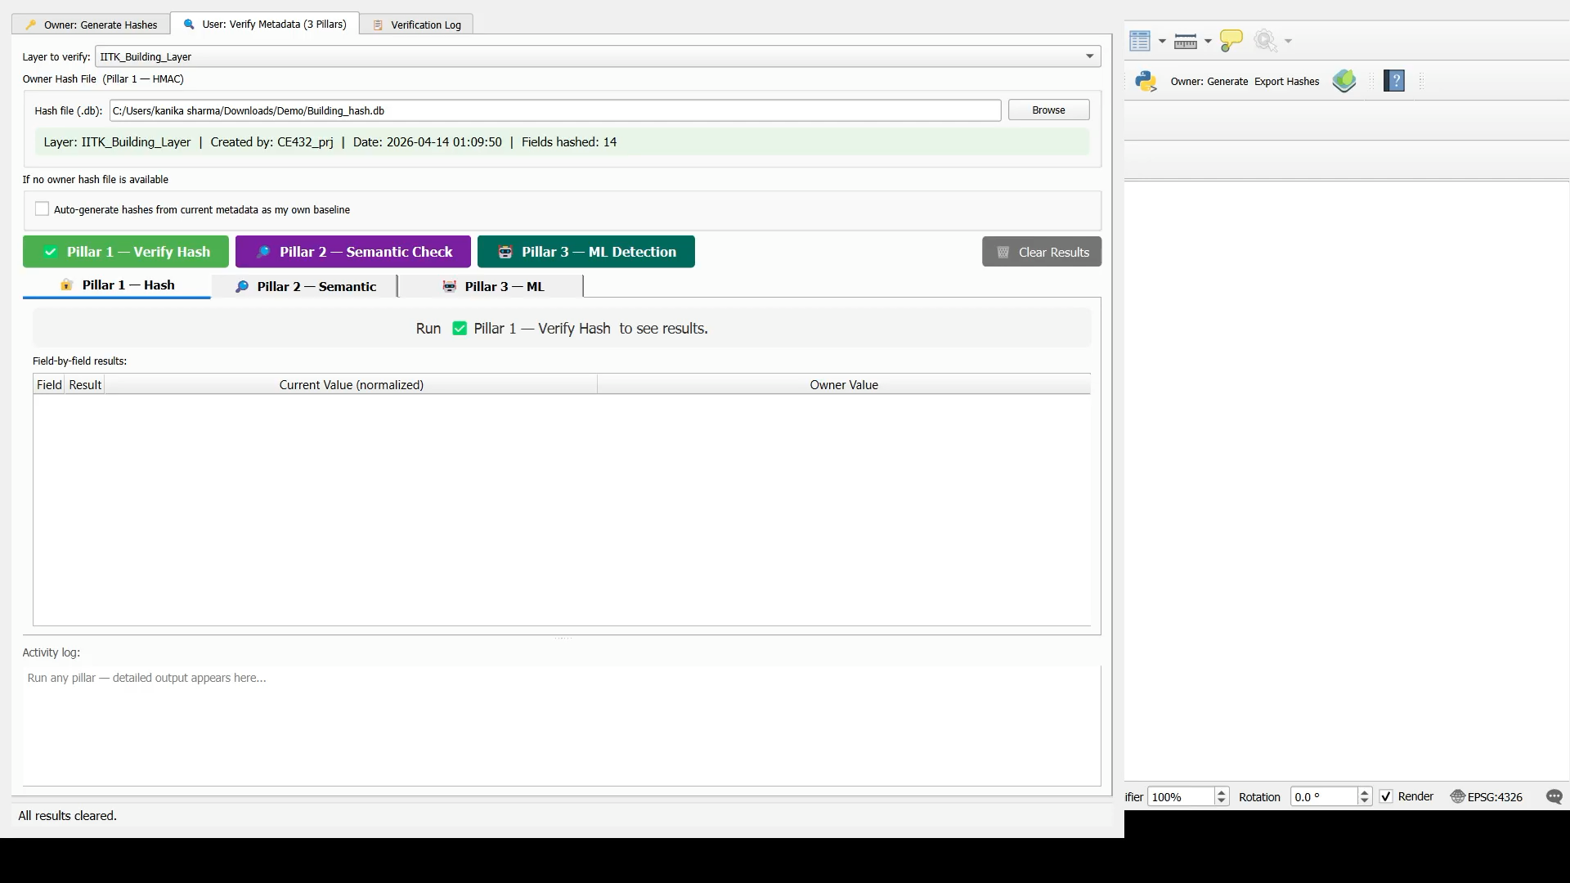
Plugin Demo
Live demonstration of the Metadata Verifier QGIS Plugin

Slide 15
Conclusions & Future Directions
A lightweight, multi-layered, extensible approach to GIS metadata integrity
✓ HMAC Engine
✓ Semantic Checker
90.5% accuracy, 100% precision, zero false positives at sub-millisecond speeds. Key-in-database architecture is production-ready.
Catches implausible CRS/content combinations without any baseline. Perfect specificity — safe to run always without generating noise.
✓ ML Detector
✓ Complementarity
77.8% ensemble recall on real Copernicus data. Catches wholesale metadata replacement that hash comparison cannot detect without a baseline.
Three pillars cover distinct threat models. Together they defend against subtle edits, coherent forgeries, and misconfigured exports.
FUTURE DIRECTIONS
🔗
Blockchain
Hash Storage
🧠
Incremental
ML Learning
🌐
Server-Side
Verification API
📝
LLM-Powered
Semantic Rules
📦
Batch &
Cloud GIS
CE432 GIS Project · Group 3 · IIT Kanpur · April 2026

Slide 16
Thank You!
We appreciate your time and attention
Questions? We’d love to hear from you.
CE432 GIS Project · Group 3 · IIT Kanpur · April 2026

