Slide 1

Advanced Image Processing
Project: Traffic Sign Recognition
Survey and Plan
School of Computer Science
and Engineering
Team5
2022-2

Slide 2
Contents
Team Introduction
Project Survey and Proposal
Plan

Slide 3
Team Introduction
Team5
Tran Nam Phuong
2022120207
Ultra-intelligent Computing/Communication Network Lab
Pham Thi Thu Hien (Leader)
2022120203
Ultra-intelligent Computing/Communication Network Lab
Nguyen Lan Anh
2022220111
Systems and Storage Lab

Slide 4
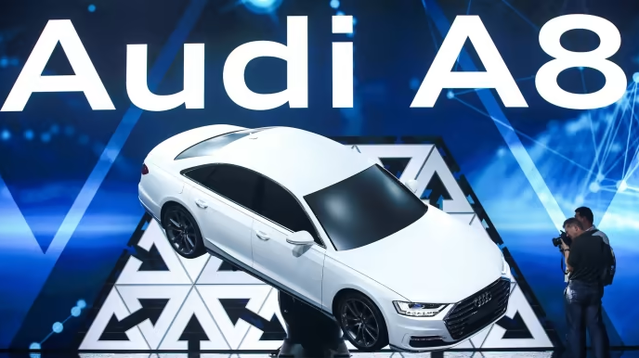
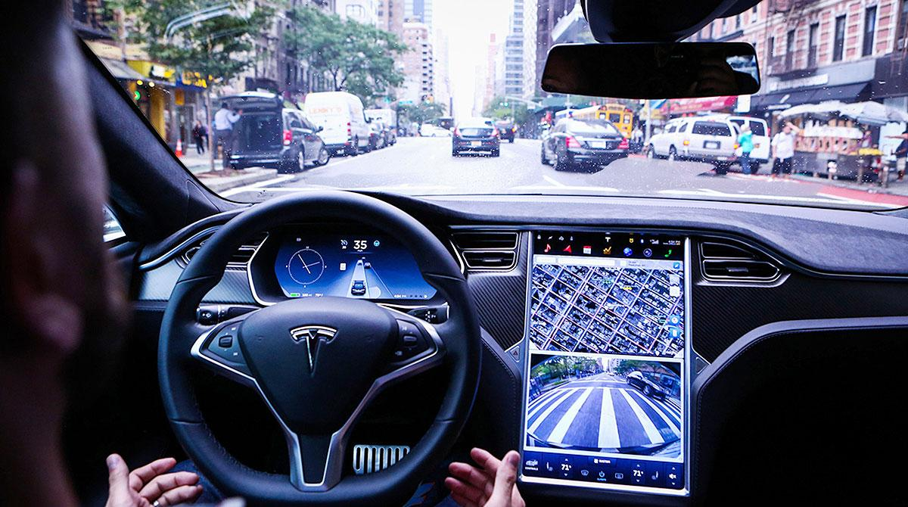
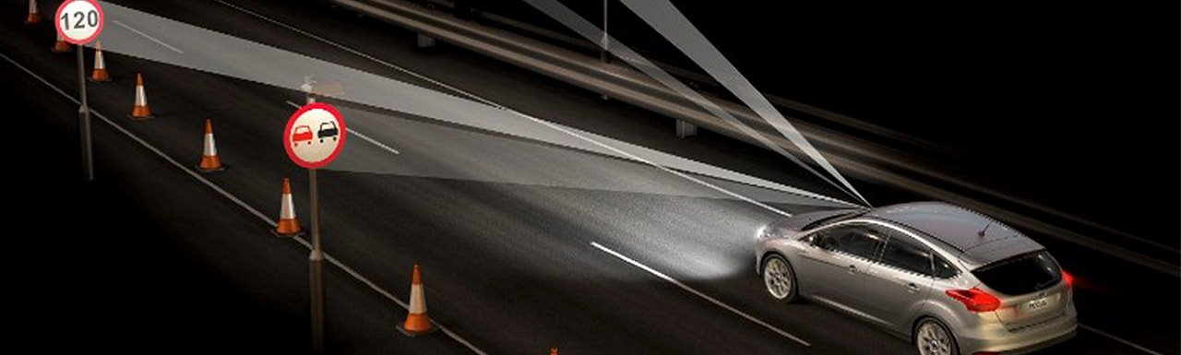
2. Project Survey and Proposal
2.1 The necessity of traffic sign recognition
Nowadays, self-driving cars (Autonomous cars) have emerged as essential vehicles in transportation.
Traffic sign recognition (TSR) is an important tool/ module in all self-driving systems/ driver-assistance systems.
Ex:
TSR recognizes a speed limit sign -> informs car’s driver -> driver takes a suitable action.
TSR recognizes the red light -> informs the self-driving controller -> Car stops.
Figure1. In 2017, Audi launched the Audi A8 D5 with the Autonomous Intelligent Driving (AID), an Audi’s self-driving technology
Figure2. In 2015, Tesla introduced Tesla Autopilot with the Advanced driver-assistance system (ADAS)
Figure3. Car with traffic sign recognition

Slide 5
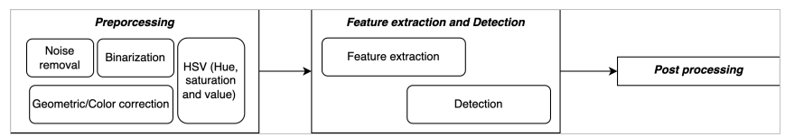
2. Project Survey and Proposal
2.2 Proposal
This project addresses the traffic sign recognition problem.
To solve the problem, we utilize the Convolution Neural Network (CNN) for feature extraction and detection.
This work follows common steps of the detection problem[1].
Data
Figure4. Detection process

Slide 6
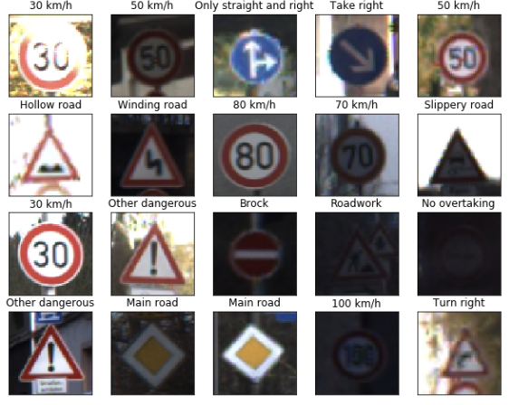
2. Project Survey and Proposal
2.3 Experiment setup
Dataset: German Traffic Sign Recognition Benchmark (GTSRB)[2,3].
It was created from about 10 hours of video recorded while driving in Germany.
It consists of about 40.000 colorful photos of traffic signs.
Images have .ppm extension and their size varies from 15x15 to 250x250 pixels.
Tools:
Coding language: Python
Libraries/ modules:
TensorFlow, OpenCV,
NumPy, OS, Matplotlib
IDE: Visual Studio
Source: [4]
Figure5. Traffic sign images in GTSRB

Slide 7
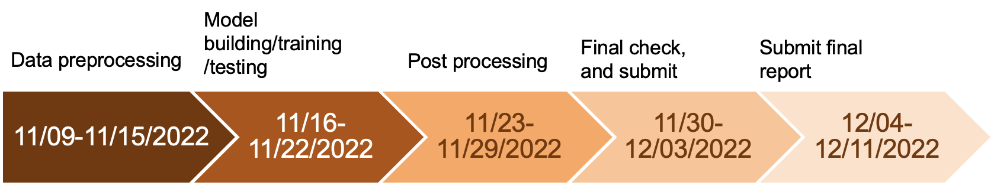
3. Plan

Slide 8
References
[1] Mogelmose, Andreas, Mohan Manubhai Trivedi, and Thomas B. Moeslund. "Vision-based traffic sign detection and analysis for intelligent driver assistance systems: Perspectives and survey." IEEE Transactions on Intelligent Transportation Systems 13.4 (2012): 1484-1497.
[2] J. Stallkamp, M. Schlipsing, J. Salmen, and C. Igel, “The german traffic sign recognition benchmark: A multi-class classification competition,” in Proc. IJCNN, 2011, pp. 1453–1460. [Online]. Available: http://benchmark.ini.rub.de/?section=gtsrb
[3] https://www.kaggle.com/datasets/meowmeowmeowmeowmeow/gtsrb-german-traffic-sign
[4] https://github.com/phuongtrannam/advanced-image-processing-cau

