Slide 1




AGRI SHOP
MANAGEMENT
Presented by: namra dhol

Slide 2
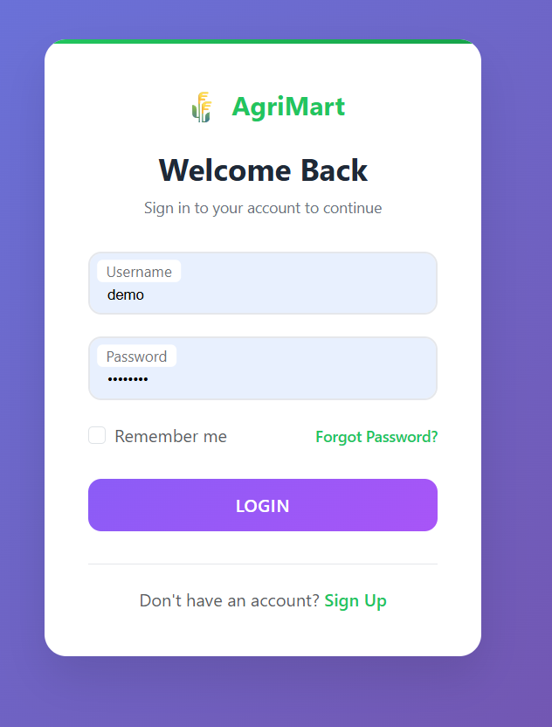
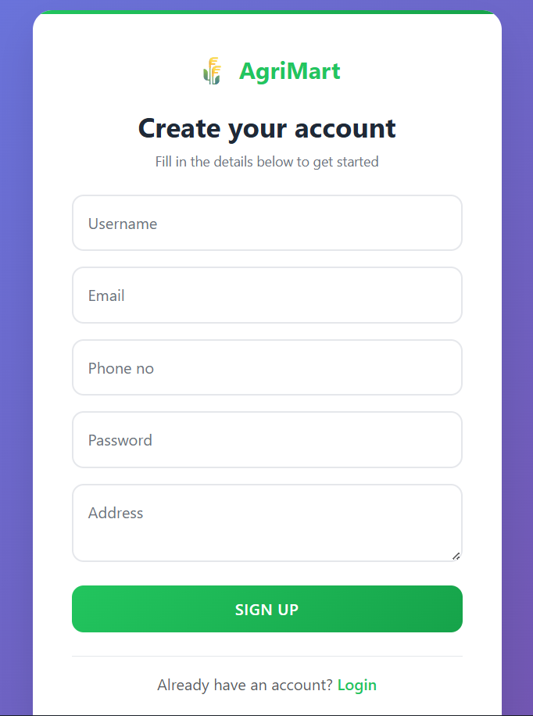

Slide 3
Login Page
Allows existing users to securely sign in with username and password.
Provides options like "Remember Me" and Forgot Password recovery.
Ensures easy access to user accounts with a simple and clean interface.
Register Page
Enables new users to create an account by filling in details like username, email, phone number, password, and address.
Designed with a user-friendly layout for quick registration.
Once registered, users can log in and access personalized services.

Slide 4
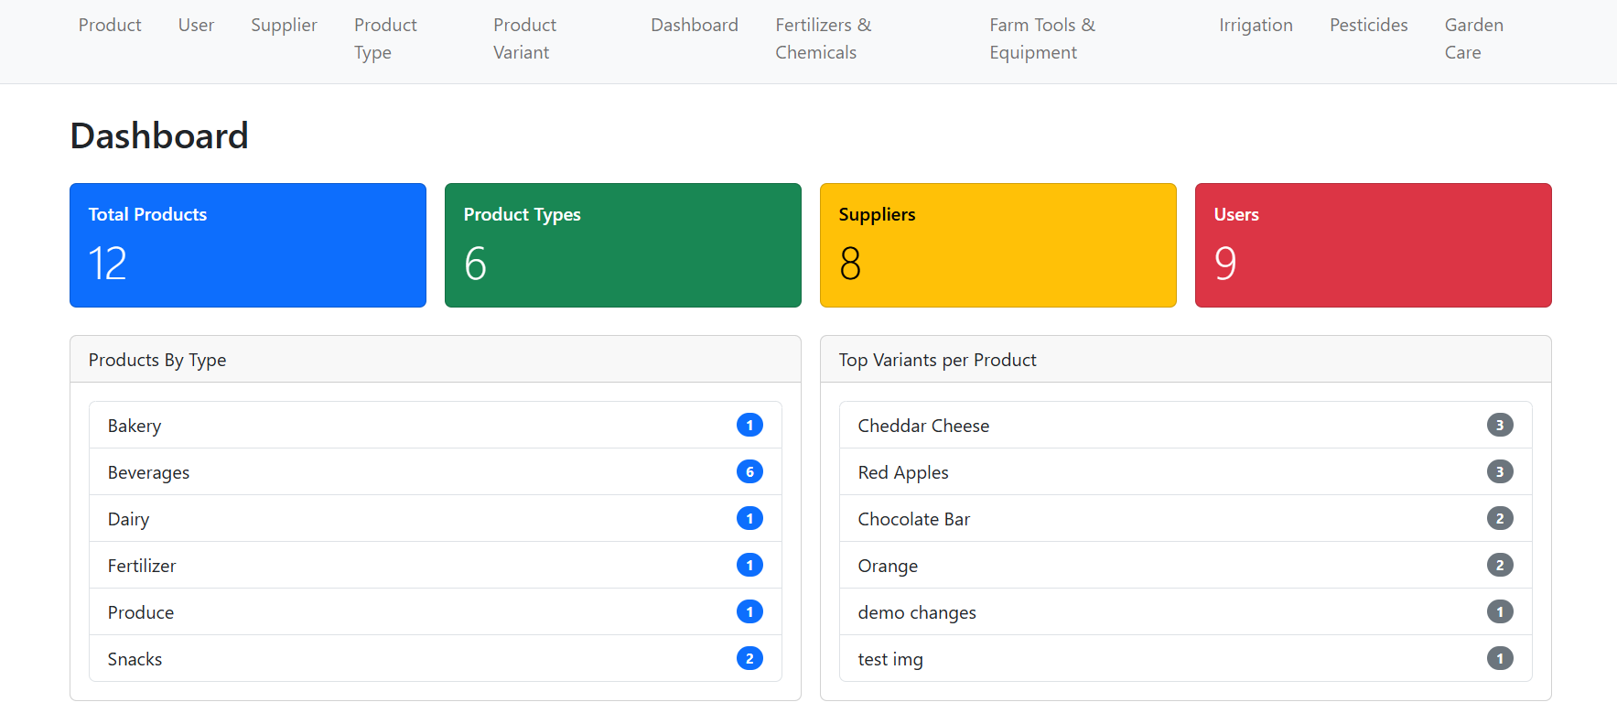

Slide 5
Dynamic Admin Dashboard
Clearly displays the total number of products, product types, and suppliers at a glance.
Presents the count of variants per product in easily readable listings.
Assists admins in managing inventory effectively through a centralized and interactive interface.

Slide 6
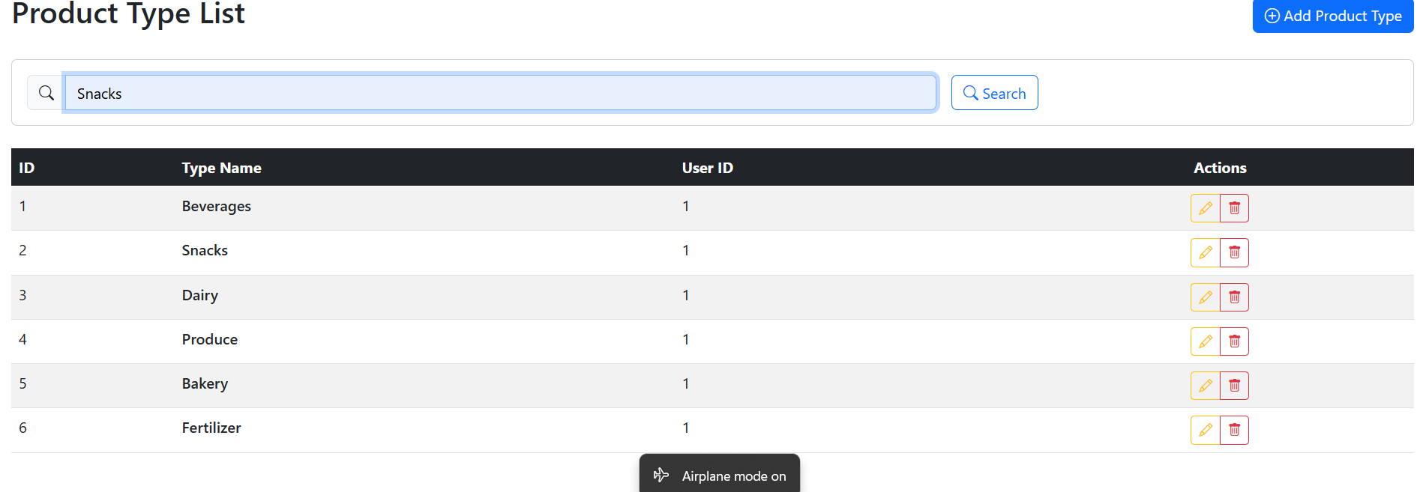
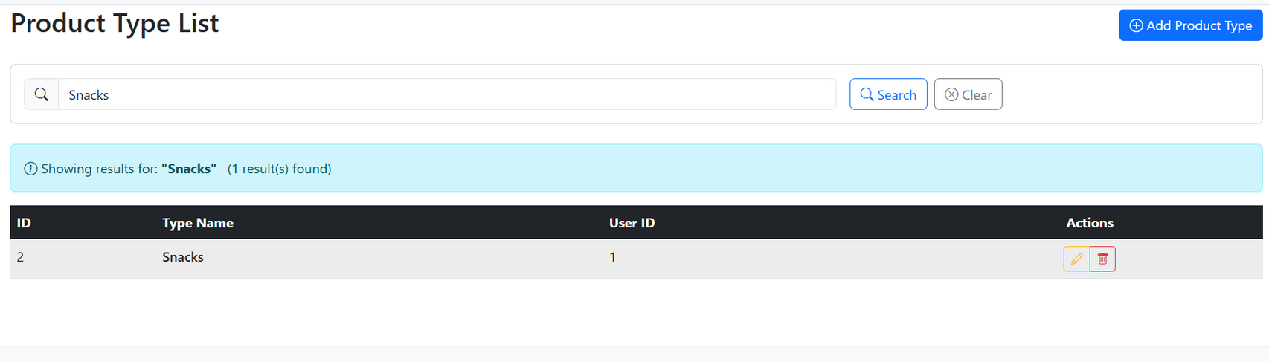

Slide 7
Product Type List – Search Feature :
Admin can search product types dynamically by entering a name in the search box.
The system calls the API with query parameter (e.g., ?typeName=Snacks) to fetch filtered results.
Displays matching product types in a table with details like ID, Type Name, and User ID.
Provides quick actions (edit / delete) directly from the list.
Includes clear option to reset the search and view the full list again.

Slide 8
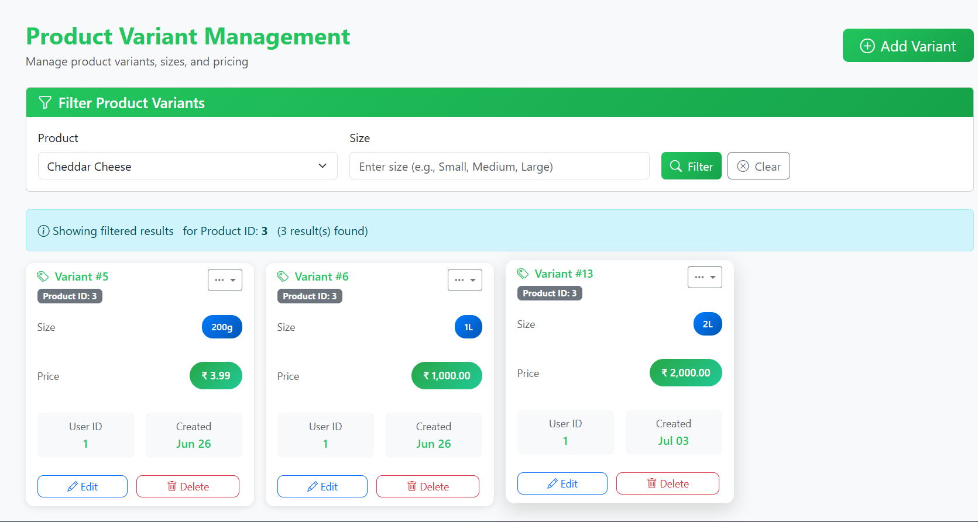

Slide 9
Product Variant Management :
Allows admin to manage multiple product variants (e.g., size, weight, quantity, price).
Supports filtering variants by product and size using API queries (e.g., ?productId=3&size=).
Displays each variant in a card view showing size, price, user ID, and creation date.
Provides quick actions like Add, Edit, and Delete variants.
Ensures flexible product catalog management for different customer needs.

Slide 10
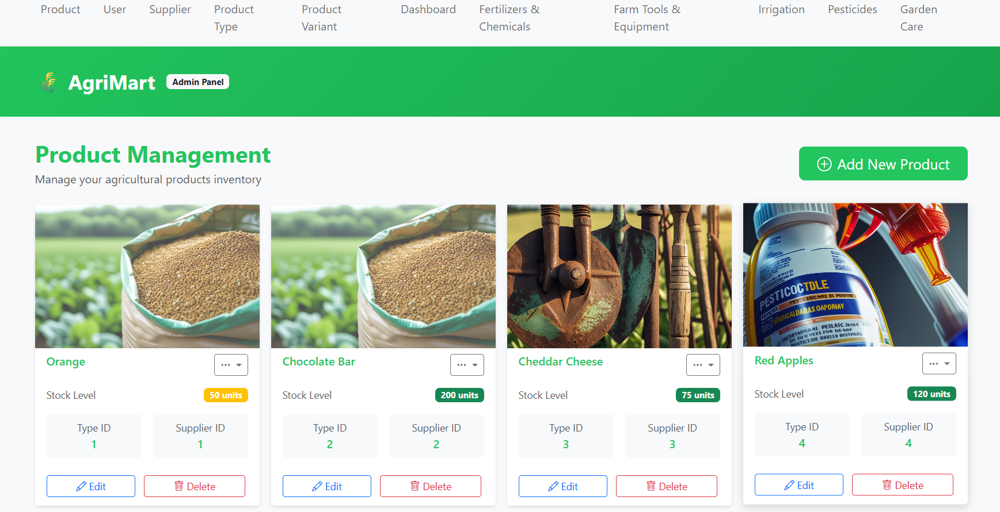

Slide 11
Product Management – View Page :
Displays all available products in a card-based layout with images.
Shows key details like Product Name, Stock Level, Type ID, and Supplier ID.
Provides quick action buttons for Edit and Delete operations.
Includes an option to Add New Product for expanding the catalog.
Helps admins monitor inventory levels and manage products efficiently.

Slide 12
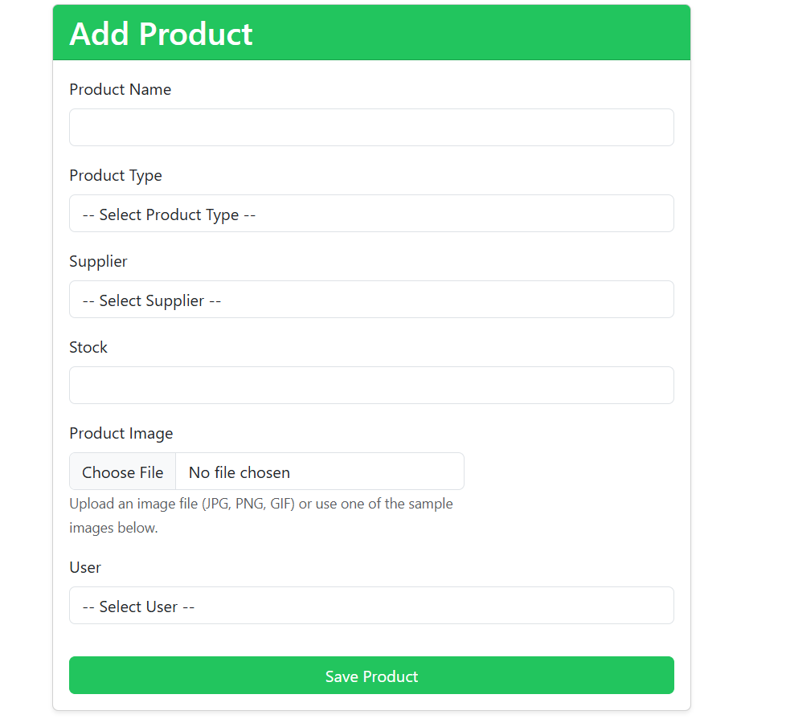

Slide 13
Add Product Page :
Allows admin to add new products into the system with complete details.
Includes dropdowns for:
Supplier (select supplier from the list).
Product Type (choose relevant category).
User (assign the user who is creating/owning the product).
Provides a file upload option to attach product images.
Captures stock level and other key details to manage inventory.
Ensures that all new products are added with proper linkage to supplier, type, and user for consistency

Slide 14
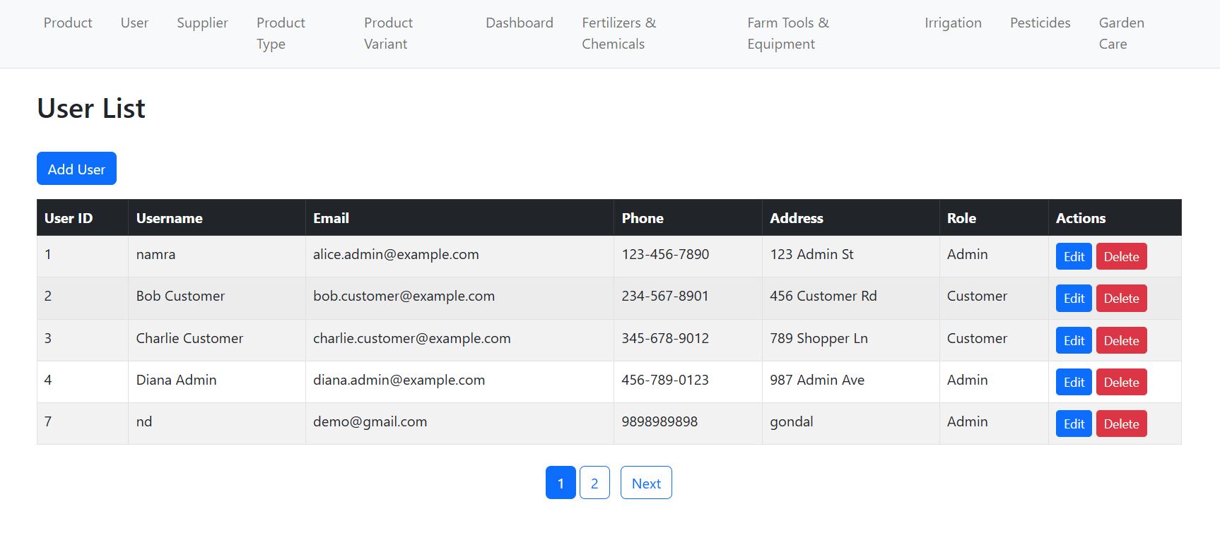
User List page Paginatation Using Api .

Slide 15
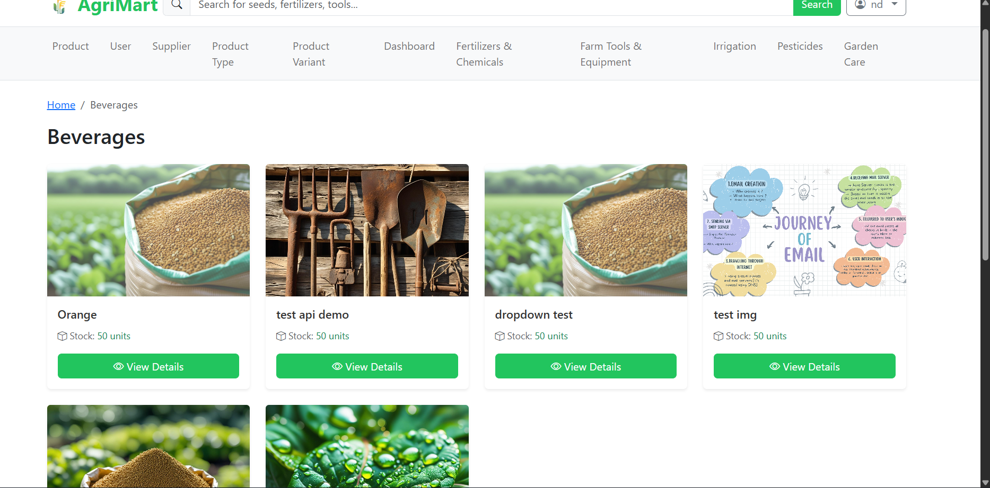

Slide 16
“This is our product listing page under the Beverages category. Each product is displayed with an image, name and a quick action button to view details. The clean card layout makes it easy for users to browse multiple products at once, while ensuring important details like stock availability are highlighted. This structure helps improve user experience and makes product navigation simple and efficient.”

Slide 17
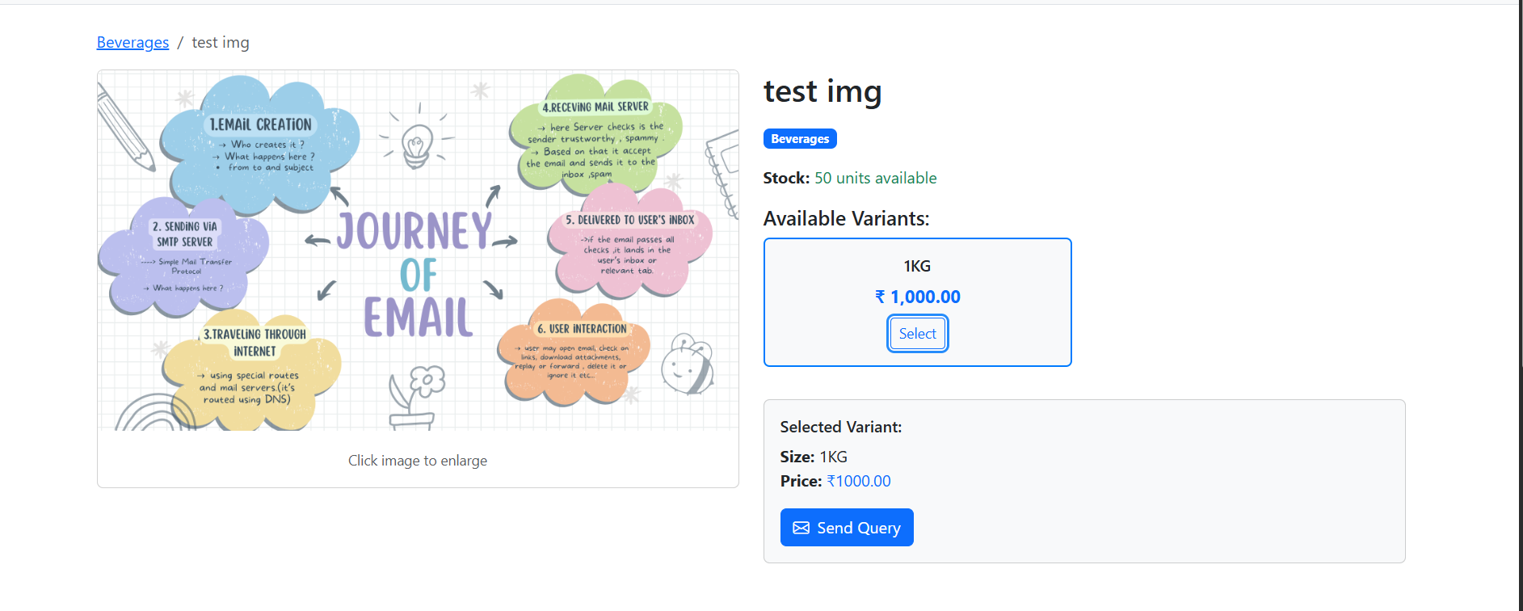

Slide 18
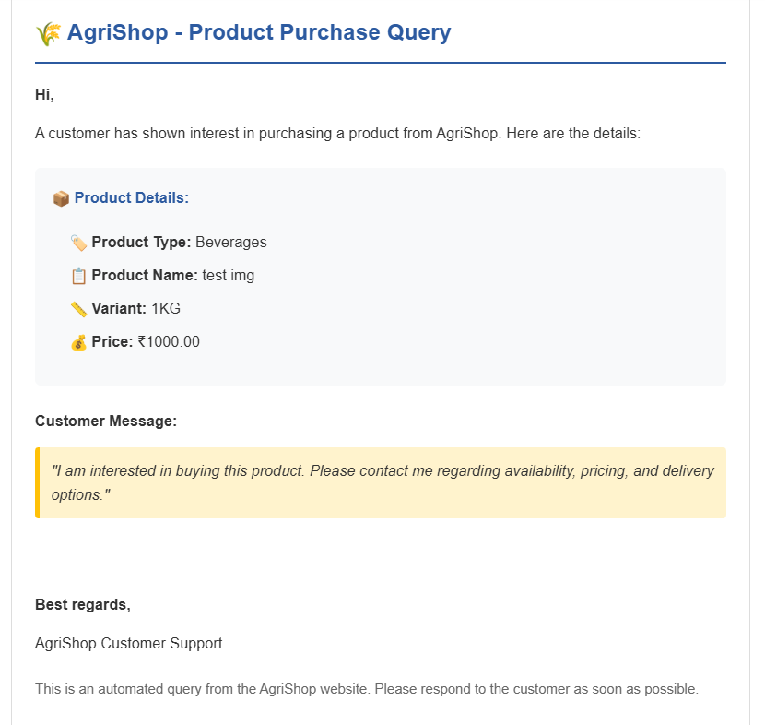
this is specific product and in that using select it’s varient we can send inqury for that productType , product and it’s varient .
Send Inquery using mail kit Package and using api call

