Slide 1
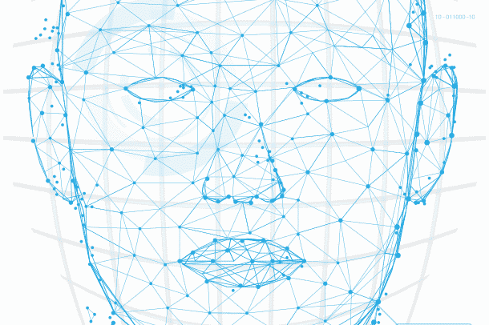
Face Recognition using CRI AI Thermal Camera
Assignment 9

Slide 2
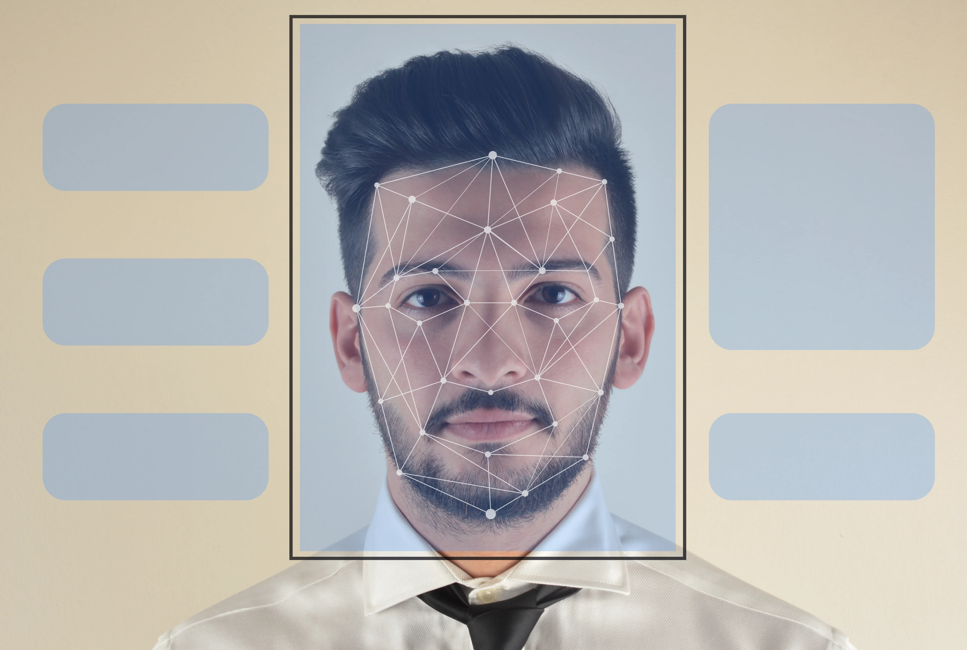
Agenda
Introduction
PROJECT SUMMARY
MEET OUR TEAM
SCOPE OF WORK
Project Progress
Individual status
Gantt chart
Glimpse of work
Weekly report
Now onward
References
IMAGE SOURCE: LEARN G2

Slide 3
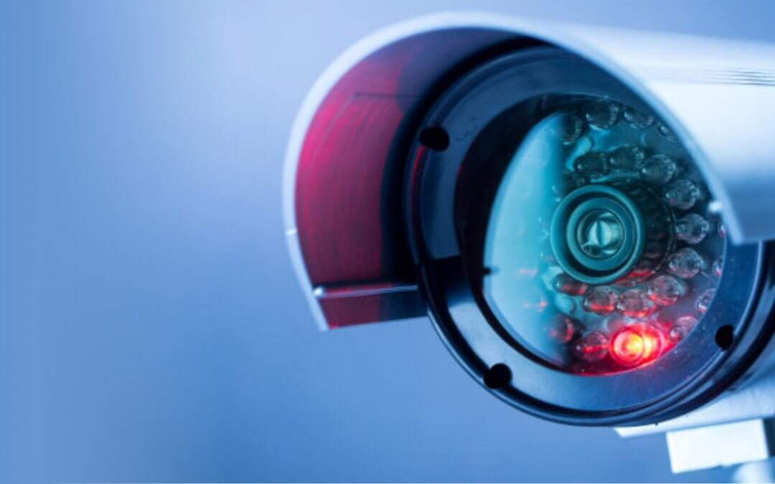
Introduction
What is CRI AI Camera?
CRI stands for Color Rendering Index and is nothing but a specification of cameras which states how accurately artificial light shows colors of the people under them.
CRI AI Thermal camera is used to develop this project.

Slide 4

Primary goals
Face Recognition
Security and surveillance
Contactless access control

Slide 5
Summary
Facial Recognition is the process of identifying a person through his or her facial features. We will be using thermal cameras to detect human faces. When we think about thermal images in the context of people, what usually comes to mind is night vision. The ability to see a person, or group of people, by the inevitable heat their bodies emit.
An important aspect of our project requires us to understand that thermal images capture heat in the form of frequency of pixels, varying from 0 to 1. Studies have found that each face emits a unique heat signature due to the blood vessels below the skin, as mentioned by Barclay (2013). Therefore, thermal facial images capture unique individual facial heat signatures which mark as unique biomarkers, providing us with rich information to classify a person correctly using a model.

Slide 6



Meet our team
Tilak Pandya
(B.C.A., M.C.A.)
Namra Patel
(B.E Computer Science.)
Kishan Patel
(B.Sc. Physics, PGDCA, Big Data Solution Architecture)
A Big Data Analyst having non-cs bachelor degree, yet significantly interested, and competent in AI industry.
A developer who explores concepts and potential in the tech industry.
A developer with real-world problem solving experience and a desire for innovation.

Slide 7
SCOPE OF WORK
Research on CRI AI thermal camera
Development of facial recognition algorithms
Integration with existing systems
Testing and validation
Deployment and training
Maintenance and support

Slide 8
Project progress
Prepare UI for better user experience
Troubleshooting Blackbody radiation box
Eliminated multiple images taken from the similar angle.
Update Git repository
Presentation.
Preparing Documentation

Slide 9
Reasons of latency
Device incompatibility:
GPUs are designed to perform complex mathematical computations and can accelerate the performance of the face recognition model.
2. Parallel Processing:
Asynchronous processing allows the camera to continue capturing frames while the face recognition model is processing the previous frame. This can reduce latency by processing images in the background.
3. Network Latency:
network latency can cause delays in the transmission of video frames. This can be fixed by optimizing network settings, using a faster network connection, or reducing the video resolution to reduce network latency.

Slide 10
Python Tkinter Library
a built-in Python library for creating graphical user interfaces (GUIs).
easy to learn and use, even for beginners.
provides a range of layout managers that allow you to position widgets within a window or frame.
provides a range of styling options that allow you to customize the appearance.

Slide 11
Individual status
Namra:
Eliminated multiple images taken from the same angle and stored from different angles
Worked on UI development
Documentation
Tilak:
Worked on UI development
Eliminated multiple images taken from the same angle and stored from different angles
Documentation
Kishan:
Worked upon finding the reason of latency and trying to fix it
Troubleshooting Blackbody radiation box and used to display the temperature.
Documentation.

Slide 12
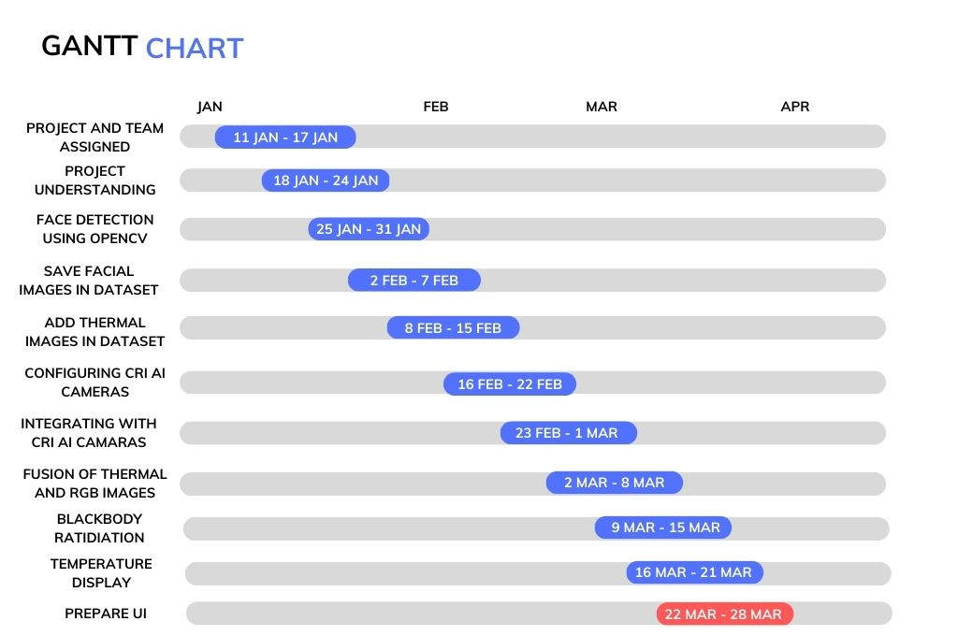
High-level timeline chart (GANTT)

Slide 13
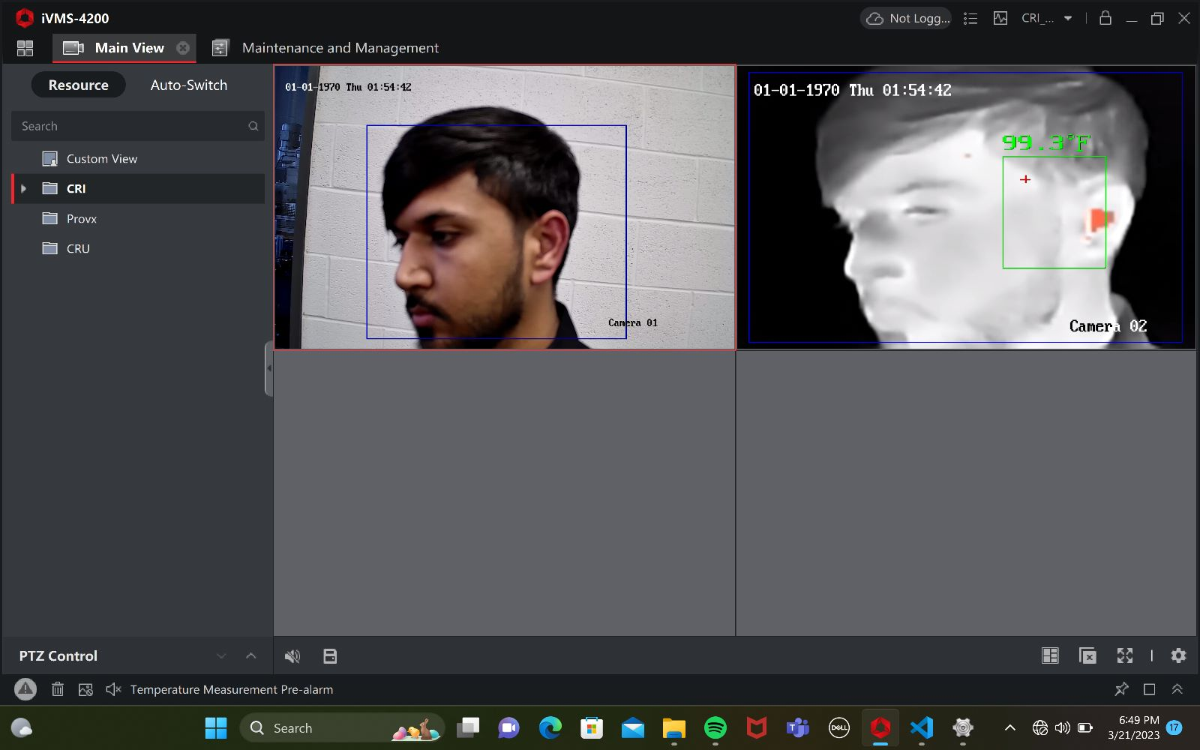
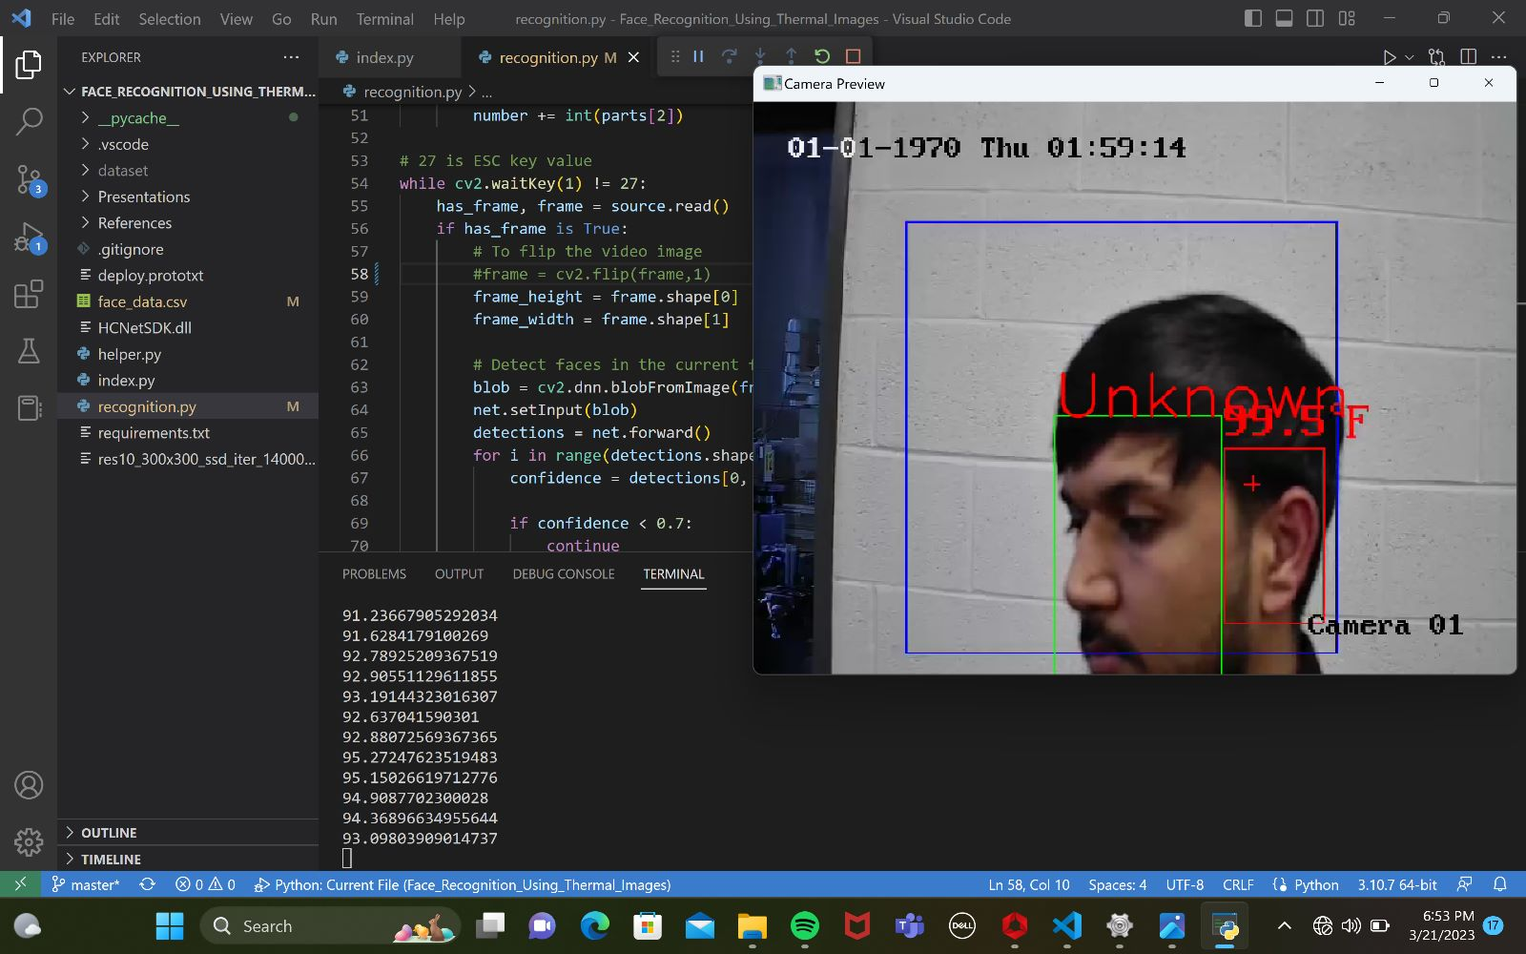
Glimpse of the work done
Blackbody radiation box integrated with camera showing temperature

Slide 14
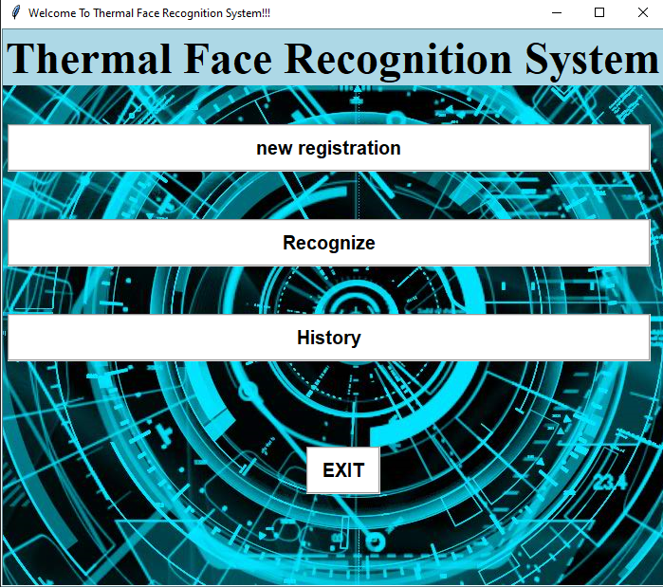
Glimpse of the work done

Slide 15
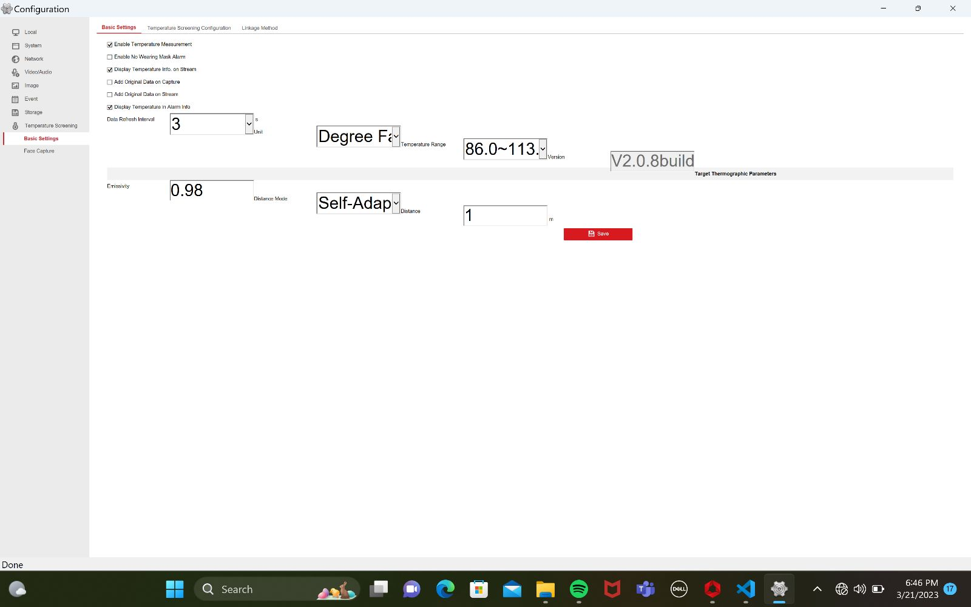
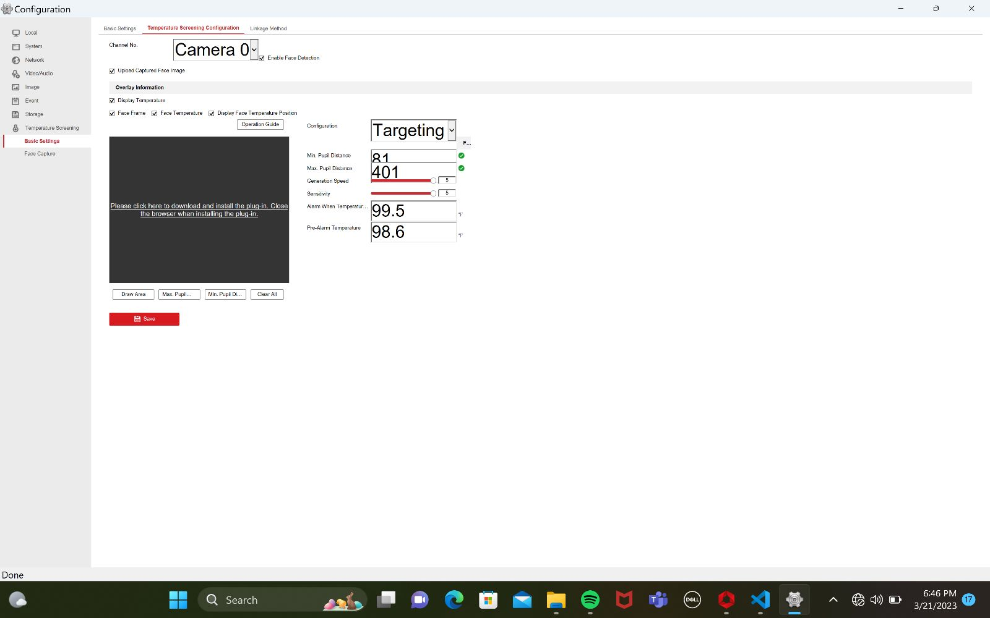

Glimpse of the work done
Camera configuration Change

Slide 16
Now onwards..
Add Splash screen in UI
Showing History data clicking on History button
Create textbox to enter name and student Id.
Documentation.

Slide 17

General Budget
•Number of developers: 3
•Hourly cost: $50 per developer
•Estimated weekly time: 8 hours per developer
•Estimated weeks: 13
•Estimated fictious budget: $15,600

Slide 18
REFERENCES
iVMS 4200 References •User Manual Of iVMS 4200: https://us.hikvision.com/en/system/files_force/ivms-4200_v2.8.2.2_windows_user_manual_v2_0.pdf?download=1
Software Used: https://www.hikvision.com/ca-en/support/download/software/ivms4200-series/
For More Information FAQs: https://us.hikvision.com/en/support-resources/documentation/faq/software
Integrating CRI Camera: https://www.aranacorp.com/en/managing-an-ip-camera-with-python/
Hikvision Thermal Image Screening Camera: https://www.jojomarketing.ae/products/hikvision-ds-2te127-g4a-thermal-image-screening-camera-dubai-uae/
Python Tkinter Library Documentation: https://docs.python.org/3/library/tk.html

Slide 19

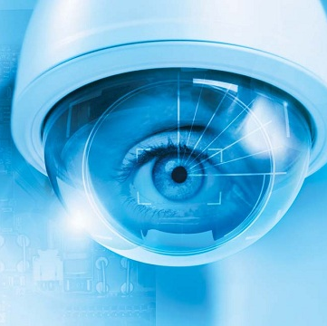
Thank you
GitHUB:
https://github.com/tilakpandya/face_recognition_using_thermal_images

