Slide 1
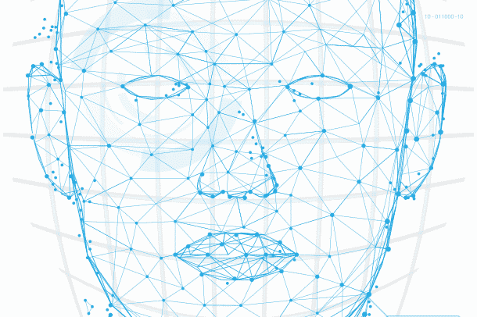
Face Recognition using CRI AI Thermal Camera

Slide 2
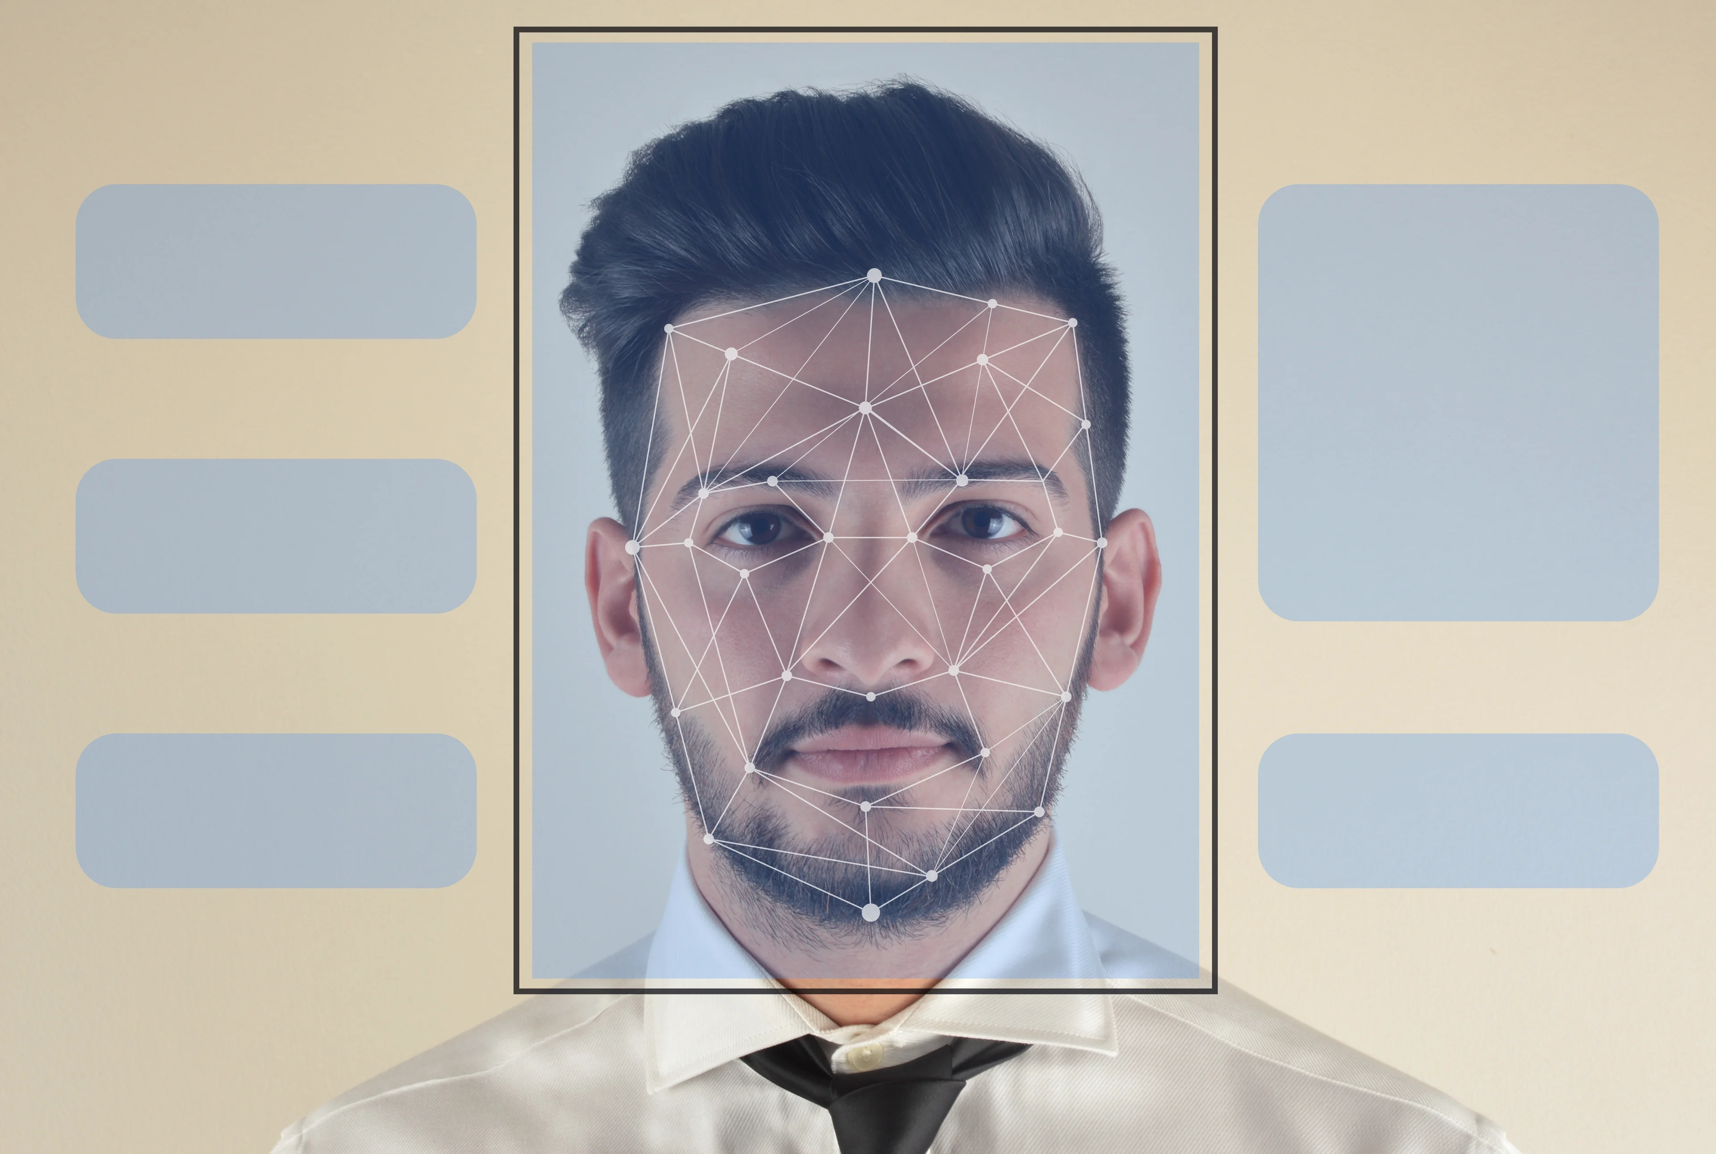
Agenda
Introduction
PROJECT SUMMARY
MEET OUR TEAM
SCOPE OF WORK
Project Progress
Individual status
Gantt chart
Glimps of work
Weekly report
Now onward
References
IMAGE SOURCE: LEARN G2

Slide 3
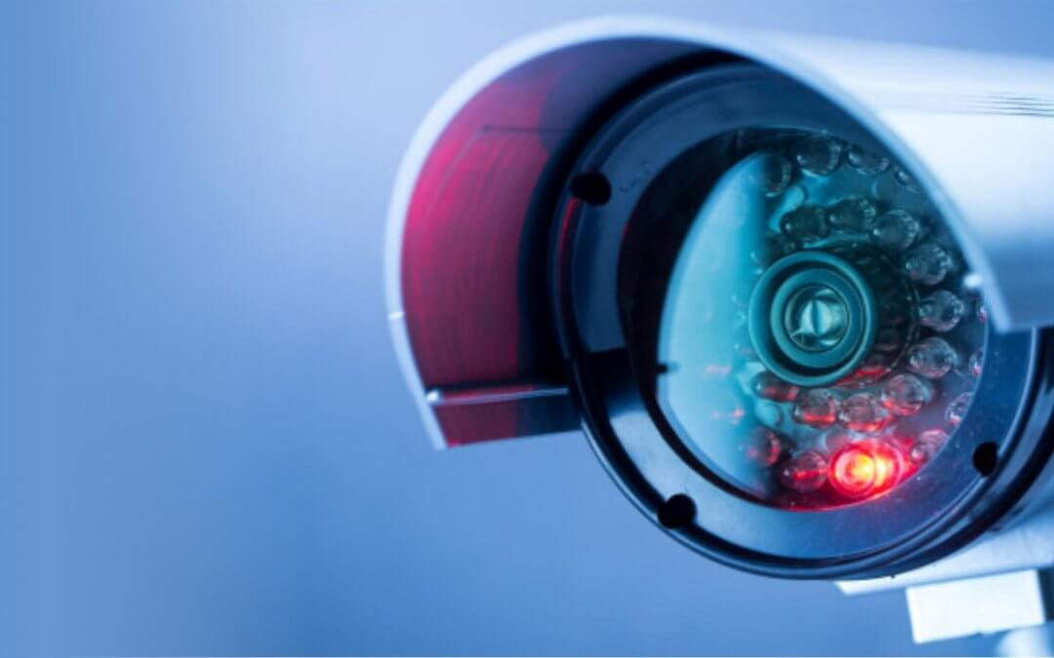
Introduction
What is CRI AI Camera?
CRI stands for Color Rendering Index and is nothing but a specification of cameras which states how accurately artificial light shows colors of the people under them.
CRI AI Thermal camera is used to develop this project.

Slide 4

Primary goals
Face Recognition
Security and surveillance
Contactless access control

Slide 5
Summary
Facial Recognition is the process of identifying a person through his or her facial features. We will be using thermal cameras to detect human faces. When we think about thermal images in the context of people, what usually comes to mind is night vision. The ability to see a person, or group of people, by the inevitable heat their bodies emit.
An important aspect of our project requires us to understand that thermal images capture heat in the form of frequency of pixels, varying from 0 to 1. Studies have found that each face emits a unique heat signature due to the blood vessels below the skin, as mentioned by Barclay (2013). Therefore, thermal facial images capture unique individual facial heat signatures which mark as unique biomarkers, providing us with rich information to classify a person correctly using a model.

Slide 6



Meet our team
Tilak Pandya
(B.C.A., M.C.A.)
Namra Patel
(B.E Computer Science.)
Kishan Patel
(B.Sc. Physics, PGDCA, Big Data Solution Architecture)
A Big Data Analyst having non-cs bachelor degree, yet significantly interested, and competent in AI industry.
A developer who explores concepts and potential in the tech industry.
A developer with real-world problem solving experience and a desire for innovation.

Slide 7
SCOPE OF WORK
Research on CRI AI thermal camera
Development of facial recognition algorithms
Integration with existing systems
Testing and validation
Deployment and training
Maintenance and support

Slide 8
Project progress
Face Recognition using thermal and RGB fusion
Reduce latency while Facial recognition using CRI AI camera (In progress)
Blackbody radiation box configuration (In process)
Update Git repository
Presentation.

Slide 9
More on BlackBody Radiation
https://www.flir.ca/discover/public-safety/do-i-need-a-blackbody-for-skin-temperature-screening/
https://www.ci-systems.com/Using-Blackbody-Radiation-in-Thermal-Imaging
https://www.x20.org/knowledgebase/thermal-infrared-black-body-radiation/

Slide 10
Individual status
Namra:
Troubleshooting Network and firewall settings for the camera.
Capturing images and facial recognition through CRI AI Camera
documentation
Tilak:
Face Recognition using RGB and thermal image fusion
Blackbody radiation analysis
documentation
Kishan:
Blackbody radiation configuration
documentation
Presentation

Slide 11
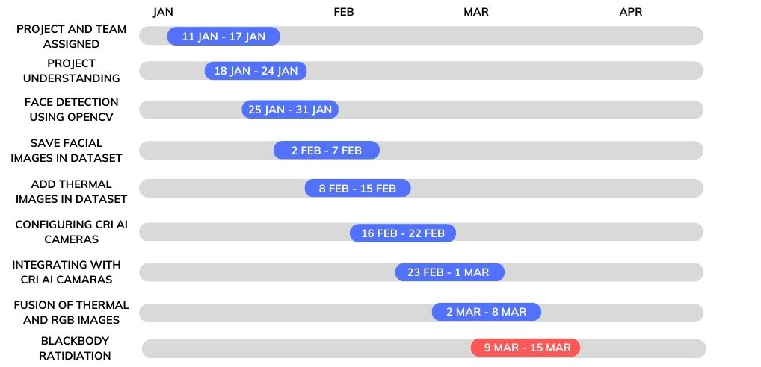
High-level timeline chart (GANTT)

Slide 12
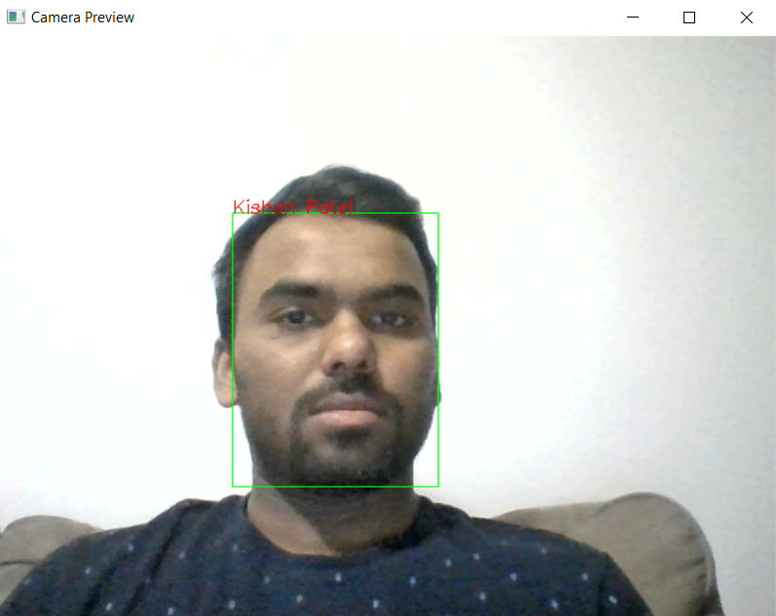
Glimpse of the work done
Face Recognition

Slide 13
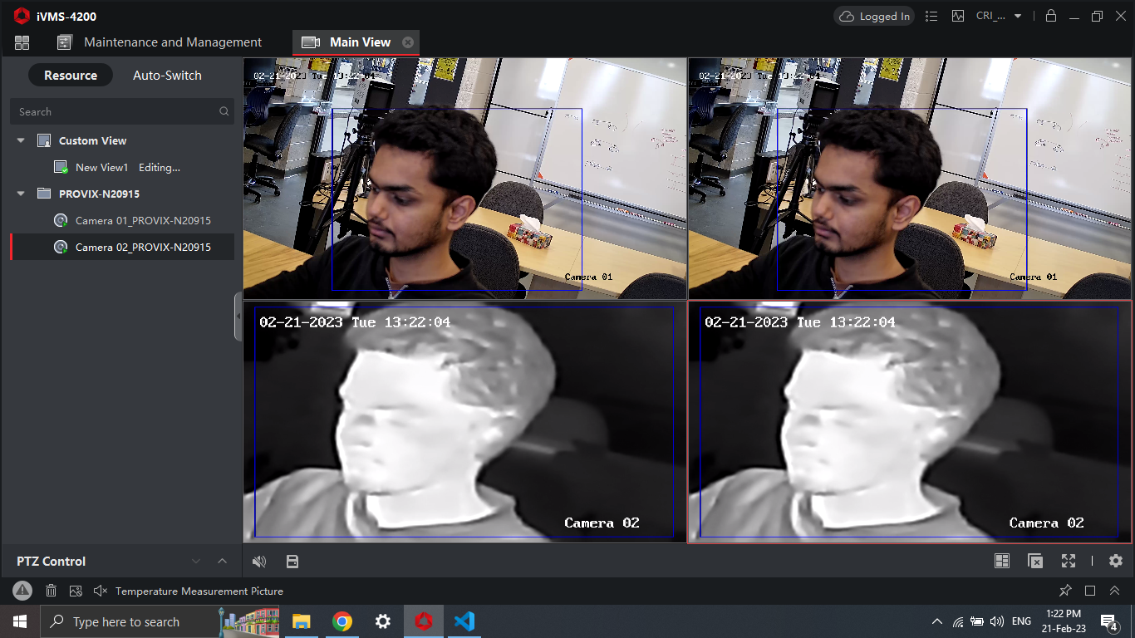

Glimpse of the work done
Accessibility to CRI AI Camera

Slide 14
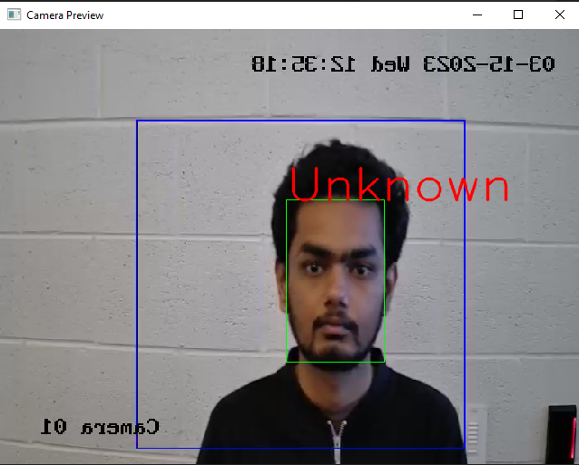
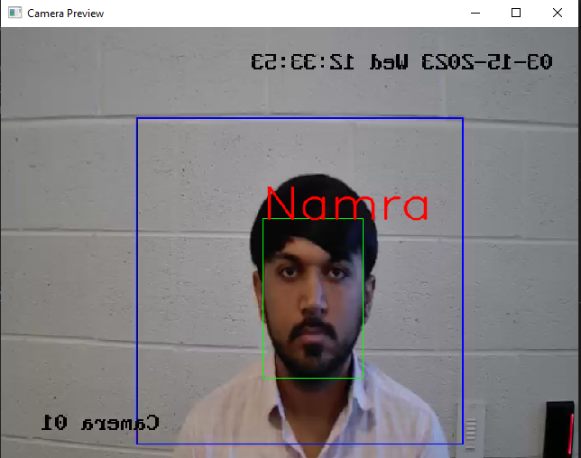
Glimpse of the work done
Face Recognition

Slide 15
Hours worked (weekly)

Slide 16
Now onwards..
Thermal temperature measurement using blackbody radiation box and CRI AI cameras
Reduce latency while Facial detection and recognition using CRI AI camera
Preparing UI for the System.

Slide 17

General Budget
•Number of developers: 3
•Hourly cost: $50 per developer
•Estimated weekly time: 8 hours per developer
•Estimated weeks: 13
•Estimated fictious budget: $15,600

Slide 18
REFERENCES
iVMS 4200 References •User Manual Of iVMS 4200: https://us.hikvision.com/en/system/files_force/ivms-4200_v2.8.2.2_windows_user_manual_v2_0.pdf?download=1
Software Used: https://www.hikvision.com/ca-en/support/download/software/ivms4200-series/
For More Information FAQs: https://us.hikvision.com/en/support-resources/documentation/faq/software
Integrating CRI Camera: https://www.aranacorp.com/en/managing-an-ip-camera-with-python/
Hikvision Thermal Image Screening Camera: https://www.jojomarketing.ae/products/hikvision-ds-2te127-g4a-thermal-image-screening-camera-dubai-uae/

Slide 19

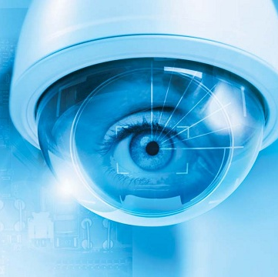
Thank you
GitHUB:
https://github.com/tilakpandya/face_recognition_using_thermal_images

